Slide 1
PMN IT Instructions
Dipl.-Ing. Steffen Kampmann
Chair of Materials Science and Nanotechnology, TU Dresden
Dresden, 16.11.2023, Biannual Chair Information Event
Contact: steffen.kampmann@tu-dresden.de

Slide 2
General Information
  ZIH is IT administration unit of TU Dresden
  Therefore, you can write to ZIH if you have any problems with IT services
  https://faq.tickets.tu-dresden.de/otrs/public.pl
  servicedesk@tu-dresden.de
  I am only contact person for
    Your office computer
    Hardware for your office computer
    Software like Microsoft Office, Origin etc.
    Network printer
    Presentation support → Laptop, Microphones, Webcams, Presenter etc.

Slide 3
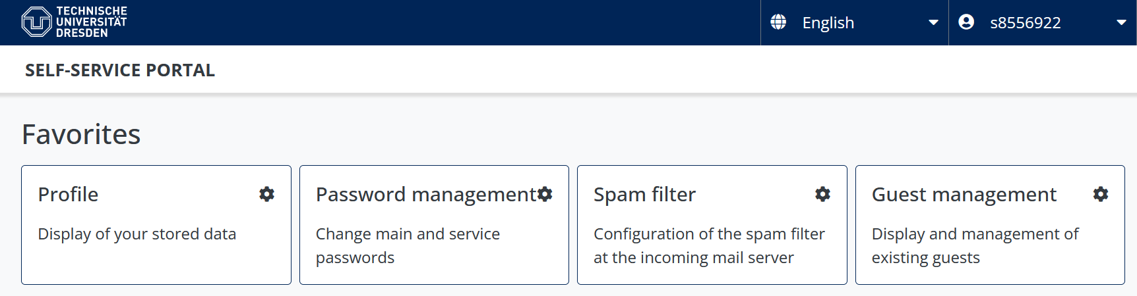
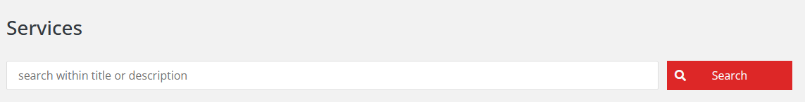
What does the IT infrastructure look like?
Communication & Collaboration
  How can we work efficient in a team?
Data storage
  Where can I save my data?
  How can I share my data?
Powerful Software
  How can I get helpful licensed software for my work?
Workstations and Server
  Where can I run hardware resource-hungry software?
Security and Network
  What do I need to do to protect my data and the data of my colleagues?
What do I need to have access to all of that?
→ Your ZIH login ←
To manage your passwords and personal information go to
https://selfservice.tu-dresden.de/
See all services at glance in Self-Service Portal

Slide 4

1. Communication and Collaboration – Email
Email
    In Browser: https://msx.tu-dresden.de
    Setup instructions for email clients:
    → Outlook: https://tud.link/k43h for Windows and https://tud.link/8gfu for MacOS
    → Thunderbird: https://tud.link/8wpk for Windows, MacOS, Linux
    → Apple Mail: https://tud.link/7jpf for MacOS and https://tud.link/nhcq for iOS/iPadOS
    → Gmail: https://tud.link/15t4 for Android
    Please setup your signature according to your affiliation
    → Template example:
  YourTitle YourFullName
  Chair of Materials Science and Nanotechnology
  Institute for Materials Science and Max Bergmann Center for Biomaterials Dresden
  TU Dresden
    Phone: YourOfficePhoneNumber
[1]
[1] DALL-E: https://chat.openai.com

Slide 5
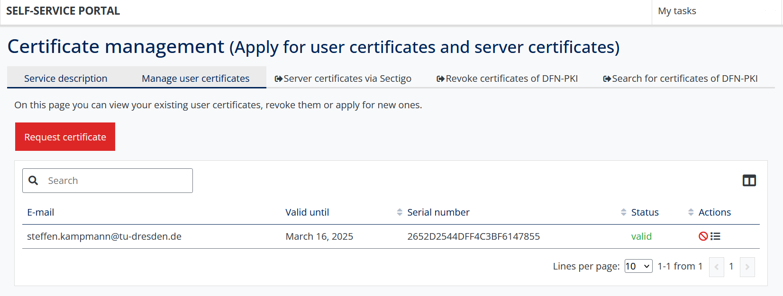
1. Communication and Collaboration – Email
Setup your user certificate - Mandatory
Sign you emails with you identity
Possibility to encrypt you emails
https://selfservice.tu-dresden.de/services/certificate-management/overview

Slide 6
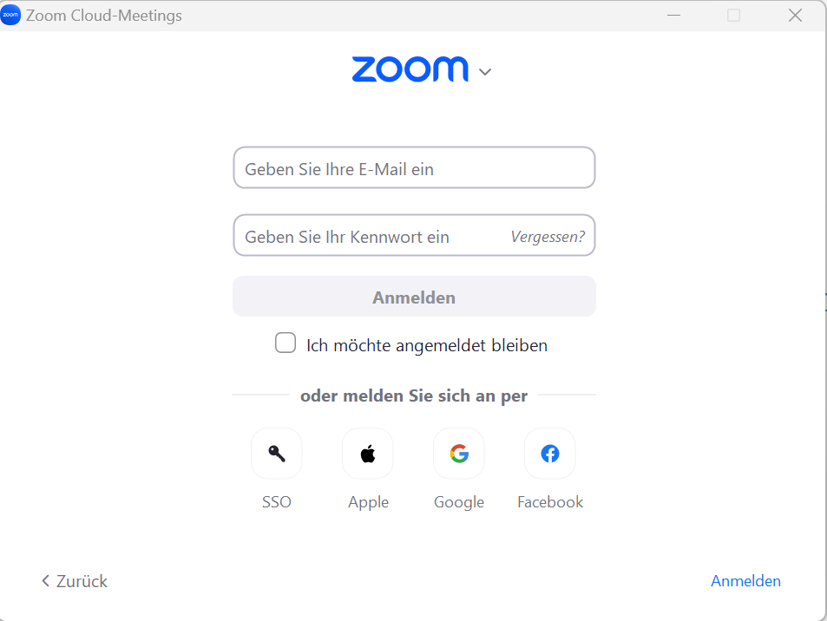
1. Communication and Collaboration – Zoom
Zoom
    Click „Sign in“ at https://tu-dresden.zoom.us/
    Create your personal link for your own Zoom room
    https://tu-dresden.zoom-x.de/my/Your_Name
    (Left menu on „Meetings“ → „Private room“)
    You can sign in with your ZIH-Login if you click on SSO and type tu-dresden in the appeared text field

Slide 7



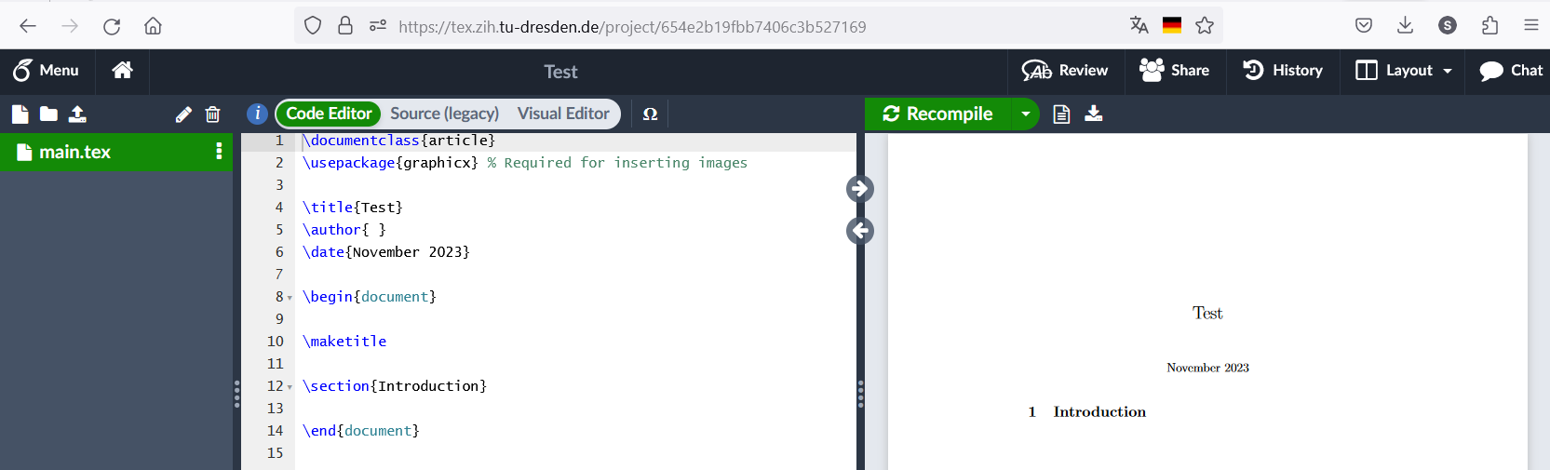
1. Communication and Collaboration – Writing article
Sharepoint (Word, Powerpoint etc.):
https://selfservice.tu-dresden.de/services/258944/
ShareLatex:
https://tex.zih.tu-dresden.de/
[1]
[1] https://de.wikipedia.org/

Slide 8
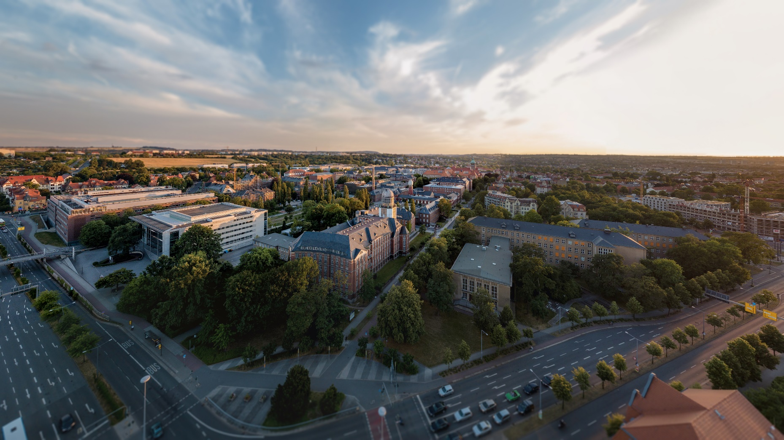




2. Data storage – Overview
Home drive
Group drive
Datashare of TU Dresden
Your data
Research Group data
Share data
Your PC/Mac
Non-backed up data
https://media-exp1.licdn.com/dms/image/C4D1BAQGhuHkHrK9Otw/company-background_10000/0?e=2159024400&v=beta&t=1cL7tUnH5XYVw6DOfbIjkskihQl2pmXPHu1d7SLXnzs

Slide 9

2. Data storage – Let the TU backup your data
  Home network drive
    For your data
    Automatic Backups and Snapshots
  Group network drives
    For many and large raw research data
    For project and group data
    Automatic Backups and Snapshots
  Archiving your research data
    Gaining more and more importance
    with OpARA (https://opara.zih.tu-dresden.de/xmlui/?locale-attribute=en )
    https://selfservice.tu-dresden.de/services/358875/
    Short and simple manual at
    https://nano.tu-dresden.de/shared/14
[1]
[1] DALL-E: https://chat.openai.com

Slide 10


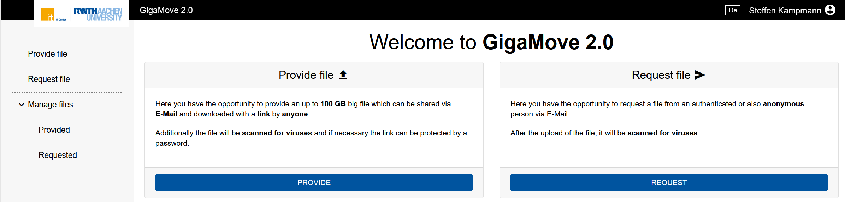
2. Data storages – Share your data easily
Datashare based on Nextcloud environment
    https://datashare.tu-dresden.de/
    You can upload, download and share Data with internal and external people
    App for Windows, Mac, iOS and Android
    → https://nextcloud.com/de/install/#install-clients
    → Installation and setup manual: https://tud.link/fsvs
Gigamove 2.0
    Share of large data until 100 GB ( Hint: Zip data to one file and then share it )
    https://selfservice.tu-dresden.de/services/2250335/
[1]
[3]
[1] https://de.wikipedia.org/
[2] https://gigamove.rwth-aachen.de/en
[3] DALL-E: https://chat.openai.com
[2]

Slide 11
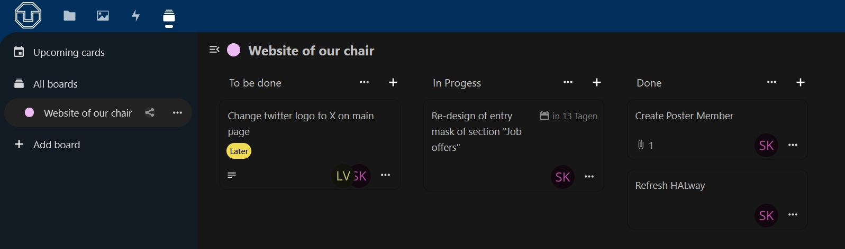
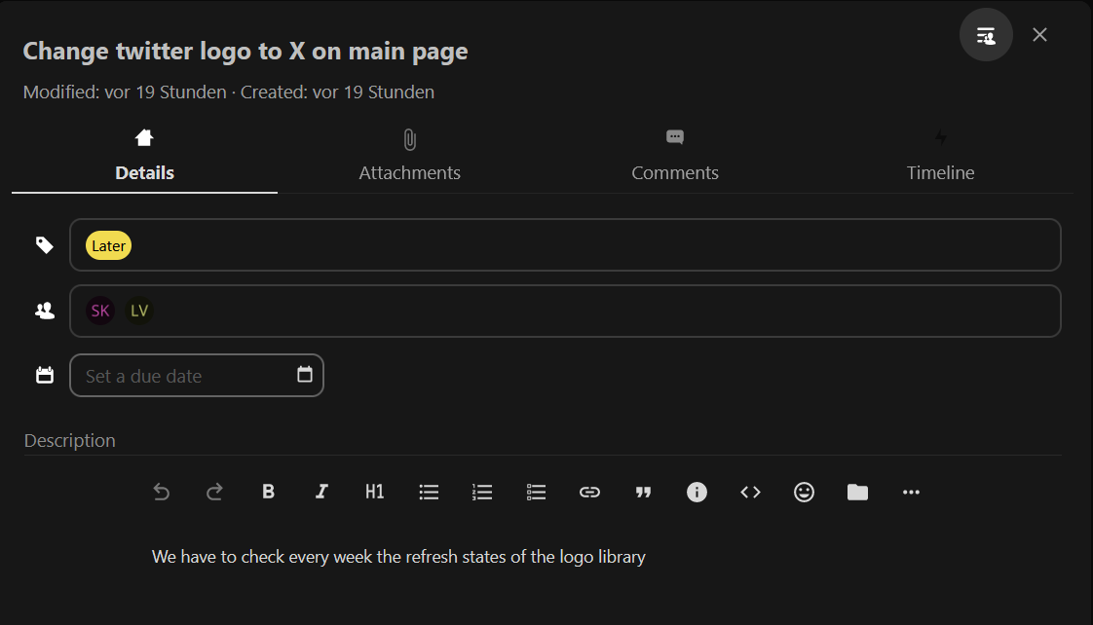
3. Software – Useful Tools
Project organizing tool Decks
Avaliable at
https://datashare.tu-dresden.de/
Further Apps will coming soon
[1]
[1] DALL-E: https://chat.openai.com

Slide 12

3. Software – Useful Tools
Microsoft Office
    is already installed on your PC/Laptop
    Microsoft Office 365 is also available for your private PC/Laptop
      → For employees: https://tud.link/9nl1
    → For students: https://campussachsen.tu-dresden.de/
  Origin
    License of chair available
      → please contact Stephanie Klinghammer or Steffen Kampmann
      ( stephanie.klinghammer@tu-dresden.de, steffen.kampmann@tu-dresden.de )
    For students private PC/Laptop: https://tud.link/h928
Software list
    https://tud.link/xn1o

Slide 13
3. Software – Be Careful
Please do not use
TeamViewer
External cloud services like Dropbox, Google Drive, OneDrive etc.
→ Do not save your research data there
Software with illegal license
Software from Kaspersky Lab
Please use following services of TU Dresden
ISL
Home and Group drives
→ Save your research data there
Software list of TU Dresden or ask colleagues for alternatives
Sophos (already installed)
Please only install software from trustworthy sources
    E. g. https://www.heise.de/download/

Slide 14
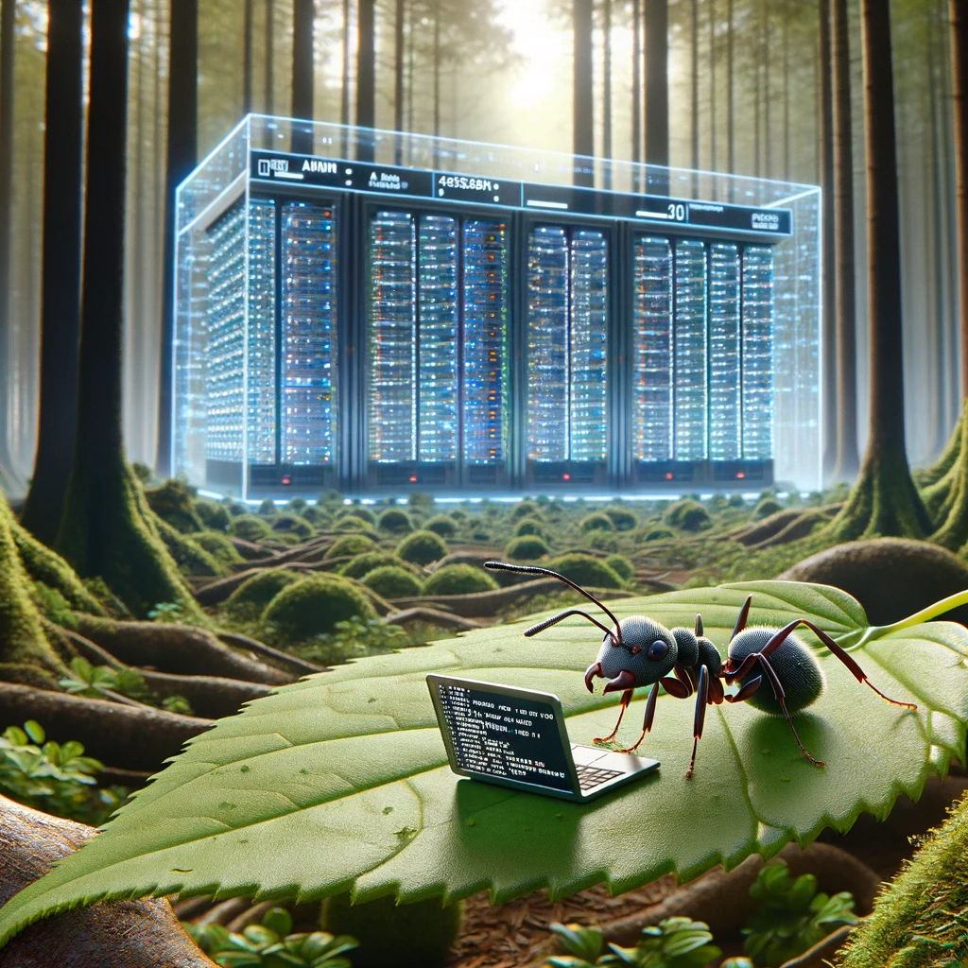

4. Workstations and Server – Powerful Hardware
Run your calculations on specialized Hardware that is available 24/7
Remote workstations for computing
    https://selfservice.tu-dresden.de/services/research-cloud/
    Access via Terminal
  High Performance Computing (HPC)
    https://doc.zih.tu-dresden.de/
    To get access please contact Dr. Rafael Gutierrez
    ( rafael.gutierrez@tu-dresden.de )
    Access via Terminal
[1]
[2]
[1] DALL-E: https://chat.openai.com
[2] https://tu-dresden.de/

Slide 15

4. Workstations and Server – First Steps
  Remote PC (Windows) hosted by TU Dresden
    https://rds.zih.tu-dresden.de/
    As student choose “Office Collection”
    Many preinstalled software like Origin, COMSOL Multiphysics, Microsoft Office, Python, SPSS, Maple etc.
    Your home drive is already mounted
    You have access to your data on your local PC too
  Control your office or lab PC remotely
    You can control your office or lab PC from everywhere
    https://rsupport.zih.tu-dresden.de/users/main/downloads.html
    You can find a simple manual in following document
    https://nano.tu-dresden.de/shared/16
[1]
[1] https://lb.islonline.com/

Slide 16
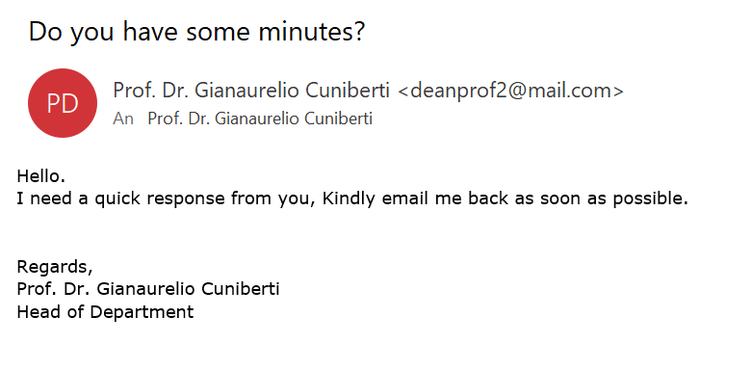
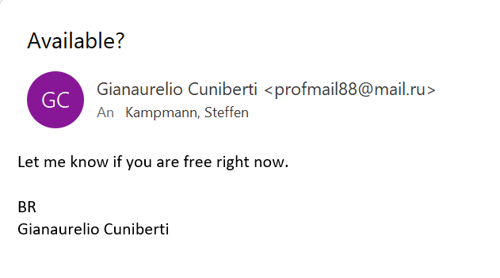
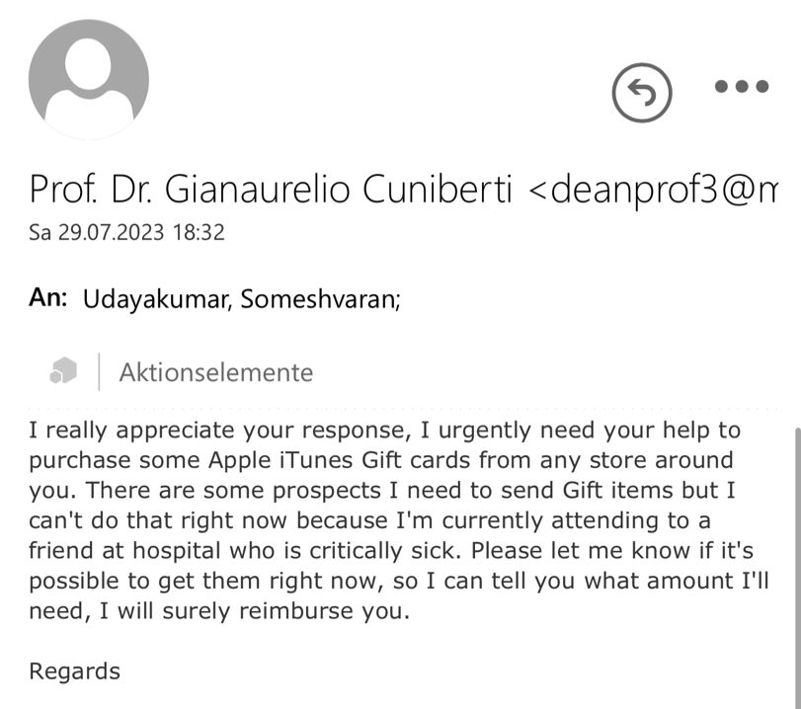
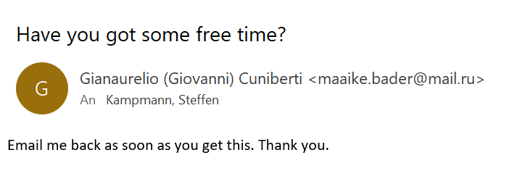
5. Security and Network – Scam Emails
You will NEVER be asked for your password or for money and vouchers
Report Scam email to TU Dresden (ZIH)
https://tud.link/35d7

Slide 17


5. Security and Network – Stay connected with TU Dresden
To have full access to all services stay in the TU network with VPN
    Secured connection in public Wi-Fi networks e. g. on conferences
  VPN
Install OpenVPN software
    https://openvpn.net/vpn-client/
Download the TU Dresden profile file
    https://selfservice.tu-dresden.de/services/vpn/openvpn
    Execute this file
  Detailed documentation:
    https://tud.link/d4s7
  eduroam
    At end of November you have to refresh your eduroam certificate on all your devices
    https://tud.link/w8z7
[1]
[2]
[1] https://de.wikipedia.org/
[2] https://tu-dresden.de/zih/die-einrichtung/news/eduroam-neukonfiguration-erforderlich?set_language=en

Slide 18

5. Security and Network
Protect you ZIH-Login
Two-Factor-Authorization is now avaliable!
https://selfservice.tu-dresden.de/services/idm/token/
[1]
[1] DALL-E: https://chat.openai.com

Slide 19
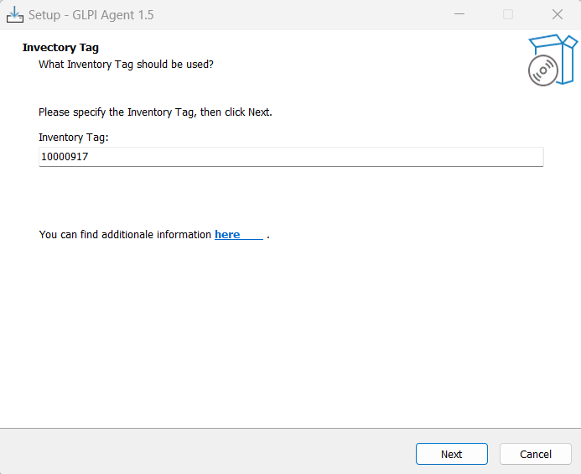
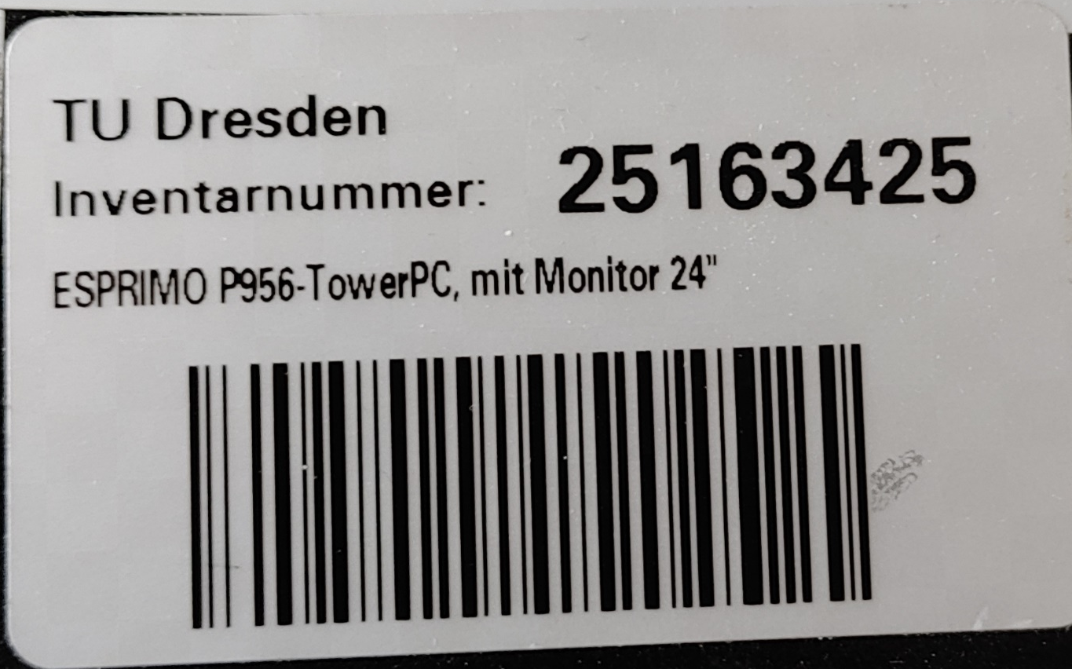
5. Security and Network – Mandatory Installation
Mandatory installation of the software GLPI for everyone
GLPI Checks installed software of all office PC/Laptops
https://tud.link/f8k6
Enter this inventory tag: 10000917
Send an email to me with following information:
    Inventory numbers of your computer
    and monitors
    Name of your computer
    Your ZIH-Login name

Slide 20
Website of our Chair
Public website
    https://nano.tu-dresden.de/ or https://nano-tud.de/
  Internal area on website
    https://nano.tu-dresden.de/shared/ or https://nano-tud.de/shared/
    User: nano
    Password: nano
    Here we share important documents
  Please check if your profile information is up to date
    https://nano.tu-dresden.de/team/

Slide 21
Thank you for your attention!

