Slide 1
PMN IT Information Event
Dipl.-Ing. Steffen Kampmann, Dipl.-Ing. Li Chen
Chair of Materials Science and Nanotechnology, TU Dresden
Dresden, 24.10.2024, Biannual Chair Information Event
Contact: steffen.kampmann@tu-dresden.de, li.chen2@tu-dresden.de

Slide 2
General information – IT administration
  ZIH is IT administration unit of TU Dresden
  Therefore, you can write to ZIH if you have any problems with IT services
  https://faq.tickets.tu-dresden.de/otrs/public.pl
  servicedesk@tu-dresden.de
  I am only contact person for
    Your office PC/laptop
    Software like Microsoft Office, Origin etc.
    Network printer
    Presentation support → Laptop, Microphones, Webcams, Presenter etc.

Slide 3
General information - Website of our Chair
Public website
    https://nano.tu-dresden.de/ or https://nano-tud.de/
  Internal area on website
    https://nano.tu-dresden.de/shared/ or https://nano-tud.de/shared/
    User: nano
    Password: nano
    Here we share helpful documents
  Please check if your profile information is up to date
    https://nano.tu-dresden.de/team/

Slide 4
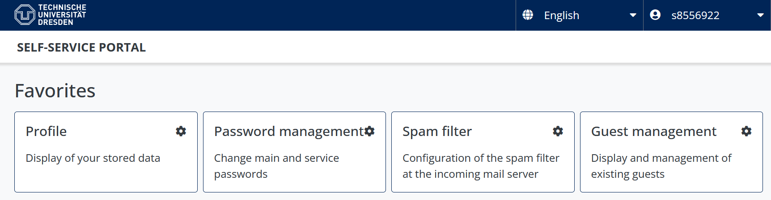
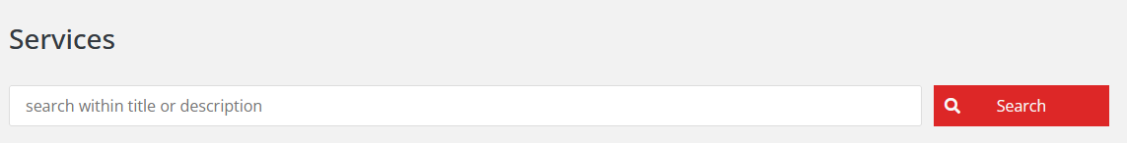
What does the IT infrastructure look like?
Basics
  What do I definitely need for my digital workplace?
Communication & Collaboration
  How can we work efficient in a team?
Data storage
  Where can I save my data?
  How can I share my data?
Software
  How can I get helpful licensed software for my work?
Workstations and Server
  Where can I run hardware resource-hungry software?
Security and Network
  What do I need to do to protect my data and the data of my colleagues?
What do I need to have access to all of that?
→ Your ZIH login ←
To manage your passwords and personal information go to
https://selfservice.tu-dresden.de/
See all services at glance in Self-Service Portal

Slide 5
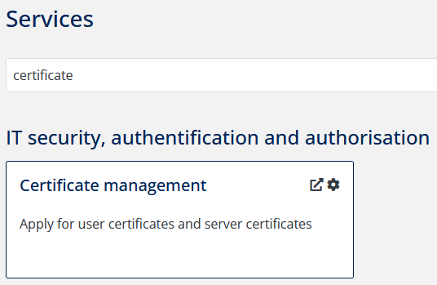
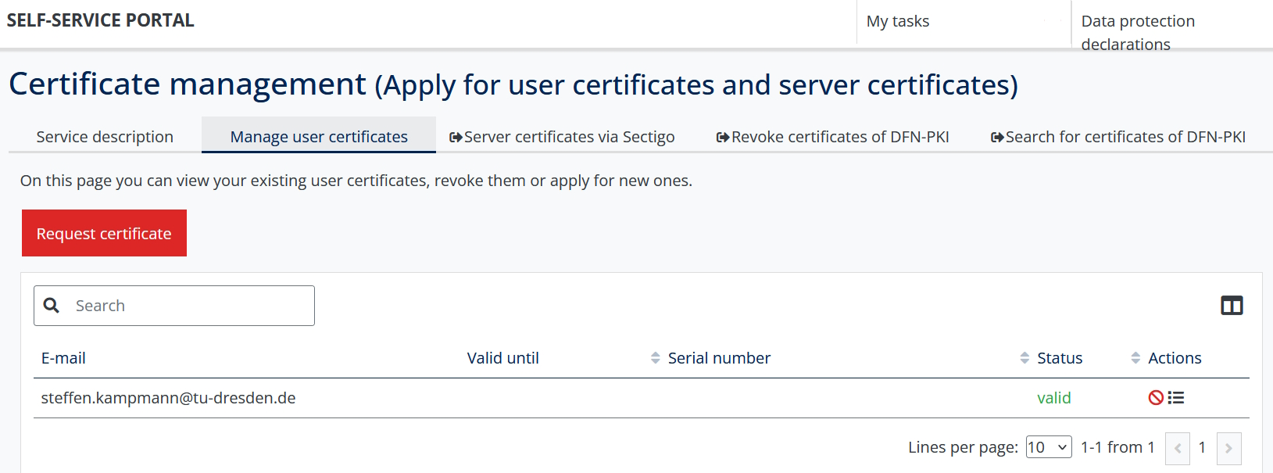
1. Basics - Your digital ID at TU Dresden (user certificate)
  Signing documents digitally (next slide), encrypt and decrypt
  Type “certificate” into the search field of the self-service portal
  Request certificate
  Service-Desk visitor address:
    Andreas-Pfitzmann-Bau, Room E036 Nöthnitzer Straße 46, 01187 Dresden
    https://navigator.tu-dresden.de/etplan/apb/00/raum/542100.2480?language=en
    Opening hours: Monday – Friday → 08:00 – 19:00
  Full documentation: https://tud.link/wtvyx5

Slide 6
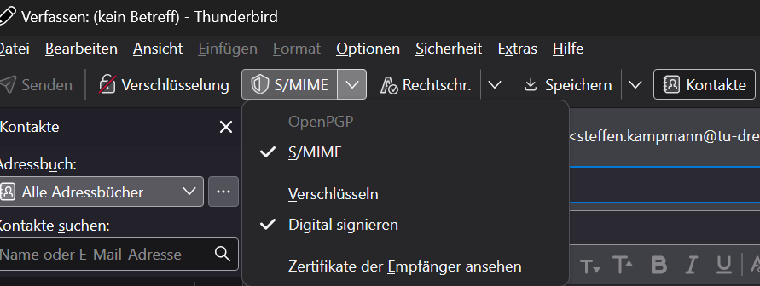
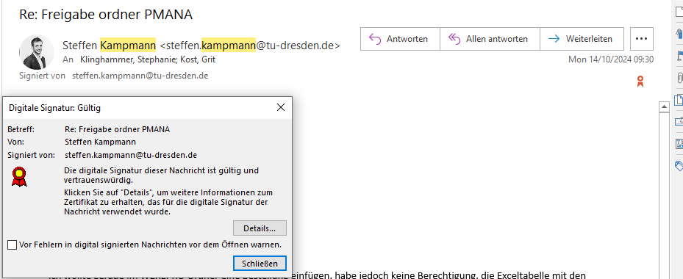
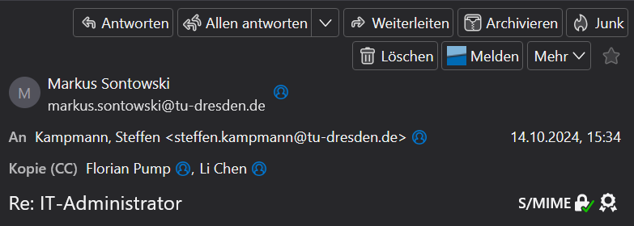
1. Basics - Use your user certificate for your emails
  After you have installed the certificate, you can select the certificate in your mail program
  Importing the user certificate into:
    Outlook: https://tud.link/m7xx9k
    Thunderbird: https://tud.link/eb25ta
  Sets the e-mails to be signed automatically
  The digital signature is displayed for the recipient
Outlook
Thunderbird
    Everybody should use the digital signature!

Slide 7
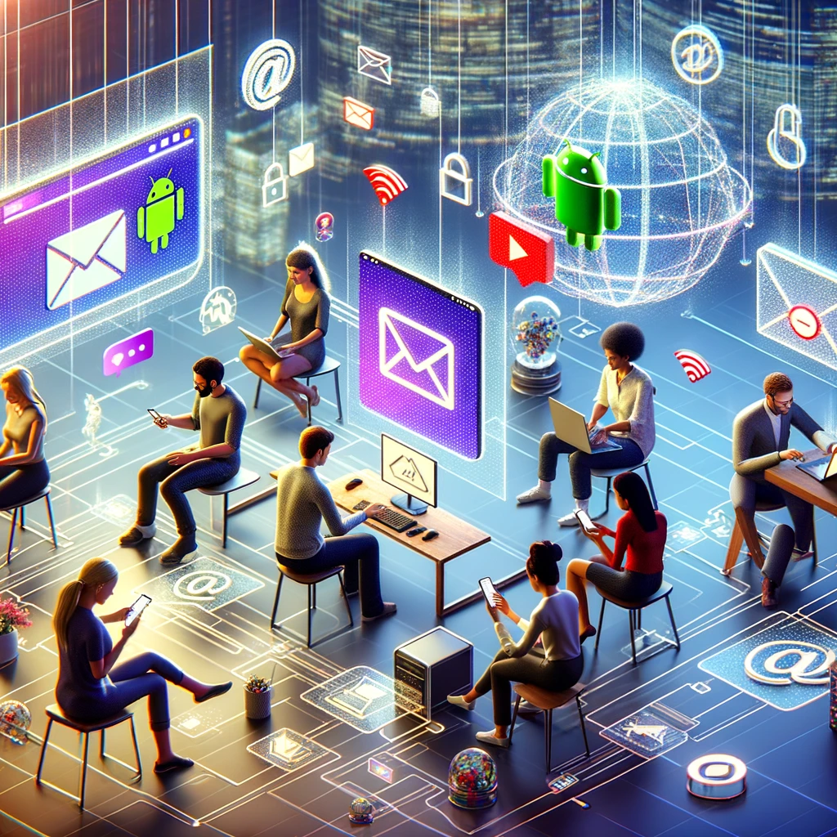
1. Basics – Email
Email
    In Browser: https://msx.tu-dresden.de
    Setup instructions for email clients:
    → Outlook: https://tud.link/k43h for Windows and https://tud.link/8gfu for MacOS
    → Thunderbird: https://tud.link/8wpk for Windows, MacOS, Linux
    → Apple Mail: https://tud.link/7jpf for MacOS and https://tud.link/nhcq for iOS/iPadOS
    → Gmail: https://tud.link/15t4 for Android
    Please setup your signature according to your affiliation
    → Template example:
    Your_title Your_name
  TUD Dresden University of Technology
  Faculty of Mechanical Science and Engineering
  Institute of Materials Science
  Chair of Materials Science and Nanotechnology
  Phone: +49 (0) 351 463-XYZ
  www.nano.tu-dresden.de
[1]
[1] DALL-E: https://chat.openai.com

Slide 8
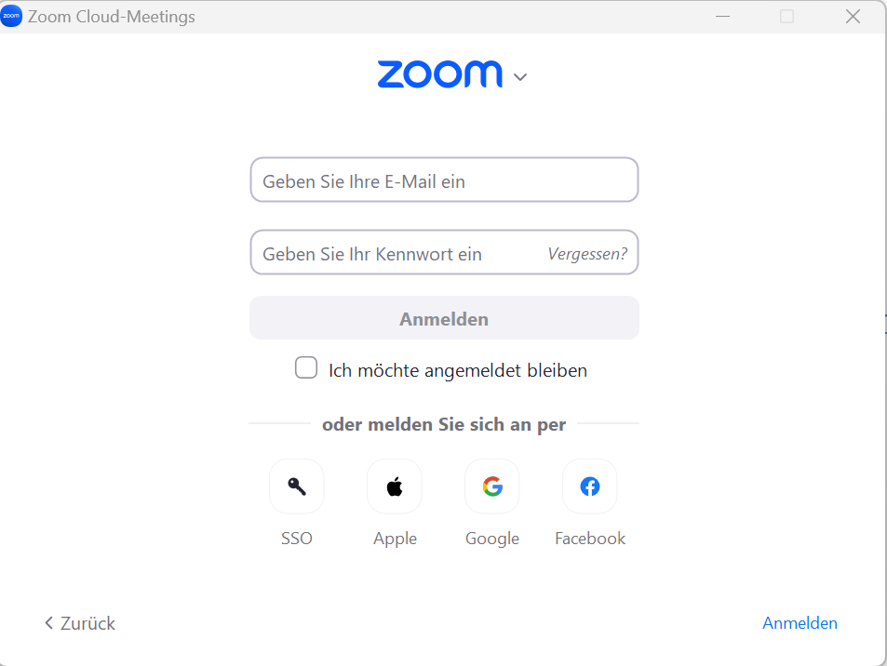
2. Communication and collaboration – Video Calls and Chats
Zoom
    Click „Sign in“ at https://tu-dresden.zoom.us/
    Create your personal link for your own Zoom room
    https://tu-dresden.zoom-x.de/my/Your_Name
    (Left menu on „Meetings“ → „Private room“)
    You can sign in with your ZIH-Login if you click on SSO and type tu-dresden in the appeared text field
  BigBlueButton
    https://bbb.tu-dresden.de/
  Matrix-Chat
    Chat for internal communication with students or colleagues
    Chat rooms, personal chats etc.
    https://matrix.tu-dresden.de

Slide 9
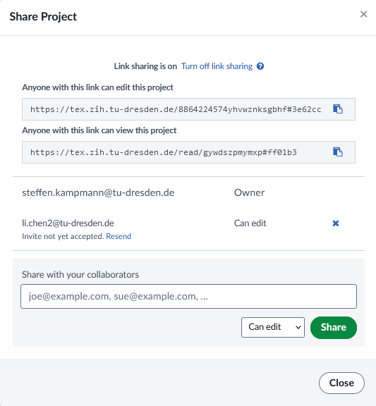



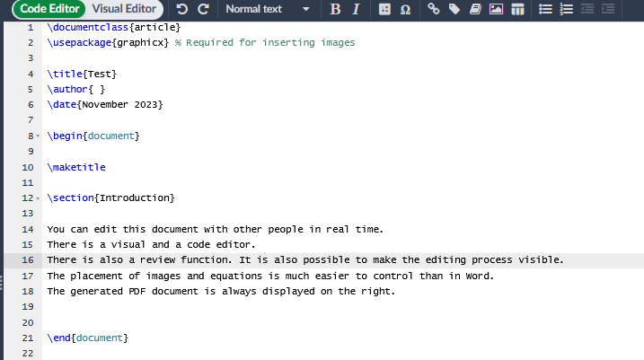
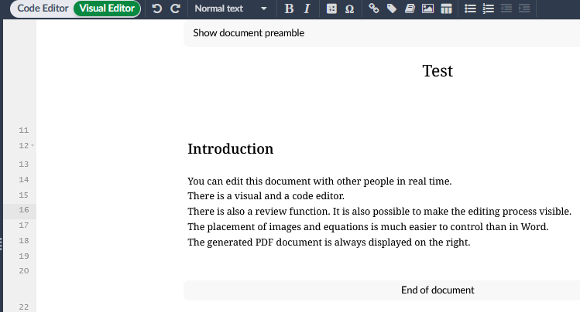
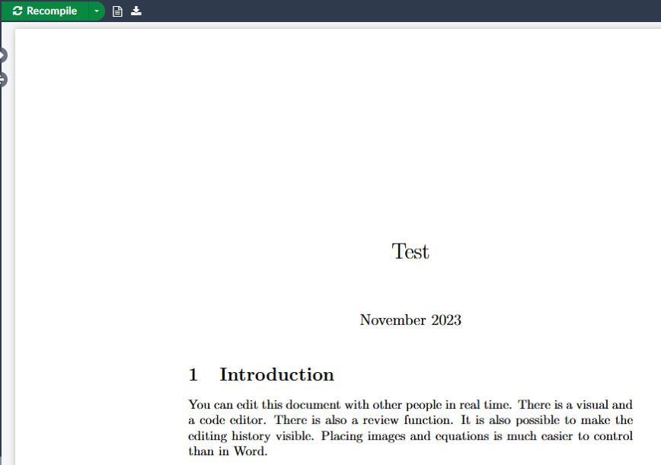
2. Communication and collaboration – Writing article
Sharepoint (Word, Powerpoint etc.):
https://selfservice.tu-dresden.de/services/258944/
ShareLatex:
equivalent to Overleaf, but can be used without restrictions
https://tex.zih.tu-dresden.de/
[1]
[1] https://de.wikipedia.org/

Slide 10
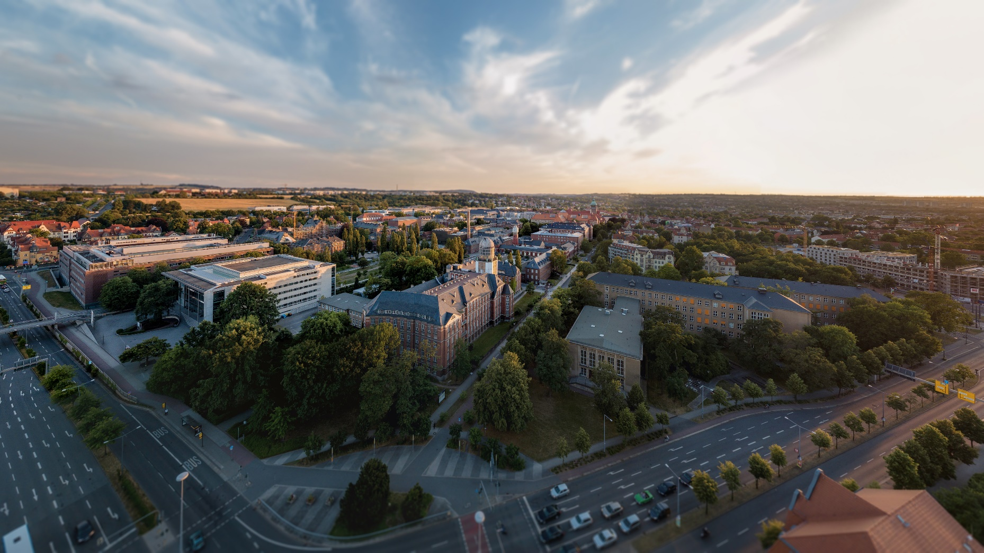






3. Data storage – Overview
Backed up data
Backed up data
Not backed up data
Home drive
Group drive
Datashare
https://tud.link/k48k1a
https://tud.link/k48k1a
https://tud.link/y72uz6
https://opara.zih.tu-dresden.de/
Your data
Research Group data
Share data
Archive your completed project data!
Your PC/Mac
No backed up data
https://media-exp1.licdn.com/dms/image/C4D1BAQGhuHkHrK9Otw/company-background_10000/0?e=2159024400&v=beta&t=1cL7tUnH5XYVw6DOfbIjkskihQl2pmXPHu1d7SLXnzs

Slide 11
3. Data storage – Which group drives are available at the chair?
pmana (10 TB)
Contains any chair related data
→ Win: \\vs-grp02.zih.tu-dresden.de\pmana Mac: smb://vs-grp02.zih.tu-dresden.de/pmana
pmnnano (5 TB)
Contains project and administrative related data of Theory group
→ Win: \\vs-grp08.zih.tu-dresden.de\pmnnano Mac: smb://vs-grp08.zih.tu-dresden.de/pmnnano
pmnent (5 TB)
Contains project and administrative related data of Environmental nanotechnology group
→ Win: \\vs-sec-smb3.zih.tu-dresden.de\pmnent Mac: smb://vs-sec-smb3.zih.tu-dresden.de/pmnent
pmnnst (5 TB)
Contains project and administrative related data of Nanoelectronics for sensor technologies group
→ \\vs-grp08.zih.tu-dresden.de\pmnnst Mac: smb://vs-grp08.zih.tu-dresden.de/pmnnst
pmnraw (50 TB) (only Snapshots, no backup, no mirror)
Contains raw research data of every group
→ \\vs-grp07.zih.tu-dresden.de\pmnraw Mac: smb://vs-grp07.zih.tu-dresden.de/pmnraw

Slide 12
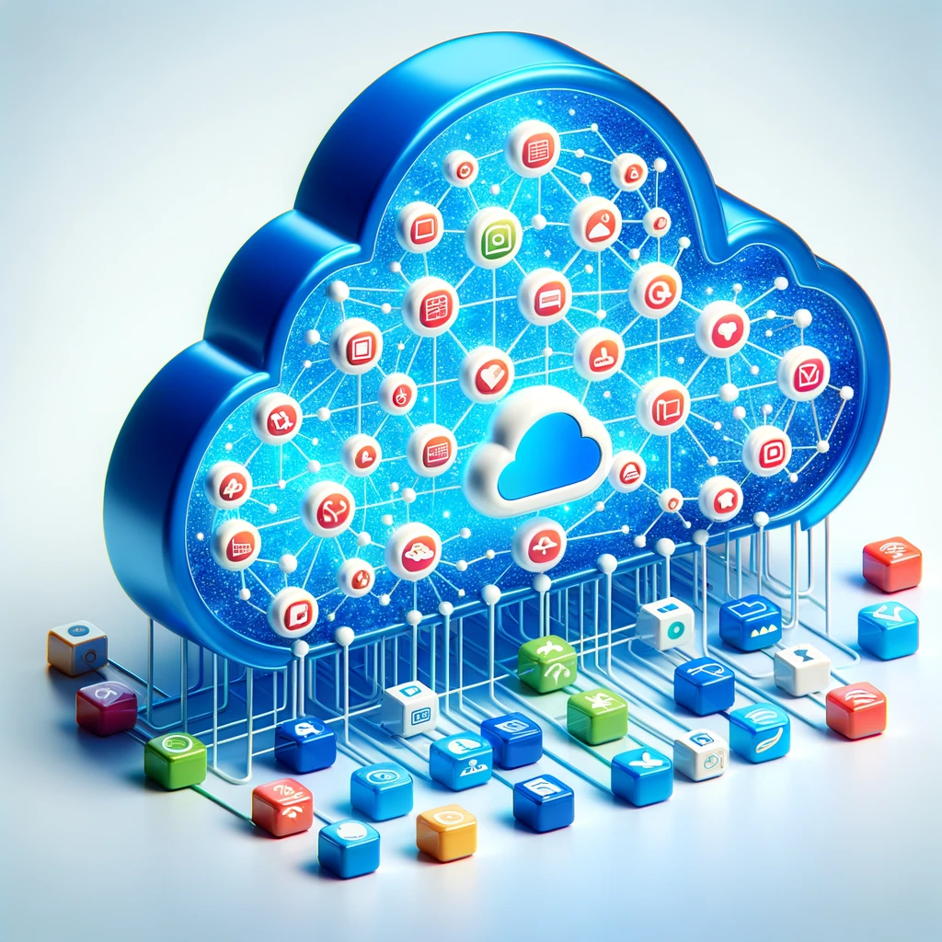

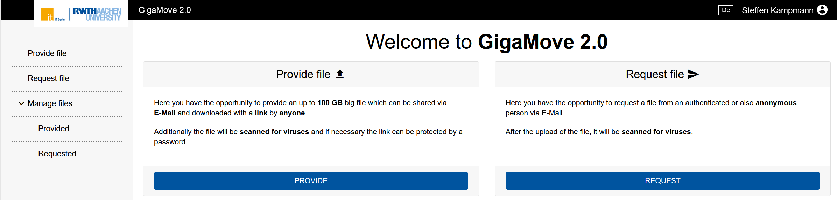
3. Data storages – Share your data easily
Datashare based on Nextcloud environment
    https://datashare.tu-dresden.de/
    You can upload, download and share Data with internal and external people
    App for Windows, Mac, iOS and Android
    → https://nextcloud.com/de/install/#install-clients
    → Installation and setup manual: https://tud.link/fsvs
Gigamove 2.0
    Share of large data until 100 GB ( Hint: Zip data to one file and then share it )
    https://selfservice.tu-dresden.de/services/2250335/
[1]
[3]
[1] https://de.wikipedia.org/
[2] https://gigamove.rwth-aachen.de/en
[3] DALL-E: https://chat.openai.com
[2]

Slide 13



4. Software – Useful Tools
Microsoft Office
    Microsoft Office 365 is also available for private PC/Laptop
      → For employees: https://tud.link/9nl1 → For students: https://campussachsen.tu-dresden.de/
  Origin
    License of chair available (Version 2024, also usable in VPN of TU Dresden)
      → please contact stephanie.klinghammer@tu-dresden.de or steffen.kampmann@tu-dresden.de
    For students private PC/Laptop: https://tud.link/h928
  Matlab
    For students and employees office/private PC/laptop
    https://de.mathworks.com/academia/tah-portal/tu-dresden-40758619.html
  Solidworks
    License of chair available → please contact steffen.kampmann@tu-dresden.de
Sophos
    Anti Virus for private Laptop → https://home.sophos.com/en-us/employee
  Alternatives for Adobe Products: https://tud.link/pmx21m (Affinity Designer), https://tud.link/7u6kbt (PDF Studio Pro), https://tud.link/jrqhvw CorelDRAW Technical Suite
    Full software list: https://tud.link/xn1o

Slide 14
4. Software – Be Careful
Please do not use
External cloud services like:
Dropbox, iCloud, Google Drive, OneDrive etc.
→ Do not save your research data here
Software with illegal license
Software from Kaspersky Lab
Please use following services of TU Dresden
Home and Group drives
→ Save your research data here
Software list of TU Dresden or ask colleagues for alternatives
Sophos (already installed)
Please only install software from trustworthy sources
    E. g. for open source software: https://www.heise.de/download/

Slide 15
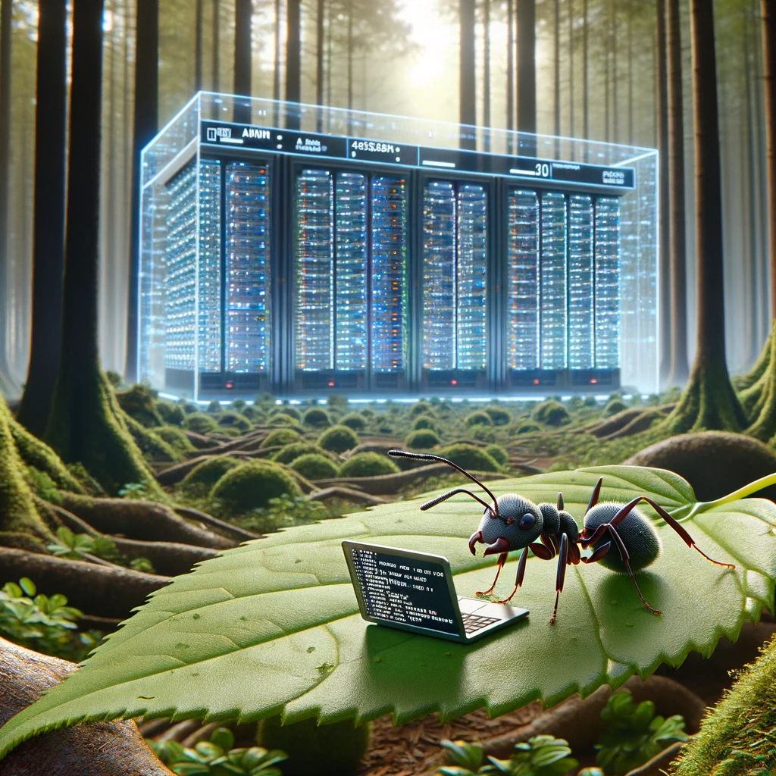
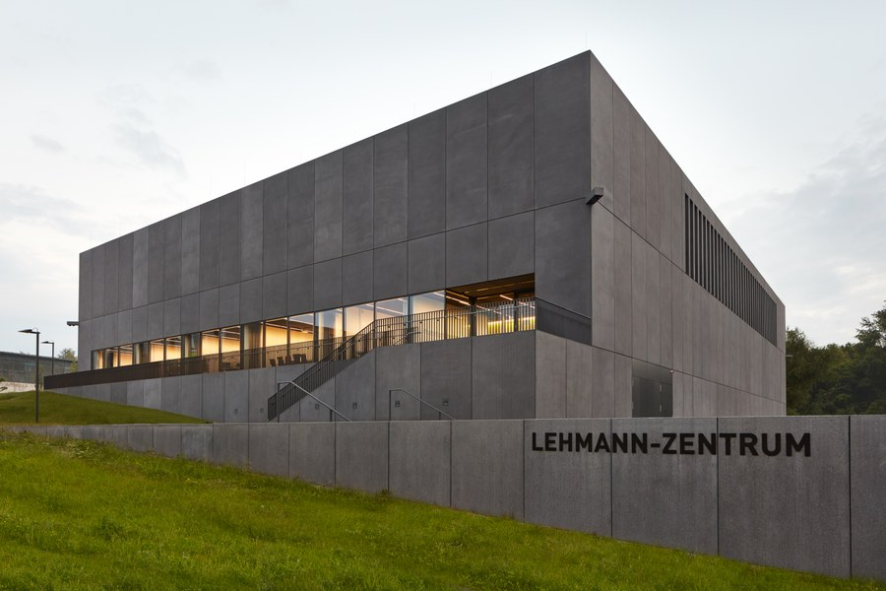
5. Workstations and Server – Powerful Hardware
Run your calculations on specialized Hardware that is available 24/7
Remote workstations for computing
    https://selfservice.tu-dresden.de/services/research-cloud/
    Preinstalled (Ubuntu, Windows …)
    Easy installation of software
    No waiting times
  High Performance Computing (HPC)
    https://doc.zih.tu-dresden.de/
    To get access please contact Dr. Rafael Gutierrez
    ( rafael.gutierrez@tu-dresden.de )
[1]
[2]
[1] DALL-E: https://chat.openai.com
[2] https://tu-dresden.de/

Slide 16

5. Workstations and Server – First Steps
  Remote PC (Windows) hosted by TU Dresden
    https://rds.zih.tu-dresden.de/
    As student choose “Office Collection”
    Many preinstalled software like Origin, COMSOL Multiphysics, Microsoft Office, Python, SPSS, Maple etc.
    Your home drive is already mounted
    You have access to your data on your local PC too
  Control your office or lab PC remotely
    You can control your office or lab PC from everywhere
    https://rsupport.zih.tu-dresden.de/users/main/downloads.html
    You can find a simple manual in following document
    https://nano.tu-dresden.de/shared/16
[1]
[1] https://lb.islonline.com/

Slide 17
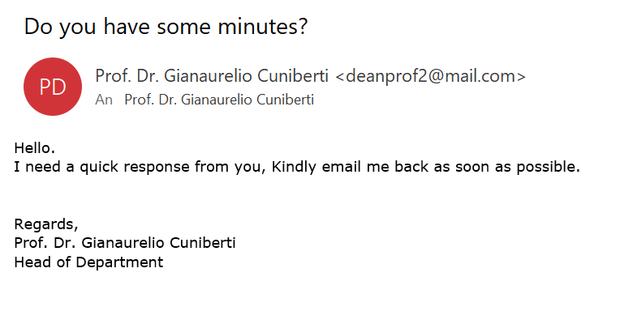
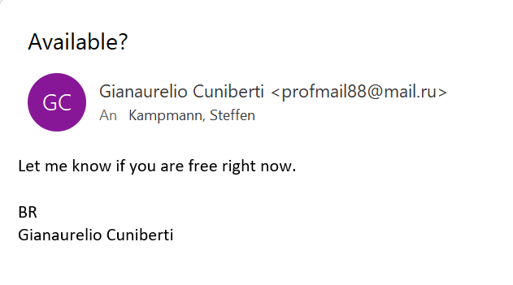
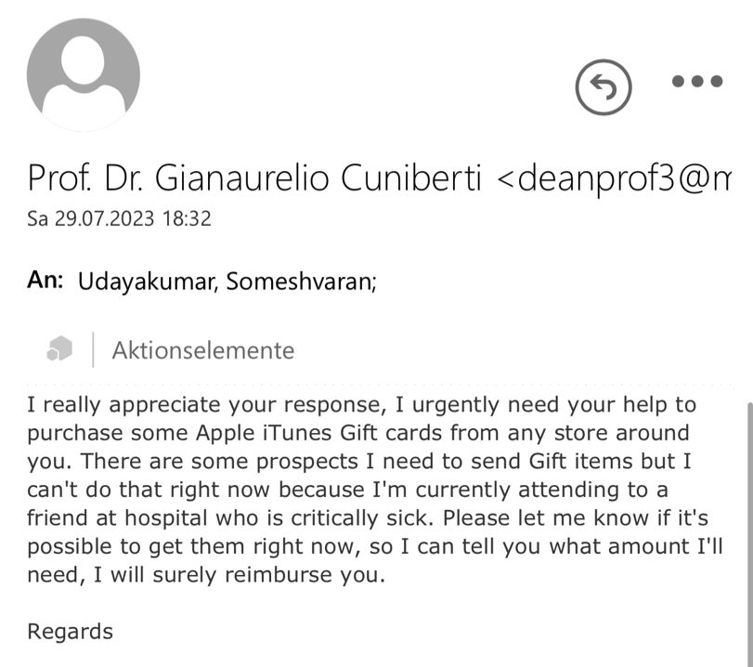
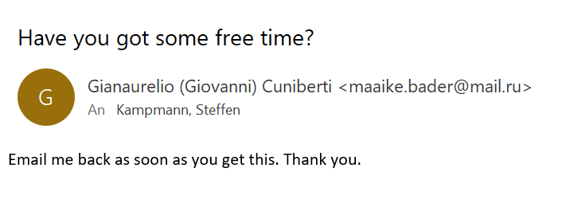
6. Security and Network – Scam Emails
You will NEVER be asked for your password or for money and vouchers
Report Scam email to TU Dresden (ZIH)
https://tud.link/35d7

Slide 18

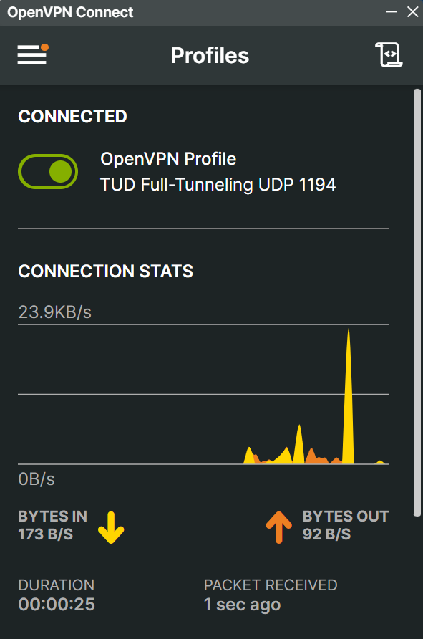
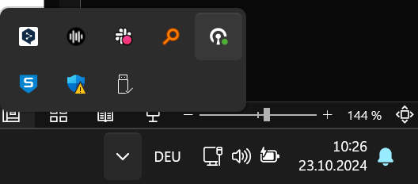
6. Security and Network – Stay connected with TU Dresden
To have full access to all services stay in the TU network with VPN
    Secured connection in public Wi-Fi networks e. g. on conferences
    Required for accessing the home and group drives
  VPN
Install OpenVPN software
    https://openvpn.net/vpn-client/
Download your TU Dresden profile file
    https://selfservice.tu-dresden.de/services/vpn/openvpn
    Execute this file
    Done!
  Detailed documentation: https://tud.link/d4s7
[1]
    You can install on your private and office laptop/PC
[1] https://de.wikipedia.org/wiki/OpenVPN#/media/Datei:OpenVPN_logo.svg

Slide 19
Thank you for your attention!

