Slide 1
PMN IT Information Event
Dipl.-Ing. Steffen Kampmann, Dipl.-Ing. Li Chen
Chair of Materials Science and Nanotechnology, TU Dresden
Dresden, 04.02.2025
Contact: steffen.kampmann@tu-dresden.de, li.chen2@tu-dresden.de

Slide 2
General information – IT administration
ZIH is IT administration unit of TU Dresden
Therefore, you can write to ZIH if you have any problems with IT services
https://faq.tickets.tu-dresden.de/otrs/public.pl
servicedesk@tu-dresden.de
We are only contact persons for
Your office PC/laptop
Software like Microsoft Office, Origin etc.
Network printer
Presentation support → Laptop, Microphones, Webcams, Presenter etc.

Slide 3
General information - Website of our Chair
Public website
https://nano.tu-dresden.de/
Internal area on website
https://nano.tu-dresden.de/shared/
User: nano Password: nano
Here we share helpful documents
Please check if your profile information is up to date
https://nano.tu-dresden.de/team/

Slide 4
What does the IT infrastructure look like?
Basics
What do I definitely need for my digital workplace?
Communication & Collaboration
How can we work efficient in a team?
Data storage
Where can I save my data?
How can I share my data?
Software
How can I get helpful licensed software for my work?
Workstations and Server
Where can I run hardware resource-hungry software?
Security and Network
What do I need to do to protect my data and the data of my colleagues?
What do I need to have access to all of that?
→ Your ZIH login ←
To manage your passwords and personal information go to https://selfservice.tu-dresden.de/
See all services at glance in Self-Service Portal

Slide 5
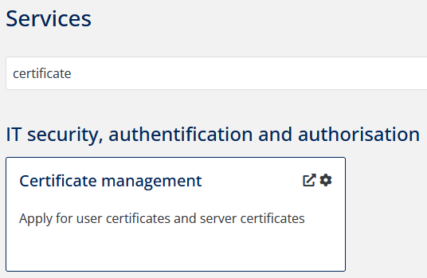
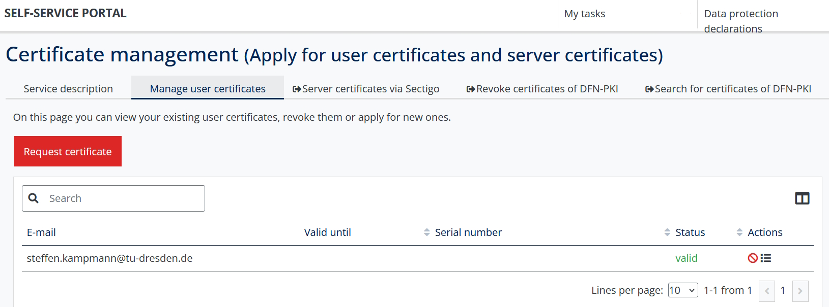
1. Basics - Your digital ID at TU Dresden (user certificate)
Signing documents digitally (next slide), encrypt and decrypt
Type “certificate” into the search field of the self-service portal
Request certificate
Service-Desk visitor address:
Andreas-Pfitzmann-Bau, Room E036 Nöthnitzer Straße 46, 01187 Dresden
https://navigator.tu-dresden.de/etplan/apb/00/raum/542100.2480?language=en
Opening hours: Monday – Friday → 08:00 – 19:00
Full documentation: https://tud.link/wtvyx5

Slide 6
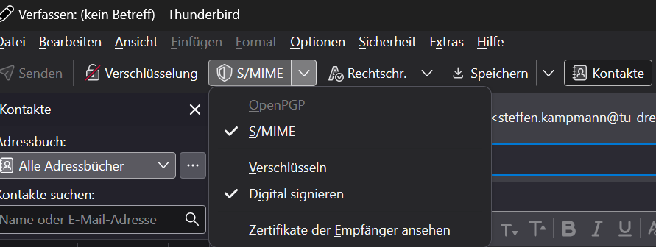
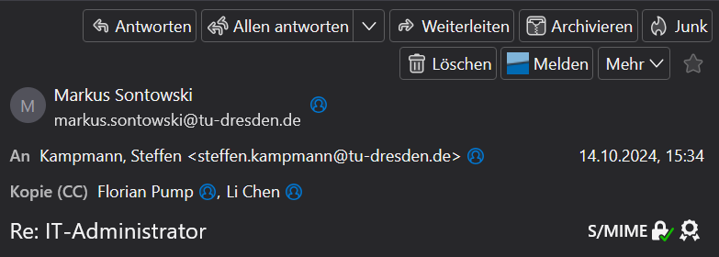
1. Basics - Use your user certificate for your emails
After you have installed the certificate, you can select the certificate in your mail program
Importing the user certificate into:
Outlook: https://tud.link/m7xx9k
Thunderbird: https://tud.link/eb25ta
Sets the e-mails to be signed automatically
The digital signature is displayed for the recipient
Outlook
Thunderbird
Everybody should use the digital signature!

Slide 7
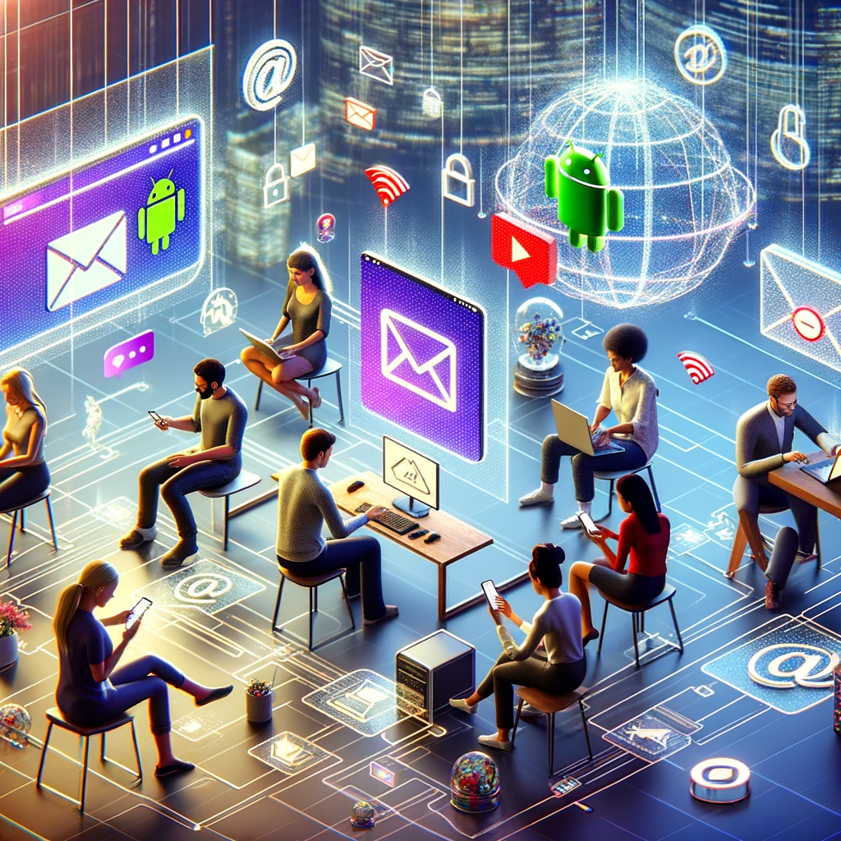
1. Basics – Email
Email
In Browser: https://msx.tu-dresden.de
Setup instructions for email clients:
→ Outlook: https://tud.link/k43h for Windows and https://tud.link/8gfu for MacOS
→ Thunderbird: https://tud.link/8wpk for Windows, MacOS, Linux
→ Apple Mail: https://tud.link/7jpf for MacOS and https://tud.link/nhcq for iOS/iPadOS
→ Gmail: https://tud.link/15t4 for Android
Please setup your signature according to your affiliation
→ Template example:
Your_title Your_name
TUD Dresden University of Technology Faculty of Mechanical Science and Engineering Institute of Materials Science Chair of Materials Science and Nanotechnology
Phone: +49 (0) 351 463-XYZ www.nano.tu-dresden.de
[1]
[1] DALL-E: https://chat.openai.com

Slide 8
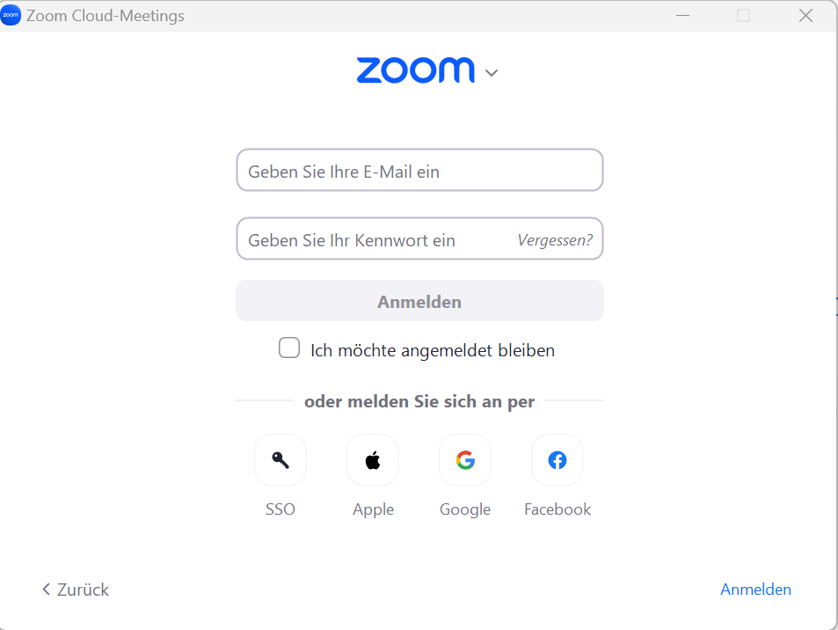
2. Communication and collaboration – Video Calls and Chats
Zoom
Click „Sign in“ at https://tu-dresden.zoom.us/
Create your personal link for your own Zoom room
https://tu-dresden.zoom-x.de/my/Your_Name (Left menu on „Meetings“ → „Private room“)
You can sign in with your ZIH-Login if you click on SSO and type tu-dresden in the appeared text field
BigBlueButton
https://bbb.tu-dresden.de/
Matrix-Chat
Chat for internal communication with students or colleagues
Chat rooms, personal chats etc.
https://matrix.tu-dresden.de

Slide 9
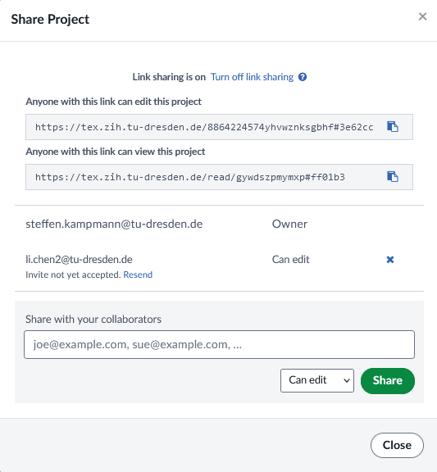
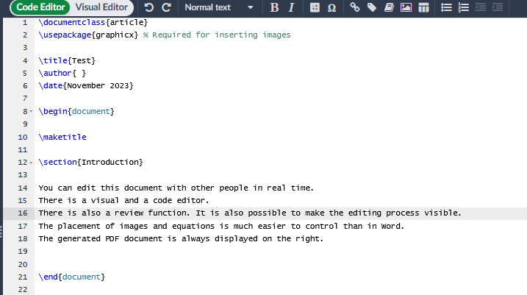
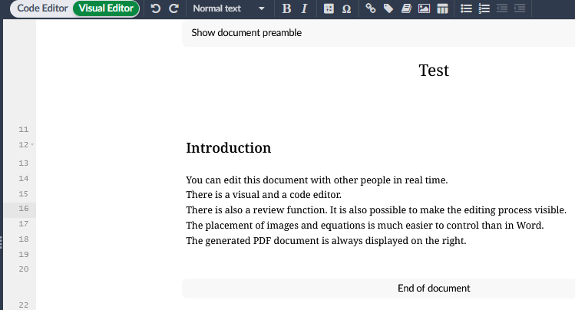
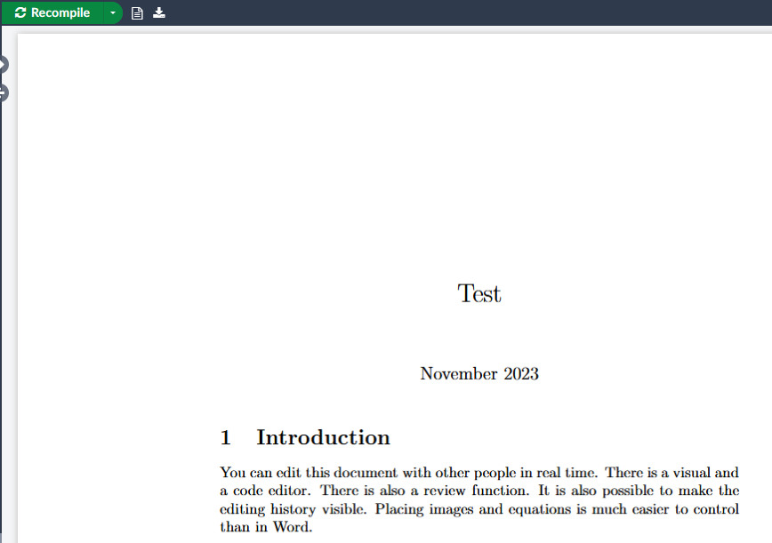
2. Communication and collaboration – Writing article
Sharepoint (Word, Powerpoint etc.):
https://selfservice.tu-dresden.de/services/258944/
ShareLatex:
equivalent to Overleaf, but can be used without restrictions
https://tex.zih.tu-dresden.de/
[1]
[1] https://de.wikipedia.org/

Slide 10
3. Data storage – Overview
Backed up data
Backed up data
Not backed up data
Home drive
Group drive
Datashare
https://tud.link/k48k1a
https://tud.link/k48k1a
https://tud.link/y72uz6
https://opara.zih.tu-dresden.de/
Your data
Research Group data
Share data
Archive your completed project data!
Your PC/Mac
No backed up data
https://media-exp1.licdn.com/dms/image/C4D1BAQGhuHkHrK9Otw/company-background_10000/0?e=2159024400&v=beta&t=1cL7tUnH5XYVw6DOfbIjkskihQl2pmXPHu1d7SLXnzs

Slide 11
3. Data storage – Which group drives are available at the chair?
pmana (10 TB)
Contains any chair related data → Win: \\vs-grp02.zih.tu-dresden.de\pmana Mac: smb://vs-grp02.zih.tu-dresden.de/pmana
pmnnano (5 TB)
Contains project and administrative related data of Theory group → Win: \\vs-grp08.zih.tu-dresden.de\pmnnano Mac: smb://vs-grp08.zih.tu-dresden.de/pmnnano
pmnent (5 TB)
Contains project and administrative related data of Environmental nanotechnology group → Win: \\vs-sec-smb3.zih.tu-dresden.de\pmnent Mac: smb://vs-sec-smb3.zih.tu-dresden.de/pmnent
pmnnst (5 TB)
Contains project and administrative related data of Nanoelectronics for sensor technologies group → \\vs-grp08.zih.tu-dresden.de\pmnnst Mac: smb://vs-grp08.zih.tu-dresden.de/pmnnst
pmnraw (50 TB) (only Snapshots, no backup, no mirror)
Contains raw research data of every group → \\vs-grp07.zih.tu-dresden.de\pmnraw Mac: smb://vs-grp07.zih.tu-dresden.de/pmnraw

Slide 12
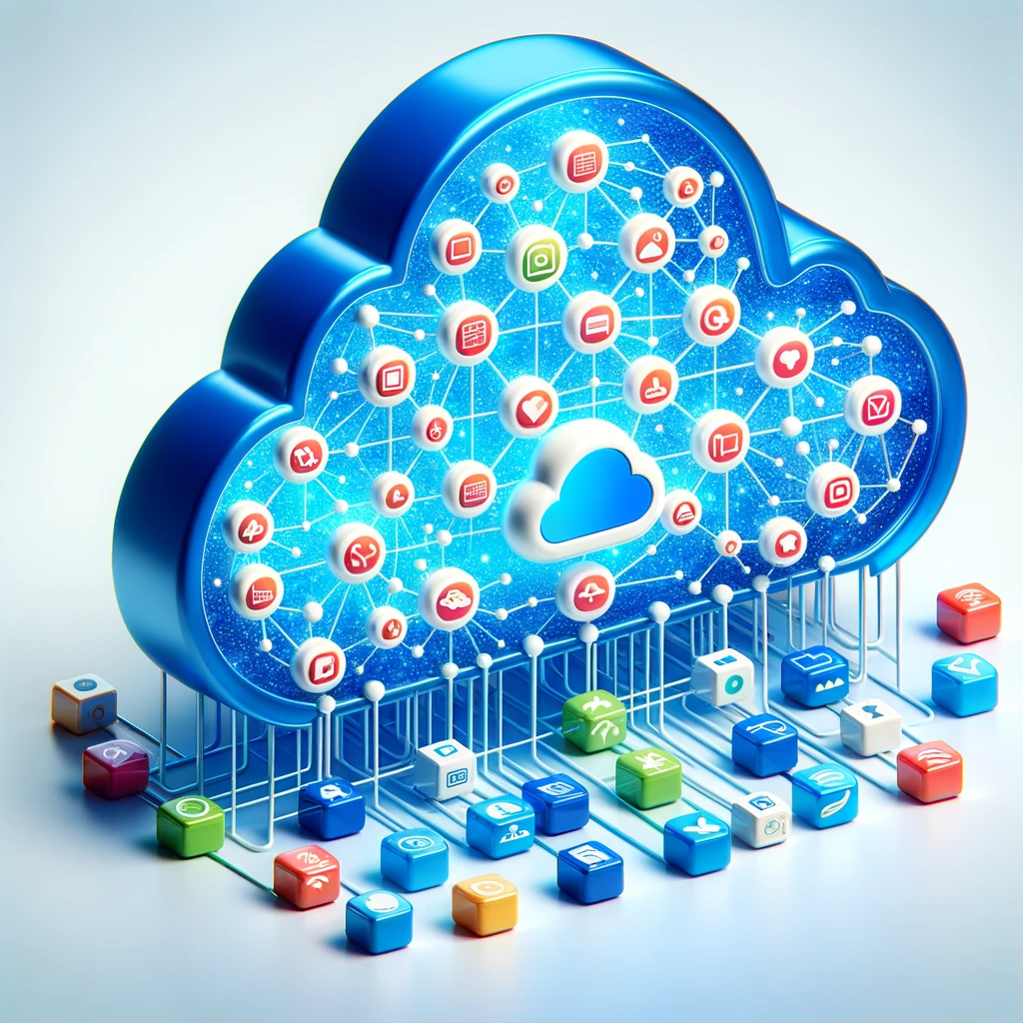
3. Data storages – Share your data easily
Datashare based on Nextcloud environment
https://datashare.tu-dresden.de/
You can upload, download and share Data with internal and external people
App for Windows, Mac, iOS and Android
→ https://nextcloud.com/de/install/#install-clients
→ Installation and setup manual: https://tud.link/fsvs
Gigamove 2.0
Share of large data until 100 GB ( Hint: Zip data to one file and then share it )
https://selfservice.tu-dresden.de/services/2250335/
[1]
[3]
[1] https://de.wikipedia.org/
[2] https://gigamove.rwth-aachen.de/en
[3] DALL-E: https://chat.openai.com
[2]

Slide 13
4. Software – Useful Tools
Microsoft Office
Microsoft Office 365 is also available for private PC/Laptop (WARNING: No permission to use Outlook 365 for TU email account)
→ For employees: https://tud.link/9nl1 → For students: https://campussachsen.tu-dresden.de/
Origin
License of chair available (Version 2024, also usable in VPN of TU Dresden)
→ please contact stephanie.klinghammer@tu-dresden.de or steffen.kampmann@tu-dresden.de
For students private PC/Laptop: https://tud.link/h928
Matlab
For students and employees office/private PC/laptop
https://de.mathworks.com/academia/tah-portal/tu-dresden-40758619.html
Solidworks
License of chair available → please contact steffen.kampmann@tu-dresden.de
Sophos
Anti Virus for private Laptop → https://home.sophos.com/en-us/employee
Alternatives for Adobe Products: https://tud.link/pmx21m (Affinity Designer), https://tud.link/7u6kbt (PDF Studio Pro), https://tud.link/jrqhvw CorelDRAW Technical Suite
Full software list: https://tud.link/xn1o

Slide 14
4. Software – Be Careful
Please do not use
External cloud services like:
Dropbox, iCloud, Google Drive, OneDrive etc.
→ Do not save your research data here
Software with illegal license
Software from Kaspersky Lab
Please use following services of TU Dresden
Home and Group drives
→ Save your research data here
Software list of TU Dresden or ask colleagues for alternatives
Sophos (already installed)
Please only install software from trustworthy sources
E. g. for open source software: https://www.heise.de/download/

Slide 15
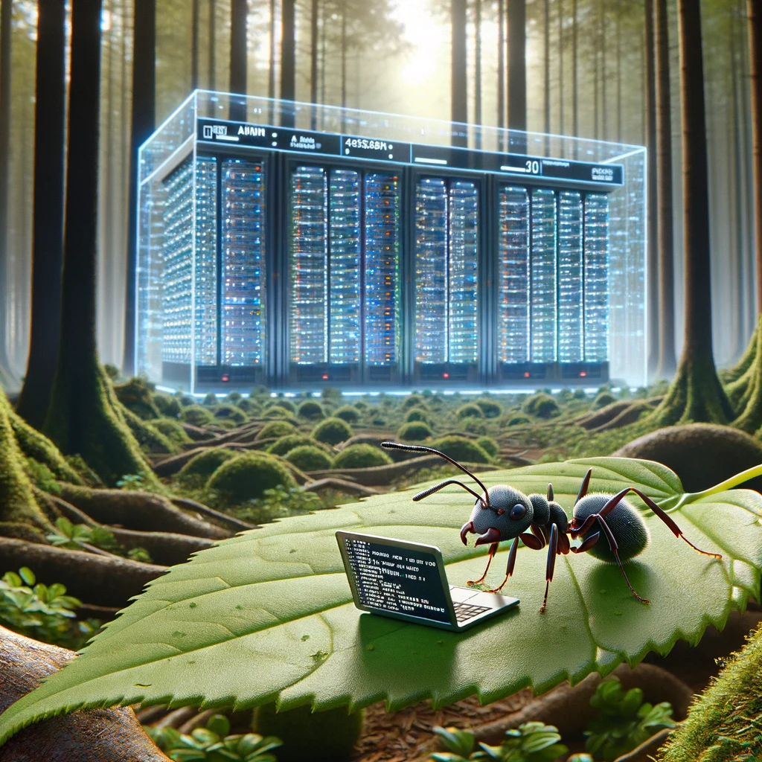
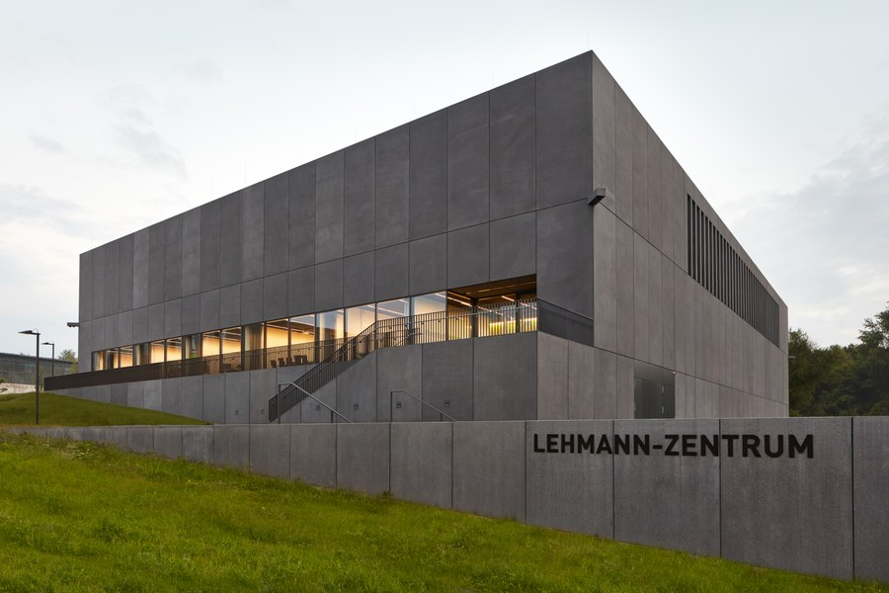
5. Workstations and Server – Powerful Hardware
Run your calculations on specialized Hardware that is available 24/7
Remote workstations for computing
https://selfservice.tu-dresden.de/services/research-cloud/
Preinstalled (Ubuntu, Windows …)
Easy installation of software
No waiting times
High Performance Computing (HPC)
https://doc.zih.tu-dresden.de/
To get access please contact Dr. Rafael Gutierrez ( rafael.gutierrez@tu-dresden.de )
Third largest GPU cluster in Germany
[1]
[2]
[1] DALL-E: https://chat.openai.com
[2] https://tu-dresden.de/

Slide 16
5. Workstations and Server – First Steps
Remote PC (Windows) hosted by TU Dresden
https://rds.zih.tu-dresden.de/
As student choose “Office Collection”
Many preinstalled software like Origin, COMSOL Multiphysics, Microsoft Office, Python, SPSS, Maple etc.
Your home drive is already mounted
You have access to your data on your local PC too
Control your office or lab PC remotely
You can control your office or lab PC from everywhere
https://rsupport.zih.tu-dresden.de/users/main/downloads.html
You can find a simple manual in following document https://nano.tu-dresden.de/shared/16
[1]
[1] https://lb.islonline.com/

Slide 17
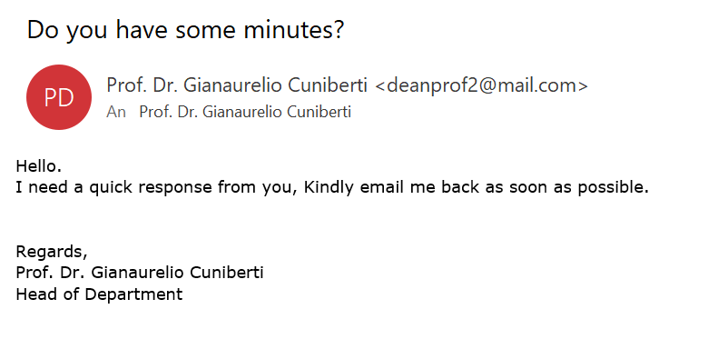
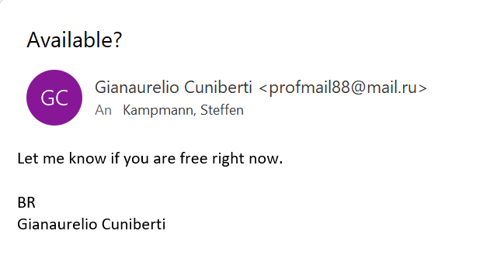
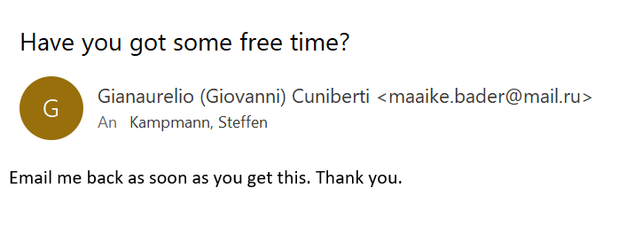
6. Security and Network – Scam Emails
You will NEVER be asked for your password or for money and vouchers
Report Scam email to TU Dresden (ZIH)
https://tud.link/35d7

Slide 18
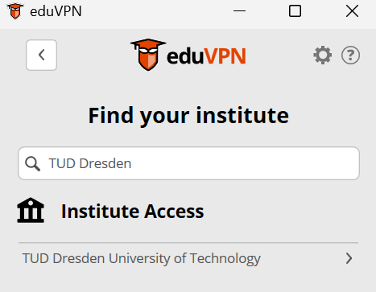
6. Security and Network – Stay connected with TU Dresden
To have full access to all services stay in the TU network with VPN
Secured connection in public Wi-Fi networks e. g. on conferences
Required for accessing the home and group drives
VPN
Install eduVPN software
https://www.eduvpn.org/client-apps/
Search for TUD Dresden… and select TUD Dresden University of Technology
Done!
Please note: Support for OpenVPN and Cisco AnyConnect will end during this year
[1]
You can install on your private and office laptop/PC
[1] https://de.wikipedia.org/wiki/OpenVPN#/media/Datei:OpenVPN_logo.svg

Slide 19
Thank you for your attention!

