Slide 1
PMN IT Information
Dipl.-Ing. Steffen Kampmann
Chair of Materials Science and Nanotechnology, TU Dresden
Dresden, 25.04.2024, Biannual Chair Information Event
Contact: steffen.kampmann@tu-dresden.de

Slide 2
General Information
ZIH is IT administration unit of TU Dresden
Therefore, you can write to ZIH if you have any problems with IT services
https://faq.tickets.tu-dresden.de/otrs/public.pl
servicedesk@tu-dresden.de
I am only contact person for
Your office PC/laptop
Software like Microsoft Office, Origin etc.
Network printer
Presentation support → Laptop, Microphones, Webcams, Presenter etc.

Slide 3
What does the IT infrastructure look like?
Communication & Collaboration
How can we work efficient in a team?
Data storage
Where can I save my data?
How can I share my data?
Software
How can I get helpful licensed software for my work?
Workstations and Server
Where can I run hardware resource-hungry software?
Security and Network
What do I need to do to protect my data and the data of my colleagues?
What do I need to have access to all of that?
→ Your ZIH login ←
To manage your passwords and personal information go to https://selfservice.tu-dresden.de/
See all services at glance in Self-Service Portal

Slide 4
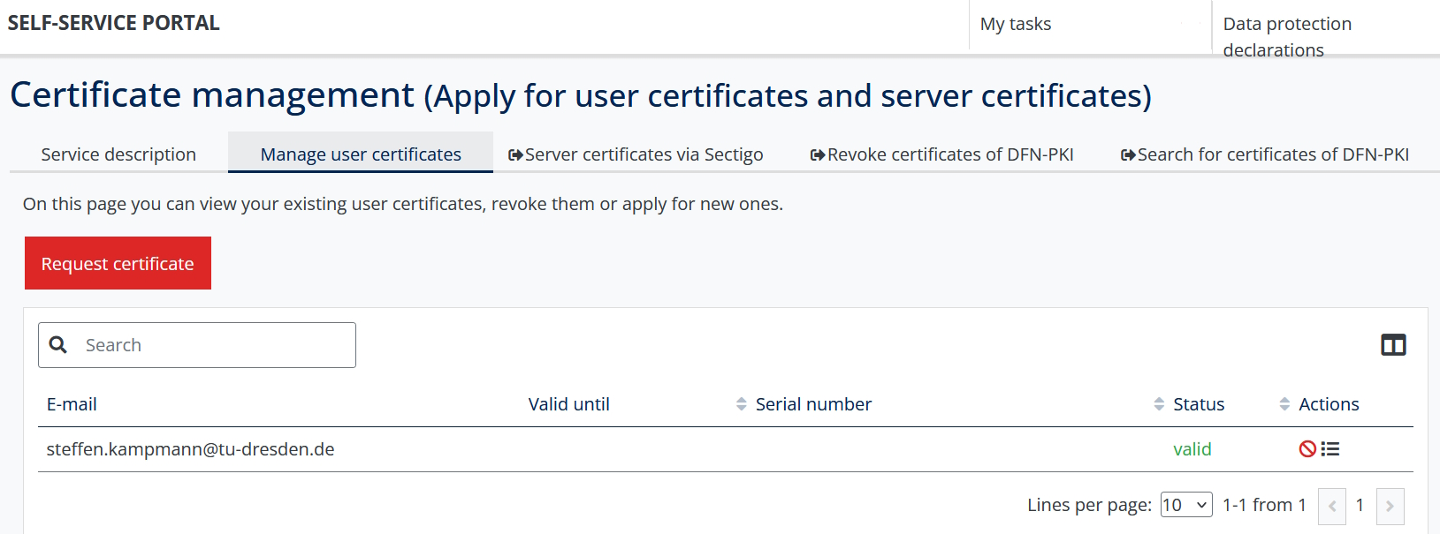
Your digital ID at TU Dresden (user certificate)
Signing documents digitally, encrypt and decrypt emails (highly recommended for internal emails)
Service-Desk visitor address:
Andreas-Pfitzmann-Bau, Room E036 Nöthnitzer Straße 46, 01187 Dresden
https://navigator.tu-dresden.de/etplan/apb/00/raum/542100.2480?language=en
Opening hours: Monday – Friday → 08:00 – 19:00
Full documentation: https://tud.link/wtvyx5

Slide 5
1. Communication and Collaboration – Email
Email
In Browser: https://msx.tu-dresden.de
Setup instructions for email clients:
→ Outlook: https://tud.link/k43h for Windows and https://tud.link/8gfu for MacOS
→ Thunderbird: https://tud.link/8wpk for Windows, MacOS, Linux
→ Apple Mail: https://tud.link/7jpf for MacOS and https://tud.link/nhcq for iOS/iPadOS
→ Gmail: https://tud.link/15t4 for Android
Please setup your signature according to your affiliation
→ Template example:
Your_title Your_name
TUD Dresden University of Technology Faculty of Mechanical Science and Engineering Institute of Materials Science Chair of Materials Science and Nanotechnology
Phone: +49 (0) 351 463-31413 www.nano.tu-dresden.de
[1]
[1] DALL-E: https://chat.openai.com

Slide 6
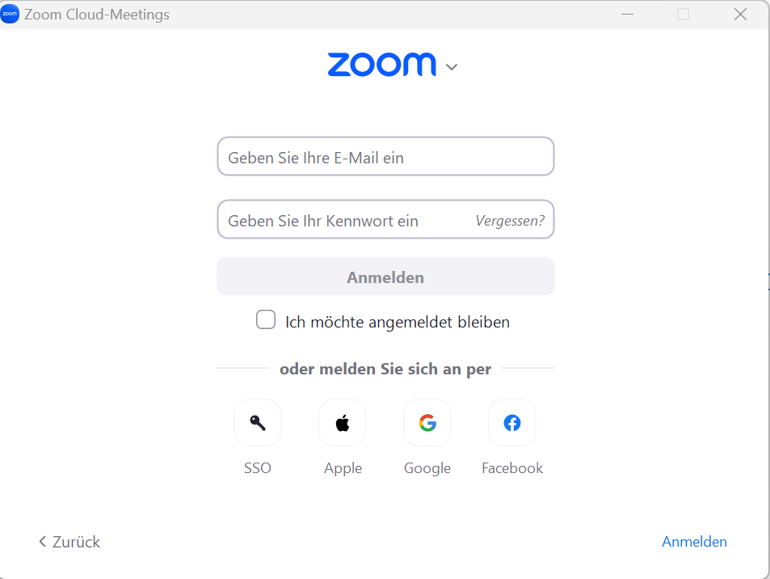
1. Communication and Collaboration – Video Calls and Chats
Zoom
Click „Sign in“ at https://tu-dresden.zoom.us/
Create your personal link for your own Zoom room
https://tu-dresden.zoom-x.de/my/Your_Name (Left menu on „Meetings“ → „Private room“)
You can sign in with your ZIH-Login if you click on SSO and type tu-dresden in the appeared text field
BigBlueButton
https://bbb.tu-dresden.de/
Matrix-Chat
Chat for internal communication with students or colleagues
Chat rooms, personal chats etc.
https://matrix.tu-dresden.de

Slide 7
1. Communication and Collaboration – Writing article
Sharepoint (Word, Powerpoint etc.):
https://selfservice.tu-dresden.de/services/258944/
ShareLatex:
https://tex.zih.tu-dresden.de/
[1]
[1] https://de.wikipedia.org/

Slide 8
2. Data storage – Overview
Home drive
Group drive
Datashare of TU Dresden
Your data
Research Group data
Share data
Your PC/Mac
Non-backed up data
https://media-exp1.licdn.com/dms/image/C4D1BAQGhuHkHrK9Otw/company-background_10000/0?e=2159024400&v=beta&t=1cL7tUnH5XYVw6DOfbIjkskihQl2pmXPHu1d7SLXnzs

Slide 9
2. Data storage – Let the TU backup your data
Home network drive
For your data
Automatic Backups and Snapshots
Group network drives
For many and large raw research data
For project and group data
Automatic Backups and Snapshots
Archiving your research data
Gaining more and more importance
with OpARA (https://opara.zih.tu-dresden.de/xmlui/?locale-attribute=en )
https://selfservice.tu-dresden.de/services/358875/
Short and simple manual at
https://nano.tu-dresden.de/shared/14
[1]
[1] DALL-E: https://chat.openai.com

Slide 10
2. Data storage – Which group drives are available at the chair?
pmana (10 TB)
Contains any chair related data → Win: \\vs-grp02.zih.tu-dresden.de\pmana Mac: smb://vs-grp02.zih.tu-dresden.de/pmana
pmnnano (5 TB)
Contains project and administrative related data of Theory group → Win: \\vs-grp08.zih.tu-dresden.de\pmnnano Mac: smb://vs-grp08.zih.tu-dresden.de/pmnnano
pmnent (5 TB)
Contains project and administrative related data of Environmental nanotechnology group → Win: \\vs-sec-smb3.zih.tu-dresden.de\pmnent Mac: smb://vs-sec-smb3.zih.tu-dresden.de/pmnent
pmnnst (5 TB)
Contains project and administrative related data of Nanoelectronics for sensor technologies group → \\vs-grp08.zih.tu-dresden.de\pmnnst Mac: smb://vs-grp08.zih.tu-dresden.de/pmnnst
pmnraw (50 TB) (only Snapshots, no backup, no mirror)
Contains raw research data of every group → \\vs-grp07.zih.tu-dresden.de\pmnraw Mac: smb://vs-grp07.zih.tu-dresden.de/pmnraw

Slide 11
2. Data storages – Share your data easily
Datashare based on Nextcloud environment
https://datashare.tu-dresden.de/
You can upload, download and share Data with internal and external people
App for Windows, Mac, iOS and Android
→ https://nextcloud.com/de/install/#install-clients
→ Installation and setup manual: https://tud.link/fsvs
Gigamove 2.0
Share of large data until 100 GB ( Hint: Zip data to one file and then share it )
https://selfservice.tu-dresden.de/services/2250335/
[1]
[3]
[1] https://de.wikipedia.org/
[2] https://gigamove.rwth-aachen.de/en
[3] DALL-E: https://chat.openai.com
[2]

Slide 12
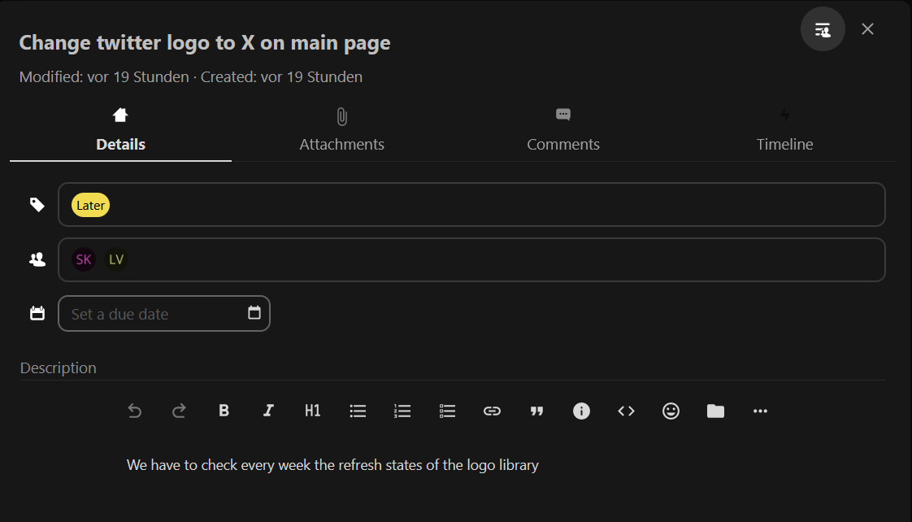
3. Software – Useful Tools
Project organizing tool Decks
Avaliable at https://datashare.tu-dresden.de/
Further Apps will coming soon
[1]
[1] DALL-E: https://chat.openai.com

Slide 13
3. Software – Useful Tools
Microsoft Office
Microsoft Office 365 is also available for private PC/Laptop
→ For employees: https://tud.link/9nl1 → For students: https://campussachsen.tu-dresden.de/
Origin
License of chair available (Version 2024, also usable in VPN of TU Dresden)
→ please contact stephanie.klinghammer@tu-dresden.de or steffen.kampmann@tu-dresden.de
For students private PC/Laptop: https://tud.link/h928
Matlab
For students and employees office/private PC/laptop
https://de.mathworks.com/academia/tah-portal/tu-dresden-40758619.html
Solidworks
License of chair available → please contact steffen.kampmann@tu-dresden.de
Sophos
Anti Virus for private Laptop → https://home.sophos.com/en-us/employee
Software list
https://tud.link/xn1o

Slide 14
3. Software – Be Careful
Please do not use
External cloud services like Dropbox, Google Drive, OneDrive etc.
→ Do not save your research data there
Software with illegal license
Software from Kaspersky Lab
Please use following services of TU Dresden
Home and Group drives
→ Save your research data there
Software list of TU Dresden or ask colleagues for alternatives
Sophos (already installed)
Please only install software from trustworthy sources
E. g. https://www.heise.de/download/

Slide 15
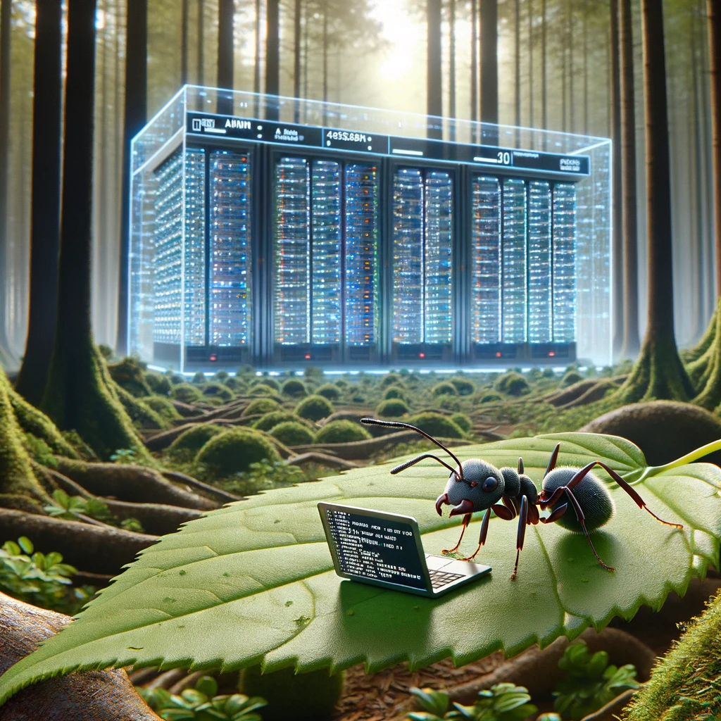
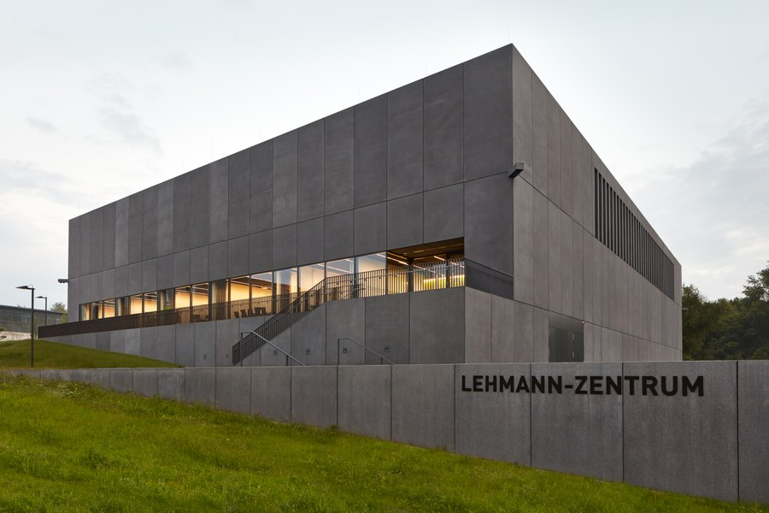
4. Workstations and Server – Powerful Hardware
Run your calculations on specialized Hardware that is available 24/7
Remote workstations for computing
https://selfservice.tu-dresden.de/services/research-cloud/
Access via Terminal
High Performance Computing (HPC)
https://doc.zih.tu-dresden.de/
To get access please contact Dr. Rafael Gutierrez ( rafael.gutierrez@tu-dresden.de )
Access via Terminal
[1]
[2]
[1] DALL-E: https://chat.openai.com
[2] https://tu-dresden.de/

Slide 16
4. Workstations and Server – First Steps
Remote PC (Windows) hosted by TU Dresden
https://rds.zih.tu-dresden.de/
As student choose “Office Collection”
Many preinstalled software like Origin, COMSOL Multiphysics, Microsoft Office, Python, SPSS, Maple etc.
Your home drive is already mounted
You have access to your data on your local PC too
Control your office or lab PC remotely
You can control your office or lab PC from everywhere
https://rsupport.zih.tu-dresden.de/users/main/downloads.html
You can find a simple manual in following document https://nano.tu-dresden.de/shared/16
[1]
[1] https://lb.islonline.com/

Slide 17
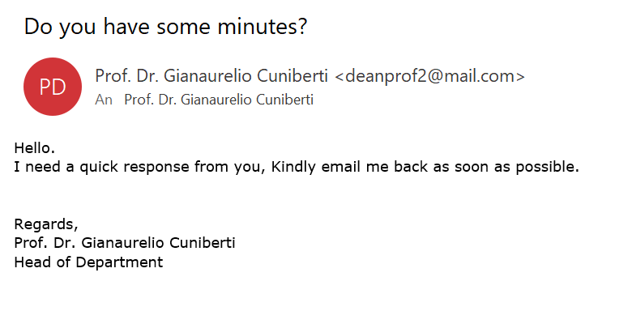
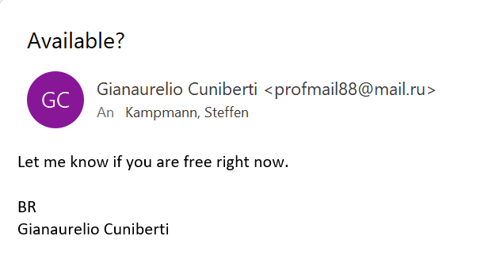
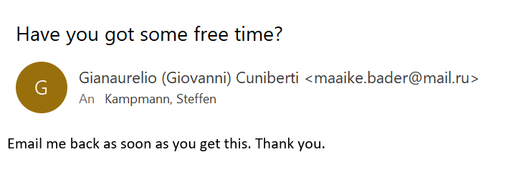
5. Security and Network – Scam Emails
You will NEVER be asked for your password or for money and vouchers
Report Scam email to TU Dresden (ZIH)
https://tud.link/35d7

Slide 18
5. Security and Network – Stay connected with TU Dresden
To have full access to all services stay in the TU network with VPN
Secured connection in public Wi-Fi networks e. g. on conferences
VPN
Install OpenVPN software
https://openvpn.net/vpn-client/
Download your TU Dresden profile file
https://selfservice.tu-dresden.de/services/vpn/openvpn
Execute this file
Detailed documentation:
https://tud.link/d4s7
[1]
[2]
[1] https://de.wikipedia.org/
[2] https://tu-dresden.de/zih/die-einrichtung/news/eduroam-neukonfiguration-erforderlich?set_language=en

Slide 19
Website of our Chair
Public website
https://nano.tu-dresden.de/ or https://nano-tud.de/
Internal area on website
https://nano.tu-dresden.de/shared/ or https://nano-tud.de/shared/
User: nano Password: nano
Here we share important documents
Please check if your profile information is up to date
https://nano.tu-dresden.de/team/

Slide 20
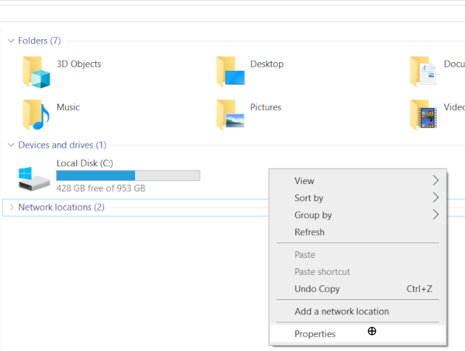
Send me the name of your office PC/laptop
Email to: steffen.kampmann@tu-dresden.de

Slide 21
Thank you for your attention!

