Slide 1
PMN IT Instructions
Dipl.-Ing. Steffen Kampmann
Chair of Materials Science and Nanotechnology, TU Dresden
Dresden, 13.04.2023, Biannual Chair Information Event
Contact: steffen.kampmann@tu-dresden.de

Slide 2
General Information
ZIH is IT administration unit of TU Dresden
Therefore, you can write to ZIH if you have any problems with IT services
servicedesk@tu-dresden.de
I am only contact person for
Your work computer
Hardware for your work computer
Software like Microsoft Office, Origin etc.
Network printer
Presentation support → Laptop, Microphones, Webcams, Presenter etc.

Slide 3
Which information do we have and need?
Starting point for access to IT infrastructure at TU Dresden:
Your ZIH-Login
To manage your passwords and personal information go to https://selfservice.tu-dresden.de/
See all services at glance in Self-Service Portal

Slide 4
What does the IT infrastructure look like?
Communi-cation & Collabo-ration
Data storages
Communicate efficient
Organize your data
Email
Zoom
SharePoint
Others
Cloudstore
Home network drive
Group drive
Others
1
2
Software
Server
Use helpful tools
Use powerful hardware
Microsoft Office
MATLAB
Origin
Others
High Performance Computing (HPC)
Remote workstations
Others
3
4

Slide 5
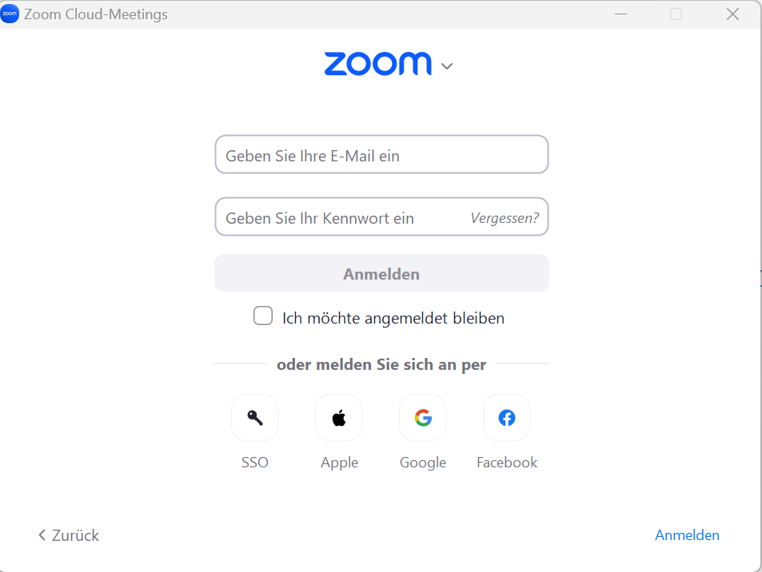
1. Communication and Collaboration – First Steps
Email
Setup your signature according to your affiliation
Zoom
Click „Sign in“ at https://tu-dresden.zoom.us/
Create your personal link for your own Zoom room https://tu-dresden.zoom.us/my/Your_Name (Left menu on „Meetings“ → „Private room“)
You can sign in with your ZIH-Login if you click on SSO and type tu-dresden in the appeared text field

Slide 6
2. Data storages – First Steps
Home drive
Group drive
Cloudstore of TU Dresden
Your data
Research Group data
Share data
Non-backed up data
https://media-exp1.licdn.com/dms/image/C4D1BAQGhuHkHrK9Otw/company-background_10000/0?e=2159024400&v=beta&t=1cL7tUnH5XYVw6DOfbIjkskihQl2pmXPHu1d7SLXnzs

Slide 7
2. Data storages – First Steps
Cloudstore
https://cloudstore.zih.tu-dresden.de/
You can upload, download and share Data with internal and external people
App for Windows, Mac, iOS and Android
No Backups
Home network drive
For your data
Automatically Backups and Snapshots
Group network drives
For many and large raw research data
For project and group data
Automatically Backups and Snapshots
[1]
Short and simple manual at
https://nano.tu-dresden.de/shared/14
[1] https://de.wikipedia.org/

Slide 8
3. Software – First Steps
Mandatory
Install Sophos anti virus https://tu-dresden.de/zih/dienste/service-katalog/arbeitsumgebung/dir_software/softwareliste/virenschutz/sophos/index/?set_language=en (as Windows user you can also download Endpoint Security and Control)
Microsoft Office
is already installed on your PC/Laptop
Microsoft Office 365 is also available for your own PC/Laptop
→ For employees: https://selfservice.tu-dresden.de/services/software-licenses/microsoft-365/
→ For students: https://campussachsen.tu-dresden.de/
Origin
License of chair available → please contact me ( steffen.kampmann@tu-dresden.de )
For students at own PC: https://tu-dresden.de/zih/dienste/service-katalog/arbeitsumgebung/dir_software/softwareliste/origin/index
Software list
https://tu-dresden.de/zih/dienste/service-katalog/arbeitsumgebung/dir_software/softwareliste

Slide 9
3. Software – First Steps
Prohibited software
TeamViewer
External cloud services like Dropbox, Google Drive, OneDrive etc.
Cracked software
Software with illegal license
Please only install software from trustworthy sources
E. g. https://www.heise.de/download/

Slide 10
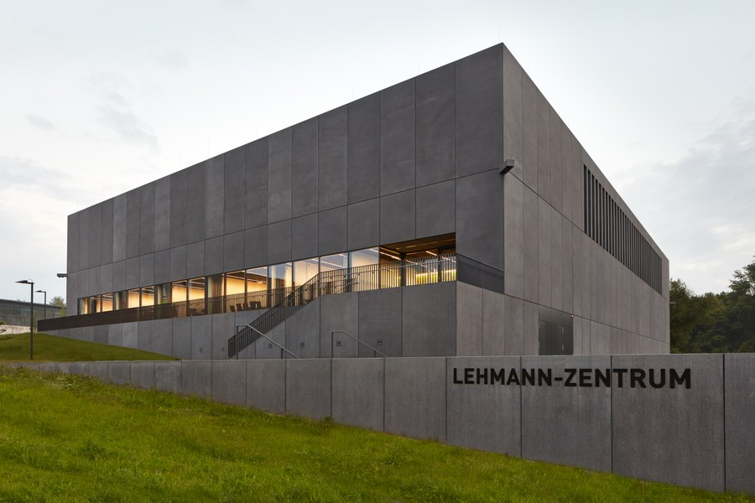
4. Server – First Steps
Remote Desktop Client (ISL)
You can control your Lab or Office PC from everywhere
https://rsupport.zih.tu-dresden.de:7615/users/main/downloads.html
You can find a simple manual in following document https://nano.tu-dresden.de/shared/16
Remote workstations for computing
https://selfservice.tu-dresden.de/services/research-cloud/
Access via ssh connection
High Performance Computing (HPC)
https://doc.zih.tu-dresden.de/
To get access please contact Dr. Rafael Gutierrez ( rafael.gutierrez@tu-dresden.de )
Access via ssh connection
[1]
[2]
[1] https://lb.islonline.com/ [2] https://tu-dresden.de/

Slide 11
Stay connected with TU Dresden
To have full access to all services stay in the TU network with VPN
Secured connection in public Wi-Fi networks e. g. on conferences
https://selfservice.tu-dresden.de/services/vpn/
Install OpenVPN software
https://openvpn.net/vpn-client/
Download the TU Dresden profile file
https://selfservice.tu-dresden.de/services/vpn/openvpn
Execute this file
Detailed documentation:
https://tu-dresden.de/zih/dienste/service-katalog/arbeitsumgebung/zugang_datennetz/vpn/openvpn
[1]
[1] https://de.wikipedia.org/

Slide 12
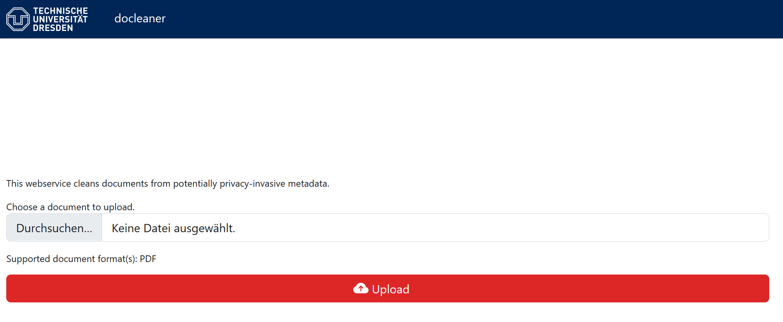
Publishing and Sharing of Documents
Clean your meta data
Use the following tool docleaner before you publishing or share documents:
https://docleaner.cert.tu-dresden.de/

Slide 13
Website of our Chair
Public website
https://nano.tu-dresden.de/ or https://nano-tud.de/
Internal area on website
https://nano.tu-dresden.de/shared/ or https://nano-tud.de/shared/
User: nano Password: nano
Here we share important documents
Please check if your profile information is up to date
https://nano.tu-dresden.de/team/

Slide 14
Thank you for your attention!

