Slide 1
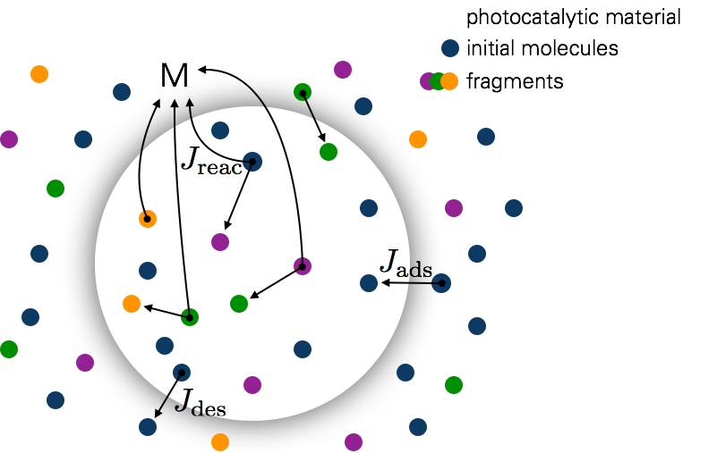
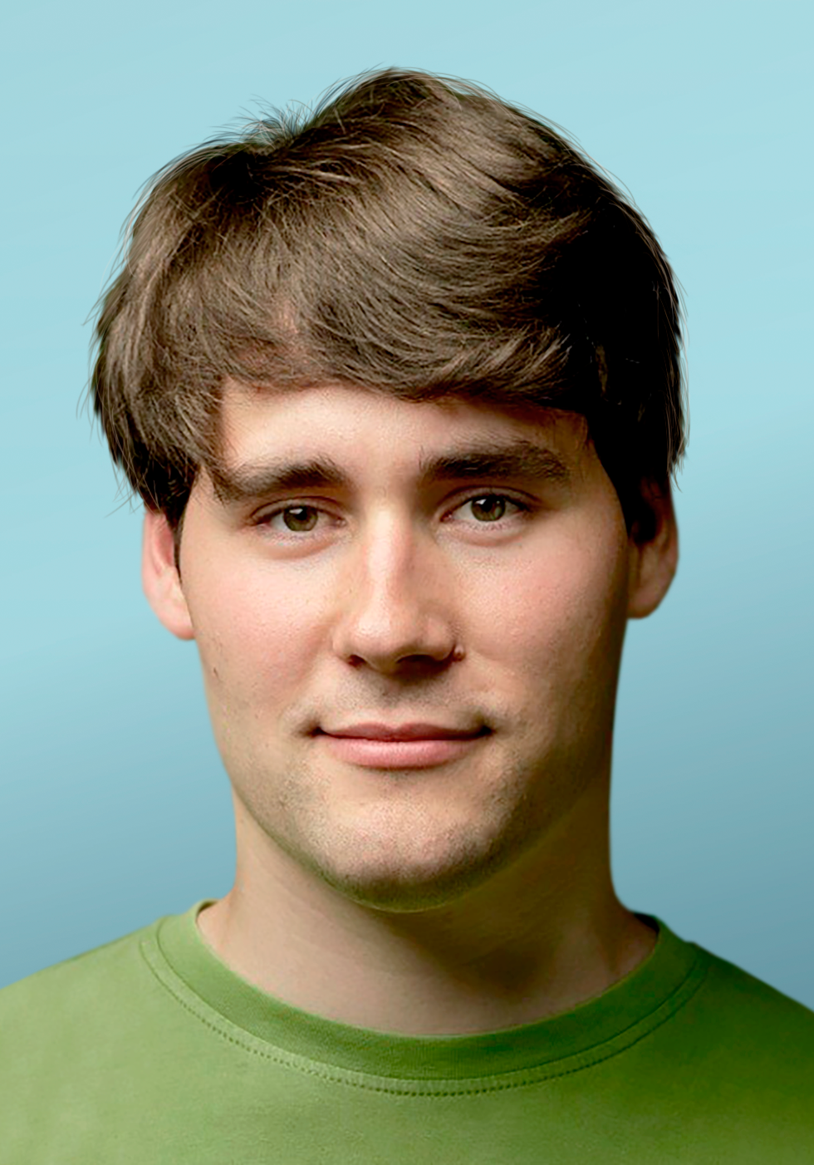
Modeling photocatalytic degradation
Understanding the photocatalytic process in detail
Rate-theory & FEM
Models for different photocatalytic reactor setups.
Hagen Eckert

