Slide 1
Working with Home & Group Drives from ZIH
Institute of Materials Science - Chair of Materials Science and Nanotechnology
Introduction to the use of network drives in the TU network
^{Dipl.-Ing. Steffen Kampmann}

Slide 2
Which kind of data storages exists?
Home drive
Group drive
Datashare of TU Dresden
Research Group
[1]

Slide 3
Differences between storages
 | Home drive | Group drive | Datashare
Usage | Personal | Groups | Groups/External
Storage capacity | Up to 200 GB | Up to 50 TB | 10 GB (2GB)
Backup
Snapshots
Mirror
Datashare is only for sharing redundant data

Slide 4
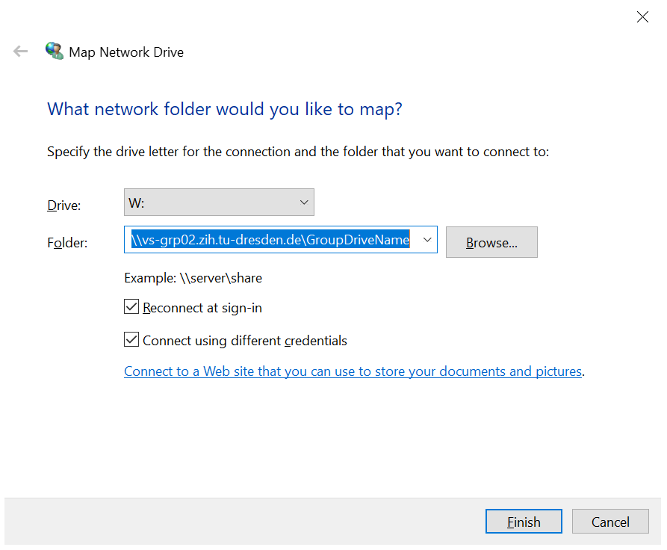
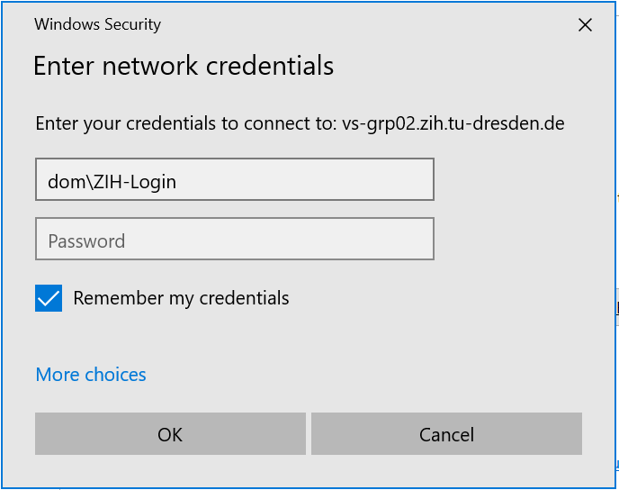
How to connect with Windows?
Windows:
You can enter in the field Folder the address of your home drive or the address of the group drive (slide 8)
User: dom\ZIH-Login
For ZIH-Login you type your ZIH-Login-name
Your home drive:
\\vs-home.zih.tu-dresden.de/ZIH-Login
For ZIH-Login you type your ZIH-Login-name

Slide 5
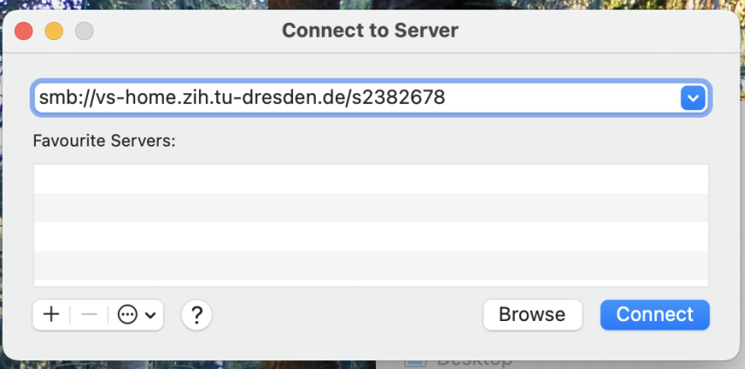
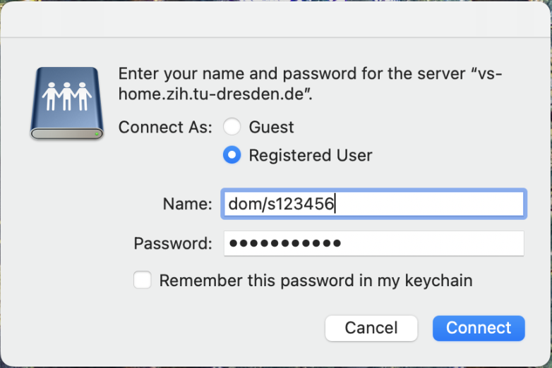
How to connect with Mac?
Mac:
You can enter in the field Folder the address of your home drive or the address of the group drive (slide 8)
cmd + k
User: dom/ZIH-Login
For ZIH-Login you type your ZIH-Login-name
ZIH-Login
Your home drive:
Smb://vs-home.zih.tu-dresden.de/ZIH-Login
For ZIH-Login you type your ZIH-Login-name
ZIH-Login

Slide 6
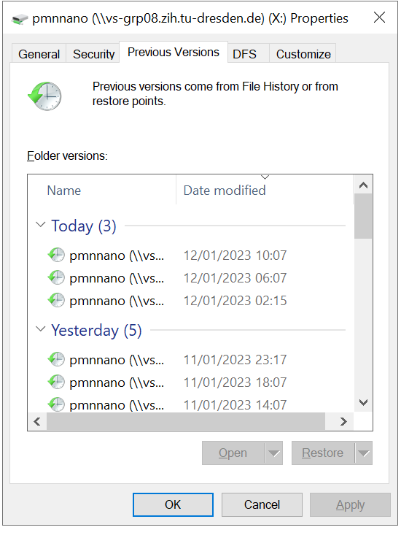
Data is lost! And now?
User possible actions:
Restore lost data with previous data states (Snapshots)
Windows:
Right click to the folder which should contains the lost data

Slide 7
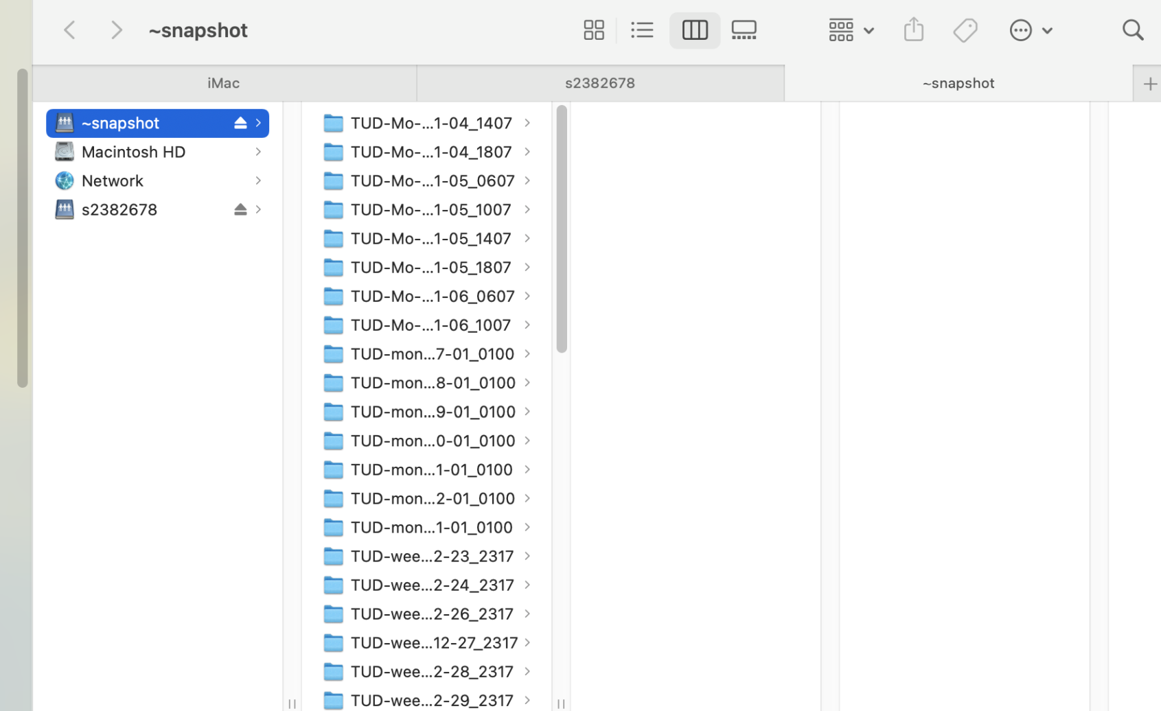
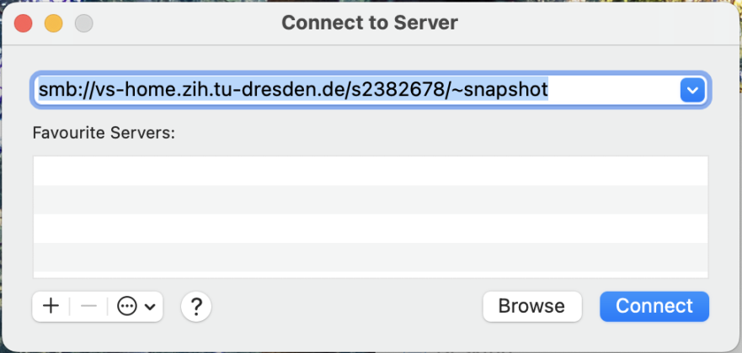
Data is lost! And now?
Mac:
Connect to the drive again with addition of /~snapshot in the end of the drive adress
ZIH-Login

Slide 8
Which group drives are available at the chair?
pmana (10 TB)
Contains any chair related data → Win: \\vs-grp02.zih.tu-dresden.de\pmana Mac: smb://vs-grp02.zih.tu-dresden.de/pmana
pmnnano (5 TB)
Contains project and administrative related data of Theory group → Win: \\vs-grp08.zih.tu-dresden.de\pmnnano Mac: smb://vs-grp08.zih.tu-dresden.de/pmnnano
pmnent (5 TB)
Contains project and administrative related data of Environmental nanotechnology group → Win: \\vs-sec-smb3.zih.tu-dresden.de\pmnent Mac: smb://vs-sec-smb3.zih.tu-dresden.de/pmnent
pmnnst (5 TB)
Contains project and administrative related data of Nanoelectronics for sensor technologies group → \\vs-grp08.zih.tu-dresden.de\pmnnst Mac: smb://vs-grp08.zih.tu-dresden.de/pmnnst
pmnraw (50 TB) (only Snapshots, no backup, no mirror)
Contains raw research data of every group → \\vs-grp07.zih.tu-dresden.de\pmnraw Mac: smb://vs-grp07.zih.tu-dresden.de/pmnraw

Slide 9
Example: pmnnano
Possible data structure:

Slide 10
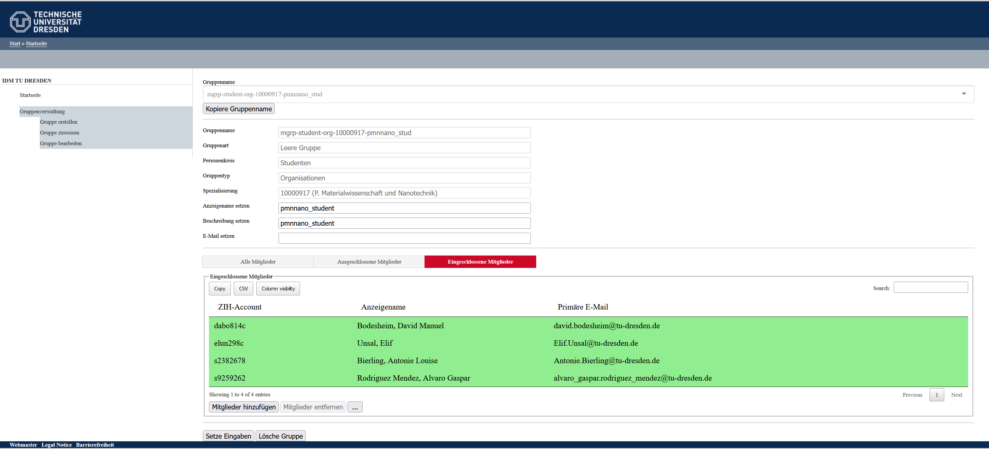
How is file access controlled?
https://idm-tools.tu-dresden.de/

Slide 11
References
[1] https://media-exp1.licdn.com/dms/image/C4D1BAQGhuHkHrK9Otw/company- background_10000/0?e=2159024400&v=beta&t=1cL7tUnH5XYVw6DOfbIjkskihQl2pmXPHu1d7SLXnzs

