Slide 1

Working with Home & Group Drives from ZIH
Institute of Materials Science - Chair of Materials Science and Nanotechnology
Introduction to the use of network drives in the TU network
^{Dipl.-Ing. Steffen Kampmann}

Slide 2
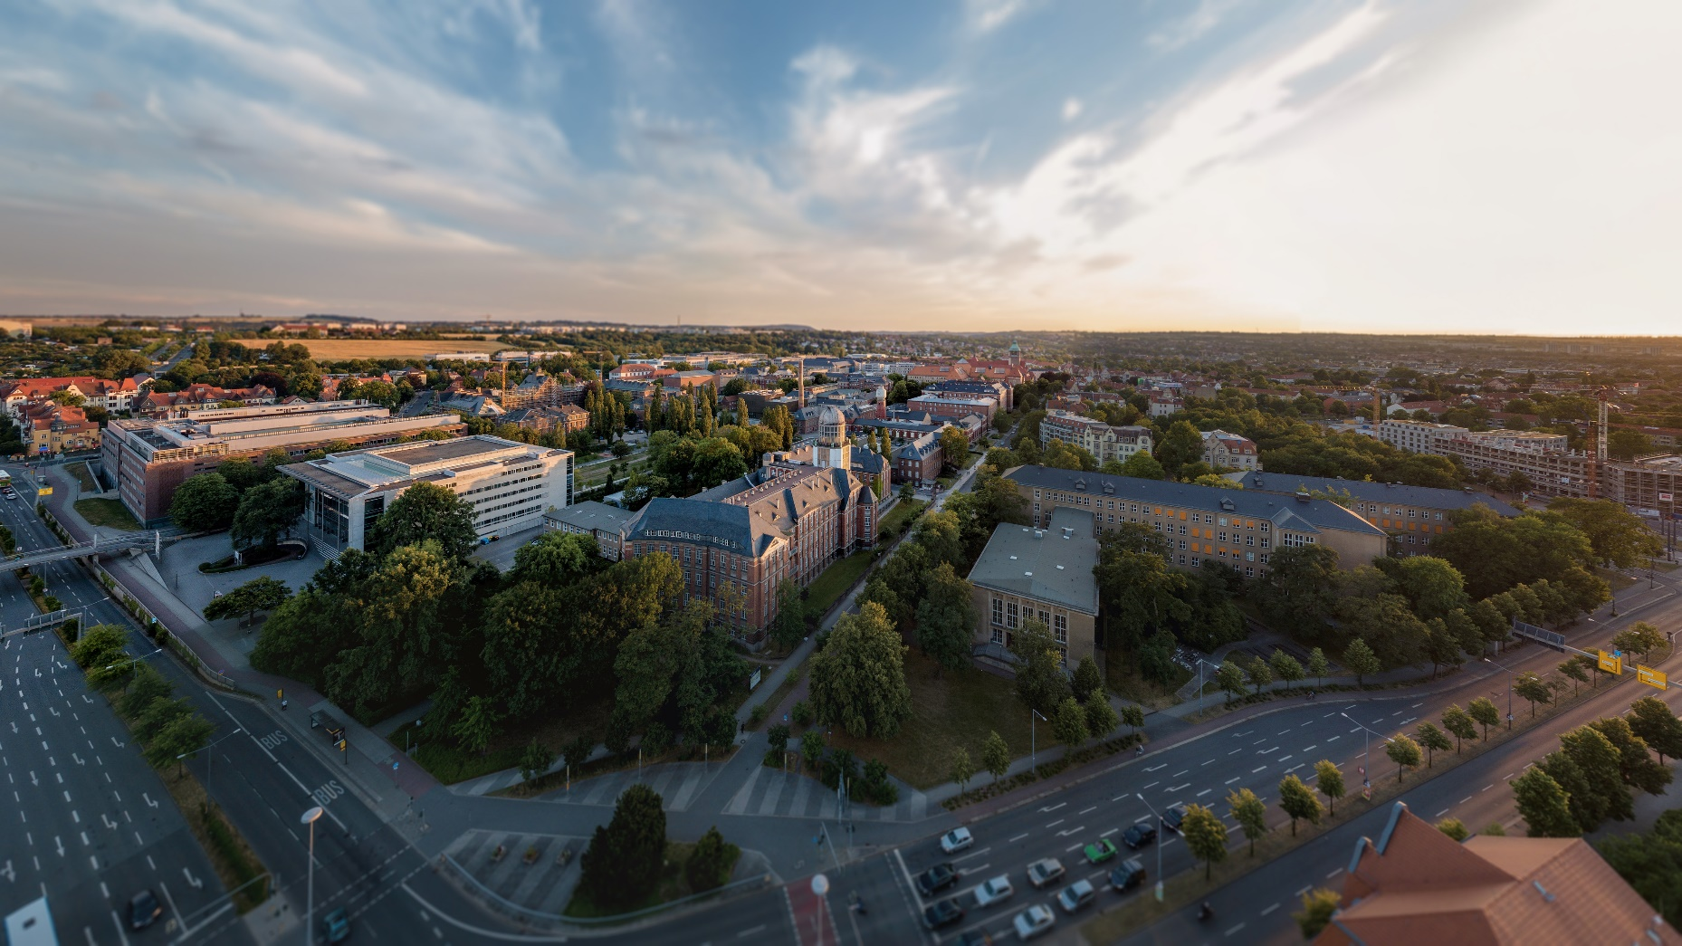


Which kind of data storages exists?
Home drive
Group drive
Cloudstore of TU Dresden
Research Group
[1]

Slide 3


Differences between storages
 | Home drive | Group drive | Cloudstore
Usage | Personal | Groups | Groups/External
Storage capacity | Up to 200 GB | Up to 50 TB | 10 GB (2GB)
Backup
Snapshots
Mirror
Cloudstore is only for sharing redundant data
Cloudstore is not suitable for research data

Slide 4
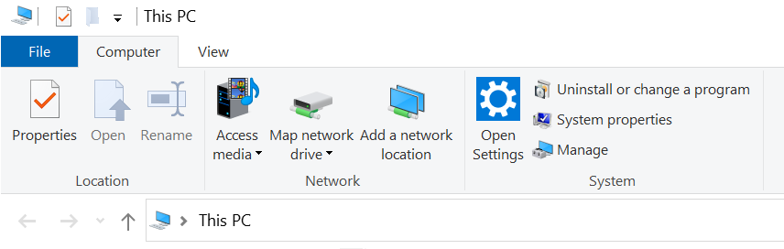
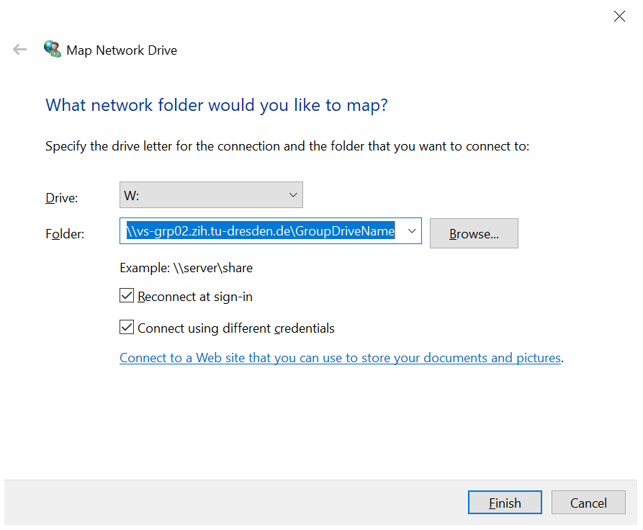
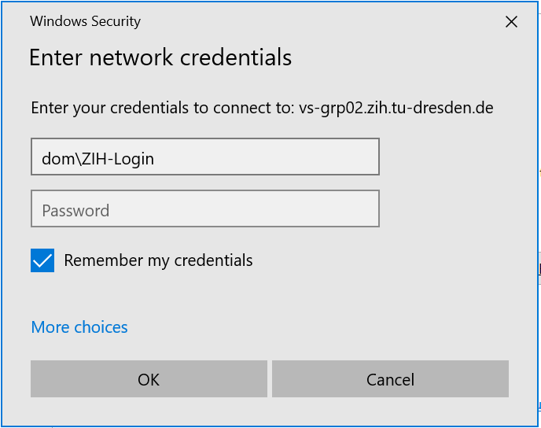
How to connect with Windows?
Windows:
Group drives:
\\vs-grp02.zih.tu-dresden.de\GroupDriveName
\\vs-home.zih.tu-dresden.de\ZIH-Login

Slide 5

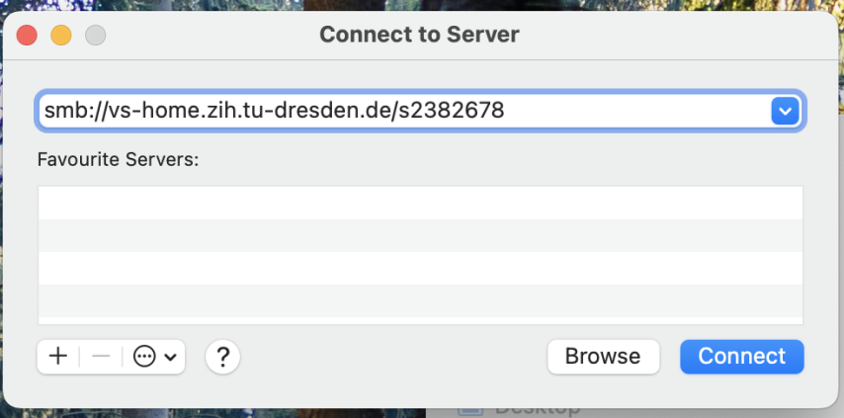
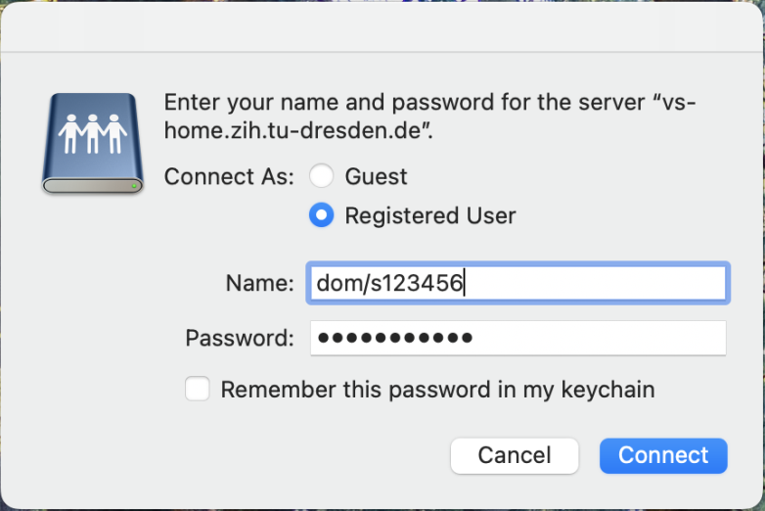
How to connect with Mac?
Mac:
Group drives:
smb://vs-grp02.zih.tu-dresden.de/GroupDriveName
smb://vs-home.zih.tu-dresden.de/ZIH-Login
cmd + k
ZIH-Login
ZIH-Login

Slide 6
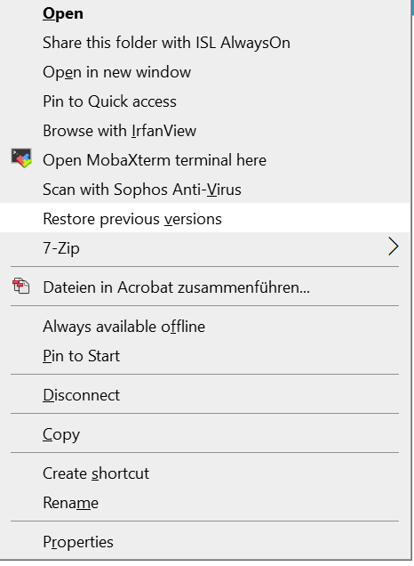
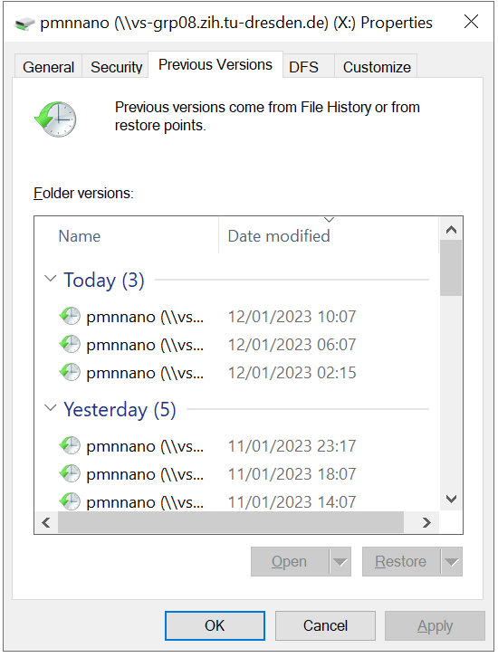
Data is lost! And now?
User possible actions:
  Restore lost data with previous data states (Snapshots)
  Windows:
  Right click to the folder which should contains the lost data

Slide 7
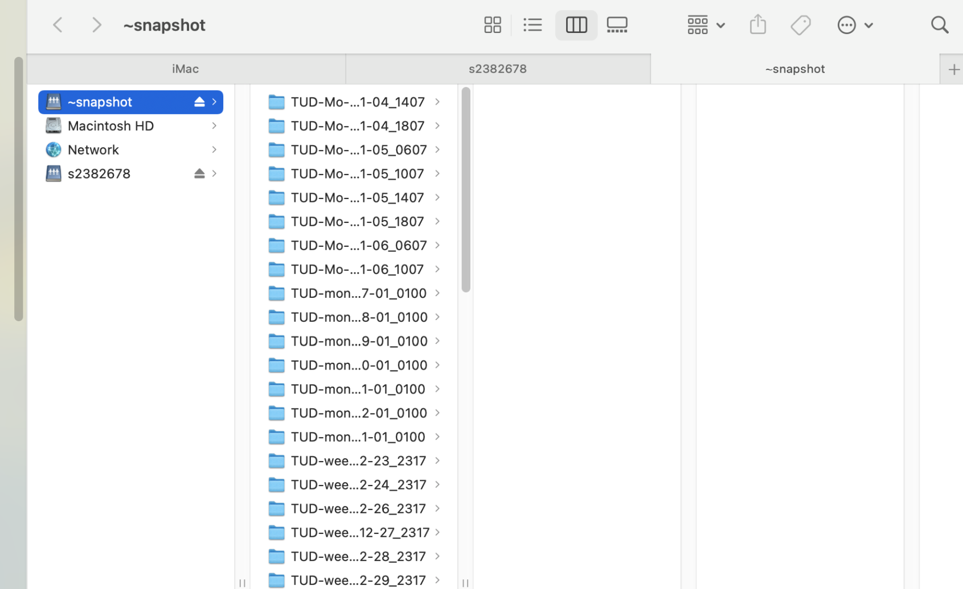
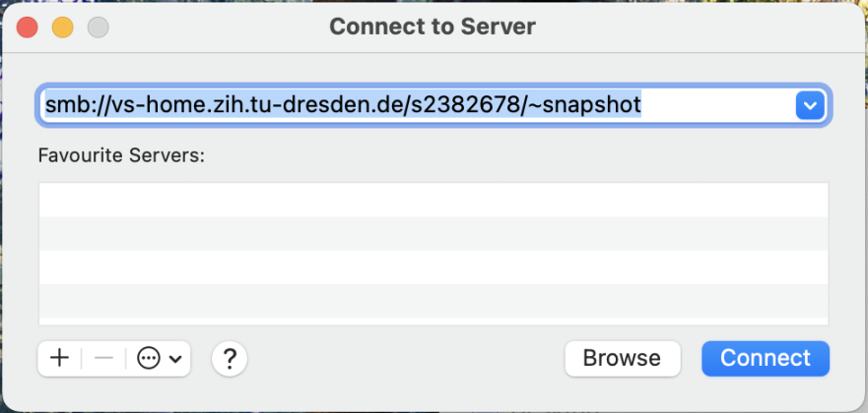
Data is lost! And now?
  Mac:
  Connect to the drive again with addition of /~snapshot in the end of the drive adress
ZIH-Login

Slide 8
Which group drives are available at the chair?
pmana (10 TB)
Contains any chair related data
→ Win: \\vs-grp02.zih.tu-dresden.de\pmana Mac: smb://vs-grp02.zih.tu-dresden.de/pmana
pmnnano (5 TB)
Contains project and administrative related data of Theory group
→ Win: \\vs-grp08.zih.tu-dresden.de\pmnnano Mac: smb://vs-grp08.zih.tu-dresden.de/pmnnano
pmnent (5 TB)
Contains project and administrative related data of Environmental nanotechnology group
→ Win: \\vs-sec-smb3.zih.tu-dresden.de\pmnent Mac: smb://vs-sec-smb3.zih.tu-dresden.de/pmnent
pmnnst (5 TB)
Contains project and administrative related data of Nanoelectronics for sensor technologies group
→ \\vs-grp08.zih.tu-dresden.de\pmnnst Mac: smb://vs-grp08.zih.tu-dresden.de/pmnnst
pmnraw (50 TB) (only Snapshots, no backup, no mirror)
Contains raw research data of every group
→ \\vs-grp07.zih.tu-dresden.de\pmnraw Mac: smb://vs-grp07.zih.tu-dresden.de/pmnraw

Slide 9
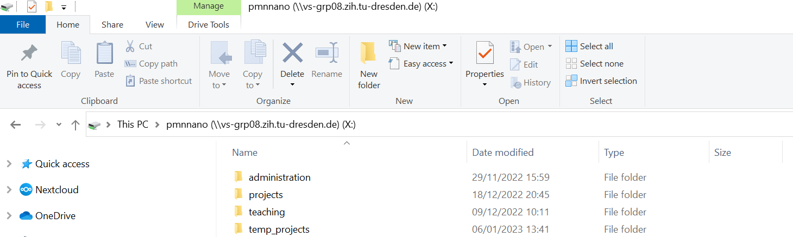
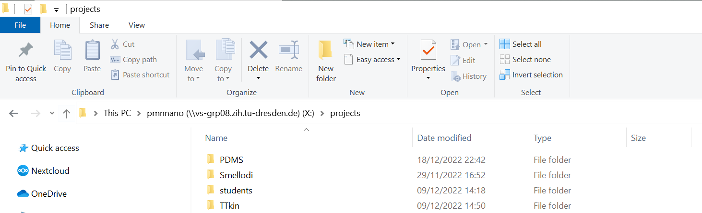
Example: pmnnano
Possible data structure:

Slide 10
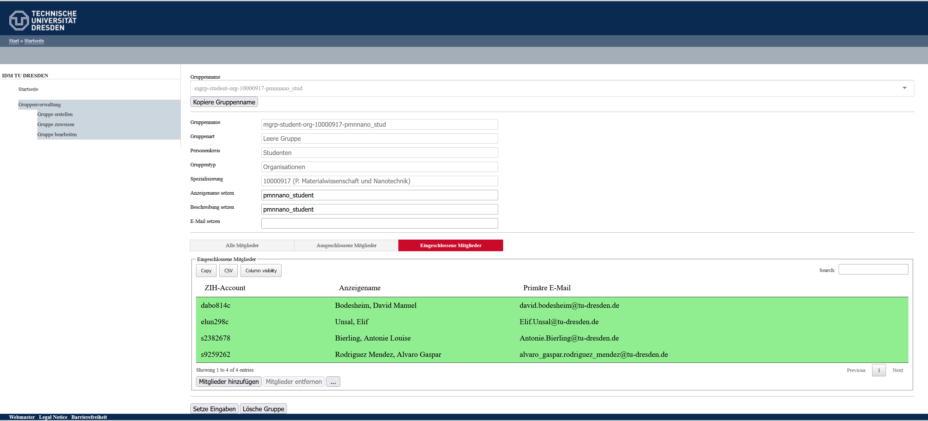
How is file access controlled?
https://idm-tools.tu-dresden.de/

Slide 11
References
[1] https://media-exp1.licdn.com/dms/image/C4D1BAQGhuHkHrK9Otw/company- background_10000/0?e=2159024400&v=beta&t=1cL7tUnH5XYVw6DOfbIjkskihQl2pmXPHu1d7SLXnzs

