Slide 1

Time-dependency of martensitic transformation in ferromagnetic Ni-Mn-Ga-based epitaxial films
1rd TAC meeting of PhD Thesis
Yuru Ge · y.ge@hzdr.de
HZDR / TU Dresden 2nd March 2023

Slide 2
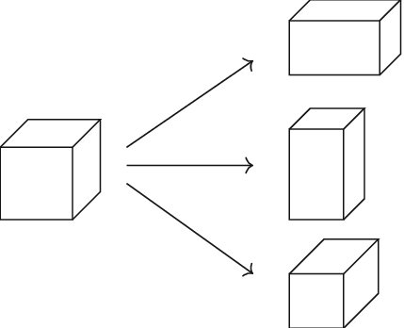
    Martensitic transformation in ferromagnetic materials
Example: Ni-Mn-Ga
x-variant
a
a
c
Cooling
z-variant
c
a
a
a
Heating
Non-magnetic
High-symmetry
Austenite
y-variant
a
c
a
Ferromagnetic
Low-symmetry
Martensites
What’s the difference if we heat/cool in different time-scales ?
(from ~ns laser to ~h metal heating)
Why ?

Slide 3
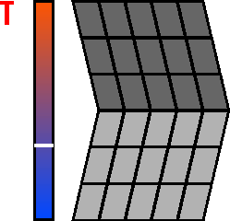
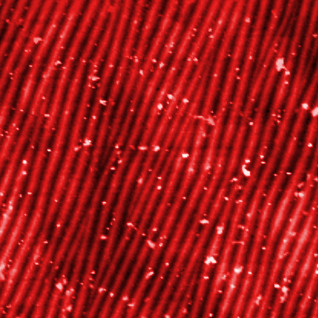

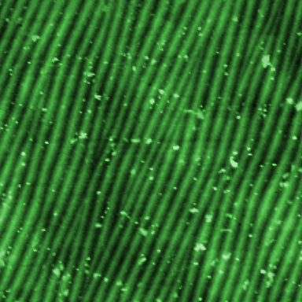
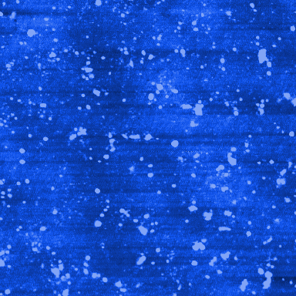
    Motivation: why study time-dependency martensitic transformation?
Reversible, observable microstructure
Reversible, thermoelastic martensitic transformations
Transform
Switch material’s crystal system by temperature
Switch
…actuation^{[1]}:
…magnetocaloric refrigeration^{[2]}:
…energy harvesting^{[3]}:
reversible cycles
releases heat
low temperature waste heat
Apply
Magnetic
field
M>>0
H
M=0
H
M>>0
absorbs heat
M=0
remove field
How?
To drive the applications faster
[1] R. Kainuma et al. Nature. 2006;439:957–960.
[2] J. Liu et al. Nat Mater. 2012;11:620–626.
[3] M. Gueltig et al.. Adv Energy Mater. 2017;7:1601879.

Slide 4



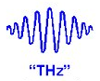

How to probe a faster martensitic transformation?
Two important considerations:
    How to induce a faster transformation?
High magnetic field pulse
Laser pulse
Current pulse
Flash lamp pulse
THz pulse
    How to measure the faster transformation?
Direct delta T during transformation
Phonon frequencies
Ultrafast electron microscopy
In-situ stress
Synchrotron diffraction
MOKE

Slide 5
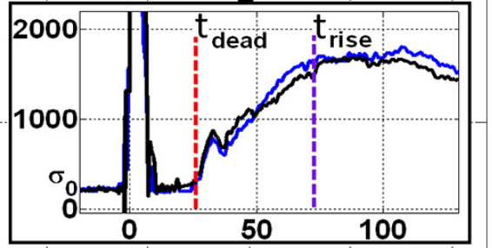
    Joule heating ^{[1,2,3]}
    How to probe the transformations?
Material: Ni-Ti wire
Joule heating:
heating by current pulse
σ [MPa]
1 µs
t [μs]
25 µs
by pulsed current
by dynamic stress change during the transformation
Transformation from M → A within 25 µs
[1] Vollach S. et. al., Scripta Mat. 2017;135:76-79.
[2] Aleksandr V. et al., Shap. Mem. Superelasticity 2018; 4:256–263
[3] Dana A. et. al. J. All. Comp. 2021;856:157968.
M: martensite
A: austenite

Slide 6
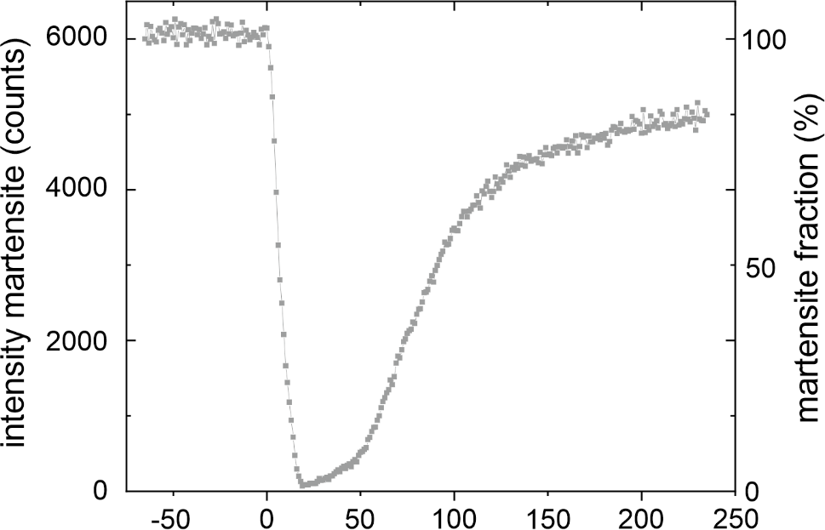
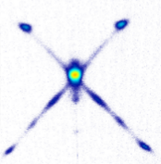
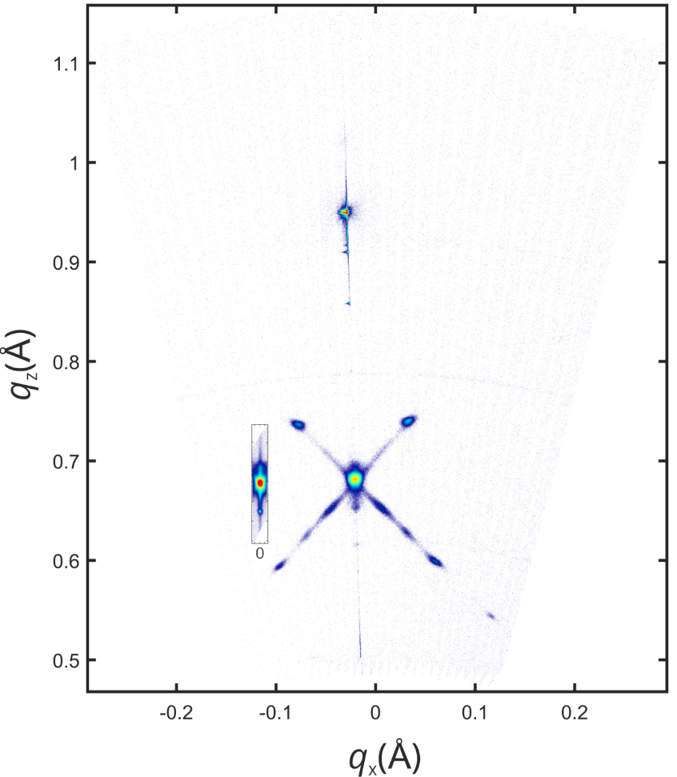
    Pulse laser heating ^{[1]}
    How to probe the transformations?
Material: Ni-Mn-Ga 500 nm film
by pulsed laser
M
by synchrotron diffraction during the martensitic transformation
M
Transform from M → A within 7 ns
A
Thin film transformation can be triggered within ~ns
t (ns)
t = 7 ns
    [1] S. Schwabe, S. Fähler* et al, Science and Technology of Advanced Materials 2022, Vol. 23, No. 1, 633–641

Slide 7
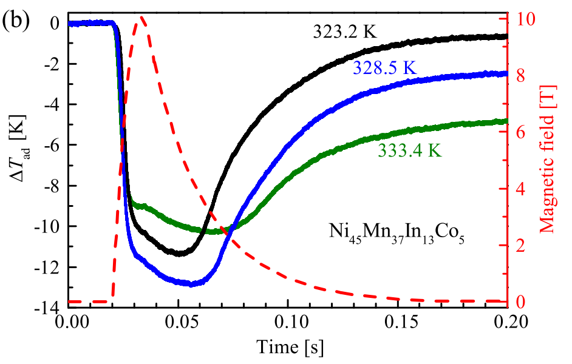
    Pulsed high magnetic field ‘cooling’^{[1]}
    How to probe the transformations?
Material: Ni-Mn-In-Co bulk
by pulsed magnetic field
by direct adiabatic temperature change during the transformation
Transformation from M → A is 13 ms.
Coupling crystal lattice and magnetic spins
Pulsed field: 10 T
Field duration: 10 ms
[1] Gottschall T. et. al. Phys Rev Appl. 2016;5:024013.

Slide 8
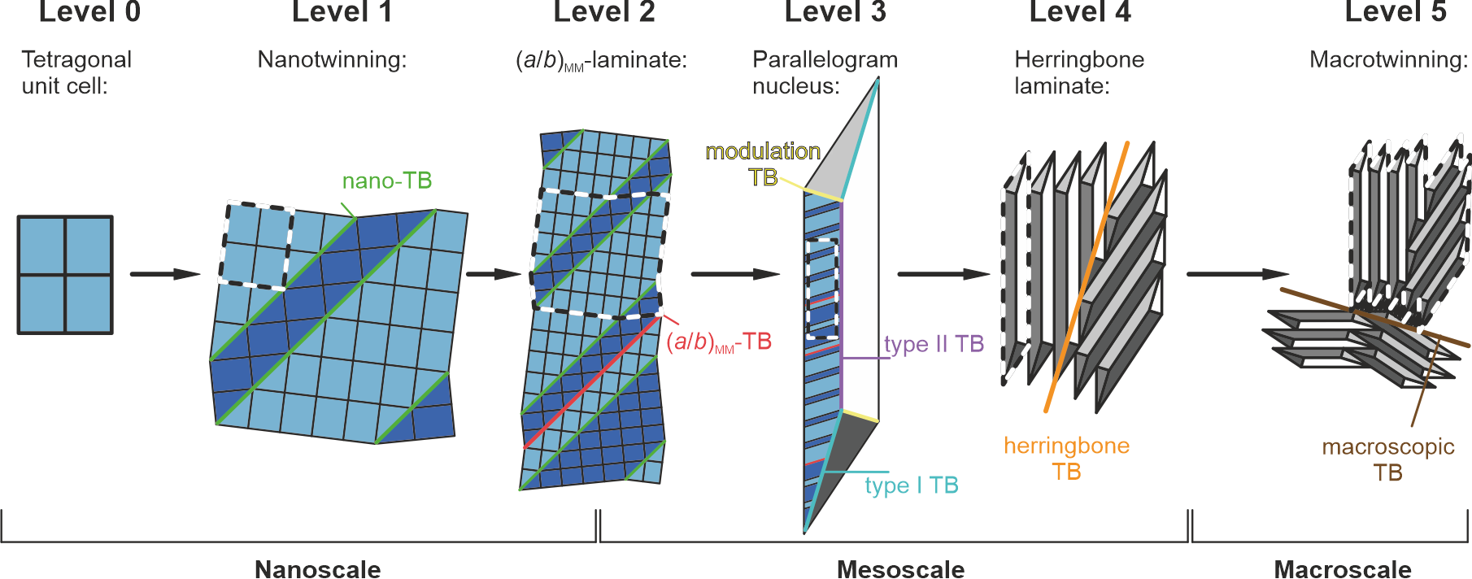
    Why Ni-Mn-Ga based ferromagnetic film ?
    Martensitic microstructure after a slower oven cooling^{[1]}:
Lattice level
Microstructural level
    Multi-stages: able to realize multi-length scale observation
    Question: are these levels obeyed or disturbed if in shorter time?
[1] S. Schwabe, S. Fähler* et al. Adv. Funct. Mater. 2021, 31, 2005715
TB: Twin boundaries

Slide 9
    PhD dissertation outline
    Ex-situ structural study
    Influence of flash lamp annealing (FLA) Paper planning
    Influence of pulsed high magnetic fields Experiments on-going
    In-situ study
    Direct delta T measurement during pulsed high magnetic fields
    Film patterning and thermocouple designing
    Synchrotron laser heating DESY 23.04-26.04.2023
    Joule heating Set-up construction

Slide 10
    Ex-situ study _ Project 1
Influence of flash lamp annealing on microstructures and transformations in ferromagnetic Ni-Mn-Ga epitaxial films
Collaboration with FWIM @ HZDR:
Thomas Schumann
Dr. Lars Rebohle
Dr. Shengqiang Zhou

Slide 11
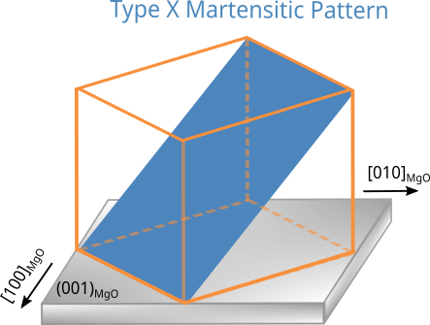
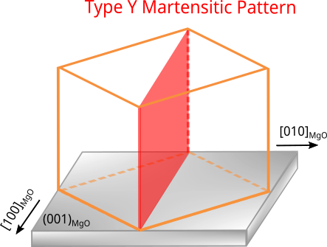
    Characterization:
Lattice level
Microstructural level
Level 1: two crystal structures
NM and 14M
(by 2D RSM and 2D Pole figure)
Level 5: two martensitic variants
Type X and Type Y
(by SEM)
Twinning: {110} plane family
14M: orthorhombic 14-layer modulated martensite
NM: tetragonal nonmodulated martensite
[1] S. Schwabe, S. Fähler* et al. Adv. Funct. Mater. 2021, 31, 2005715
2D RSM: 2D Reciprocal Space Mapping
SEM: Scanning Electron Microscope

Slide 12
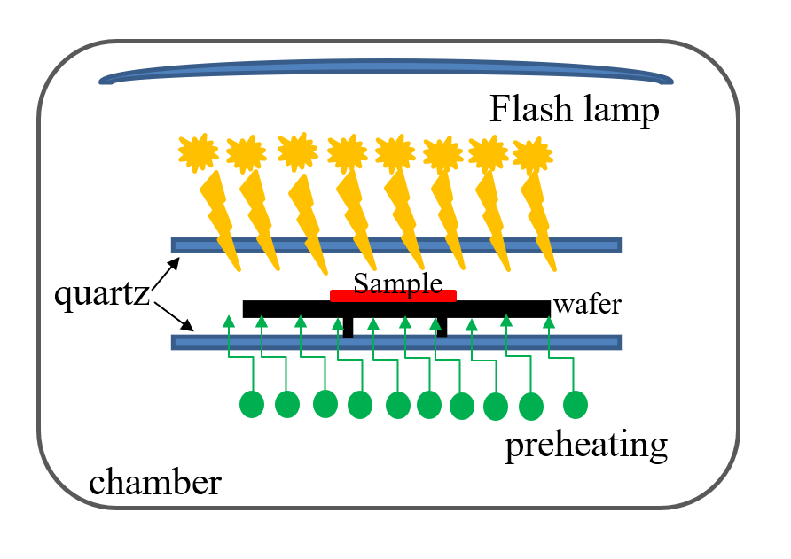
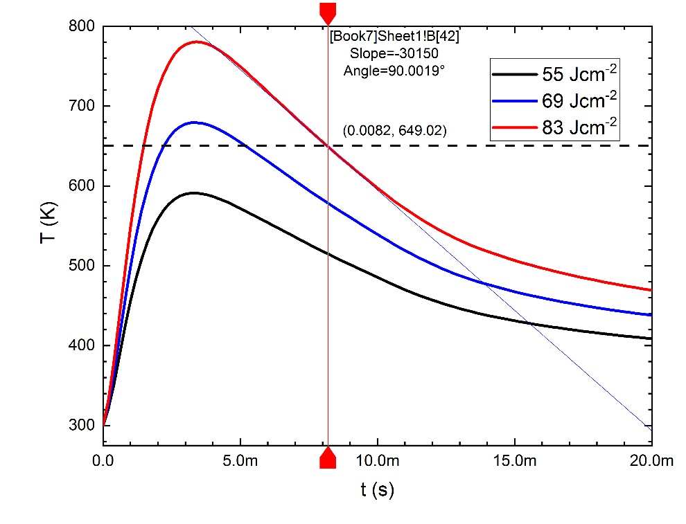
    Experiments:
Simulated heating-cooling curve
T_{M}
Flash Lamp Annealing (FLA)
Pulse : 3 ms
Flash energy density was adjusted from 14 ~ 83 J∙cm⁻², respectively.
Heating temperatures
Heating rates
What varied:
Cooling rates
Notice: might some mismatch between calculated and experimental data

Slide 13
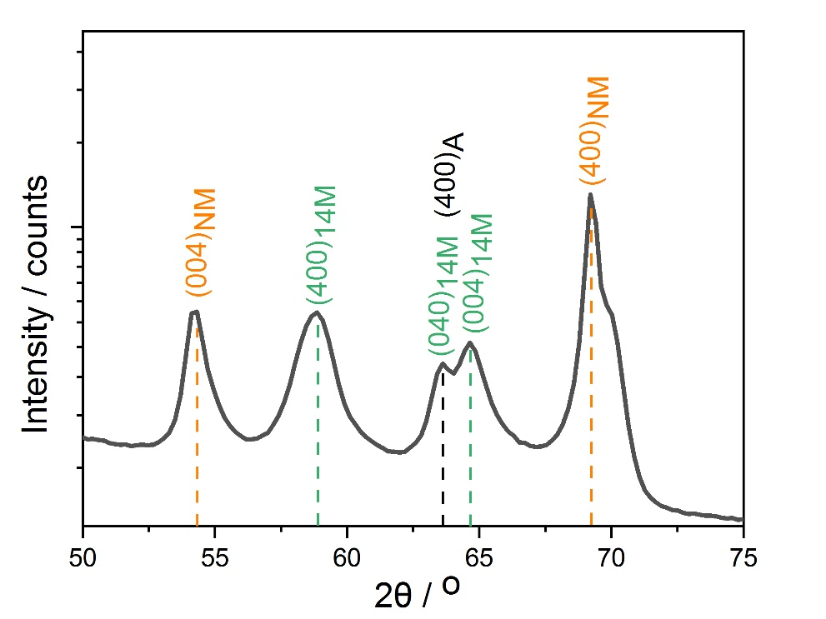
    As-deposited Ni-Mn-Ga:
Summarized from 2D RSM
Substrate edges are parallel to the picture frame
Y
X
4µm
≈ half : half
(by integration of peak area)
≈ half : half
(by MATLAB calculation)

Slide 14
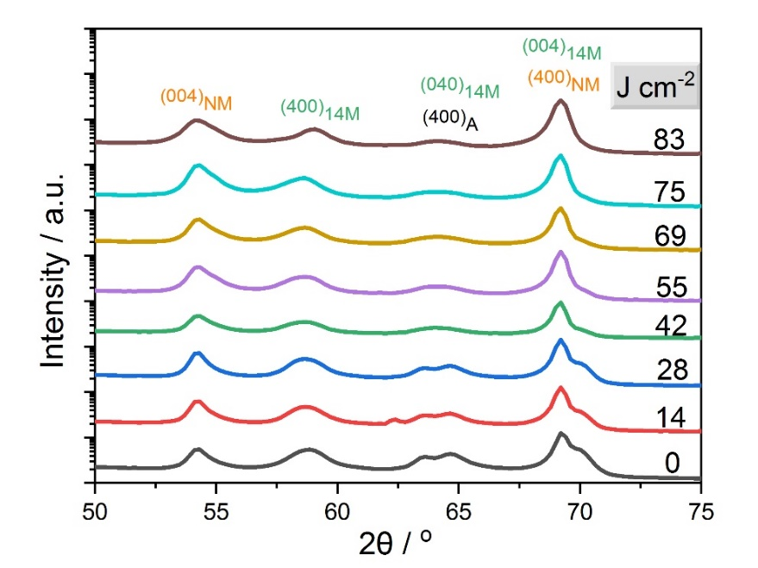
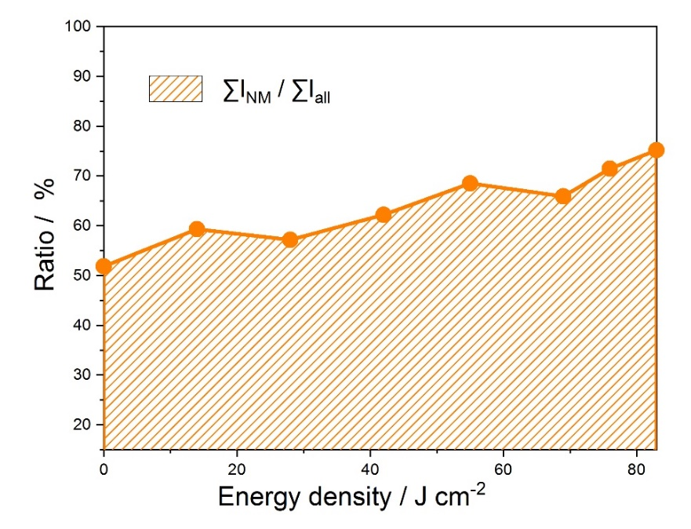
After flash lamp annealing：
∑I_{14M}
∑I_{NM}
Summarized from 2D RSM
14M → NM: tetragonal distortion and thermally activated coarsening
Why 14M → NM?
The more stress, the more tetragonal distortion, the more stress goes to NM
The more energy, the more coarsening by annihilation of TBs, the smaller number of TBs and the enlarge of the TB-spacing, the more NM.

Slide 15
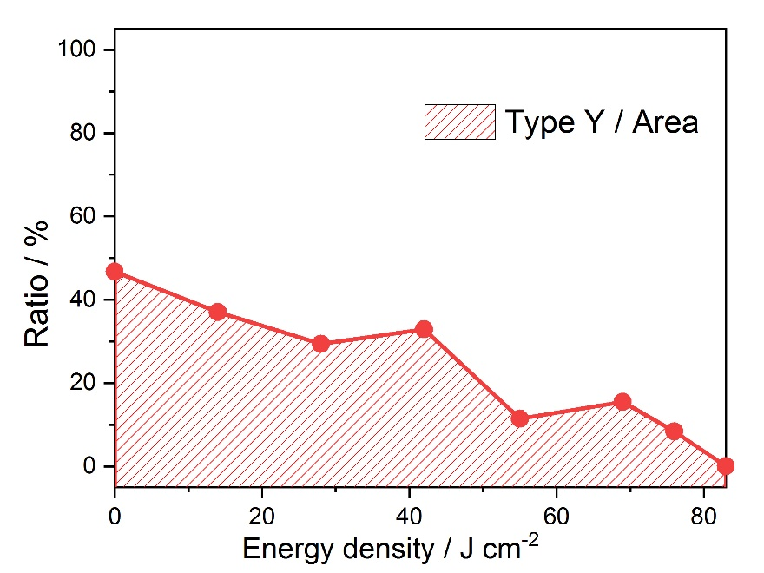
After flash lamp annealing：
No FLA
55 J∙cm⁻²
83 J∙cm⁻²
X
Y
X
X
10 µm
Y
10 µm
10 µm
Why Type Y → Type X?
Based on Schmidt's law, Schmidt factor of Type Y = 0 but Schmidt factor of Type X = max. The more stress, the more Type X.
Different level of twin boundary motion
Type X
Type Y
Calculated by MATLAB

Slide 16
Summary
Structural study of Ni-Mn-Ga film treated by faster flash pulse
Data not shown:
Pole figure measurements and calculations for orientations observations
Hysteresis loops and magnetic domain structures study
Regular wrinkles fast fast flash pulse, why and how?

Slide 17
    Ex-situ study _ Project 2
Influence of high pulsed magnetic field on microstructures and transformations in ferromagnetic Ni-Mn-Ga-Cu epitaxial films
Collaboration with HLD @ HZDR:
Timo Niehoff
Dr. Tino Gottschall
Proposal Nr.: DMA13-222

Slide 18
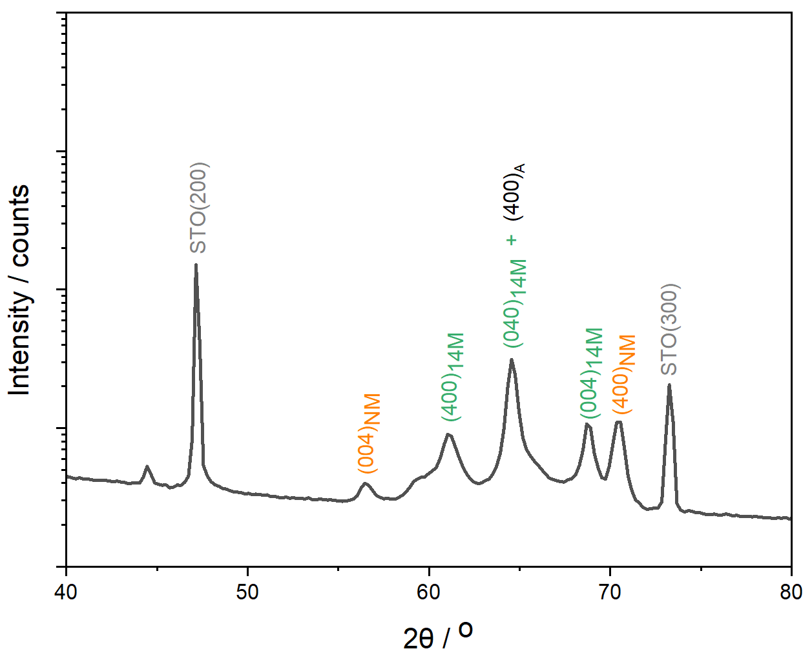
    As-deposited Ni-Mn-Ga-Cu:
In FLA section, T_{M} = 650 K >> T_{c} = 320 K. M(T), M(H)…
So, in this HLD section, we use a modified Cu doped Ni-Mn-Ga film grown on STO (100).
Y
X
Type Y dominated film

Slide 19
Experiments:
50 T, 1500 T s⁻¹
300K
335K
370K
M(T) of Ni-Mn-Ca-Cu at 0.1T / 2T / 5T / 7T
Phase diagram [ T_{M} v.s. H]
Heat the film above 370 K to get an austenite film by using an electric coil
Cool the film to 335 K which is at the hysteresis
At T = 335 K, probe the in-plane magnetic pulse going in the easy axis
After the pulse, cool the film to room temperature
M_{f}: martensite finish temperature
M_{s}: martensite start temperature
A_{s}: austenite start temperature
A_{f}: austenite finish temperature

Slide 20
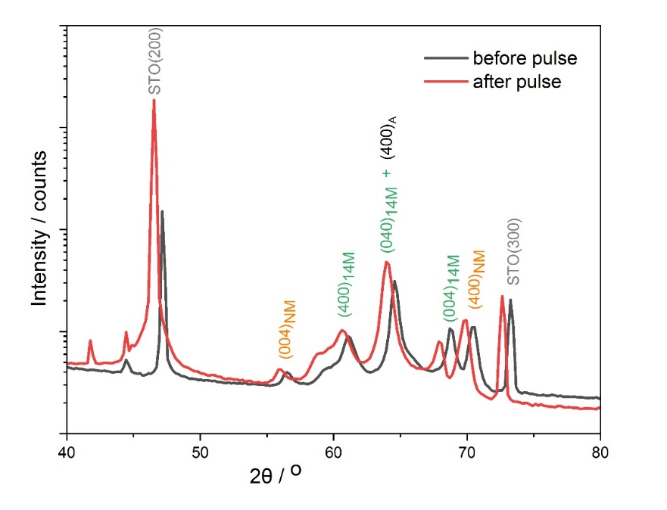
After pulsed magnetic field (50 T, 1500T∙s⁻¹):
before pulse
after pulse
Preliminary results shows that indeed something happened
Need more detailed check

Slide 21
Next steps:
Summarize the characterization of the in-plane treatment
Do one more in-plane pulse but with 5 T.
Do out-of-plane pulse treatment

Slide 22
    Time-line
    One paper is submitted to STAM on 02.23 Under reviewing
    Task of 2023
    Influence of Flash lamp annealing
    Paper submitted before 10.23
    Influence of pulsed high magnetic fields
    Experiments done and summarized before 12.23
    Direct delta T measurement with pulsed magnetic fields
    Experiments done before 12.23
    Synchrotron laser heating @ DESY 04.23 and summarized before 10.23
    Task of 2024
    Joule heating set-up testing and DESY
    Dissertation writing

Slide 23

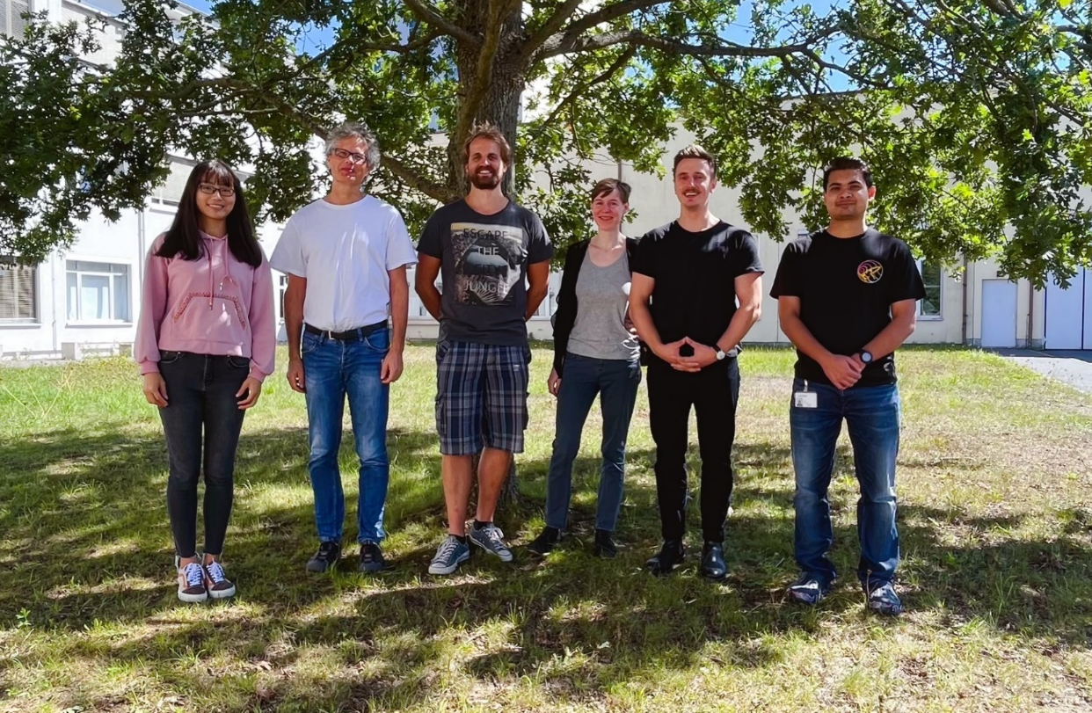
Yuru Ge
Time dependency
Satyakam Kar
Finite Size Effects
Dr. Lars Rebohle
FWIM
Bruno Neumann
Thermoelastic Harvesting
Dr. Sebastian Fähler
Supervision
Dr. Klara Lünser
Epitaxial NiTi films
Dr. Paul Chekhonin
FWOM
Thomas Schumann
FWIM
Lukas Fink
Thermomagnetic films
Dr. Fabian Ganss
FWIZ
Dr. Shengqiang Zhou
FWIM
Dr. Tino Gottschall
HLD
Mei Wu
FWIM
Timo Niehoff
HLD
Dr. René Hübner
FWIZ
Mallika Khosla
DESY
Fabian Samad
FWIN
Andreas Henschke
FWIN
Prof. Peter Gaal
DESY
Thomas Naumann
FWIN
Dr. Rysard Narkovic
FWIN
Dr. Jürgen Lindner
FWIN
Dr. Kilian Lenz
FWIN
Dr. Ciarán Fowley
FWIO
Prof. Gianaurelio Cuniberti
TU Dresden
Prof. Jürgen Faßbender
HZDR

Slide 25
    Pulse laser heating ^{[1]}
Material: Ni-Mn-Ga 500 nm film
Nanosecond Laser, repitition rate 1 kHz
Triggers laser pulse
Delay generator
M
M
Triggers
detector measurement
Synchrotron radiation
(DESY Hamburg
Petra III P23)
Pulse duration
7 ns
100 ps
Area detector
A
t (ns)
sample
t = 16 ns
Experimental set-up^{[2]}
In-situ measuring by synchrotron x-ray diffraction, induced by pulsed laser, the martensitic transformation of Ni-Mn-Ga film from M → A within 16 ns
    [1] S. Schwabe, S. Fähler* et al, Science and Technology of Advanced Materials 2022, Vol. 23, No. 1, 633–641
[2] Thanks to Dr. Klara Lünser for the sketch of the experimental set-up

Slide 26
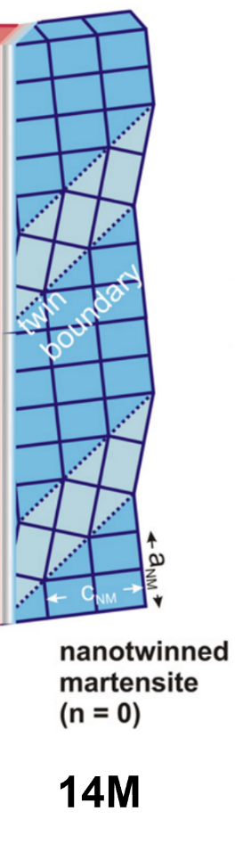
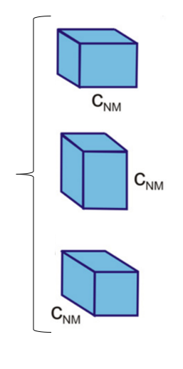


14M: 14-layer modulated martensite
NM unit cell
Stacking decribed from vertical direction ↑
(5$\overline{2}$)₂
5 a_{NM}
repeat 2 time
(2$\overline{5}$)₂
2 c_{NM}
2 a_{NM}
repeat 2 time
5 c_{NM}
= (5+2)*2 = 14-layer
14M is a nanotwinned adaptive phase, built from the NM unit cells, with the stacking periodicity (5$\overline{2}$)₂ or (2$\overline{5}$)₂.
NM…? And, 14M → NM. Why ?
S. Kaufmann, et al, NJP 13, 053029 (2011)

Slide 27
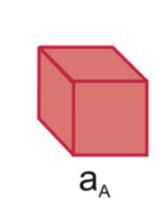
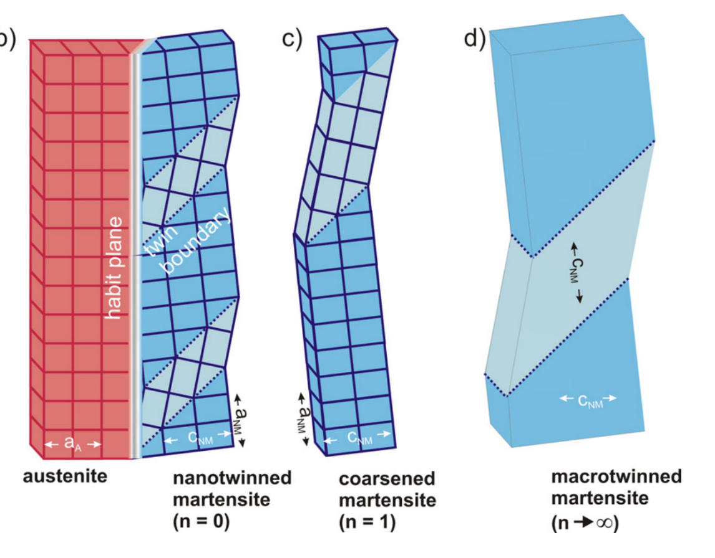

14M → NM: thermally activated coarsening
(a)
(b)
(c)
A unit cell
Substrate
NM unit cell
14M^{[1]}
NM
NM in macroscale
14M: large amount of twin-boundary, exhibits higher energy, unfavourable and thermodynamically unstable ^{[2]}, needs to energy-reducing.
How? Coarsening mechanism: by reducing twin-boundary numbers. ( (a)→(b) ). When reaches stable, we get NM. So, 14M → NM done.
The more heat driving, the heavy 14M → NM
[1] S. Kaufmann, et al., NJP 13, 053029 (2011)
[2] P. Entel, et al., J. Phys. D 39, 865 (2006)

Slide 28
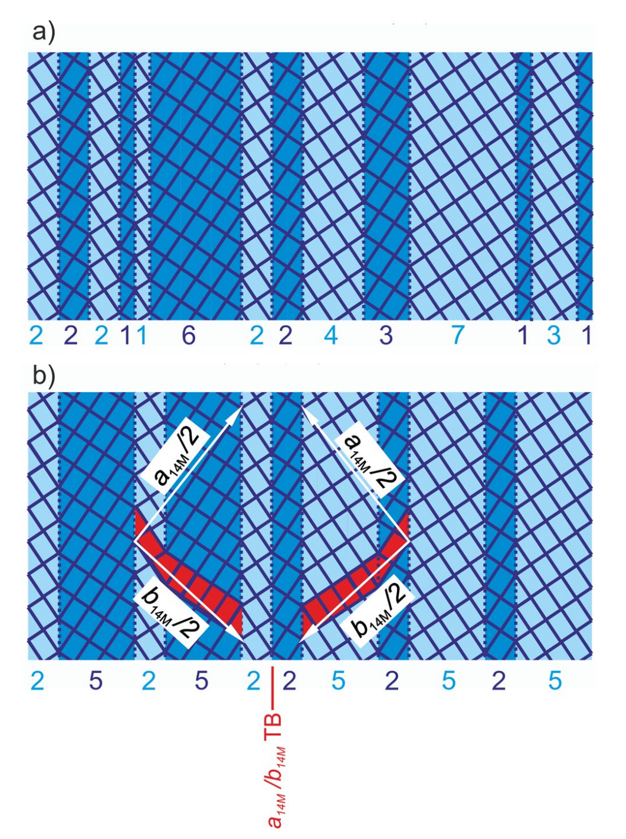


Schwabe’s paper
Level 2
a/b-TBs
The red line
(2$\overline{5}$)₂
(5$\overline{2}$)₂

Slide 29

Sketch of the continuum model
(Branching mechanism and Coarsening mechanism)
Branching of twin boundaries connecting to different variant orientations (blue and green)
Substrate
TB-spacing
A
M
Coarsening by annihilation of TBs, to reduce the number of TBs, then enlarge the TB-spacing
Branching connected the nanotwinned 14M (blue) and macroscopic NM (green), which slower the coarsening
Coarsening kill nano-TBs, which slower Branching
These two concept works together, to reach the final low-energy and harmonic state
K. Bhattacharya, Microstructure of Martensite, Oxford University Press, Oxford 2003.

Slide 30
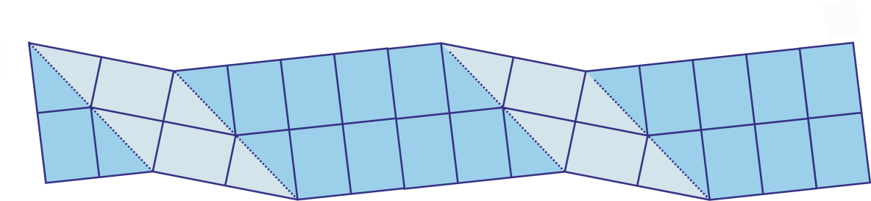
Nanotwinned 14M
2 5 2 5 …
NM
Coarsening

Slide 31
50 T, 1500 T∙s⁻¹

