Slide 1
Computational Studies of Chirality Effects in the Oxygen Evolution Reaction
TU Dresden
Chair of Materials Science and Nanotechnology
Suryansh
The $1^{st}$ TAC Meeting// 25.02.2025

Slide 2
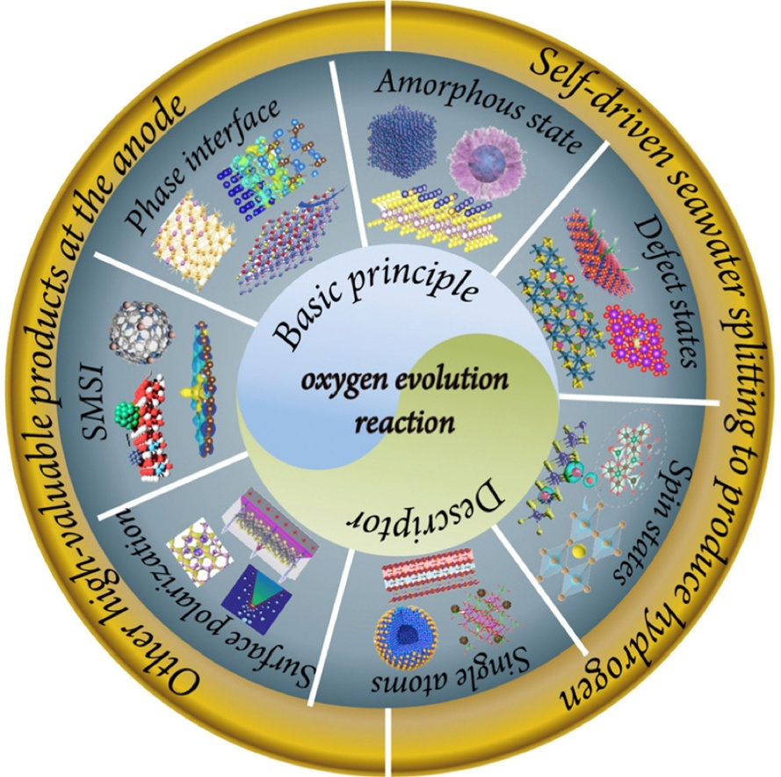
Motivation
Why is OER important ?
Electrochemical water splitting to produce H₂
Problems
Slow kinetics of the OER
high overpotential
high energy barrier
Goal: Develop highly active oxygen electrocatalysts
D. Chen et al. Mater. Chem. Front., 2023

Slide 3
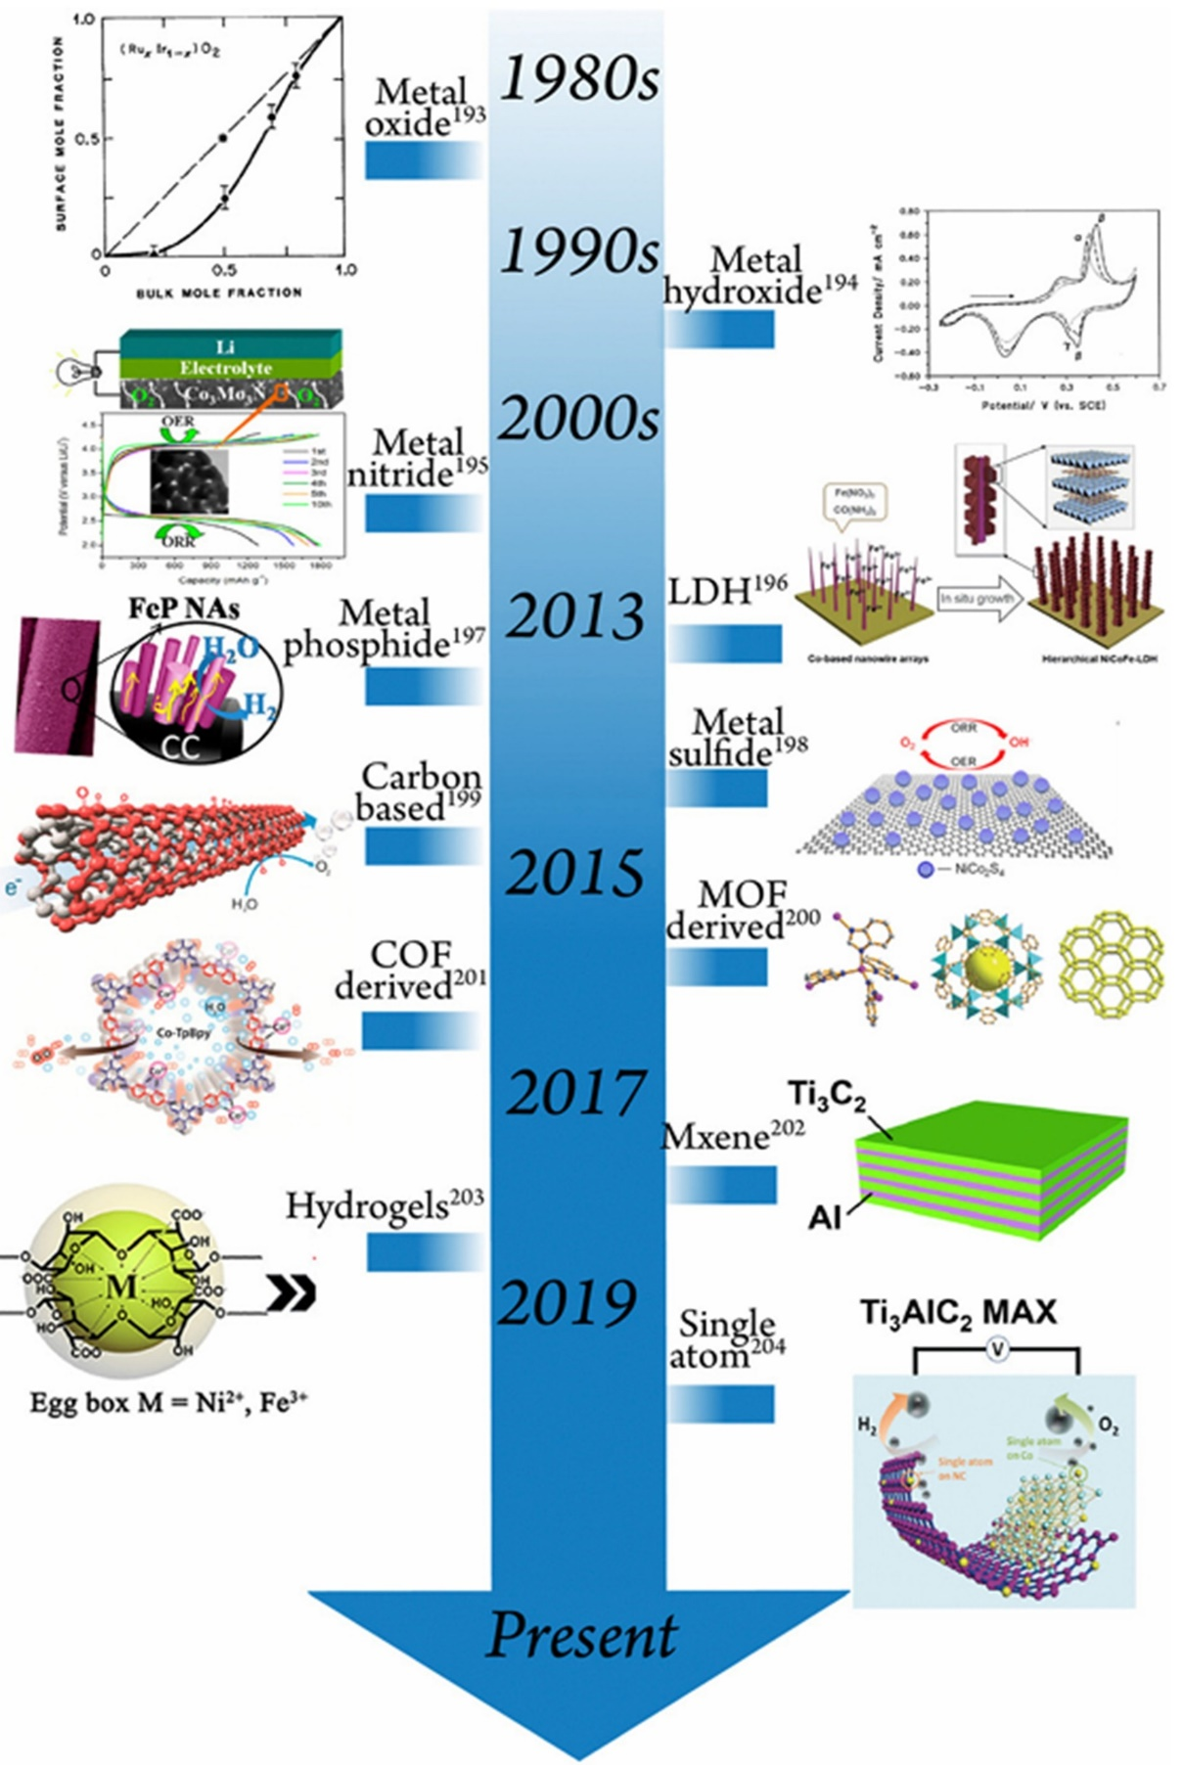
Motivation
Significant progress has been made in improving the OER efficiency
Still, there is a need of advanced OER catalysts
D. Chen et al. Mater. Chem. Front., 2023

Slide 4
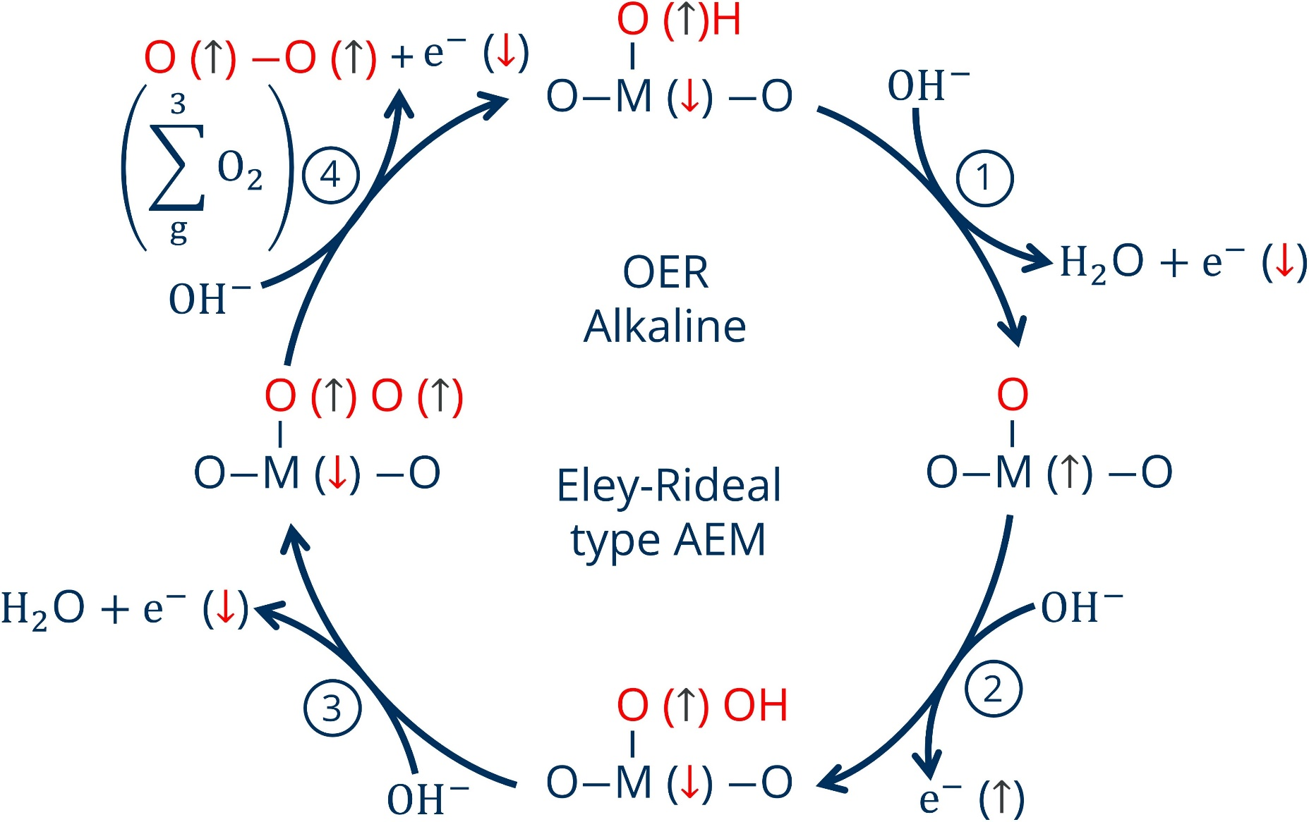
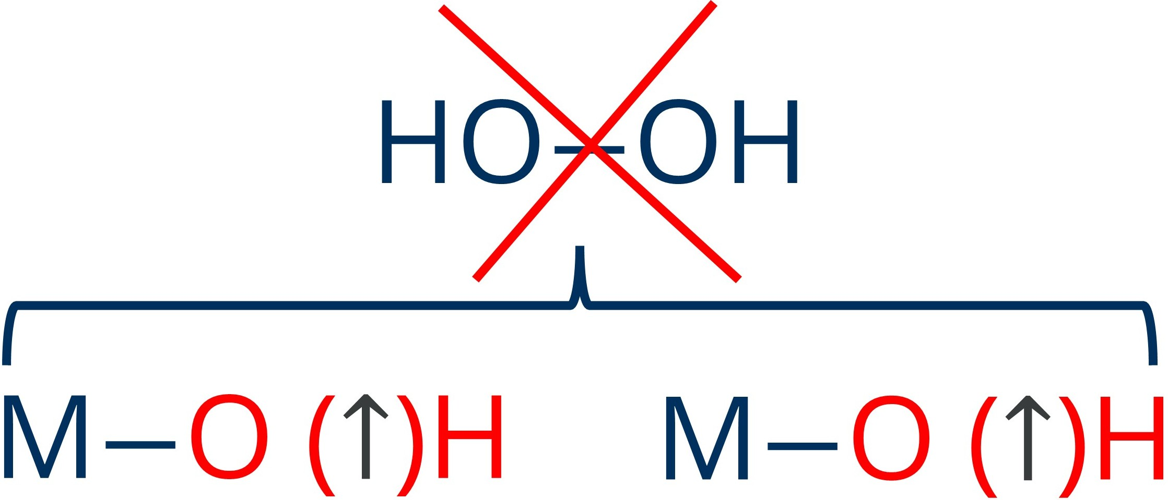
Spin-dependent effects in OER
The OER pathways are spin-dependent !
Control electron spin state during OER
One possible method External B-field
Problems
Limited to magnetic catalysts
Requires an electromagnet
F. A. Garcés-Pineda et al. Nat. Energy, 2019
Alternative?
Chirality & CISS Effect
(Correlate with the B-field strategy)

Slide 5
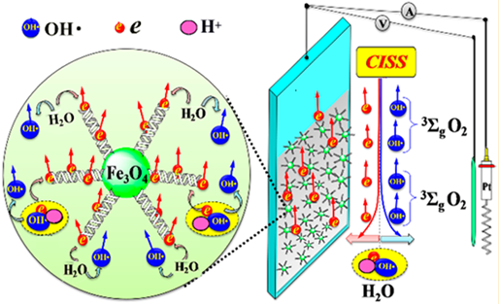
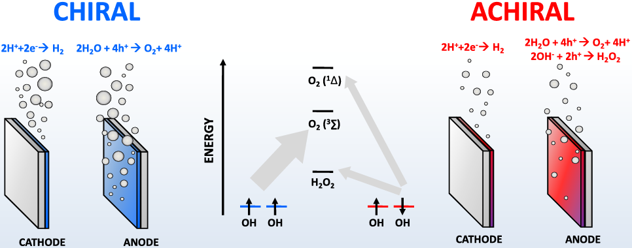
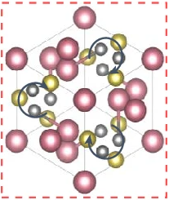
Spin-dependent effects & chirality in electrochemistry
Organic
Inorganic
Inorganic
Chiral organic linker molecules, chiral conductive polymers and chiral organic semiconductors
Chiral CuO and ${CoO}_{x}$ films
Topological chiral semimetals
(Chiral single crystals, e.g., RhBiS)
D. H. Waldeck et al. J. Phys. Chem. C., 2019
R. Naaman et al. J. Phys. Chem. Lett., 2015
D. H. Waldeck et al. J. Phys. Chem. C., 2020
C. Felser et al. Nat. Energy, 2025
R. Naaman et al. J. Am. Chem. Soc., 2017
R. Naaman et al. J. Phys. Chem. C., 2017
R. Naaman et al. ACS Energy Lett., 2018
No theoretical underpinning so far !

Slide 6
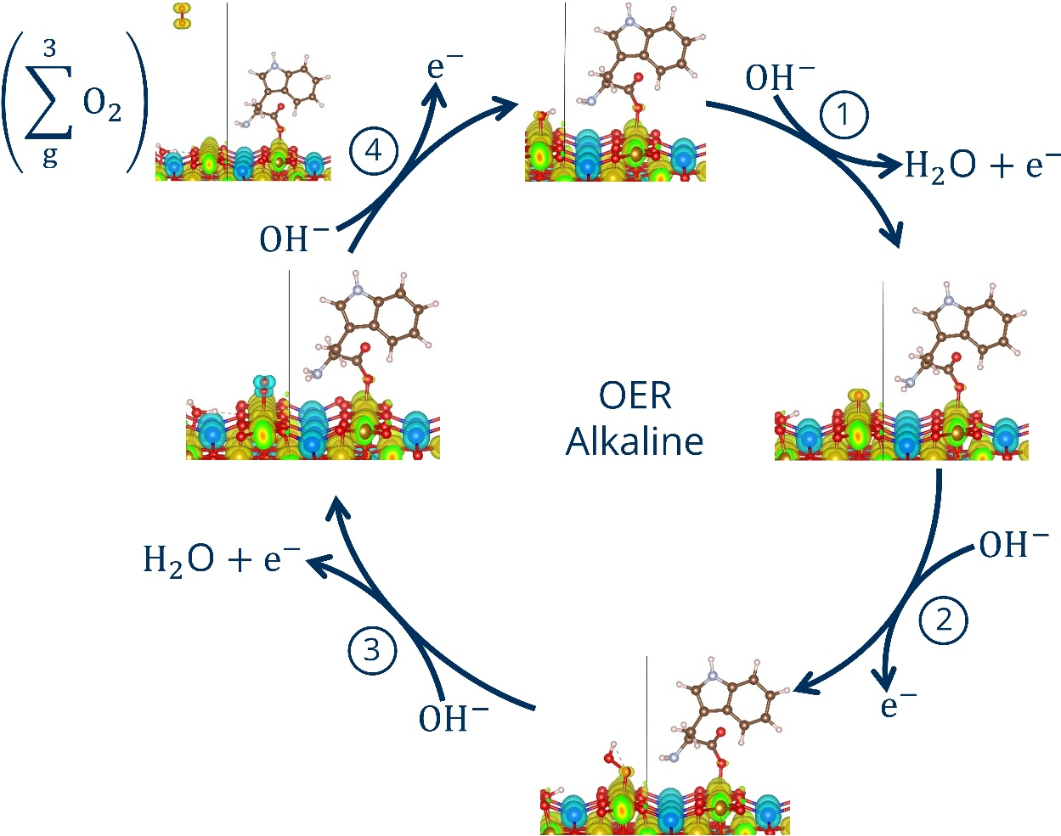
Objectives
Atomistic understanding of chirality effects in OER
Which variables influence reaction energy barrier in OER?
Can we find universal trends?

Slide 7
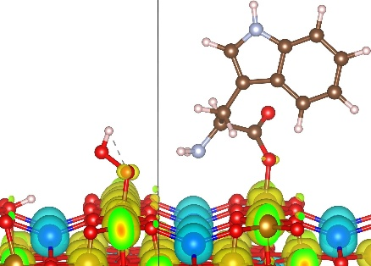
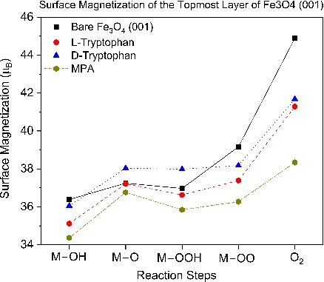
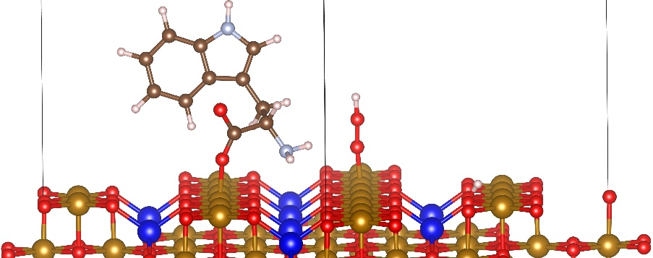
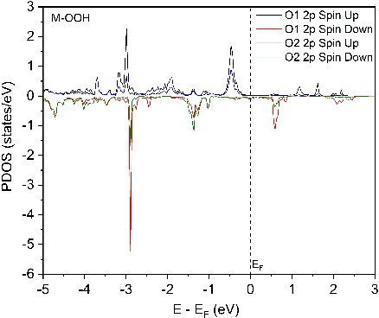
Computational workflow
Pristine Fe₃O₄ (001)
Total Spin Density
Input
Spin-Polarized DFT Calculations
Output
OER on Bare Fe₃O₄ (001)
Surface Magnetization
OER with Chiral Molecules
PDOS

Slide 8
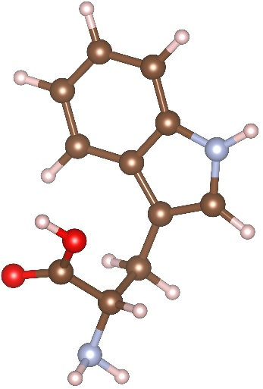
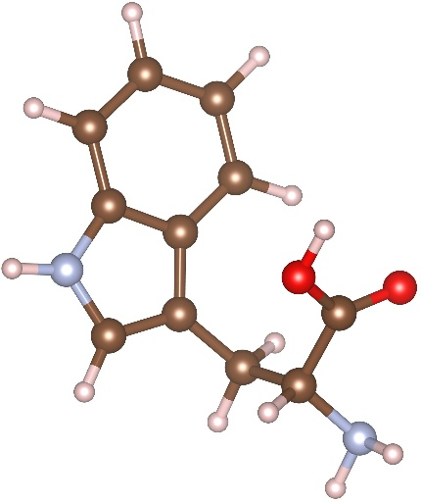
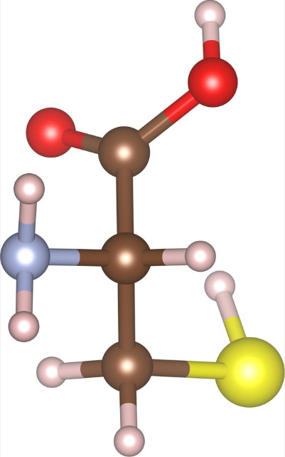
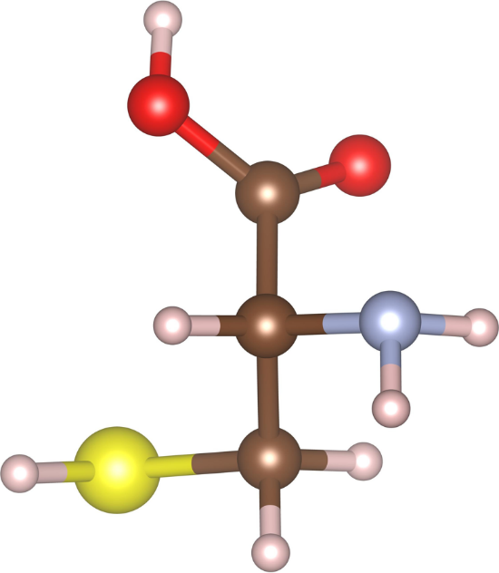
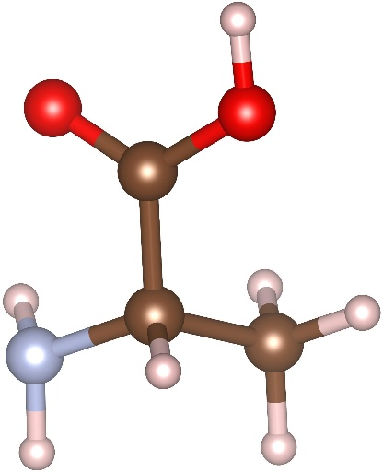
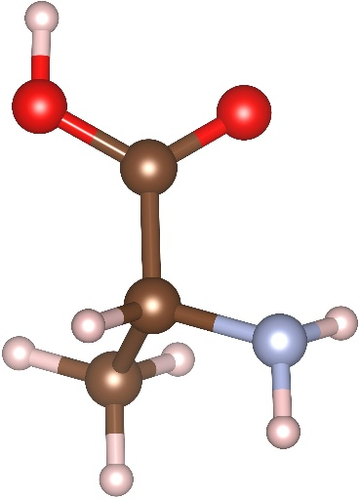
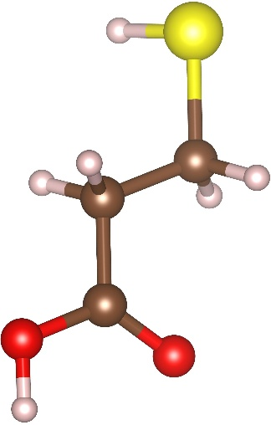
Molecules for surface functionalization
Proof of the principle
L- and D-Tryptophan
L- and D-Cysteine
L- and D-Alanine
Chiral Molecules
3-Mercaptopropionic acid (MPA)
Achiral Molecule

Slide 9
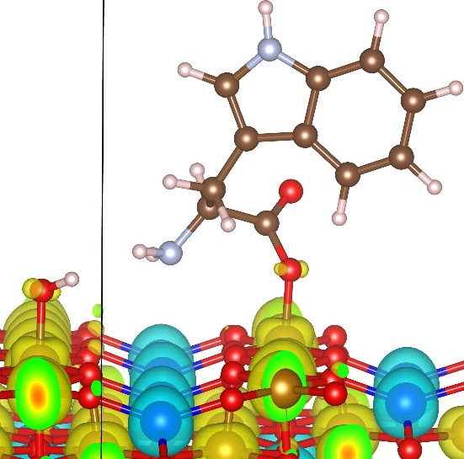
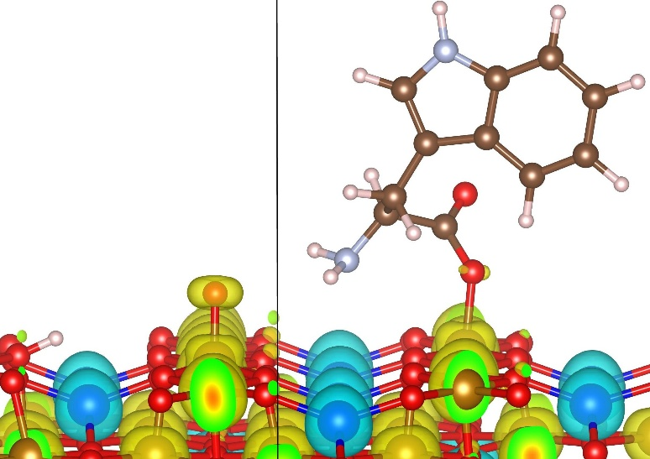
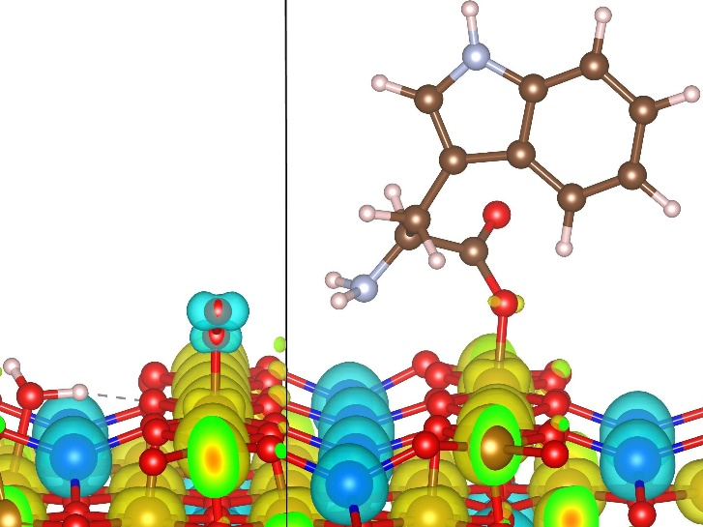
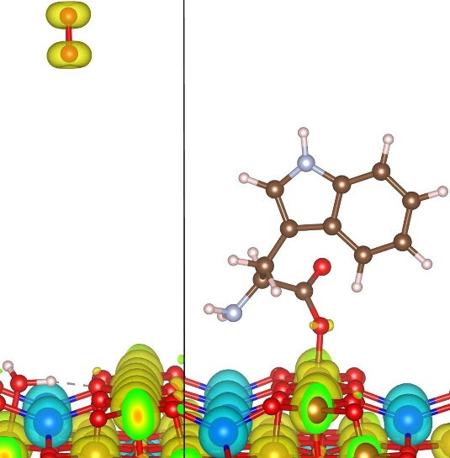
Total spin density for chiral L-Tryptophan
Spin-UP
Spin-DOWN
Step 1 OH adsorption
Step 2 H dissociation O formation
Step 3 2nd OH adsorption
Spin triplet $\sum_{g}^{3}{O_{2}}$ configuration
in steps 4 & 5
Step 4 H dissociation O₂ formation
Step 5 O₂ realized

Slide 10
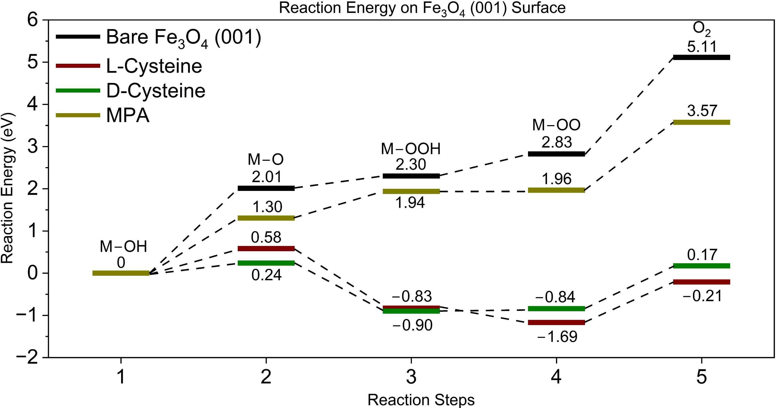
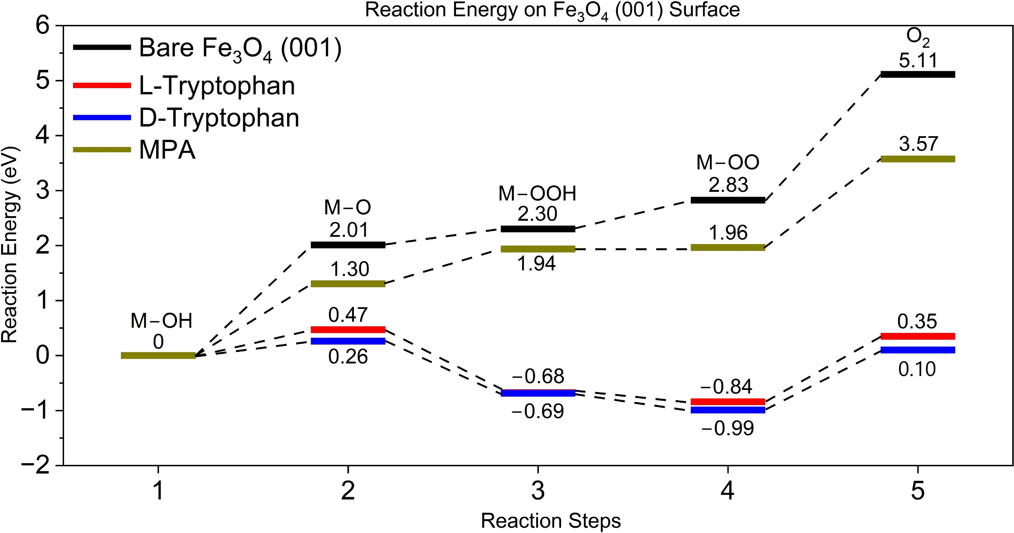
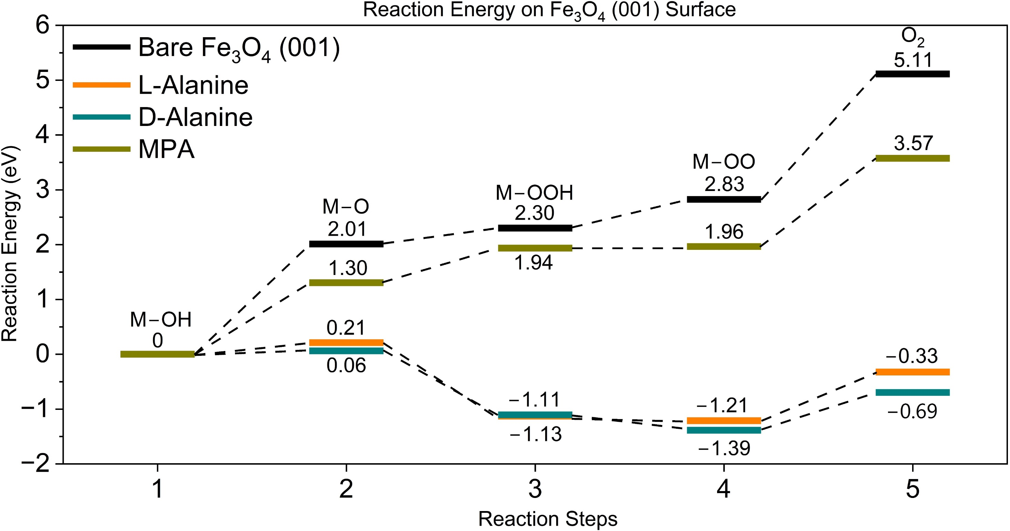
Reaction energy barriers
Chiral molecules reduce the reaction energy !

Slide 11
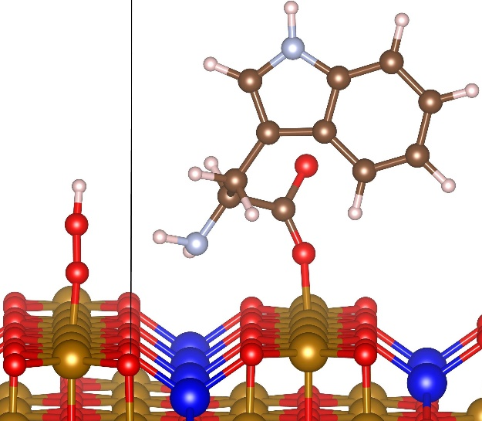
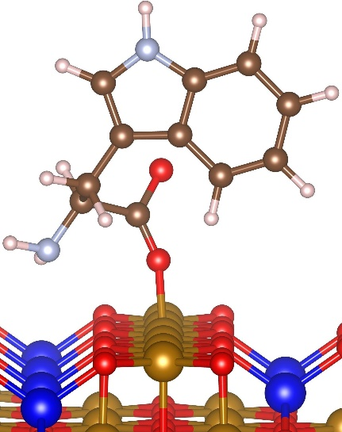
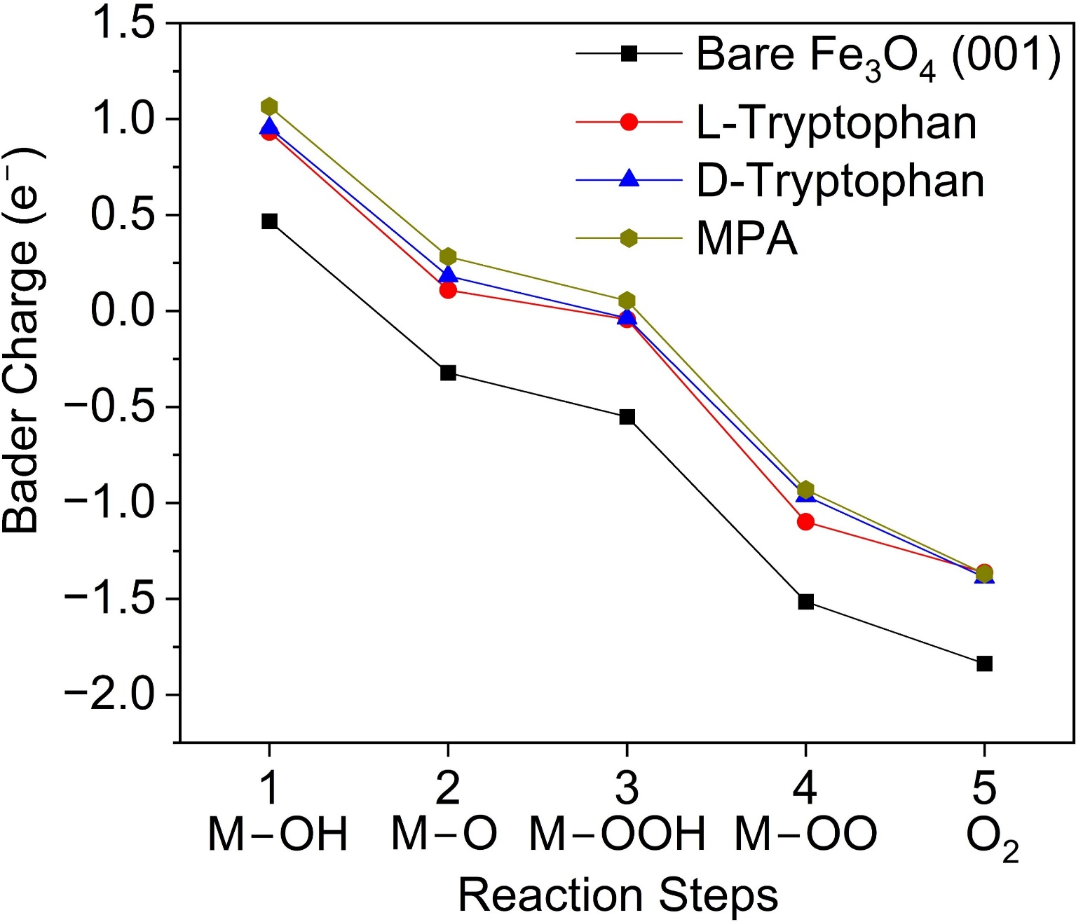
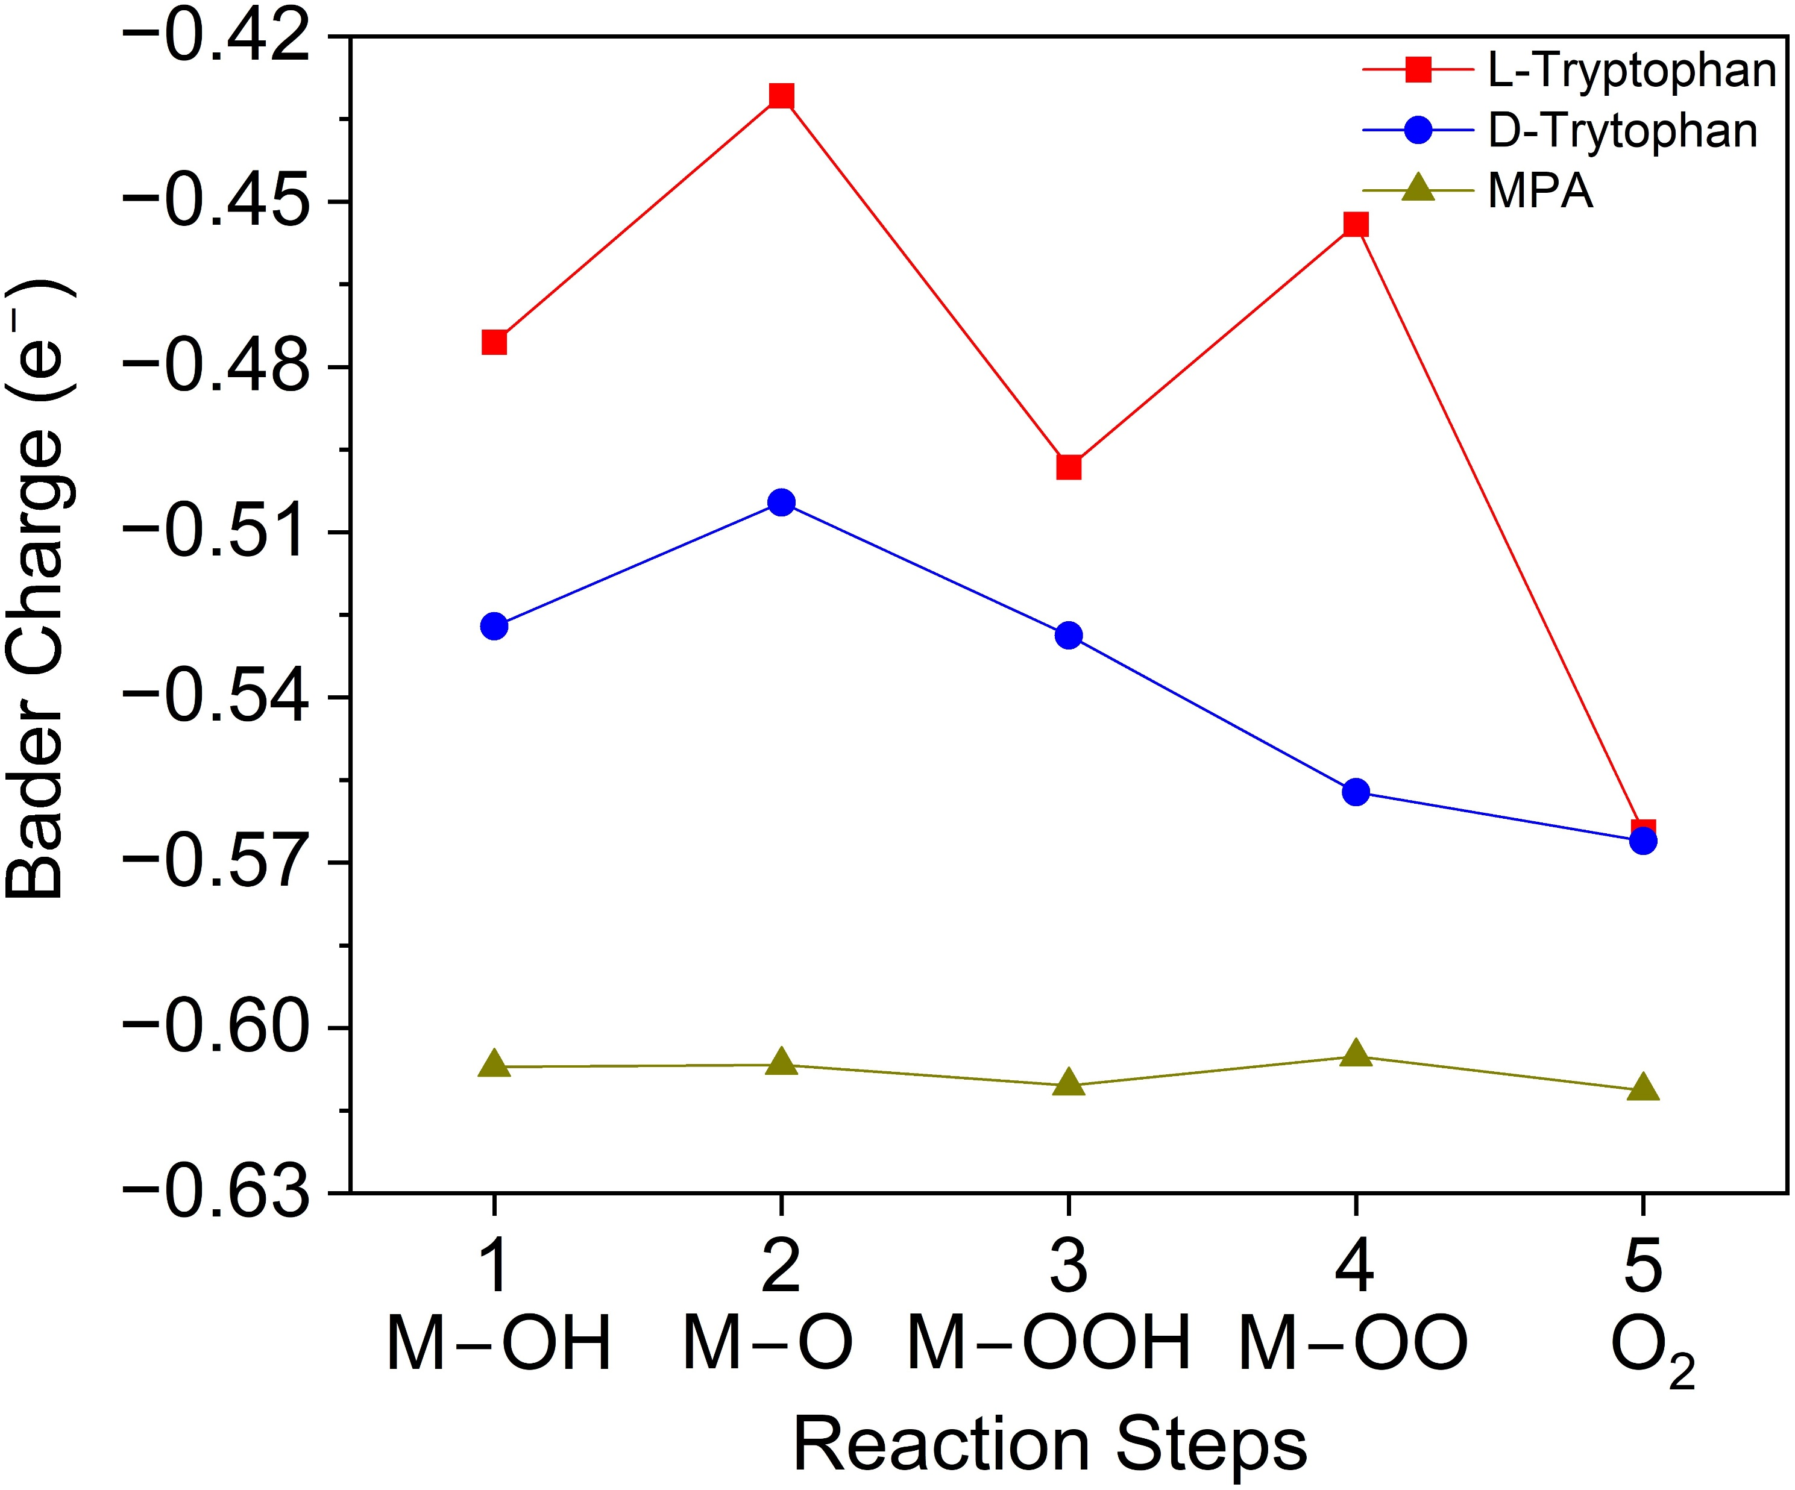
Bader charge analysis: charge transfer effects
Charge transfer between surface, intermediates and chiral molecules
Charge transfer only between surface and chiral molecules
$\sim 4e^{−}$ transfer process

Slide 12
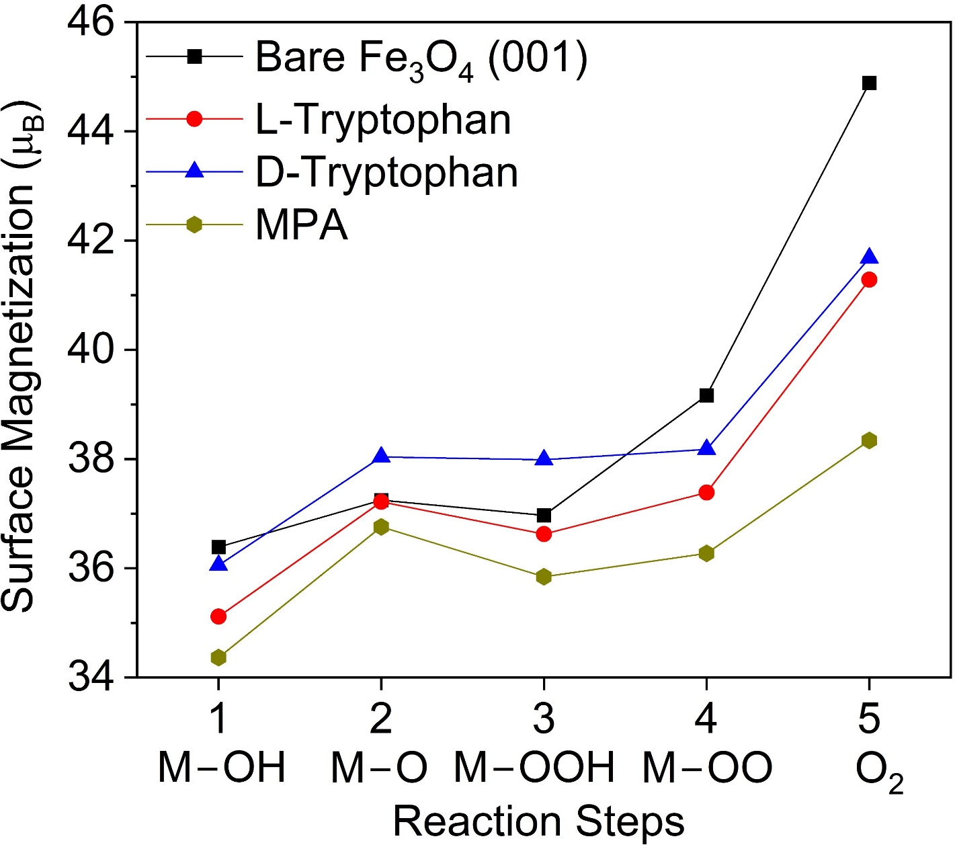
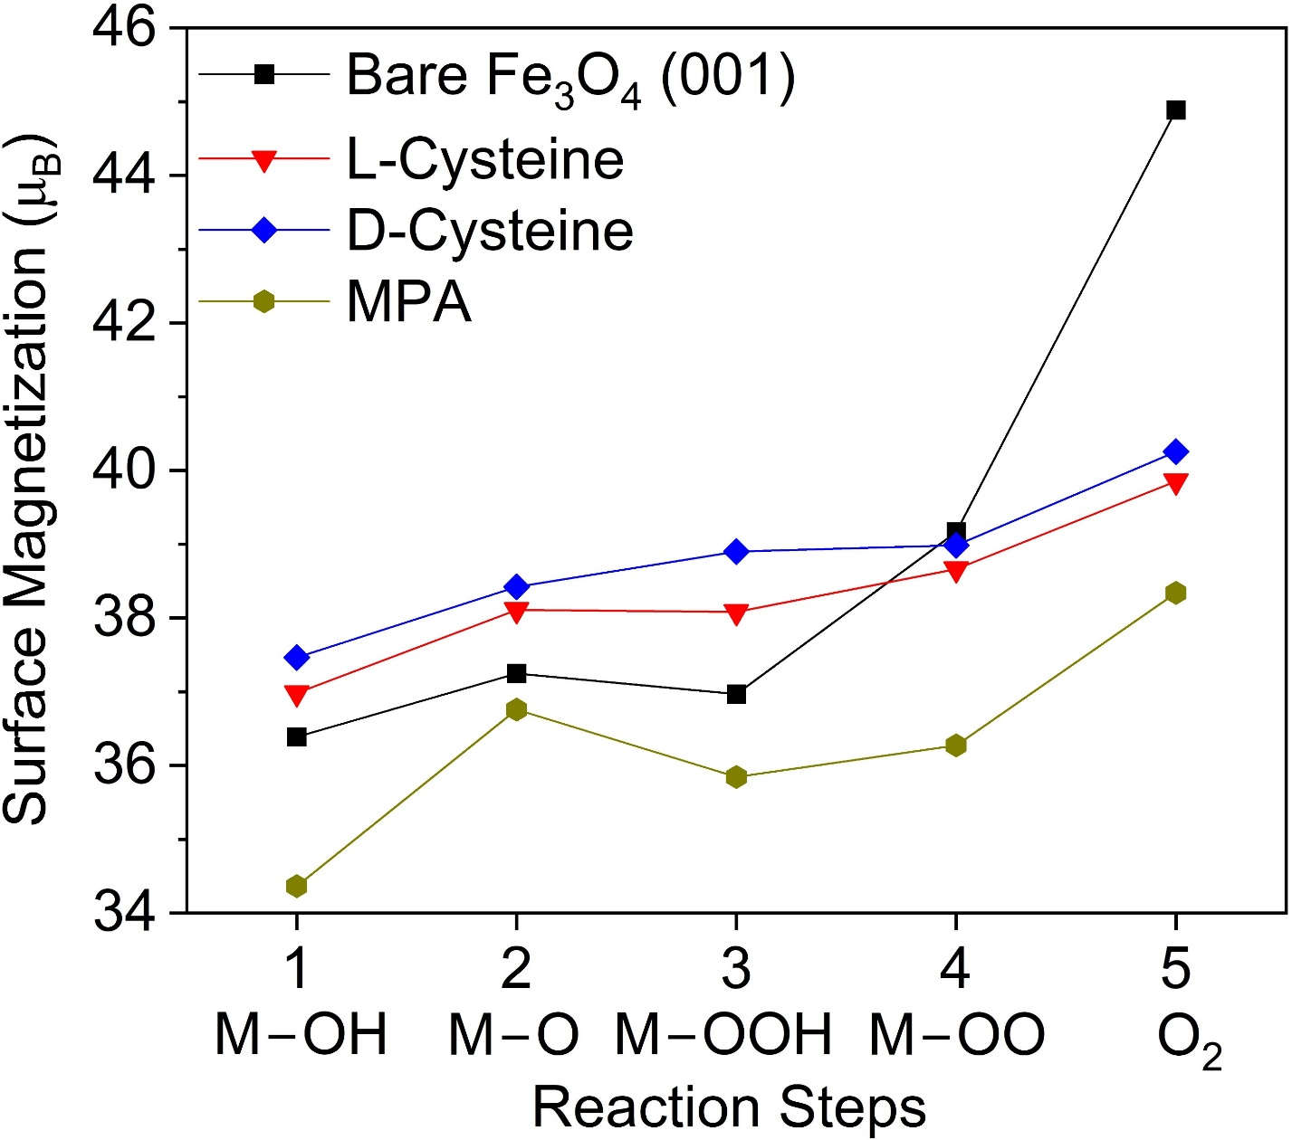
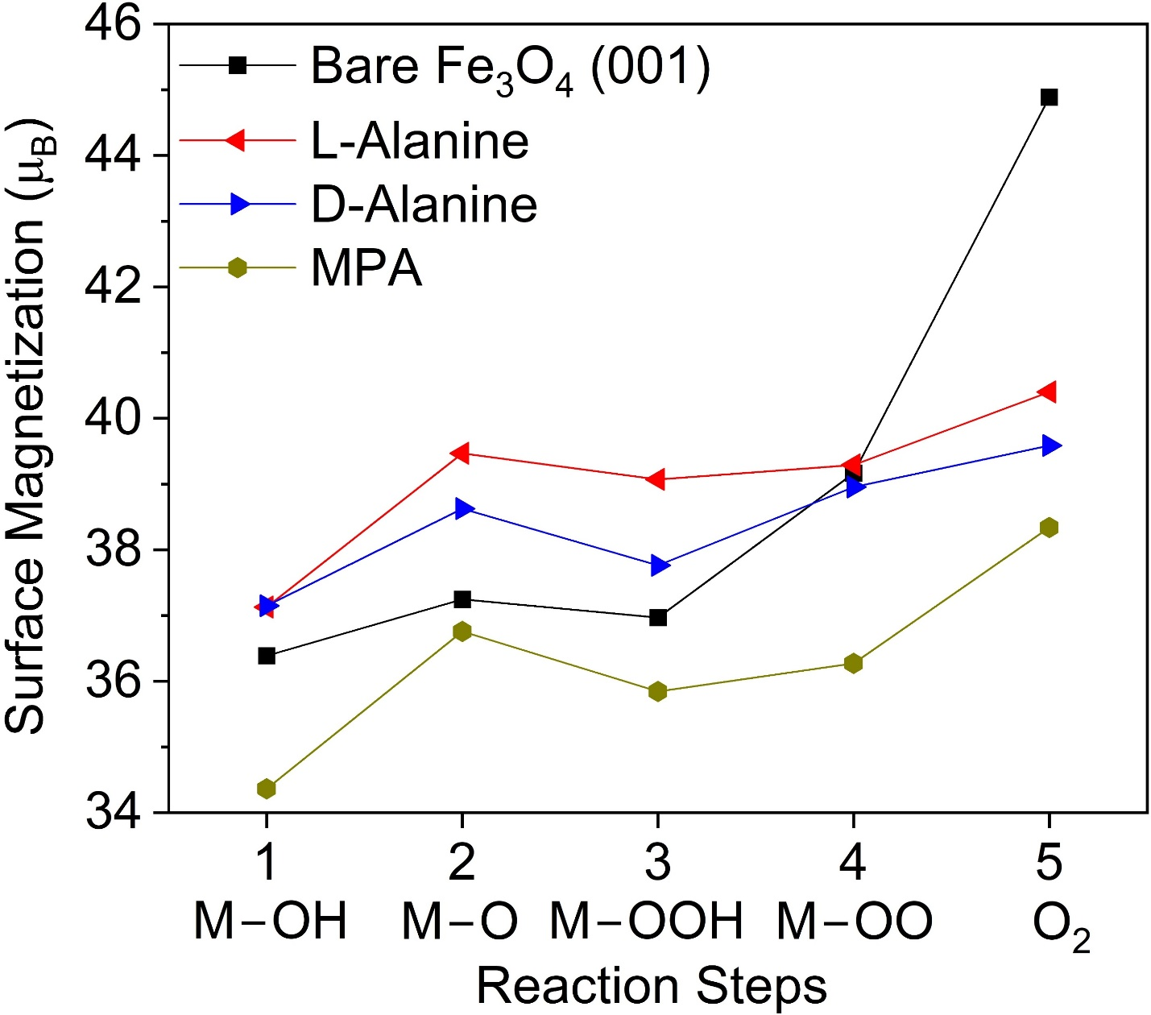
Total surface magnetization
Are chiral molecules modifying the magnetization of the surface atoms?

Slide 13
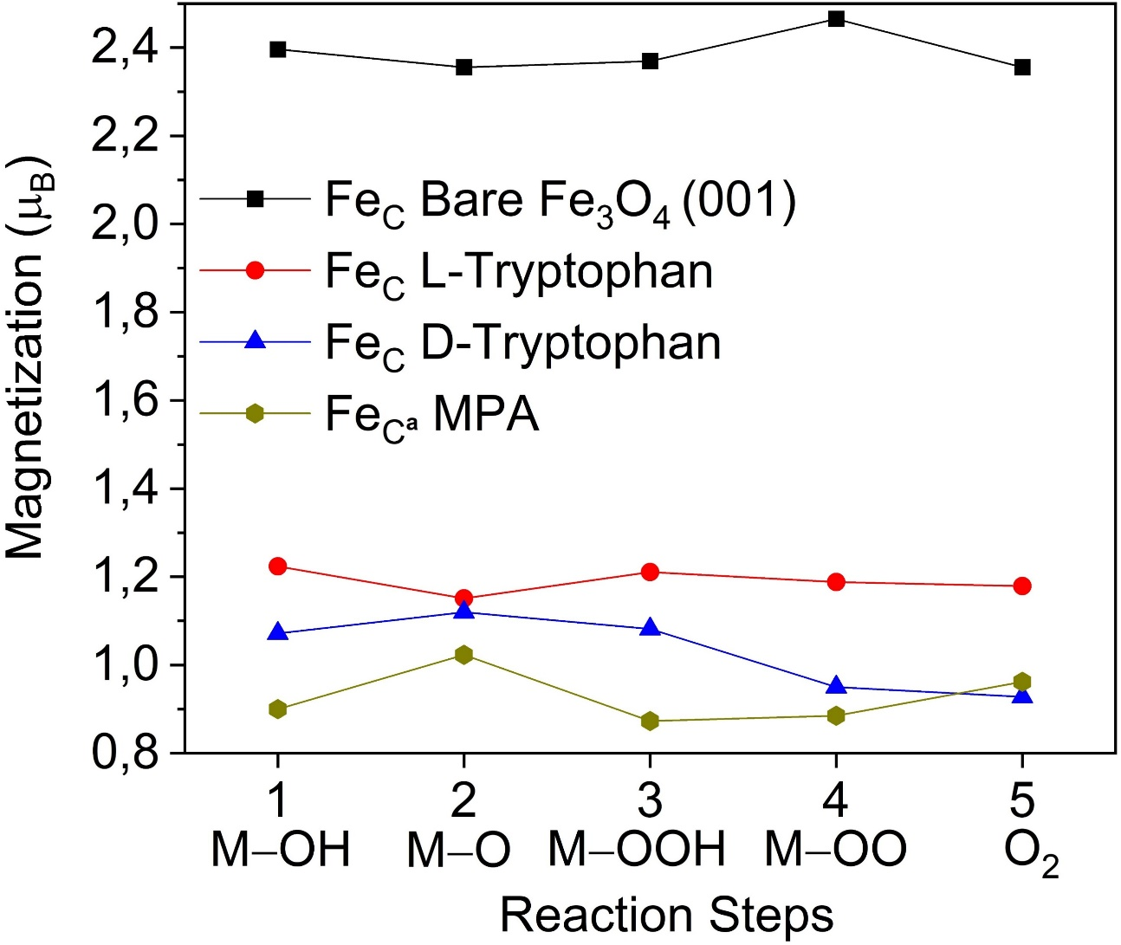
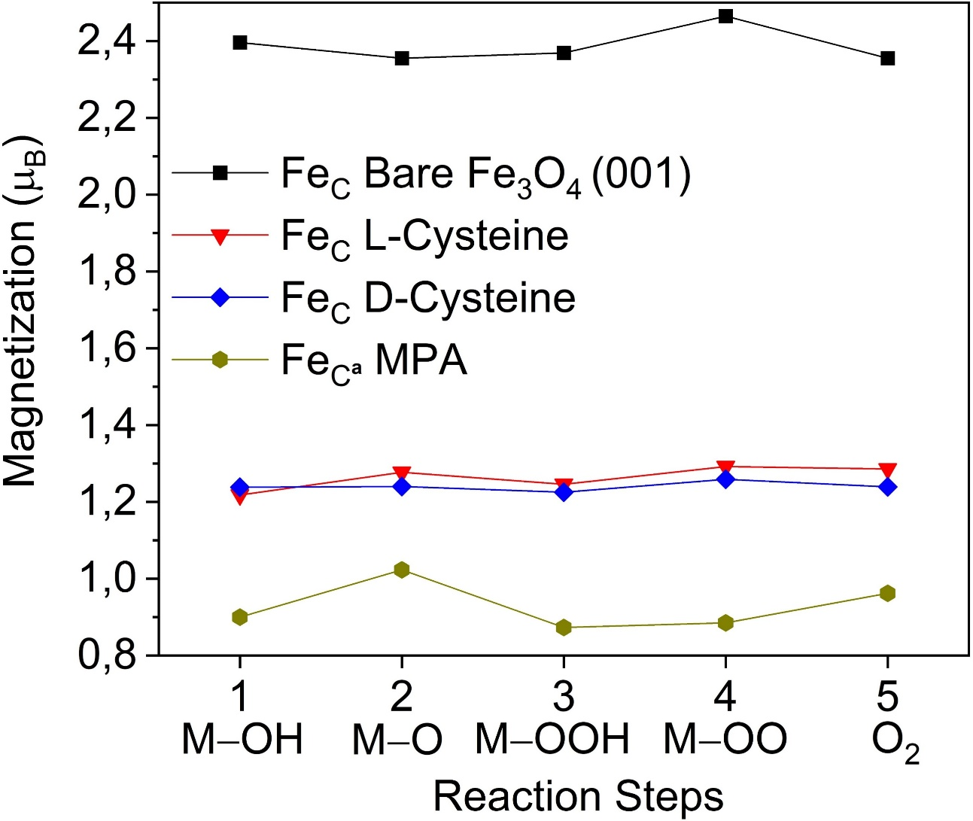
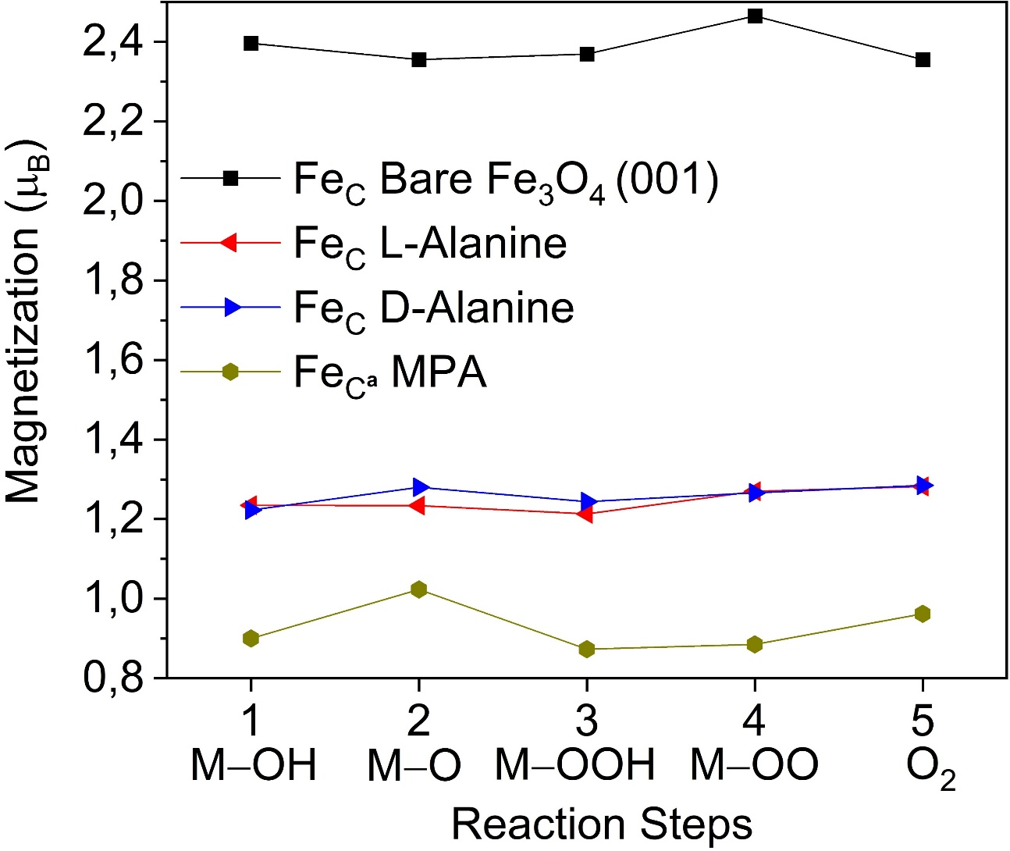
Magnetization of the Fe atom @ chiral binding site
Any change in local magnetization due to the chiral molecules?
${Fe}_{C}$ atom
Local magnetization is reduced at the chiral / achiral binding site

Slide 14
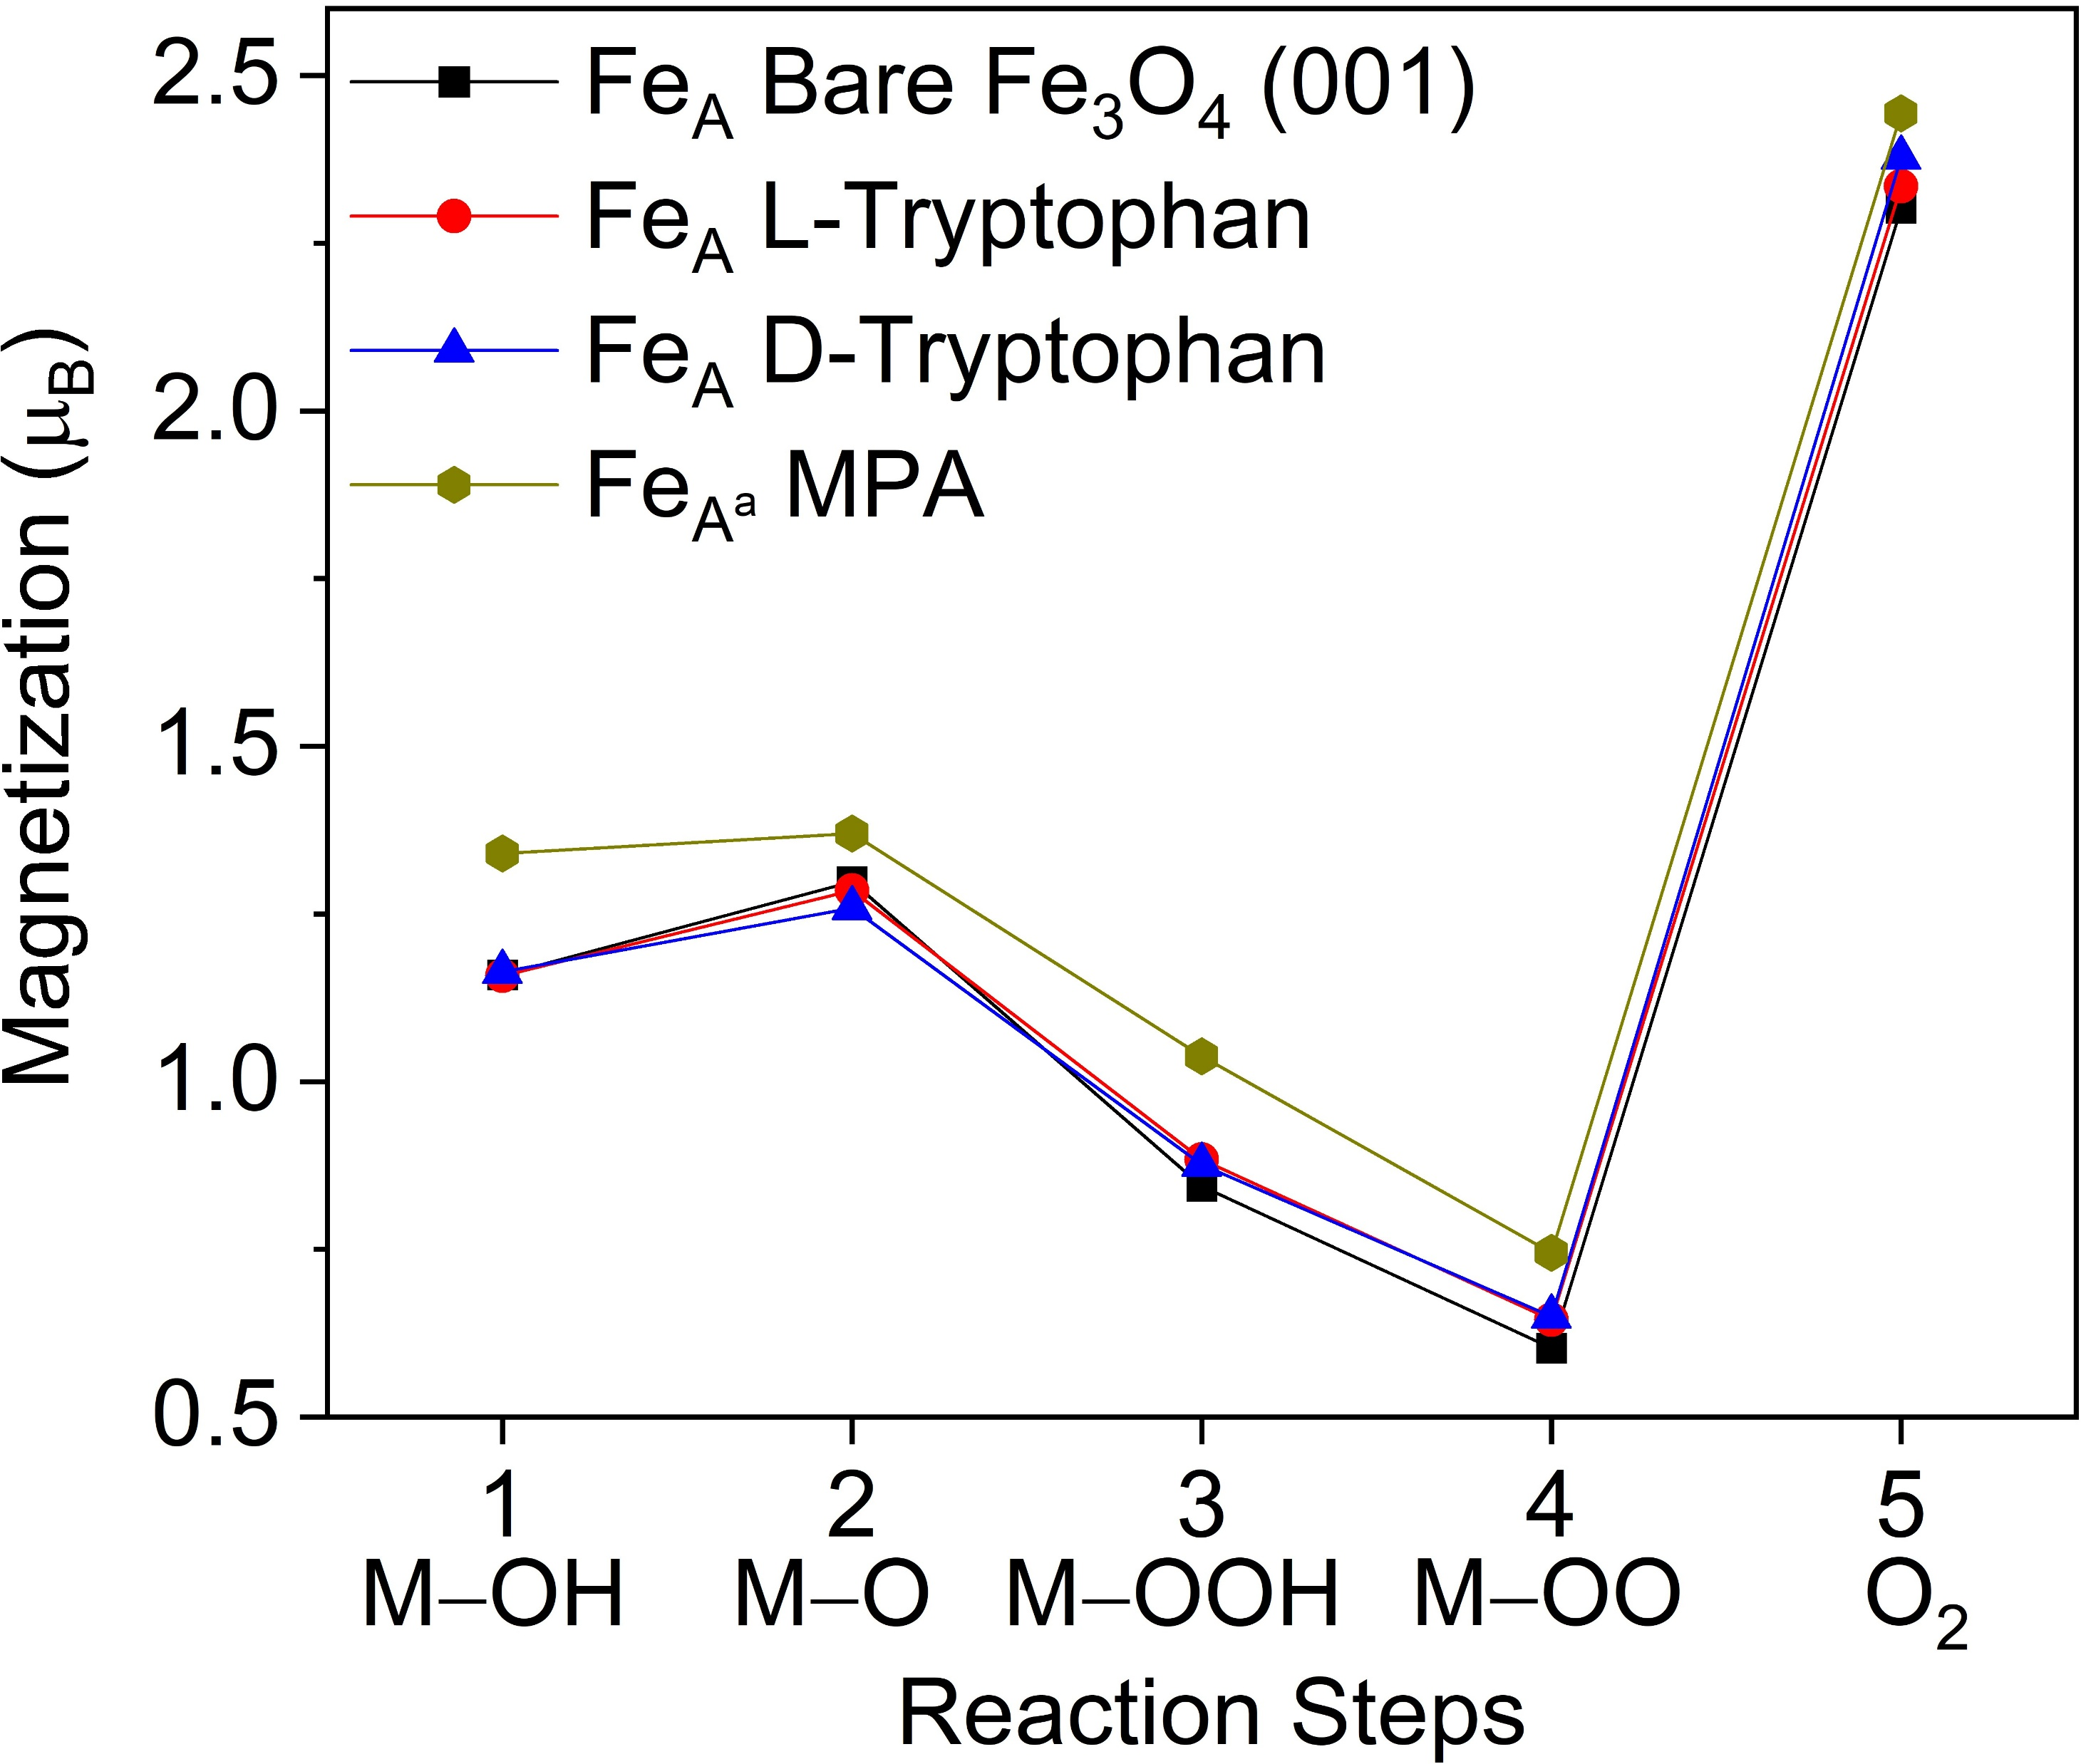
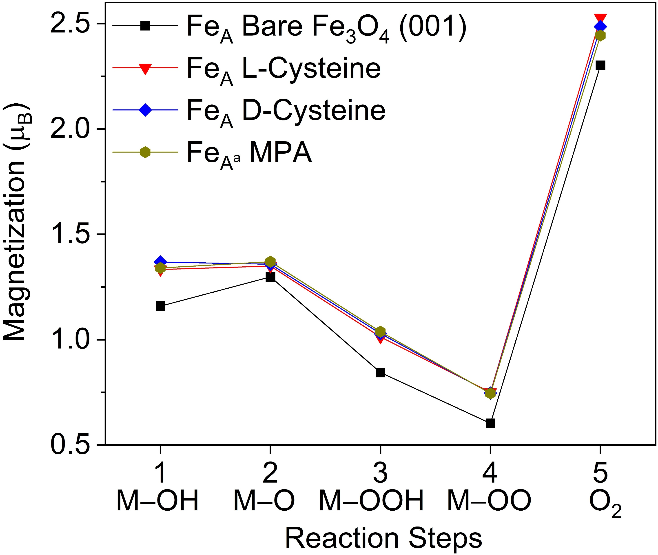
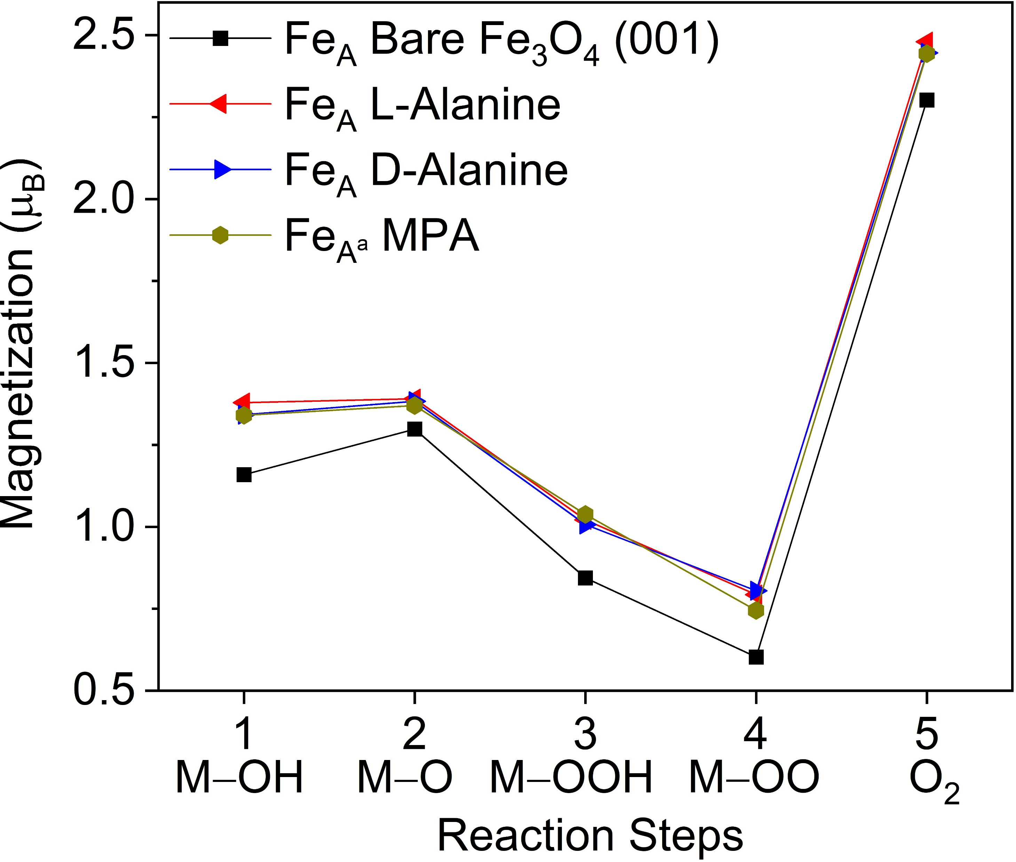
Magnetization of the Fe atom @ active site
Any change in local magnetization due to the reaction intermediates?
${Fe}_{A}$ atom
Local magnetization is affected at the active binding site by the functionalized systems

Slide 15
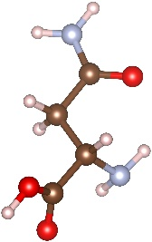
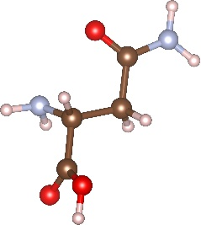
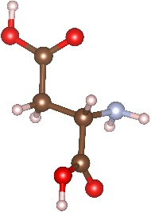
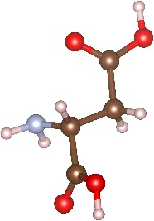
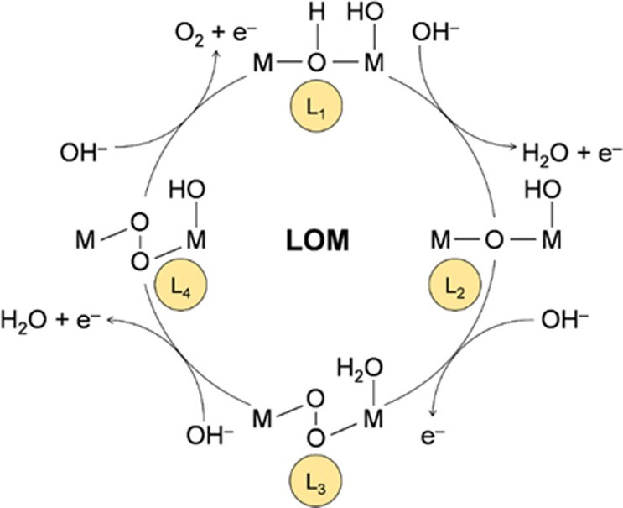
Conclusions so far…
OER reaction energy barriers are considerably reduced by chiral molecules
Local magnetization at the chiral / achiral binding site is reduced
Local magnetization at the active binding site is affected by the functionalized systems
Bader charge analysis confirms that OER is a 4 $e^{−}$ transfer process
Work in progress
Spin-dependent projected DOS: Modifications in spin-dependent spectral weights?
Simulations running:
L-and D- Asparagine
L-and D- Aspartic Acid
Ab Initio Molecular Dynamics: Is dynamics playing a role?
Microscopic reaction mechanism is not fully elucidated: alternative (“parallel”) OER pathway more favourable?
C. D. Valentin et al. ACS Catal., 2023

Slide 16
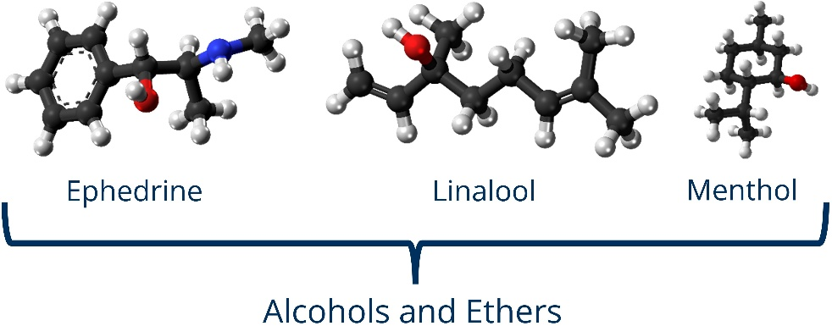
Outlook
High-throughput screening of a larger pool
of chiral molecules
…

Slide 17
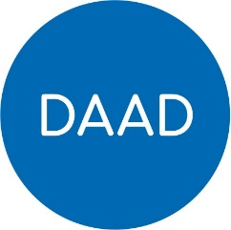
Teaching & conferences
Teaching
Concepts of Molecular Modeling. Winter term 2025/2026
Conferences and Workshops
Chirality and Quantum Spin – A Critical Assessment. Bad Honnef, December 2025
DPG Spring Meeting. Dresden, March 2 – 6, 2026
Electron Spin Interactions with Chiral Molecules and Materials. Gordon Research Conference. USA
(1) August 2 – 3, 2025 (2) August 3 – 8, 2025
460 € per year
1500 € !

Slide 18
Timeline 2025-2026
Further analysis of the current research work
Set-up of high throughput
DPG spring meetings
January
2025
February
April
June
August
January 2025
February 2026
March 2026
Prepare and submit manuscript
Next TAC meeting
The 1st TAC meeting
DAAD annual progress report

