Slide 1
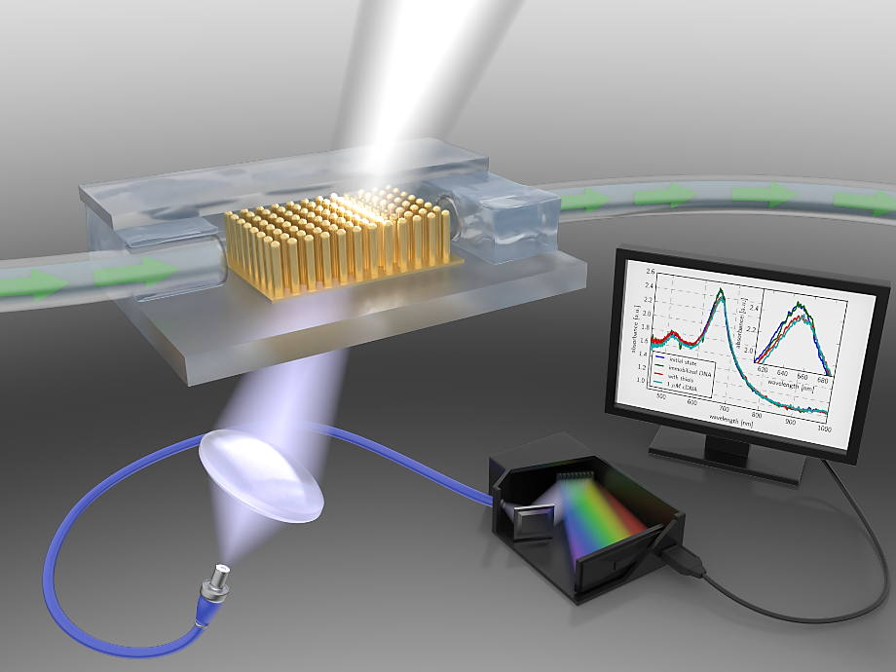
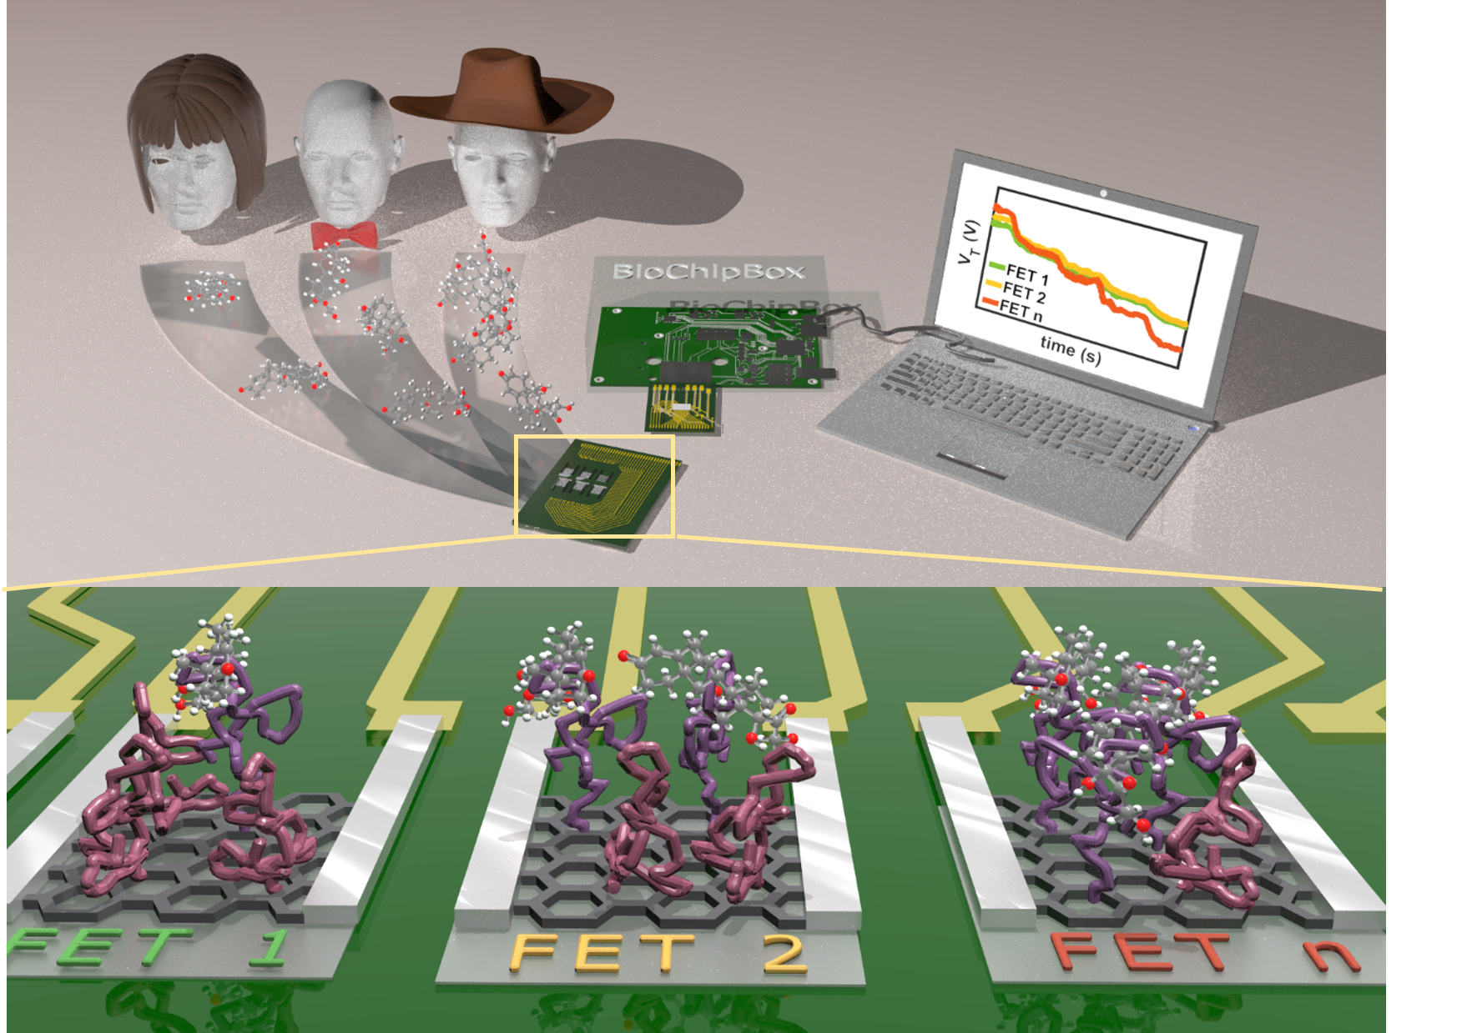
TAC – Meeting
March 23rd, 2022
Real-Time Detection of Analytes Using Nanostructured Biosensors

Slide 2
Outline
Part I – Detection of DNA hybridization with Optical biosensor based on Gold Nanoantennas
  Fabrication and characteristics of nanosensor
  Surface functionalization and Real-time detection of hybridization with targets of two lengths
  Limitation in real time detection due to diffusion and mass transfer
Part II – Aptamer based Detection of cortisol with SiNW FETs
  Fabrication, characteristics and integration of nanosensor to portable system
  Surface functionalization: development of surface capture assay
  Detection of cortisol with SiNW FETs in human saliva
  Outsmart the Debye-length limitation: explore the origin of biorecognition
Part I – Detection of DNA hybridization with Optical biosensor based on Gold Nanoantennas
  Fabrication and characteristics of nanosensor
  Surface functionalization and Real-time detection of hybridization with targets of two lengths
  Limitation in real time detection due to diffusion and mass transfer
Part II – Aptamer based Detection of cortisol with SiNW FETs
  Fabrication, characteristics and integration of nanosensor to portable system
  Surface functionalization: development of surface capture assay
  Detection of cortisol with SiNW FETs in human saliva
  Outsmart the Debye-length limitation: explore the origin of biorecognition

Slide 3
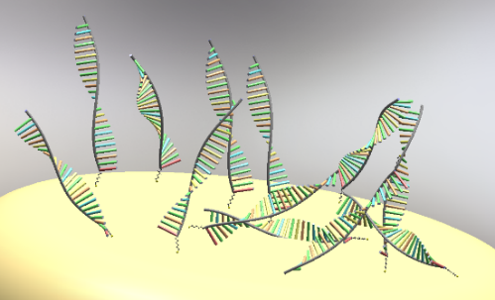
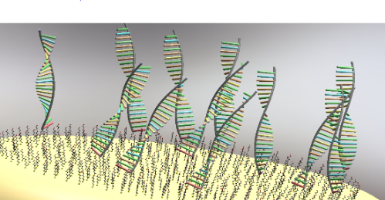
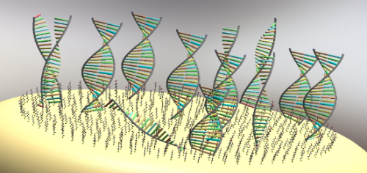
Plasmonic Biosensor Based on Vertical Arrays of Gold Nanoantennas
Klinghammer, S. et al. Plasmonic Biosensor Based on Vertical Arrays of Gold Nanoantennas. ACS Sens. 3, 1392–1400 (2018).

Slide 4
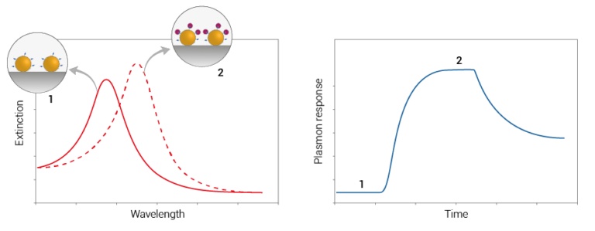
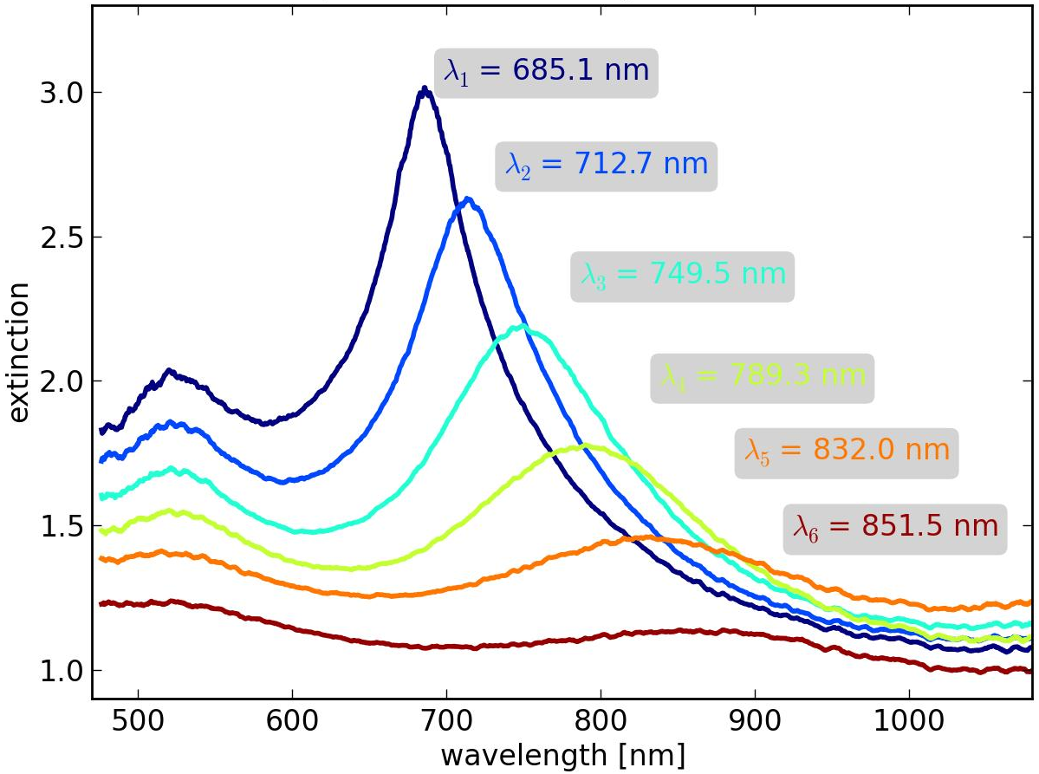
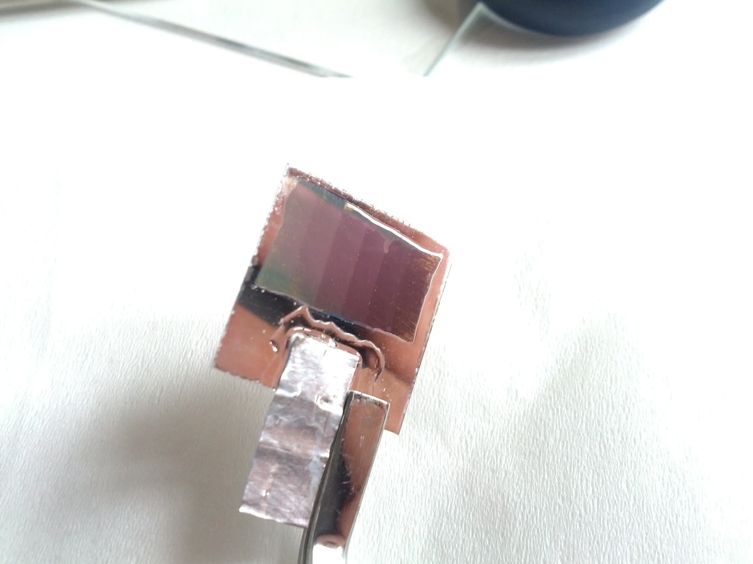
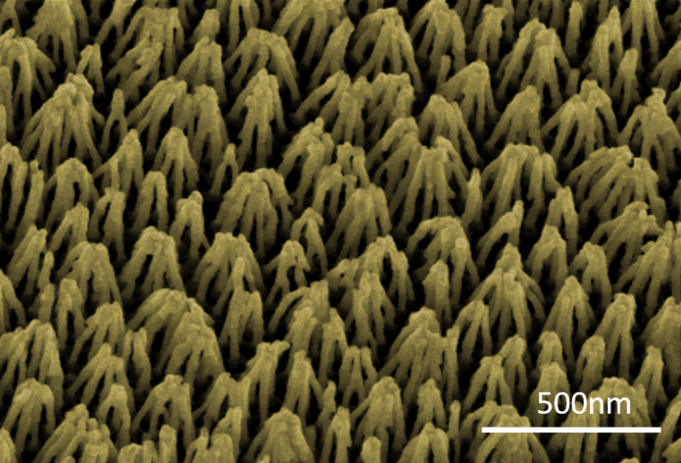
Part I – Manufacturing and properties of vertically aligned nanoantennas
DNA
6
5
Al₂O₃
4
3
2
1
Au
Ti
glass
[http://arguseye.se/technology/]

Slide 5
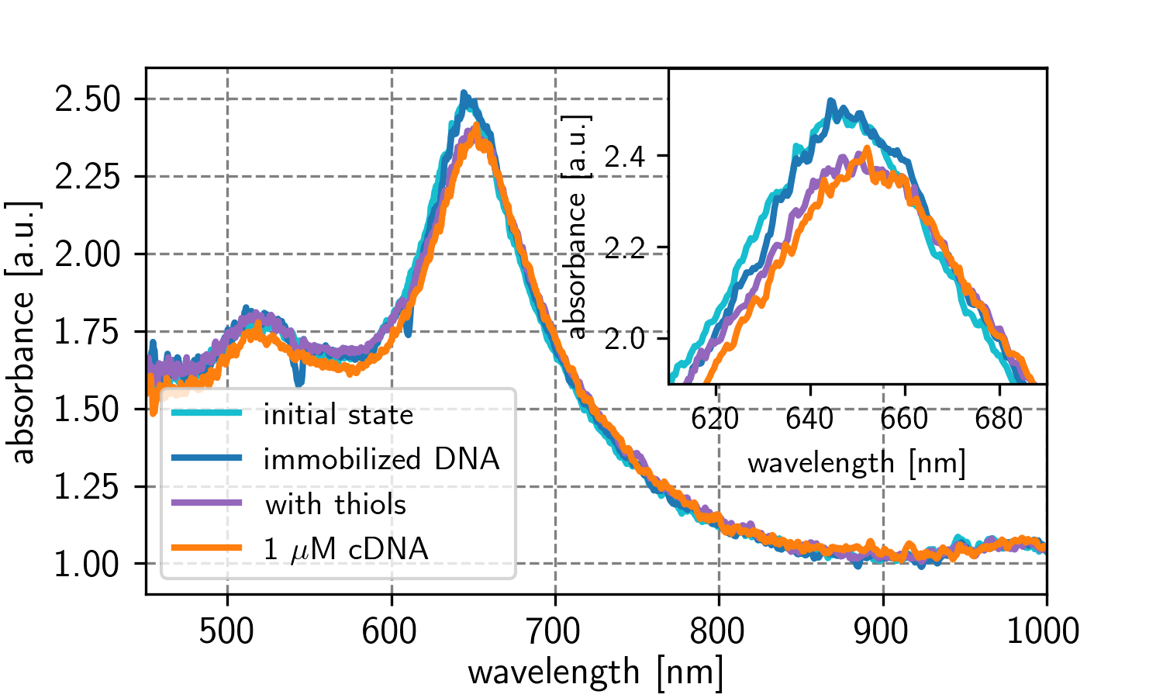
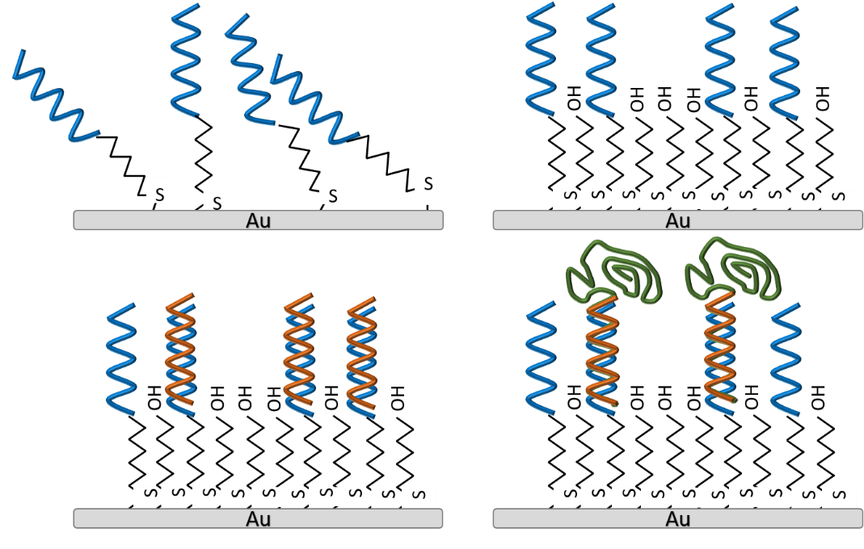
Surface functionalization of antennas
1) Immobilization
2) Backfilling
3) Hybridization:
a) complementary
b) ¼ complementary,
rest overlap
1
2
3a
3b

Slide 6

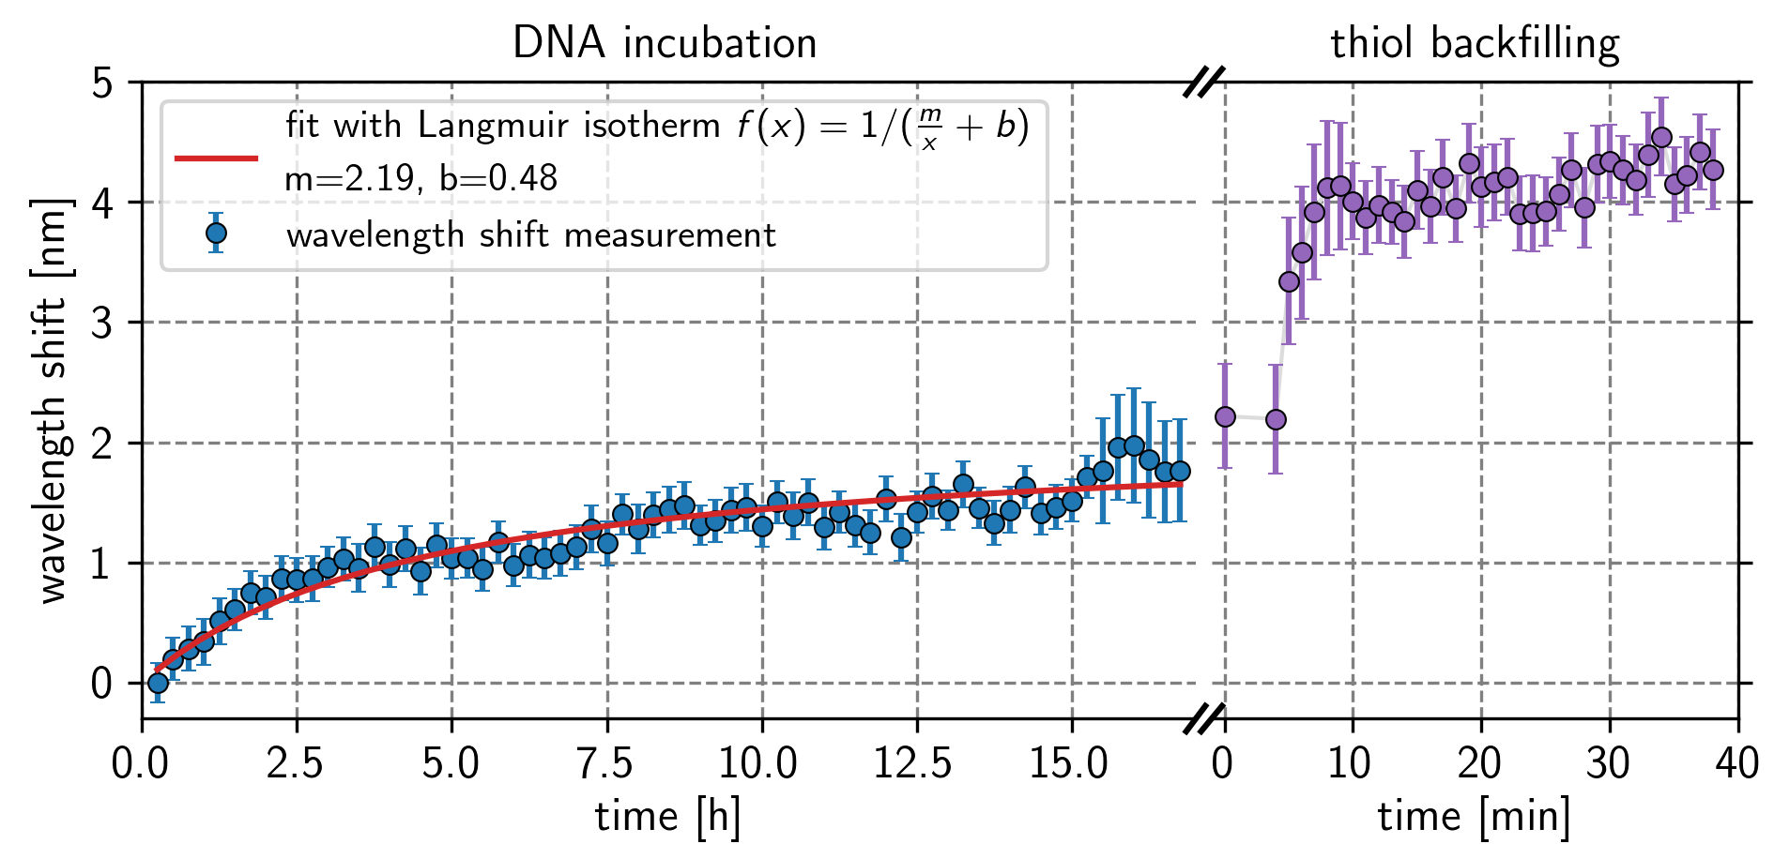
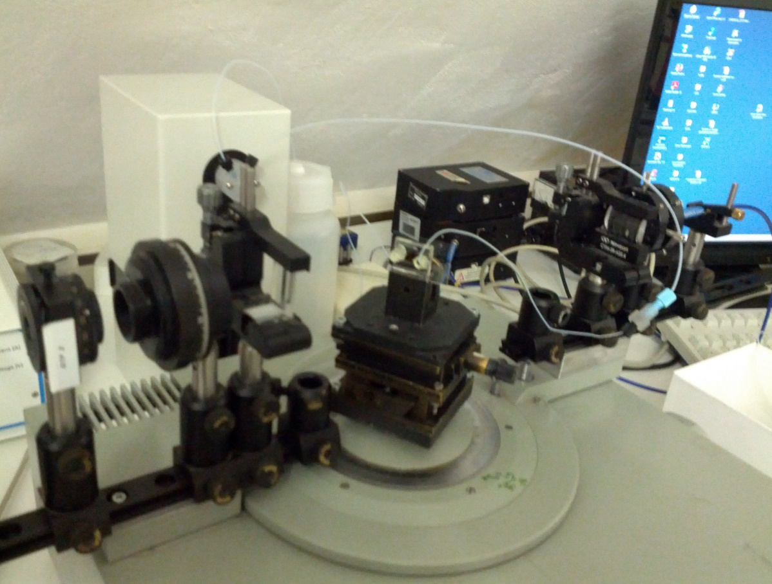
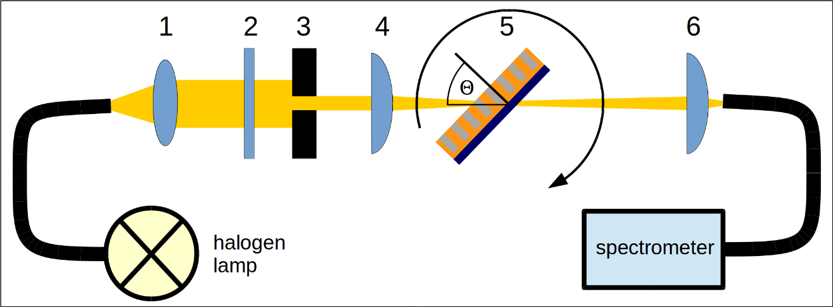
Monitoring of DNA and thiol-adsorption in real-time
glass
PDMS
glass
immobilization
backfilling
Microfluidic „integration“→ real-time measurments
Constant „red shift“ upon adsorption of DNA /thiol
Adsorption follows Langmuir kinetics
Adsorption of DNA slower than MCH

Slide 7
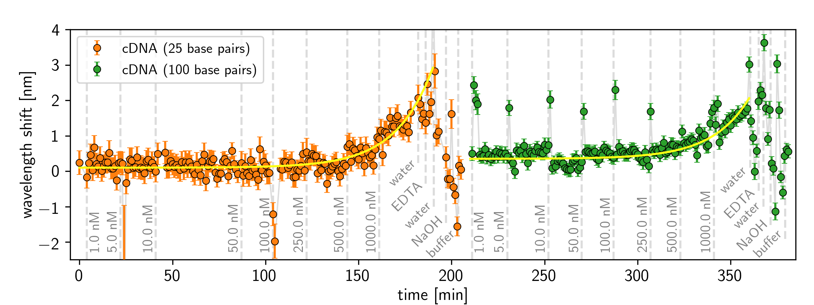
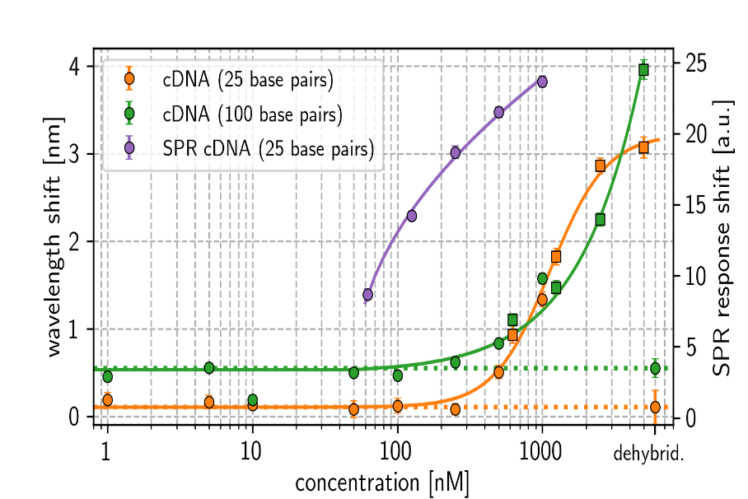
Hybridization with complementary DNA
sample | refractive index (measured) | predicted value (nm) | calculated shift (nm)
water | 1.334±0 | 660.11 | 0.00
pure meracptohexanol* | 1.486 | 675.68 | 15.57
pure ssDNA* | 1.46 | 672.60 | 12.49
pure dsDNA* | 1.54 | 681.21 | 21.10
Immobilization buffer | 1.337±0 | 660.42 | 0.31
5mM Mercaptohexanol | 1.3342±2,88E-4 | 660.13 | 0.02
Hybridization buffer (HB) | 1.3358±2,88E-4 | 660.30 | 0.19
25bp DNA in HB | 1.3360±1,15E-4 | 660.32 | 0.21
100bp DNA in HB | 1.3362±2,88E-4 | 660.33 | 0.22

Slide 8
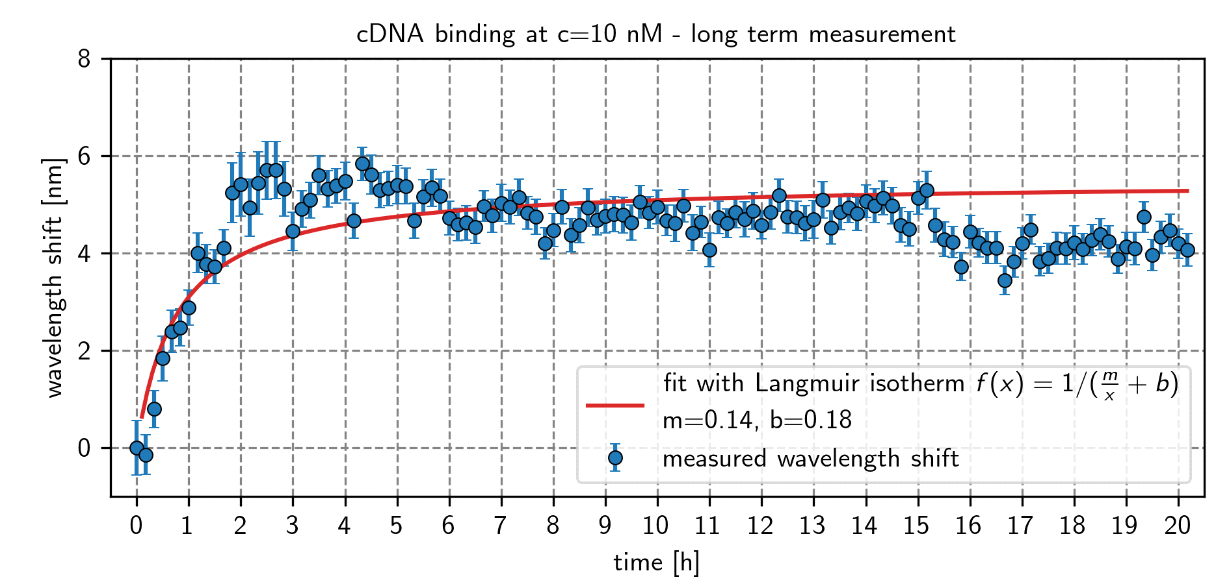
A
Diffusion, mass transfer limit and steric effects - drawback for real-time detection
v
Flow of analytes
Diffusion
Buffer/ bulk
Unstirred layer
17nm
k_{a}
k_{d}
Bound probe DNA/ ligand
Au
17nm
46nm

Slide 9
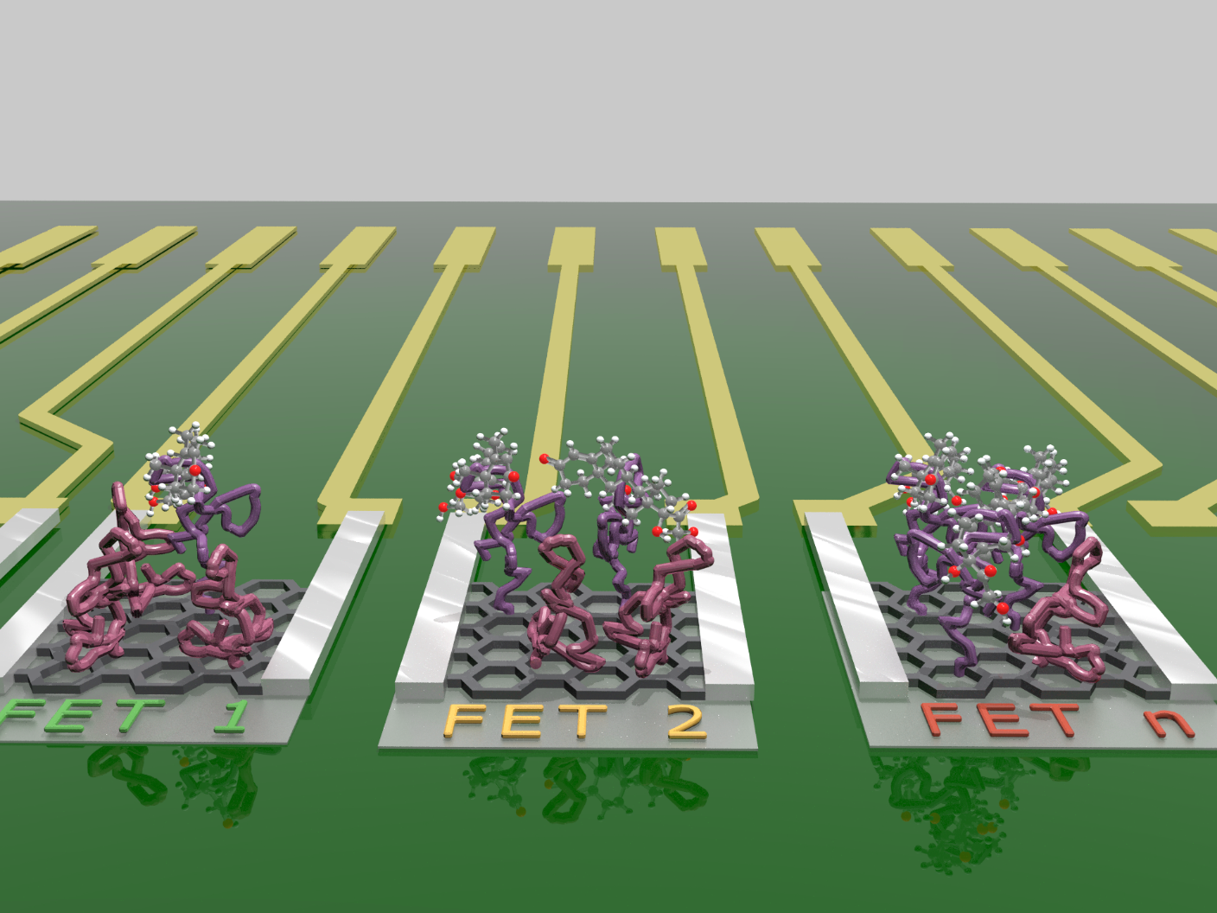
Real-Time Monitoring of Cortisol in Human Saliva with SiNW FETs
Klinghammer, S. et al. Nanosensor-Based Real-Time Monitoring of Stress Biomarkers in Human Saliva Using a Portable Measurement System. ACS Sens. 5, 4081–4091 (2020).

Slide 10
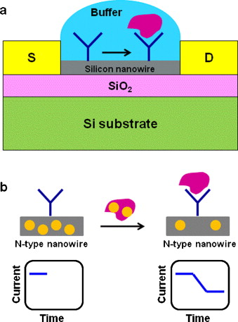
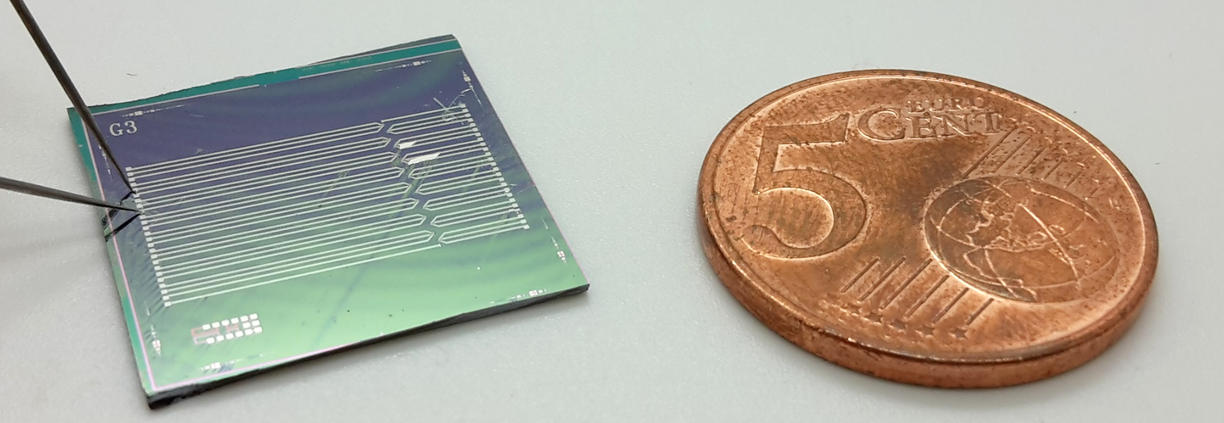
Manufacturing and properties of SiNW based FETs
S
D
RE
500nm
[Zhang G-J, Ning Y. 2012. Anal. Chim. Acta. 749:1–15]

Slide 11

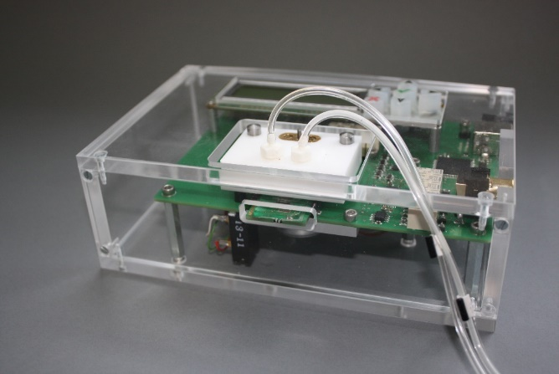


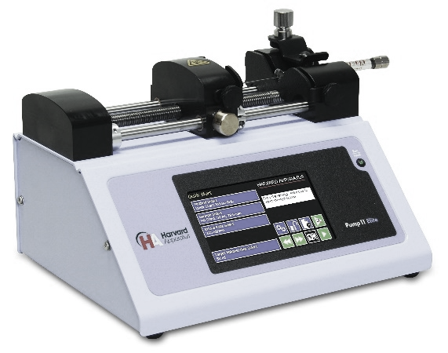
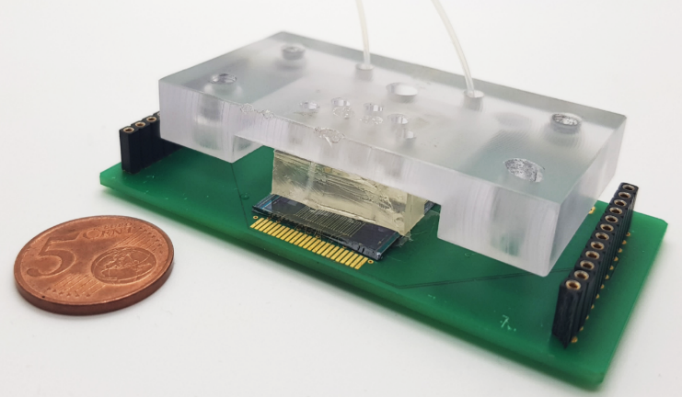
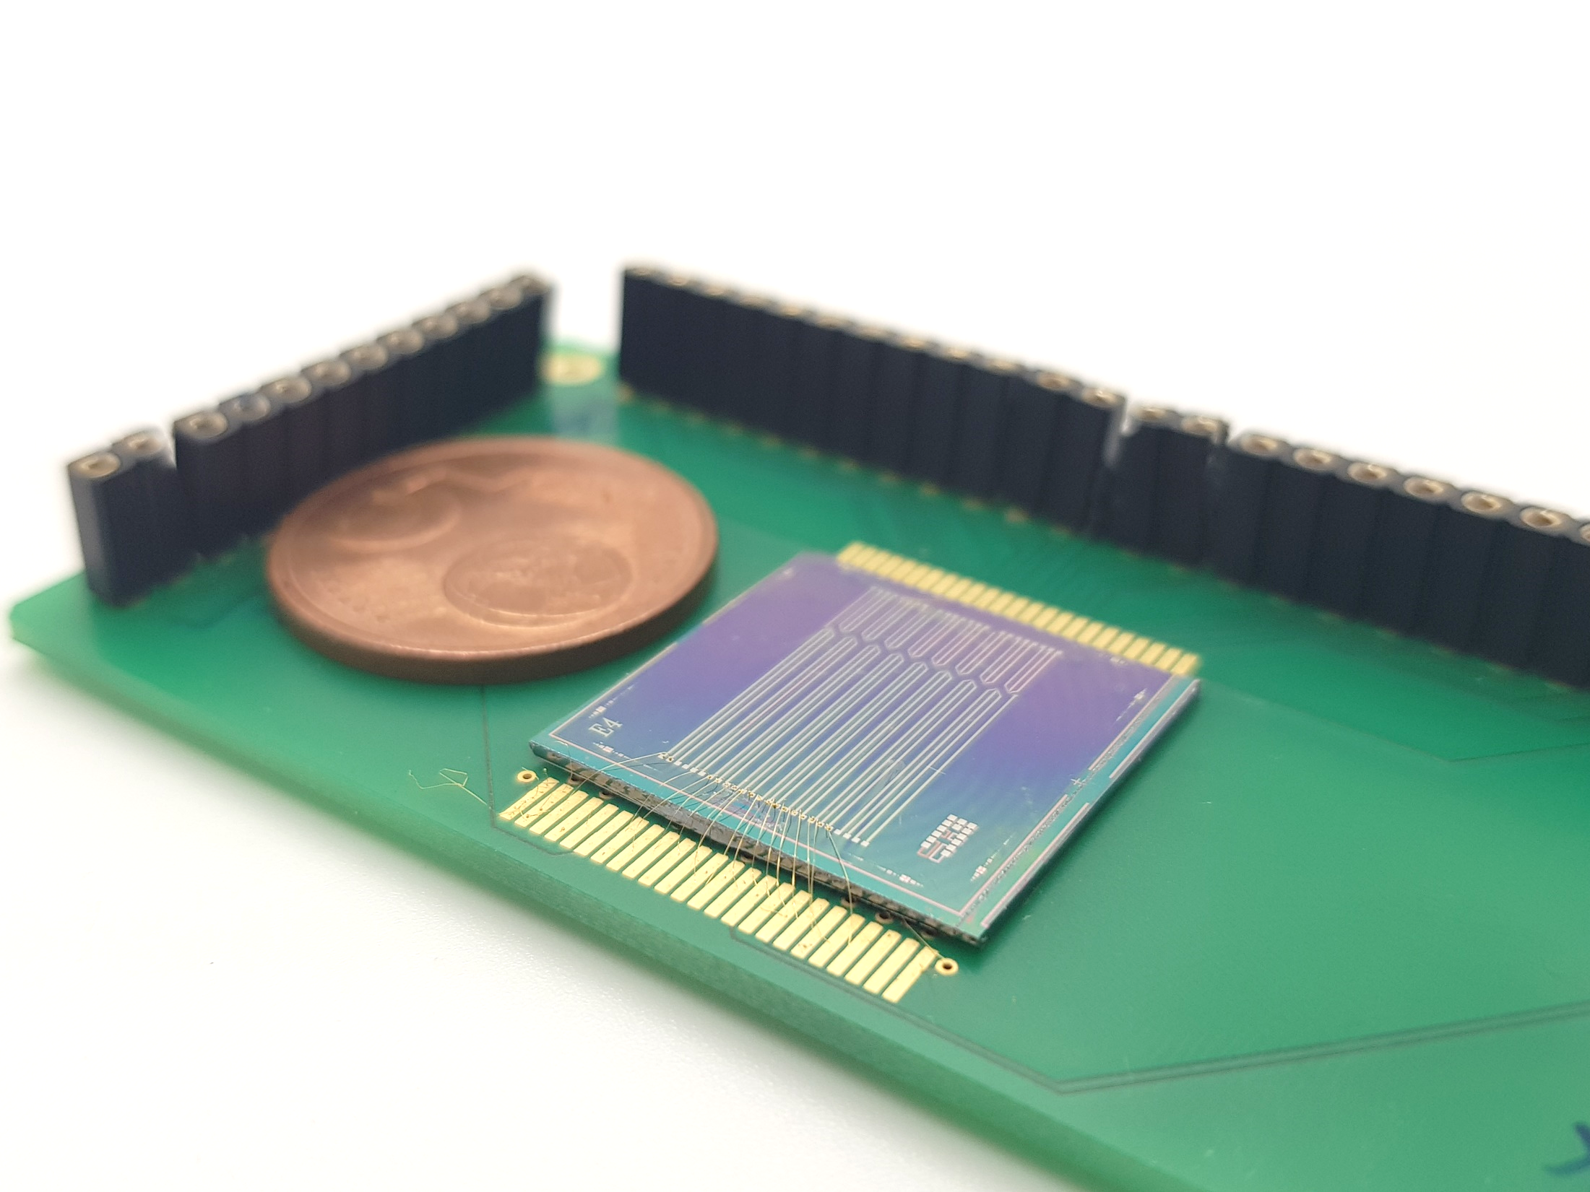
Integration into portable platform
A
M
power
Measuring unit
SD-card slot
USB
MUX- unit
Biochip
B
C

Slide 12
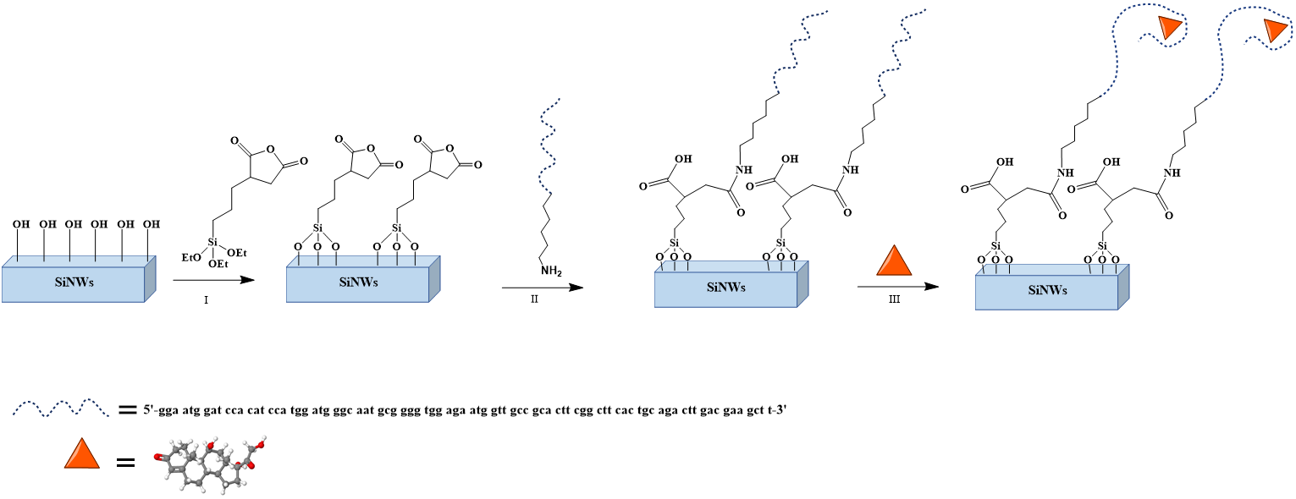
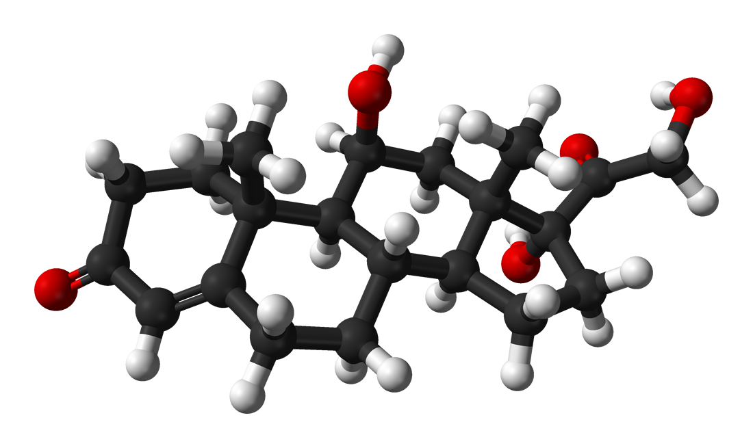
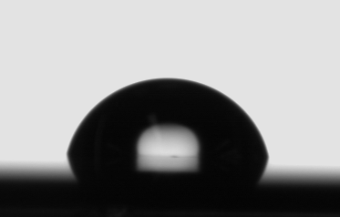
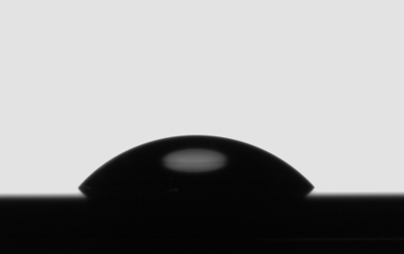
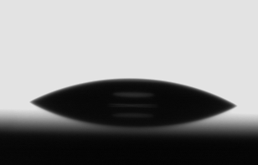
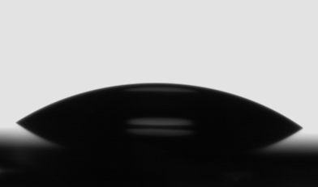
Surface functionalization
=
46.7° ± 4.1°
26.9° ± 2.3°
30.4° ±1.5°
Cortisol
62.4°±3.1°

Slide 13
Detection of cortisol in real-time
ΔV_{T}
Cortisol
*
Progesterone
Testosterone
Estradiol
*cortisone

Slide 14
Detection of Cortisol in Human Saliva
Course of an individual measurement:
Comparison with ELISA-kit:

Slide 15
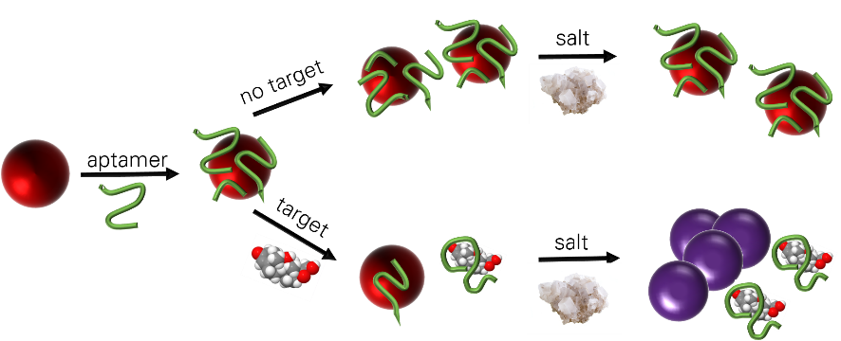
Excursus: Outsmarting the Debye-length limitation -conformational change of receptor upon binding
Conformational change of aptamer upon binding to cortisol:
Colorimetric assay
Circular dichroism:
CD peak positions AND relative intensities shift:
formation of new target-induced structural motifs

Slide 16
Summary
Nanoplasmonic biosensor:
Large arrays of vertically aligned nanoantennas
Monitoring the change of LSPR-position in presence of biomolecules
Integration with fluidic for real-time measurements
Exemplary application: detection and evaluation of immobilization and hybridizationof DNA strands

Slide 17
Summary
SiNW FET:
Honeycomb SiNW FET integrated in portable platform
Monitoring the signal change of multiple FETs simultaneously as real-time measurements
Exemplary application: Aptamer based Detection of cortisol in saliva with SiNW FETs
Overcoming Debye-limitation via formation of new target-induced structural motifs

Slide 18
Thank you!

