Slide 1
Multiscale Simulation Framework for Functional Polymers
Dipl.-Ing. Steffen Kampmann
Chair of Materials Science and Nanotechnology, TU Dresden
PhD Phase: Present and Future
Thesis Advisory Committee Meeting
TU Dresden, 14.02.2024

Slide 2
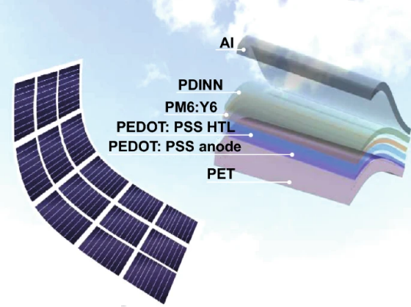
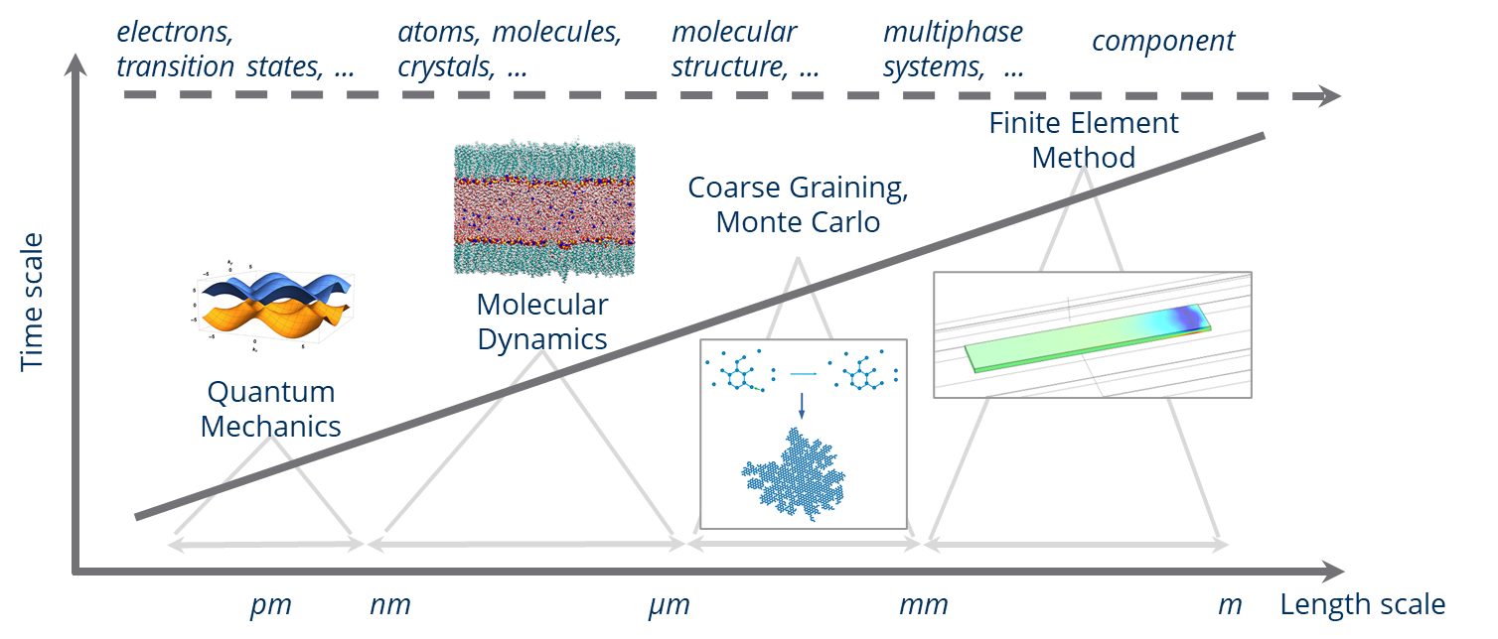
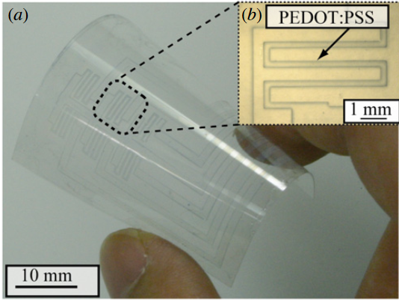
Motivation
Combination of electronic and mechanical properties of polymers can play important role for energy solution technologies → Solar cells (Perovskite [1], organic [2], hybrid [3])
How can we predict electromechanical behavior?
→ Consideration of different time and length scales
[3]
[2]
Example: Strain gauge
PEDOT:PSS (poly(3,4-ethylenedioxythiophene polystyrene sulfonate)
[4]
Hierarchical property relations → Different time and length scales → Multiscale simulation framework

Slide 3
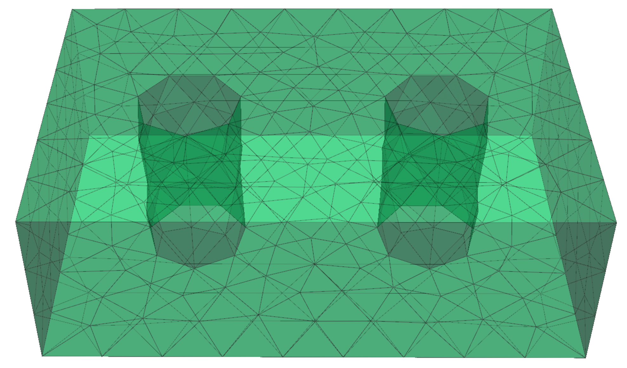
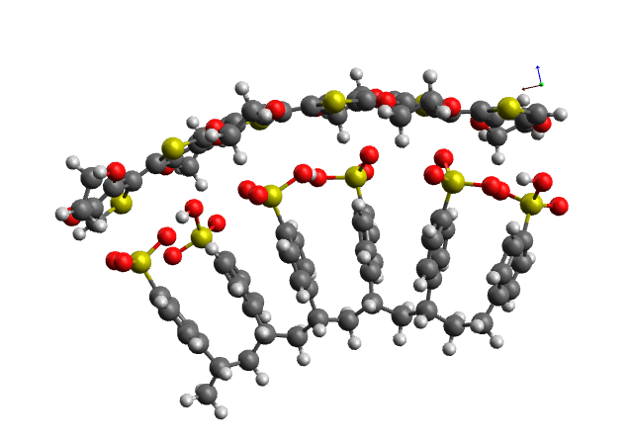
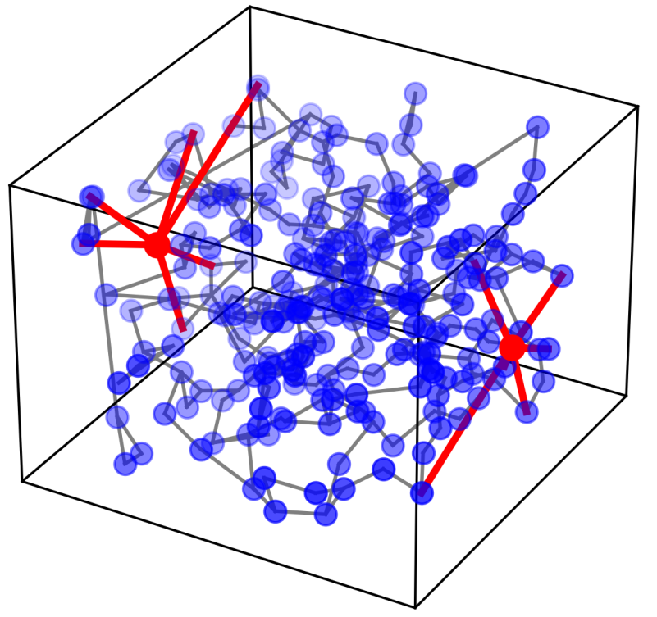
Schematic Overview
$$ε$$
Polymer structure
Force field mapping
Elastic properties
Mechanical relations
Uniaxial compression & tensile tests
Strain controlled deformation
Mapping structures to network
$$ε$$
Electromechanical coupling
Local resistance
Hopping rate
Calculation of resistivity
Resistivity-strain relation
Resistor network
One node represents one molecular unit
Electronic relations
$$l$$
Calculation of conductivity, current density and current
Electric field
$$Å$$
$$nm$$
$$μm$$
$$mm$$

Slide 4
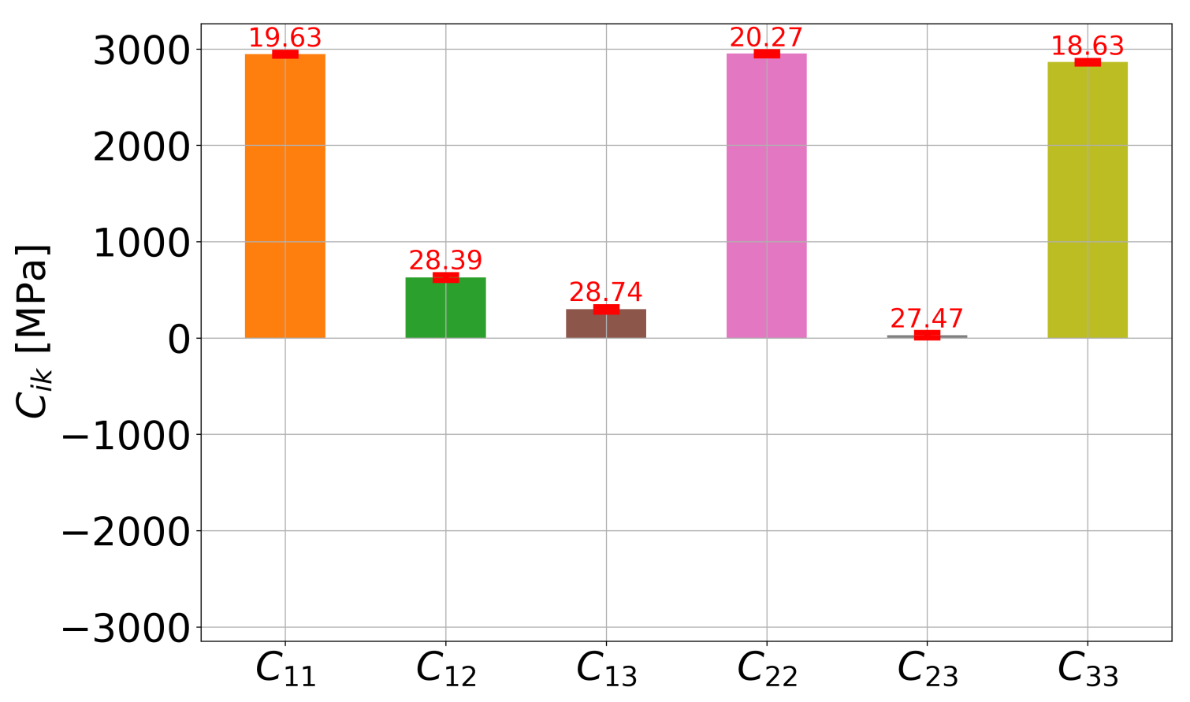
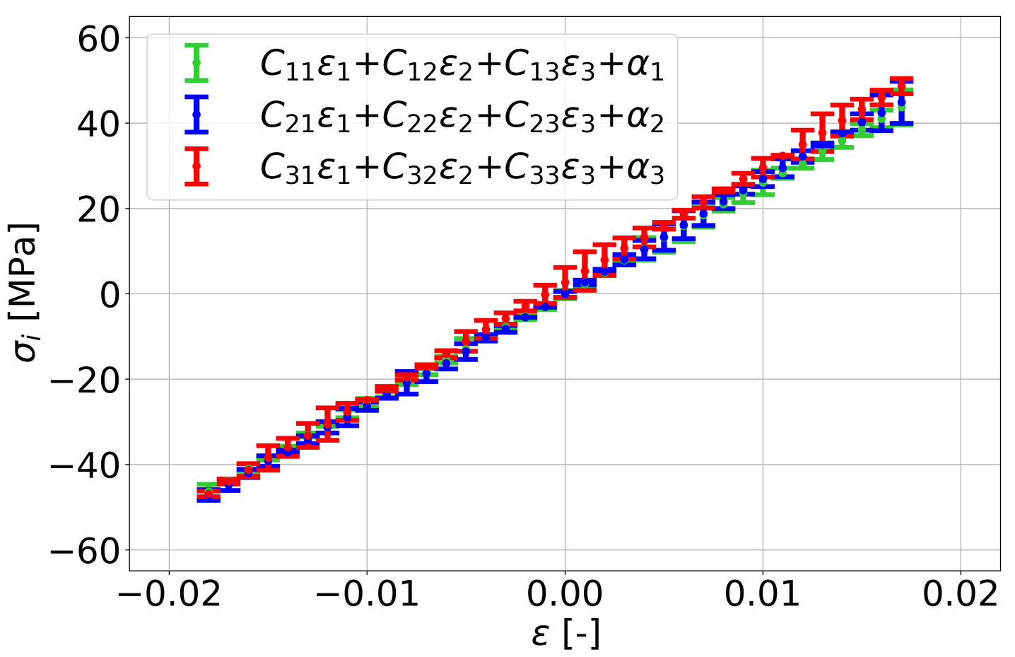
Mechanical Properties
$$ε$$
Strain-controlled mechanical deformation of the polymer structures
Uniaxial compression and tensile test on mesoscale with Molecular Dynamics (MD)
Strain states result from the microscale
Capturing stress-strain relations of main and sub directions
Multilinear regression of stress and strain states to determine components of the elasticity tensor $C$
$$C$$
$$σ_{ij}=C_{ijkl}ε_{kl}$$
Elasticity tensor based on many different stress and strain states

Slide 5
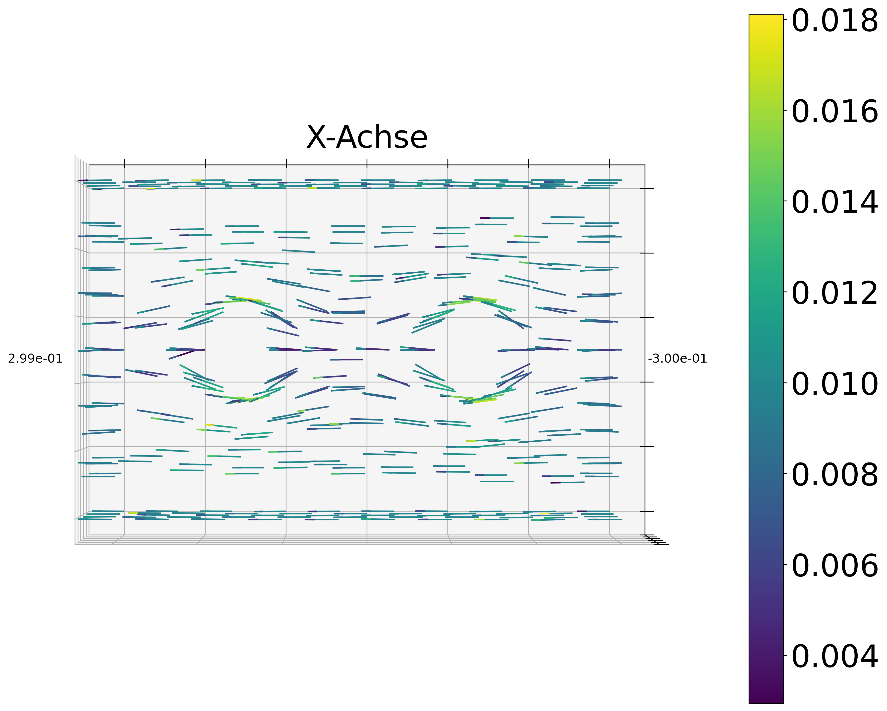
Electronic Properties
Calculation of hopping rate $t_{ab}$ with Marcus theory [5]
Solving equation system of Kirchhoff’s law
Solving of Poisson equation
$− ∇⋅\left( κ_{mic} ∇ Φ\right)= 0$ with $κ_{mic}=κ\left(M,\vec{ε}\right)+κ\left(\vec{E}\right)$
$${\vec{E}}_{mes,n}$$
$$b$$
$$I_{in,micro}$$
$$r_{ab}$$
$$r_{ab}$$
$$\left[A/m^{2}\right]$$
$$I_{out,micro}$$
$$a$$
$$t_{ab}$$
$$C,M,{\vec{ρ}}_{mes}$$
DFTB
MD
FEM
Atomistic scale
Mesoscale
Microscale
$$Å$$
$$nm$$
$$μm$$
$$mm$$
Calculation of electronic properties across three scales
[5] Marcus, R. Chemical and Electrochemical Electron-Transfer Theory. Annu. Rev. Phys. Chem. 1964, 15, 155−196.

Slide 6
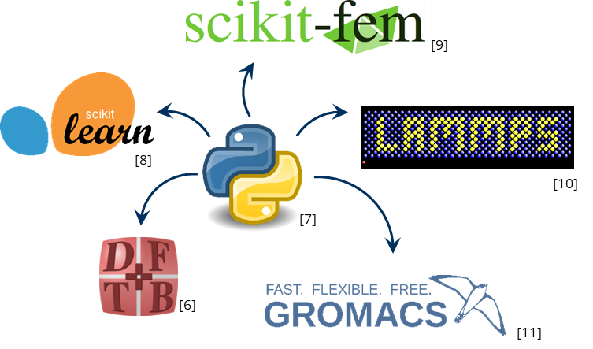
Definition of material unit
cycle = 0
atomistic scale
Github
mesoscale
Calculation of$λ$
Generation of parametrized material structure
M3F
Multiscale Mechatronic Material Framework
Uniaxial compression & tension tests
microscale
Generation of network graph
Calculation of$C$
cycle == 1
false
true
Calculation of hopping rate
$$\vec{E}={\vec{E}}_{n}$$
Calculation of hopping rate with $\vec{E}=\vec{0}$
cycle += 1
Calculation of $ρ_{uv}$for different strain states
Calculation of $κ_{c}$
false
cycle == 0
Initial cycle:
Calculation of elasticity and elastoresistance tensor
Further cycles:
Calculation of current density on microscale level
true
Calculation of $κ_{e}$
Last strain state?
false
true
false
$$Φ_{\text{cycle}\text{−1}}\left(x,y,z\right)$$ == $Φ(x,y,z)$
Calculation of $M$
true
Calculation of current density
cycle += 1

Slide 7
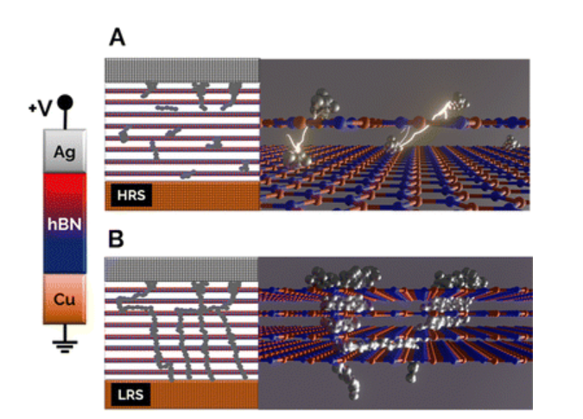
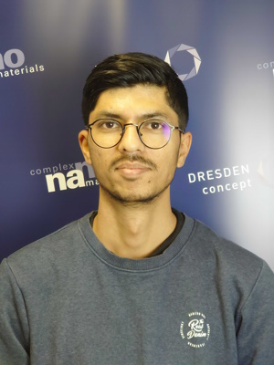
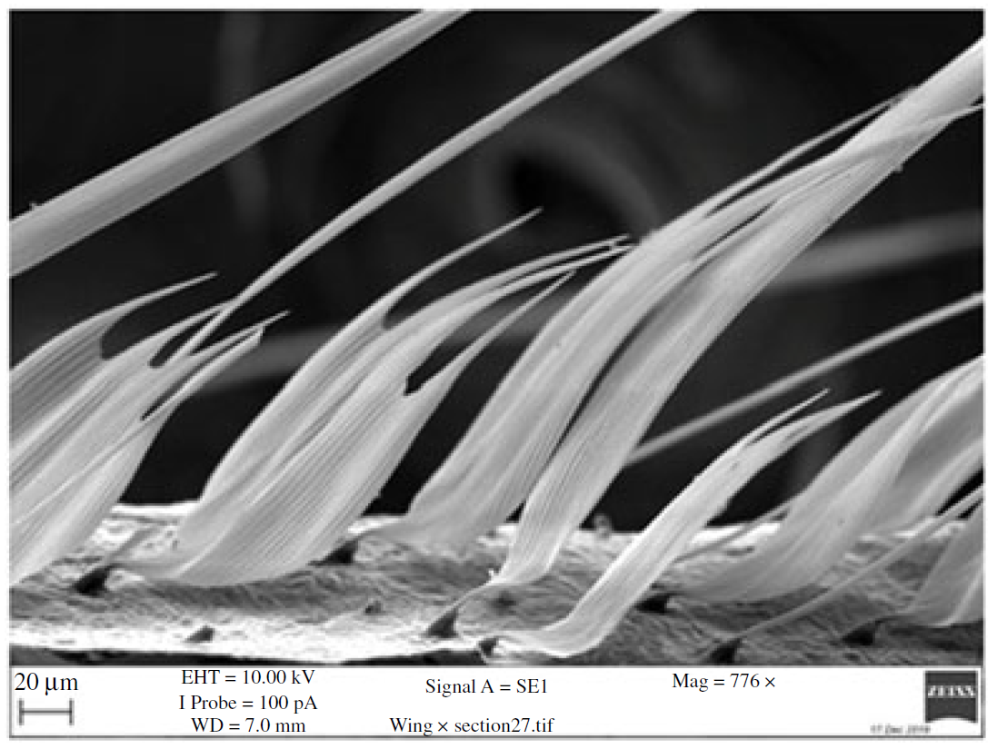
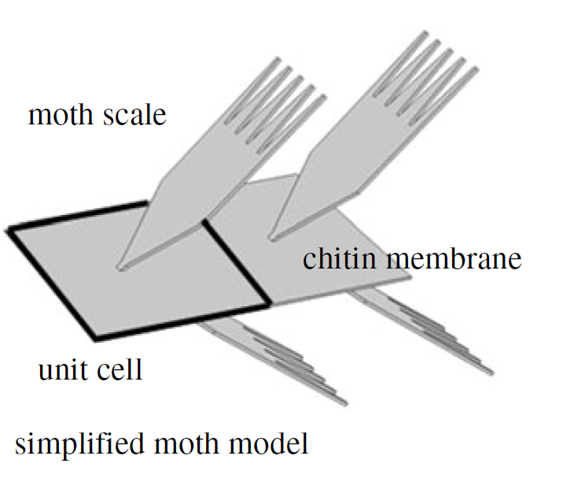
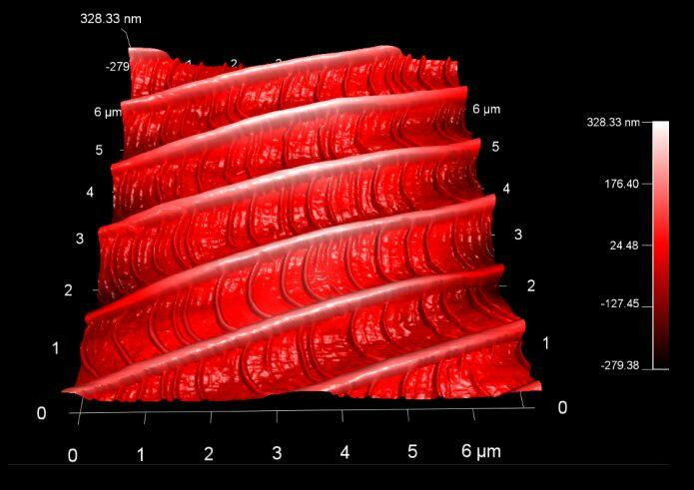
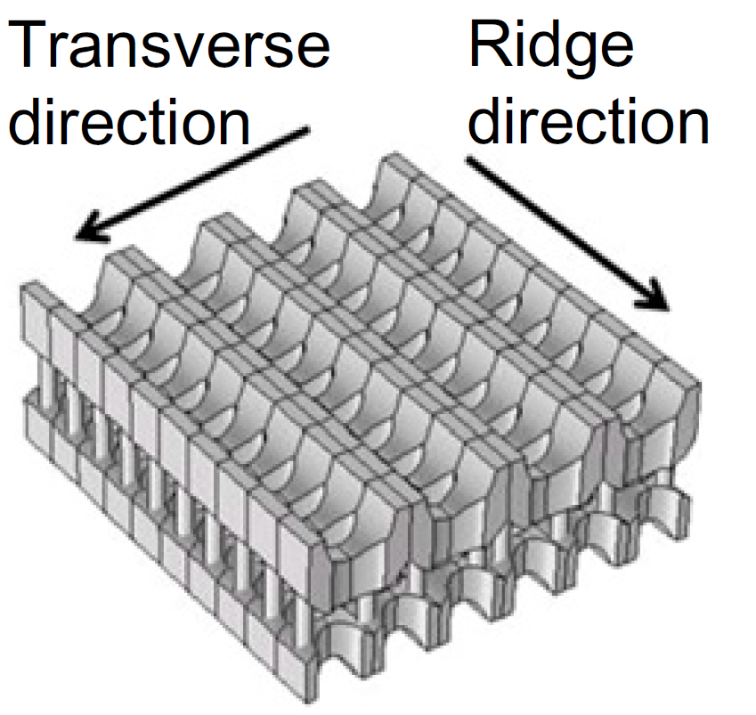
Summary and Other Projects
Multiscale simulation framework for electro-mechanical coupling is ready for use
Publication in progress
Collaboration with Vivek Dey finished
Calculation of neuromorphic network based on hexagonal Boron Nitride (hBN) layers with Ag-particles in between
Publication in progress
Supervision of Master student Sina Seyedibavilolyaei
Bioinspired passive noise cancelling
Adaptation of the ultrasound absorption property of moth wings
Structure optimization for audible frequency range
[12]
[13]
[13]
[14]
[13]

Slide 8
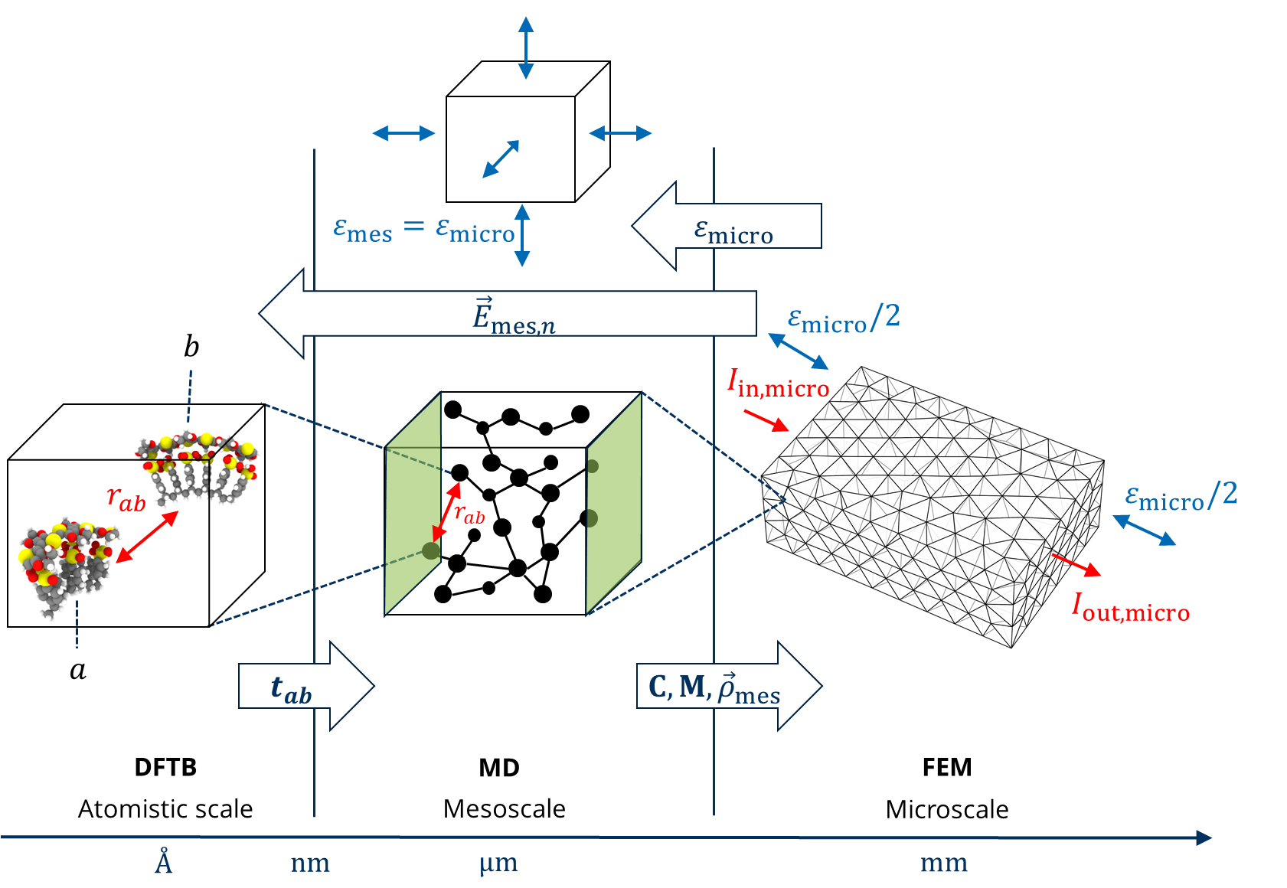
Outlook
Extensions of multiscale framework
Implementation of different kind of local Resistances (contact, intrinsic) for CNT-composites materials
Prediction of stress states on microscale in combination with Molecular Dynamics
Testing framework for other applications, for example gas-sensing applications
Timeline:
Two publications for multiscale framework
Writing thesis
Thesis defense
DPG
MSE
February
June
Fourth quarter

Slide 9
Thank you for your attention!

Slide 10
References
[1] S. Ma, et al., Solar Energy Materials and Solar Cells, 208, 2020
[2] J. Wan, et al., Efficiency. Nano-Micro Lett. 13, 44,2021
[3] S. Li, et al., Nano Research, 8, 3141–3149, 2015
[4] S. Takamatsu et al., J. Micromech. Microeng., 20, 6, 2010
[5] Marcus, R. Chemical and Electrochemical Electron-Transfer Theory. Annu. Rev. Phys. Chem. 1964, 15, 155−196.
[6] https://dftbplus.org/
[7] https://python.org/
[8] https://scikit-learn.org/
[9] https://pypi.org/project/scikit-fem/2.2.0.dev0/
[10] https://lammps.org
[11] https://gromacs.org
[12] A. Rao et al., Materials Horizons, 11, 2023
[13] Shen et. al., Biophysics and computational Biology, 115 (48), 12200-12205, 2018
[14] https://www.uibk.ac.at/ionen-angewandte-physik/chemphys/afm.html

Slide 11
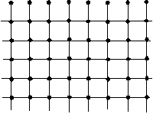
material unit
Material structure
250 units
1. cycle (over all strain states)
further cycles
Force Field mapping
$ε$_{mic}
Uniaxial compression & tension tests
x-, y-, z- main and sub directions
→ 21 datapoints
elastic properties
Stress-strain relation
mechanical relations
$$C$$
FEM
Given: $U$
Stress-strain relation
$J=κ grad\left(Φ\right)$
$κ=\frac{1}{\overline{M}ε}+σ(\vec{E})$
Network of Nodes and edges
Node at center of mass
Coupling relation
$Δρ_{mes}=Mε$
$$M$$
Separate view of hopping pairs
$$Δρ\text{(}\text{x}\text{,}\text{y}\text{,}\text{z}\text{)}$$
Reorganization energy
Calculation of resistivity in every direction
Resistivity-strain relation
Resistor network
Local resistance
DFTB+ calculations
Local conductances
$$G_{ab}$$
$${\vec{E}}_{n}$$
${\vec{E}}_{n}$ - Electric field
${\vec{R}}_{ij}$- Distance along direction of applied electric field
$ΔE_{ij}=ε_{j}−ε_{i}+e{\vec{E}}_{n}{∙\vec{r}}_{ij}$
Determination of hopping rate
$t_{AB}=\frac{{\left|H_{AB}\right|}^{2}}{ħ}\sqrt{\frac{π}{λk_{B}T}}exp⁡\left(−\frac{{\left({ΔE}_{ij}+λ\right)}^{2}}{4{λk}_{B}T}\right)$

Slide 12
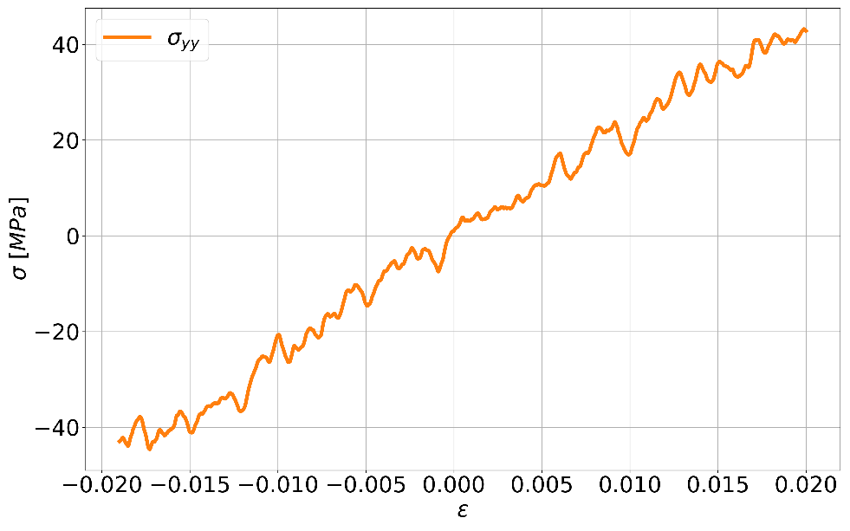
Mechanical Properties
Molecular Dynamics (MD)
Input: Polymer structures as Representative Volume Elements (RVE)
Using LAMMPS and UFF force field
Strain-controlled mechanical deformation of the polymer structures
Uniaxial compression and tensile tests
Strain states result from the microscale
Capturing stress-strain relations of main and sub directions
$$ε$$
Calculation of components of elasticity tensor $C$
$$σ_{ij}=C_{ijkl}ε_{kl}$$
Multilinear regression of stress and strain states to determine $C_{ijkl}$
$$C$$
Elasticity tensor is input component for Finite Element Method

Slide 13
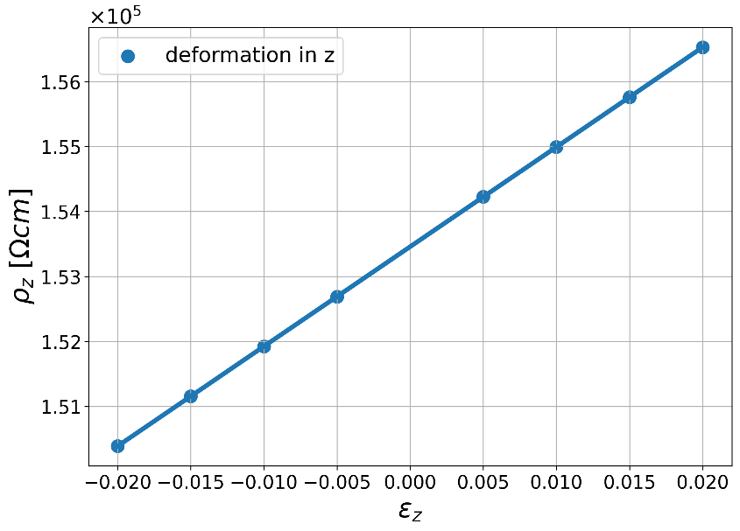
Electronic Properties
Input for Density Functional based Tight Binding : Two PEDOT:PSS units from polymer structures deformed with molecular dynamics simulations
Distances and Orientations of the two PEDOT:PSS units are preserved
Calculation of hopping rate with Marcus theory [5]:
$t_{AB}=\frac{{\left|H_{AB}\right|}^{2}}{ħ}\sqrt{\frac{π}{λk_{B}T}}e^{−\frac{{\left(ΔE_{ij}+λ\right)}^{2}}{4{λk}_{B}T}}$ with $ΔE_{ij}\left(\vec{E},{\vec{R}}_{ij}\right)$
$λ$ – reorganization energy, $H_{AB}$ – transfer integral
$\vec{E}$ – Electrical field,
${\vec{R}}_{ij}$ – Distance between unit $i$ and atom $j$
Resistivity $ρ$ depends on:
Hopping rate
Cross section of RVE
Length of RVE
Local distance between two units
The resistivity of RVE increases almost linearly!
[5] Marcus, R. Chemical and Electrochemical Electron-Transfer Theory. Annu. Rev. Phys. Chem. 1964, 15, 155−196.

Slide 14
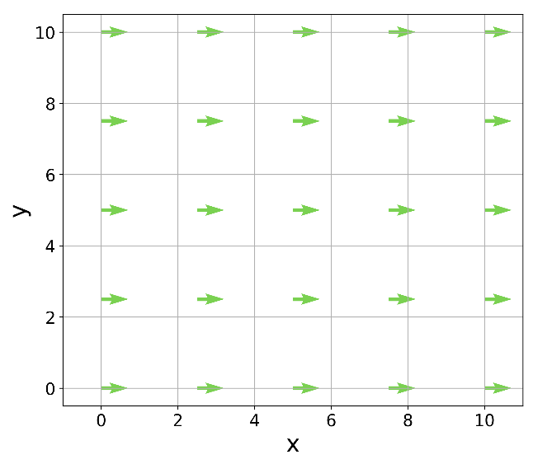
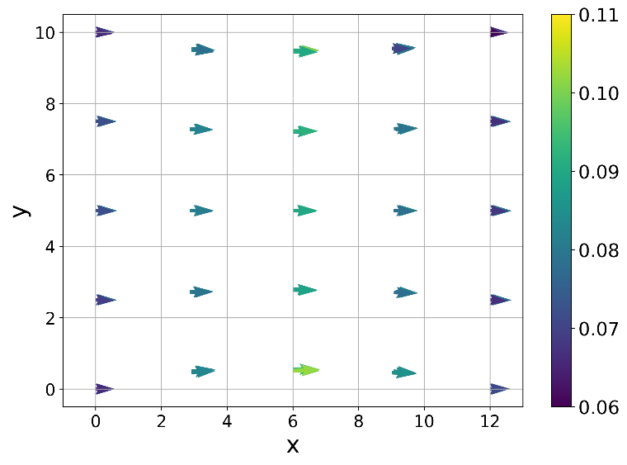
Mapping to Microscale
Input: Elasticity Tensor $C$ for elastic problem and elastoresistance tensor $M$ for electromechanical problem
Calculation of location dependent conductivity: $σ=σ_{0}\left(E\right)+M_{ε}^{−1}$
Solving Poisson equation$∇∙\left(σ ∇u\right)=0$
Calculation of current density: $J=σ grad(u)$
Evaluate electric field at every node and recalculate hopping rate → update coupling tensor $M$
Integration of current density to get electric current $I$ at boundaries
$$\left[\frac{A}{m^{2}}\right]$$
z
y
x
$$[V]$$
$$I_{in}=2.5 A$$
$$I_{out}=−2.5 A$$
$$I_{in}=1.28 A$$
$$I_{out}=−1.28 A$$

