Slide 1
TAC –Meeting
Steffen Kampmann
IfWW – TU Dresden
10.07.2020

Slide 2
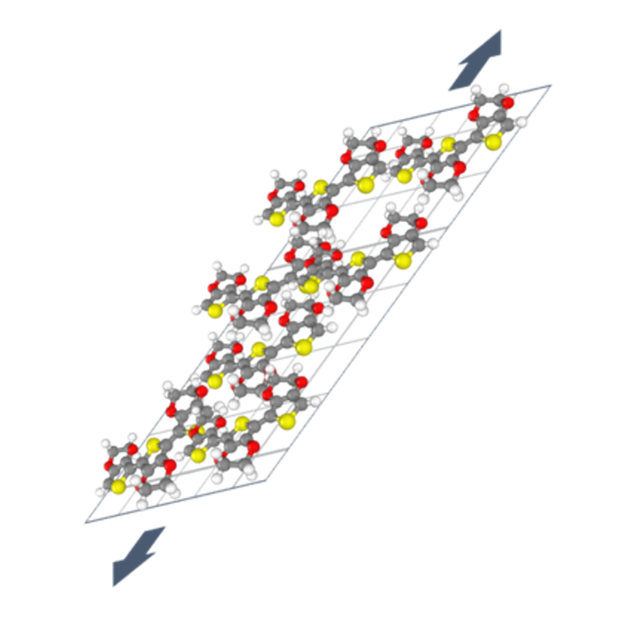
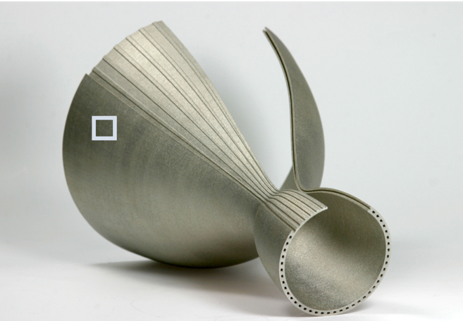
Project Goal in Leistungszentrum
Last meeting in beginning of march
Project processing time: Middle of November 2019 – end of December 2020
Goal: In situ monitoring of the strain behaviour of additively manufactured components
Construction of multiscale simulation model for the description of the piezoresistive effect
[1]
Thematic foundation for the dissertation

Slide 3
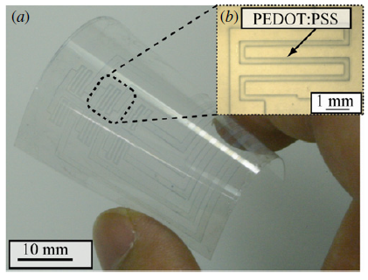
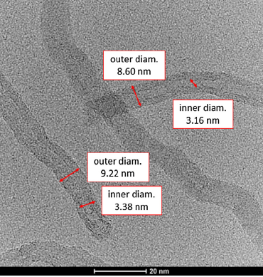
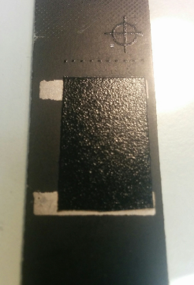
Dissertation topic: Multiscale simulation framework for functional polymers
Motivation:
Applications: Strain sensor, Gas sensor
Determination of property relation via multiscale
Requirements:
Multiscale Python-based simulation framework based on piezoresistive property profile
Basis for combination of DFTB, MD and FEM simulations
Validation and potential overview by means of comparative experiments
[2]
mm → nm
[4]
[3]
20 nm
[3]
[5]
[7]
[6]
Basic condition for further collaborations

Slide 4
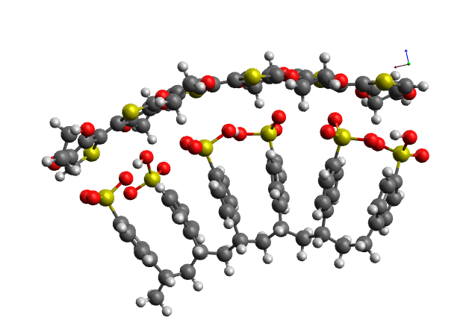
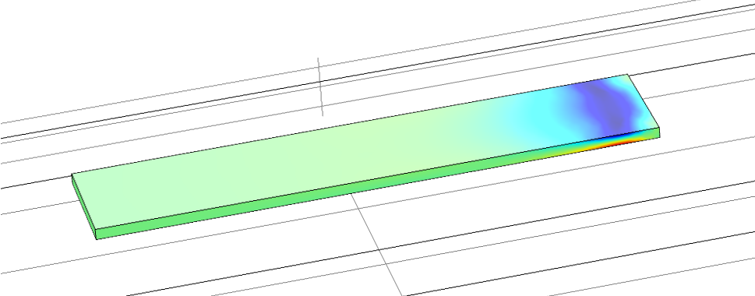
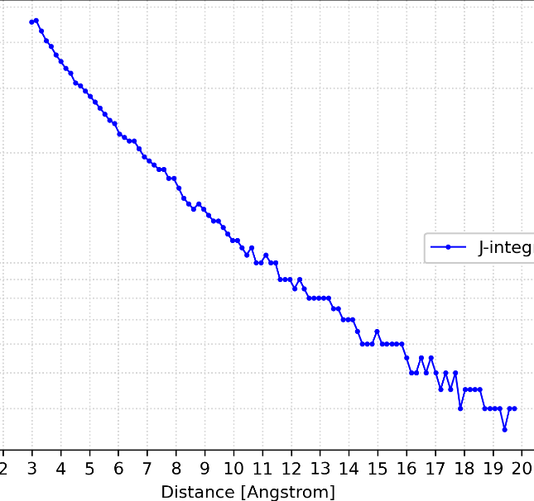
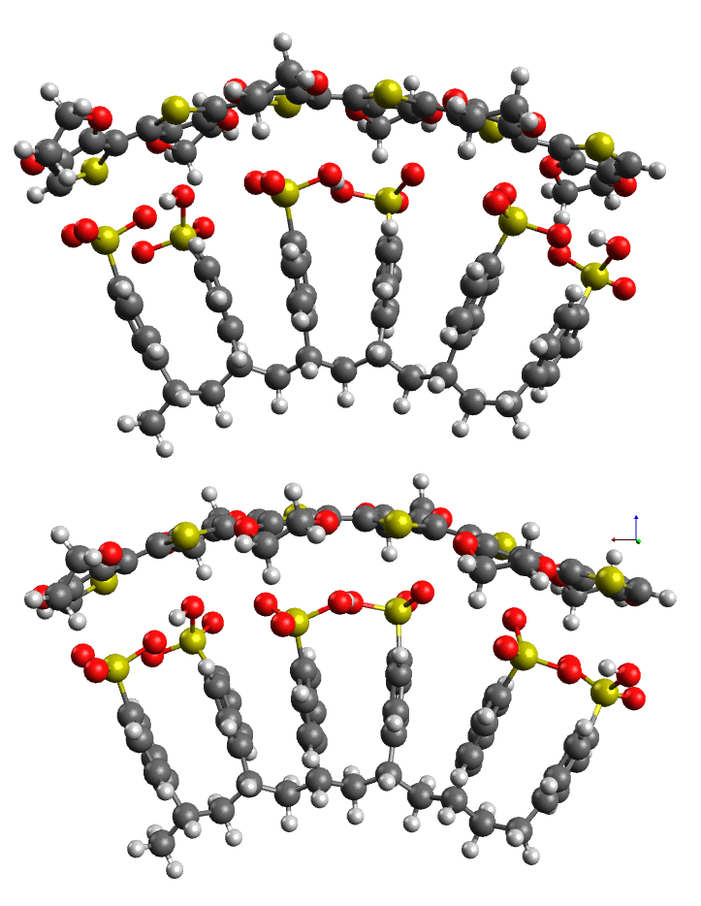
Multiscale Electronic-Mechanical Coupling
Force Field
$Elasticity$
Stress-Strain Relation
Mechanical Part
Starting Point
$$Reorganisation Energy$$
$$Resistor Network$$
Resistance
Transferintegral
Electro-Mechanical Coupling Relation
B
Electronic Part
A
Hopping Rate
$$Å$$
$$nm$$
$$μm$$
$$mm$$

Slide 5
Outlook
Goals in short term (Project of Leistungszentrum)
Presentation of the results at MSE (22. – 25. September)
Publication of results in journal
Goals in long term
Feasibility study for gas sensor: Simulation & Experiment (Bergoi, Shirong)
Possible Collaboration partner:
Group “coupled multi-field problems” of Prof. Dr.-Ing T. Wallmersperger
take the micro- & macroscale simulation part
Group “polymer physics” of Prof. Dr. J.-U. Sommer

Slide 6
PhD activities
Teaching assistant
WS 19/20 “Computer Simulation in der Werkstoffwissenschaft”
SS 20 “Nanostructured Materials”
WS 20/21 “Computer Simulation in der Werkstoffwissenschaft”
Chair internal tasks:
IT-infrastructure

Slide 7
Literature
[1] Fraunhofer IWS
[2] Takamatsu et al. ,2010: doi:10.1088/0960-1317/20/7/075017
[3] Grabowski et al., 2017: http://dx.doi.org/10.1016/j.commatsci.2017.04.019
[4] https://cdn.comsol.com/company/logo/comsol-logo-130x20.png
[5] https://www.dftbplus.org/fileadmin/_processed_/e/8/csm_DFTB-Plus-Icon_06_f_1200x1200_3b35d30574.png
[6] https://lammps.sandia.gov/movies/logo.gif
[7] https://upload.wikimedia.org/wikipedia/commons/thumb/0/0a/Python.svg/1200px-Python.svg.png

