Slide 1
1. TAC –Meeting
Steffen Kampmann
IfWW – TU Dresden
12.01.2020

Slide 2
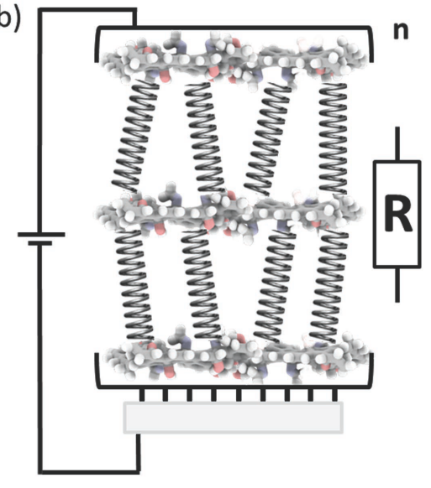
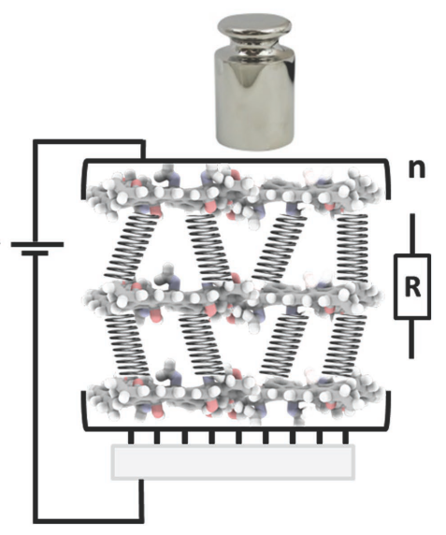
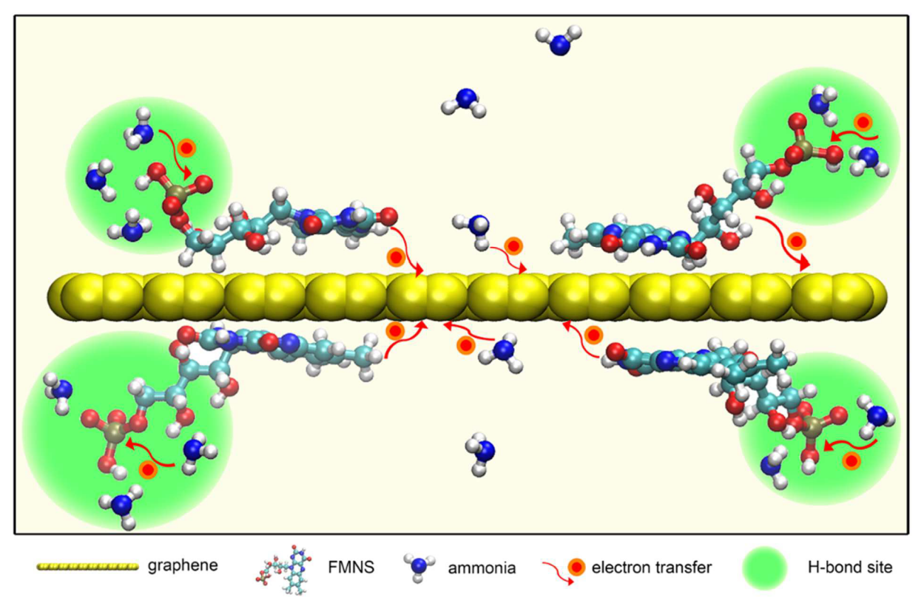
Motivation: Multiscale Simulation of Sensor Materials
Positive piezoresistive pressure sensor
Based on hybrid material (graphene + molecules)
Highly sensitive
Negative piezoresistive gauge sensor
Experimental group at IPF
Metal could be substituted by graphene
Gas sensor
Experimental group at our chair
[1]
e
e
metal layer
initial isolated layer (PDMS)
metal layer
$$ε$$
e
e
metal layer
Stretched PDMS-layer
metal layer
Based on [2]
[1] C.-H. Huang, S. Witomska, A. Aliprandi, M.-A. Stoeckel, M. Bonini, A. Ciesielski, P. Samori, Adv. Materials 2019
[2] S. Chae, I. Fotev, E. Bittrich, P. Uhlmann, M. Schuber, A. Pashkin, A. Fery, PREPRINT 2020
[3] S. Huang, L. A. Panes-Ruiz, A. Croy, M. Löffler, V. Khavrus, V. Bezugly, G. Cuniberti, Cabon 2020
[3]

Slide 3
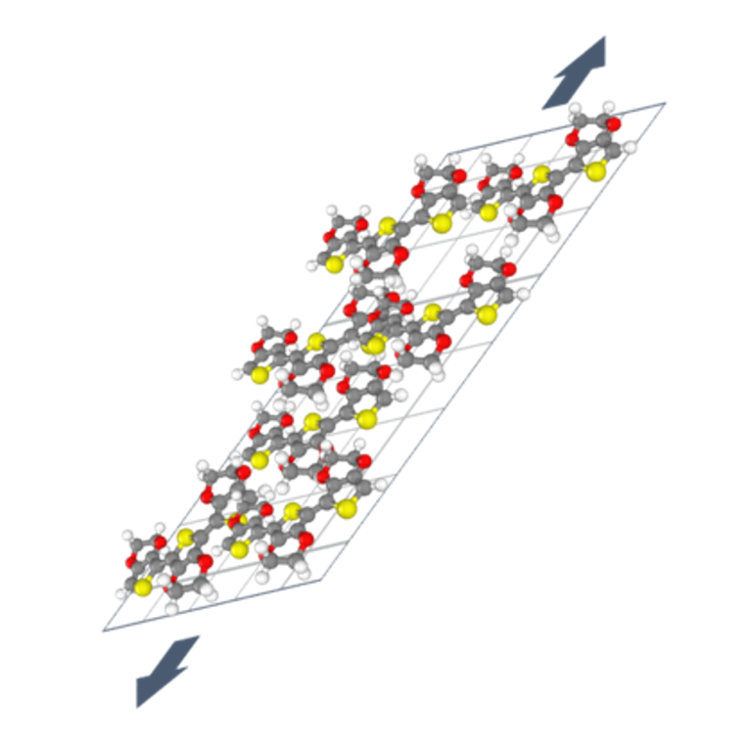
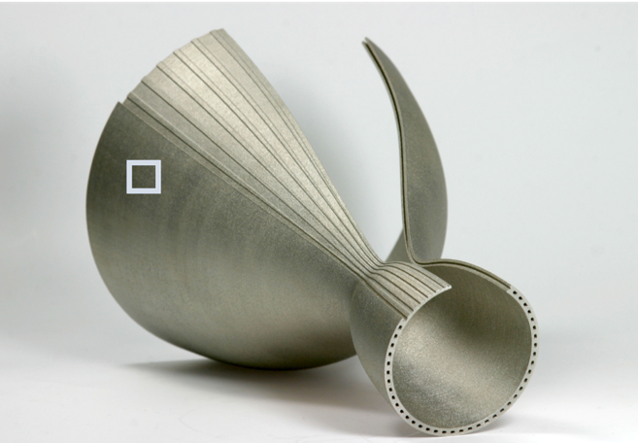
Project Goal in Leistungszentrum
Goal: In situ monitoring of the strain behaviour of additively manufactured components
Construction of multiscale simulation model for the description of the piezoresistive effect
[1]
Feasibility example for the dissertation
[1] Fraunhofer IWS

Slide 4
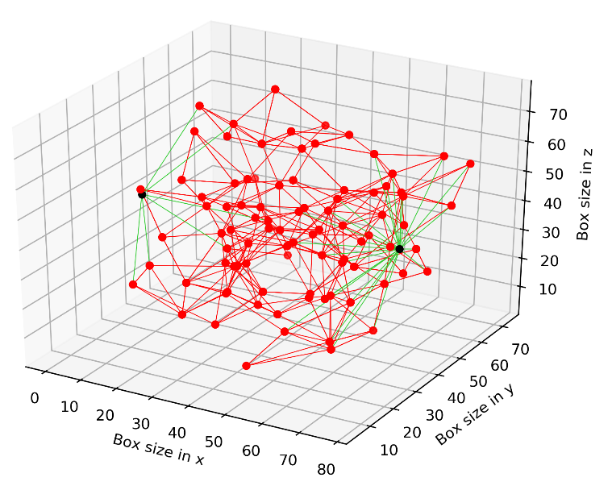
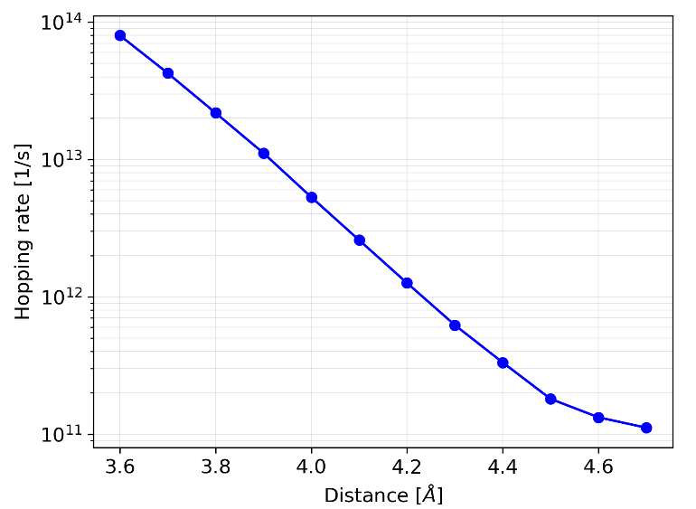
Improvements
$$ε$$
Elastic Network:
DFTB substitute MD method for elastic properties of RVE
MD method is not suitable for polymer type & amorphous structure
Electronic Network:
Improvement of calculation of hopping rate of dimer
$$ε$$
$$ε$$
U
$$d$$

Slide 5
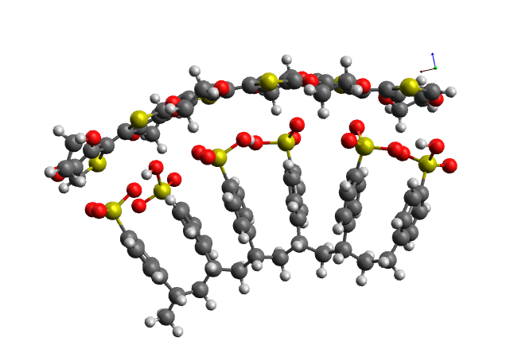
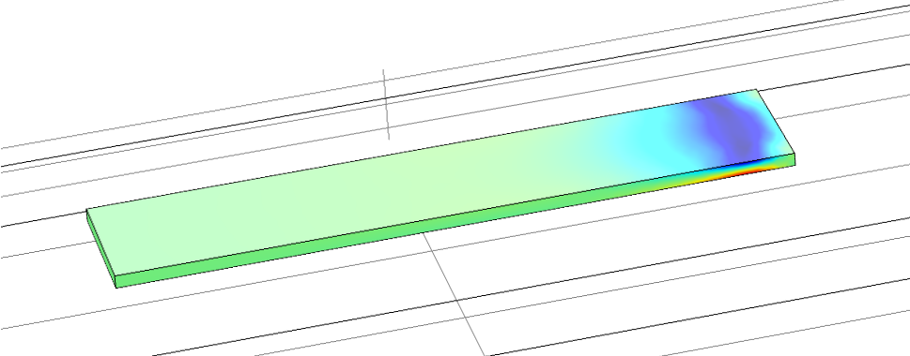
Multiscale Electronic-Mechanical Coupling
Force Field
Stress-Strain Relation
Mechanical Part
Starting Point
$$Reorganisation Energy$$
$$Resistor Network$$
Electro-Mechanical Coupling Relation
Electronic Part
Hopping Rate
$$Å$$
$$nm$$
$$μm$$
$$mm$$

Slide 6
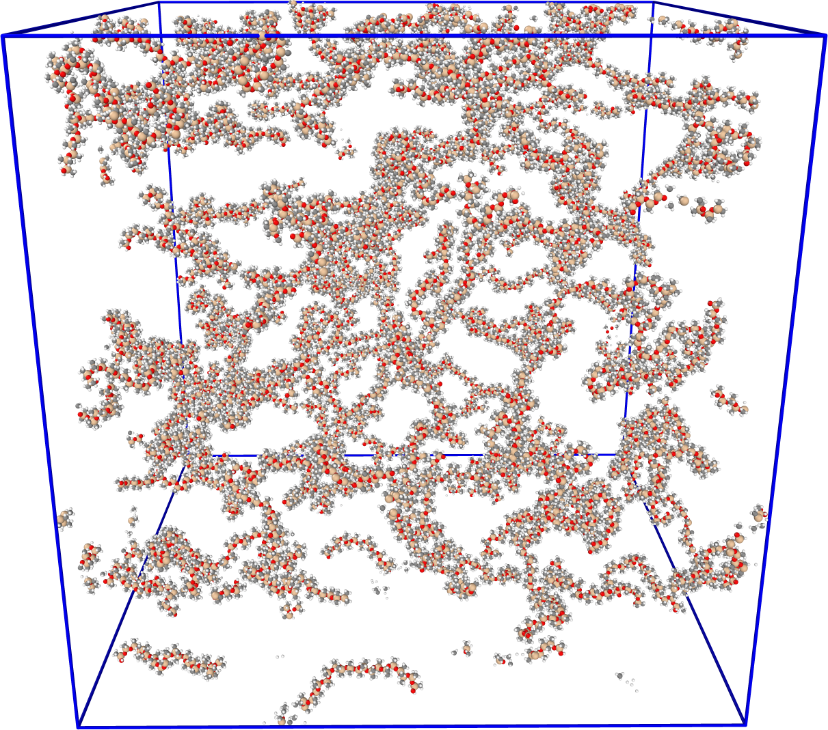
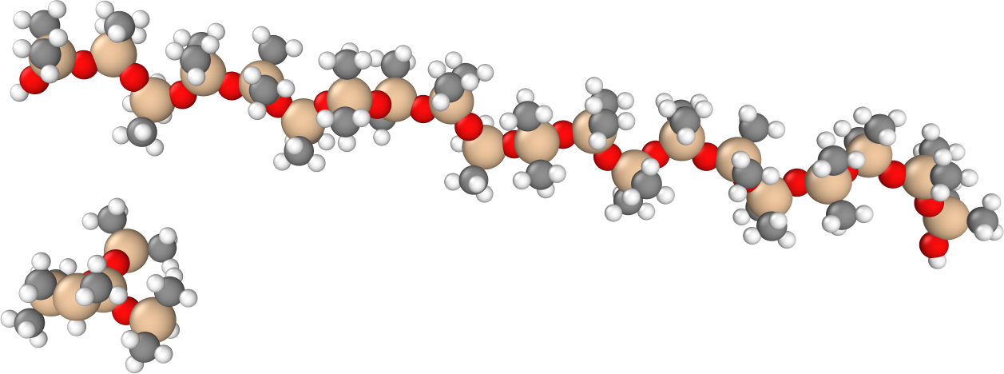
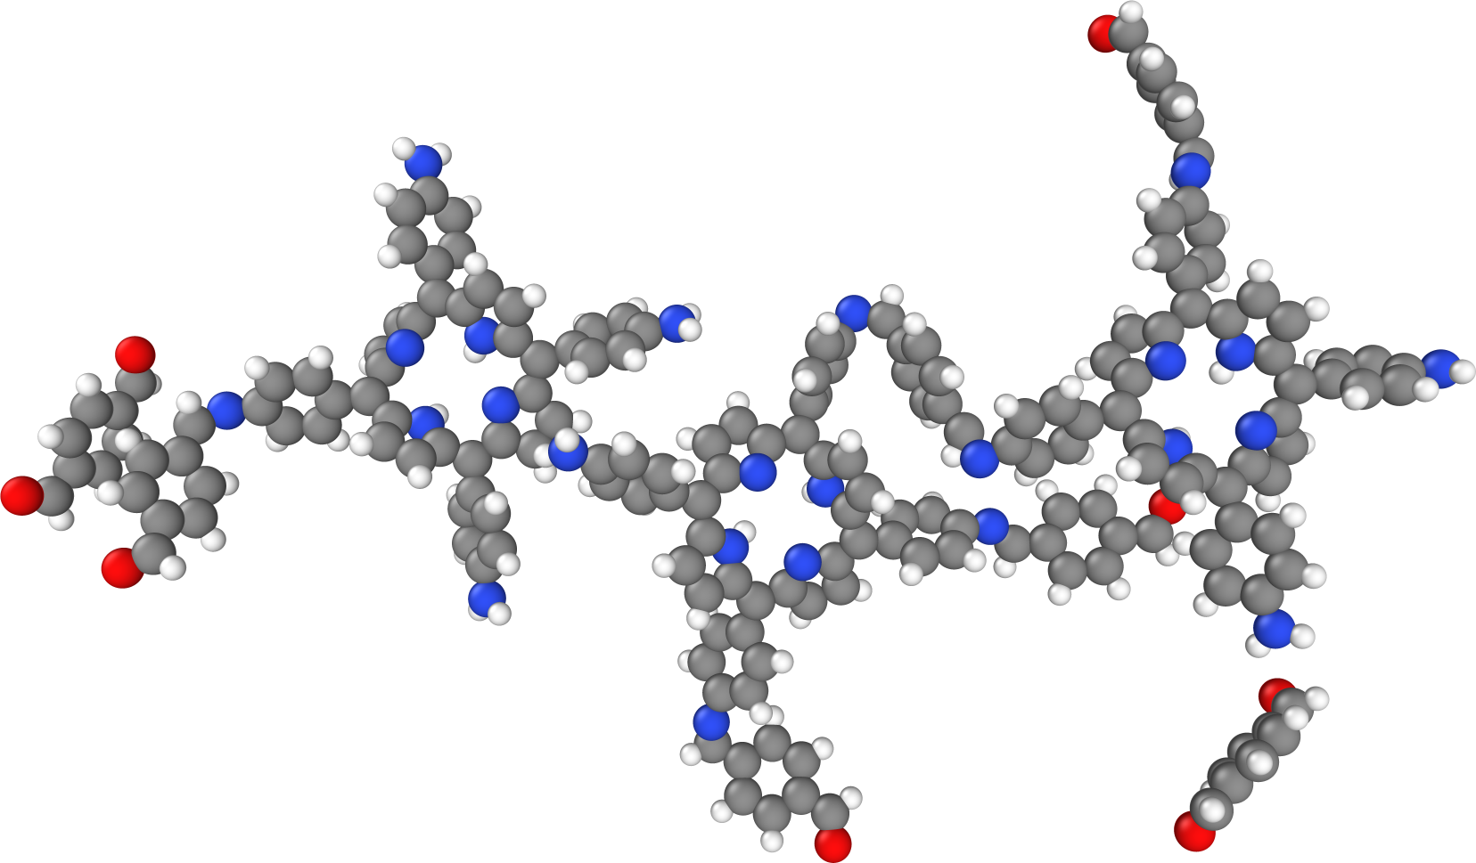
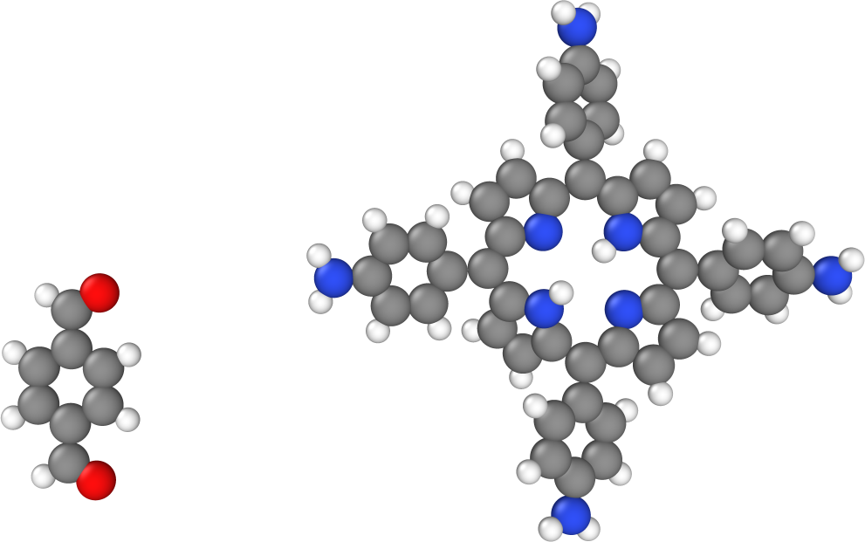
Distance-based crosslinking
Implementation for different molecules → Chains & Linker
i.e.: PDMS
PDMS Chain
Linker
i.e.: COF
Linker
Core

Slide 7
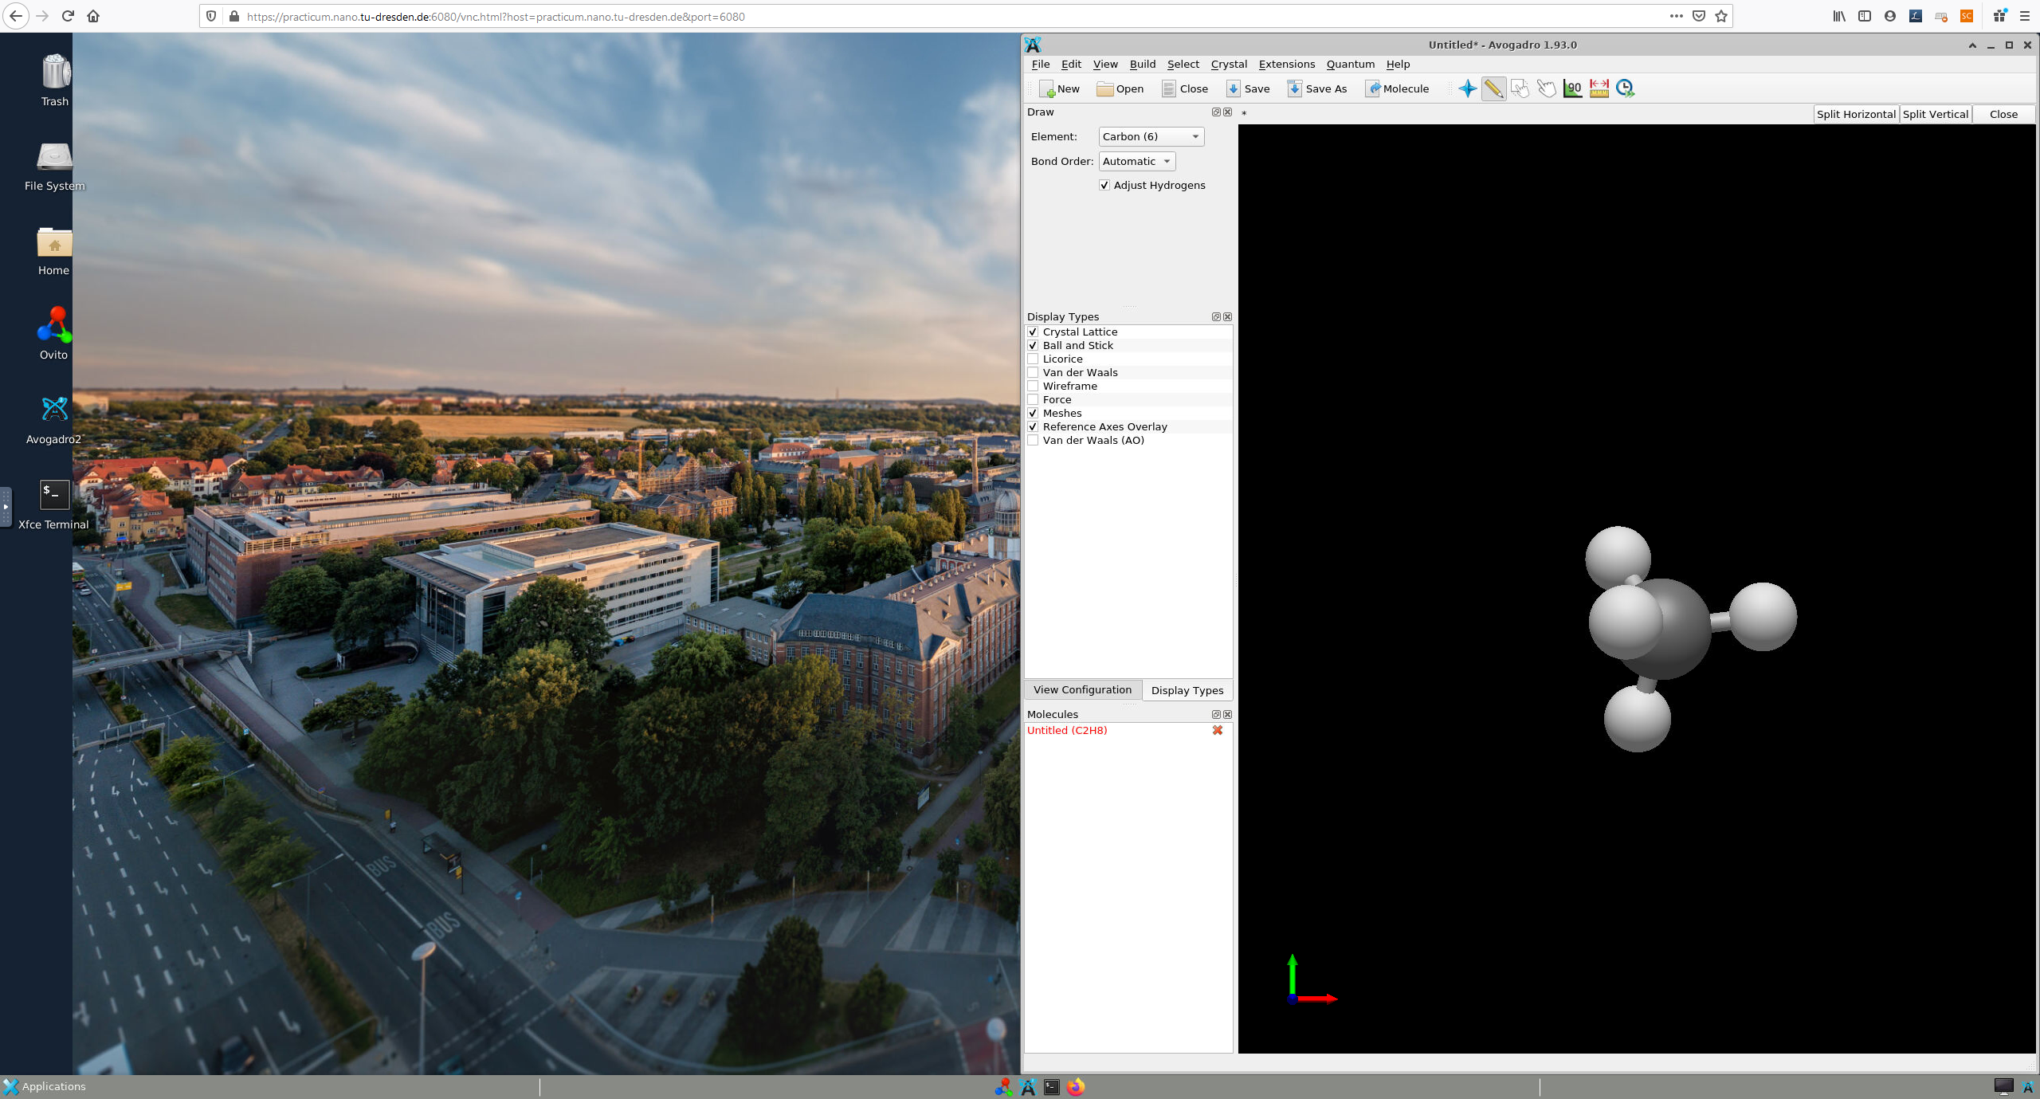
PhD activities
Digital Teaching:
Installations of Virtual Machines in corporation with ZIH
80 Virtual Machines for 3 courses: “Computational Material Science: Molekulardynamik”, “Computational Methods 2”, “Computersimulation in der Materialwissenschaft”
Web-based access
Permanently accessible
Students can work at any time
Course assistant
WS 20/21 “Computer Simulation in der Materialwissenschaft”
LAMMPS-Practicum
Python-Tutorial

Slide 8
Outlook
Goals in short term (Project of Leistungszentrum)
Completion of the project until march
Publication of results in journal
Goals 2021:
Bilayer strain sensor
Possible collaboration partner: Group of Fery (IPF)
Start of feasibility study for gas sensor: Simulation & Experiment (Bergoi, Shirong)

