Slide 1
PhD phase → present & future
Chair of Material Science and Nanotechnology
TU Dresden - IfWW
Dipl.-Ing. Steffen Kampmann
02.02.2022 - Zoom

Slide 2
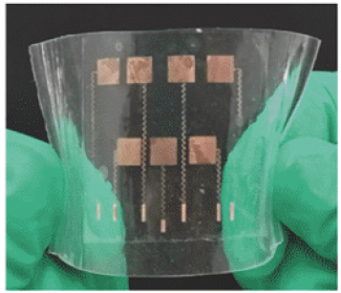
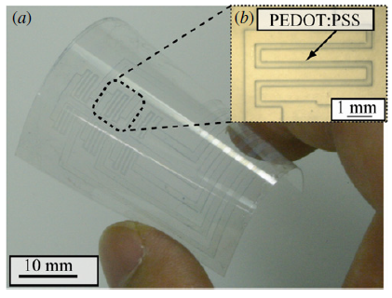
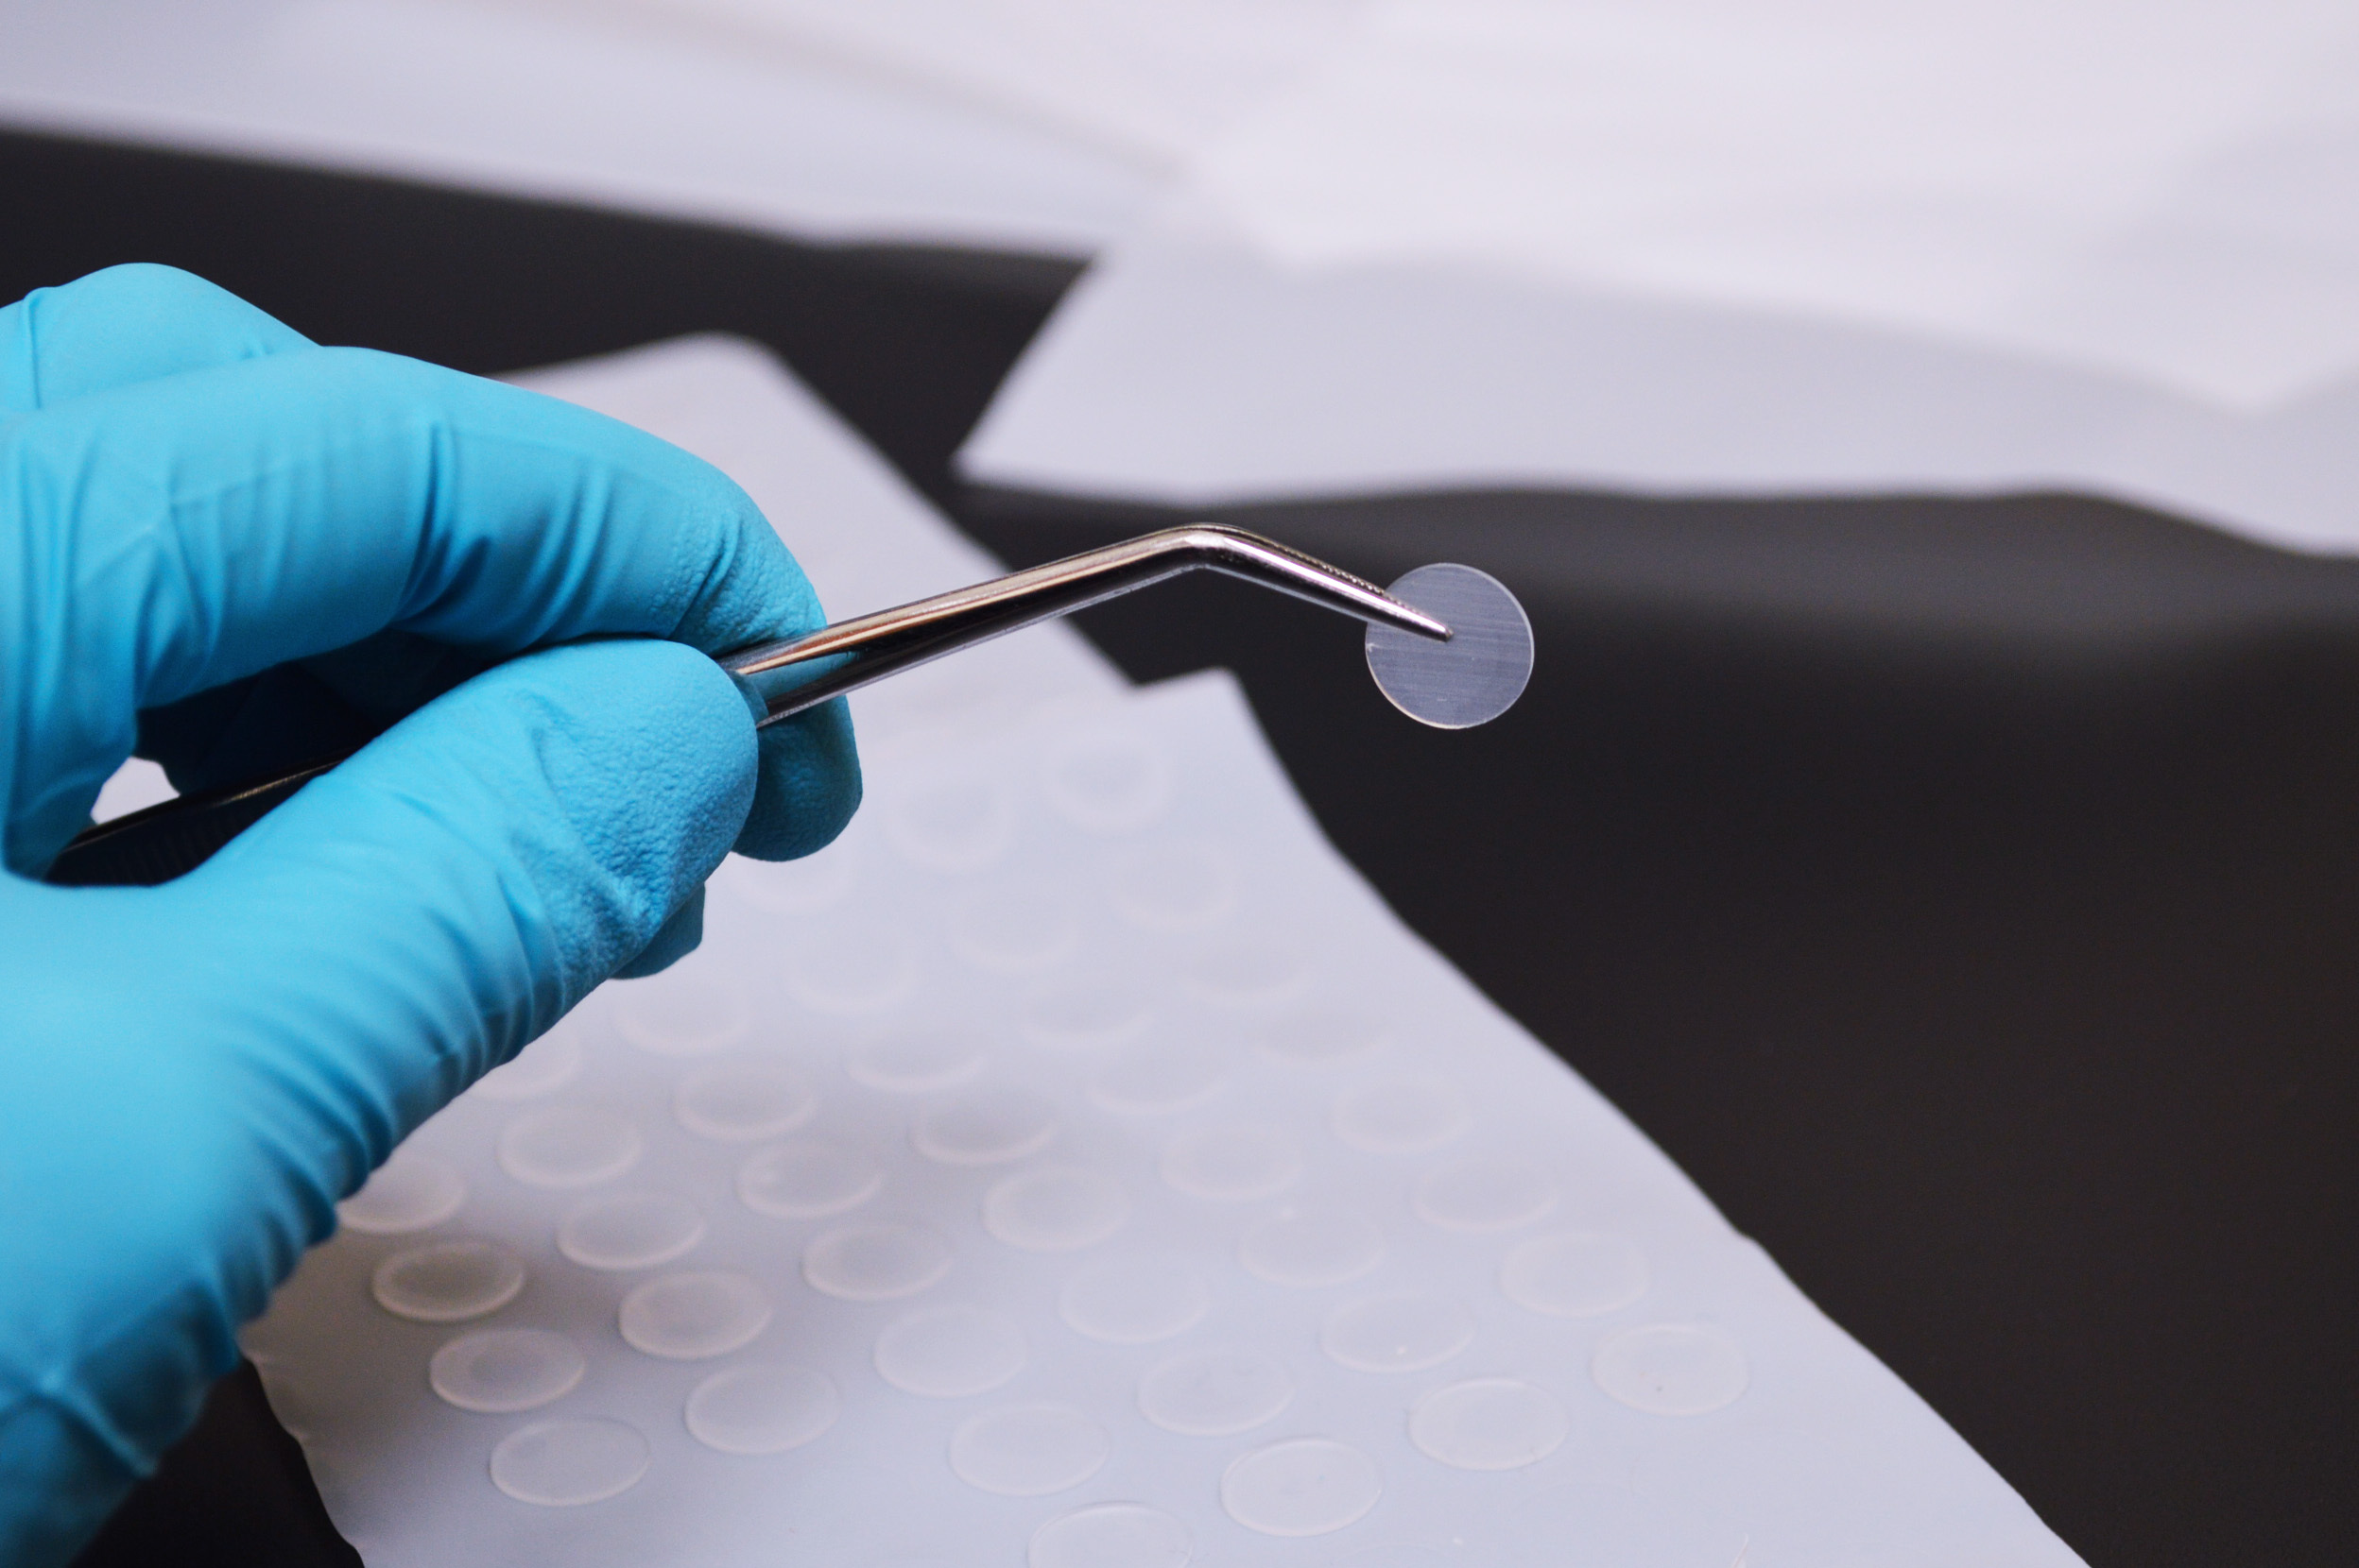
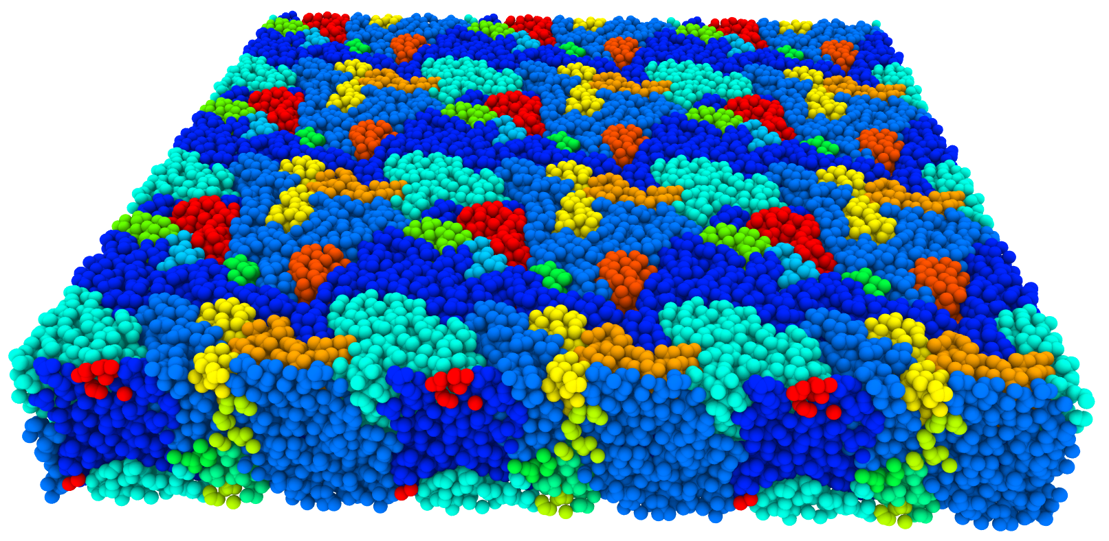
Multi-scale simulation of functional polymer materials
Functional polymers are used for different kinds of sensors
→ e.g. gas sensor, strain sensor
Thin-Films applications
Strain sensors
Mechanical stability and reliability play a keyrole for many sensing applications
Gas separation membranes
E.g. Polydimethylsiloxane membranes
[1]
PDMS
[2]
[3]
Multi-scale property description of functional polymers

Slide 3
End-Crosslinked Polymer Structures
Description:
Generation of end-crosslinked amorphous polymer structures
Different conversion degrees
Example material
PDMS (Polydimethylsiloxane) → 2 Units (Chain + Linker)
Deformation & Relaxation of polymer structures
Strain controlled deformation
Fitting of common material models (Ogden, Neo-Hook…)
Determination of mechanical properties
Next step:
Completion and submission of paper

Slide 4
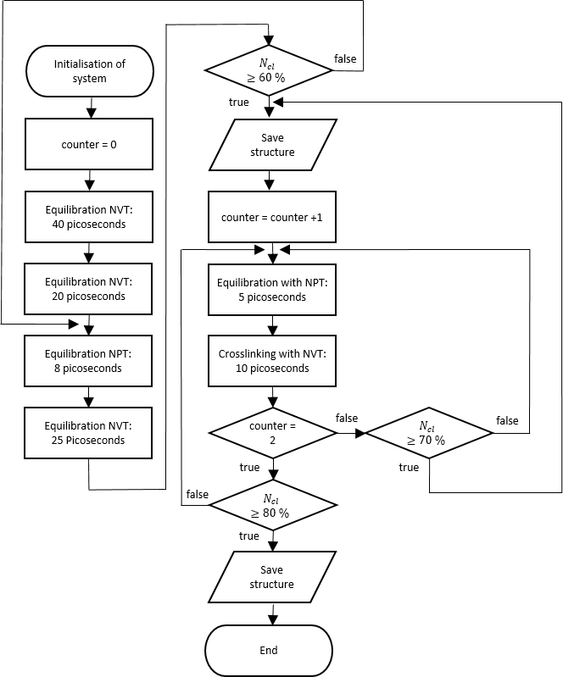
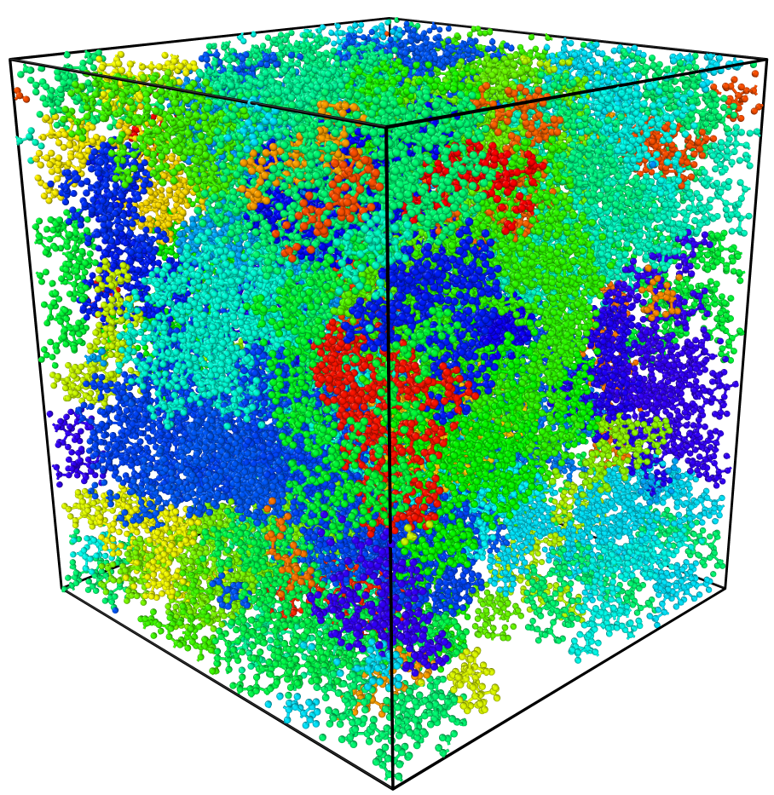
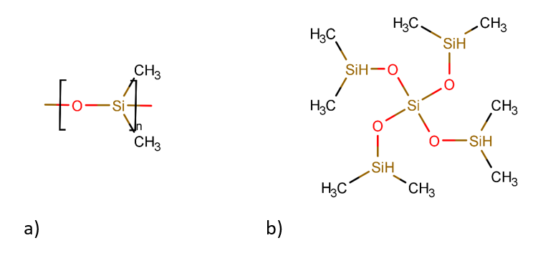
End-Crosslinked Polymer Structures
Generating structures
Ca. 40,000 Atoms pro system
Simulation time: Up to 5 Nanoseconds
→ 10⁶ timesteps → 50 CPU h
It must be ensured that there are enough degrees of freedom for crosslinking
Three different conversion degrees of crosslinking
After crosslinking:
36 different configurations
Chain
Chain
Linker

Slide 5
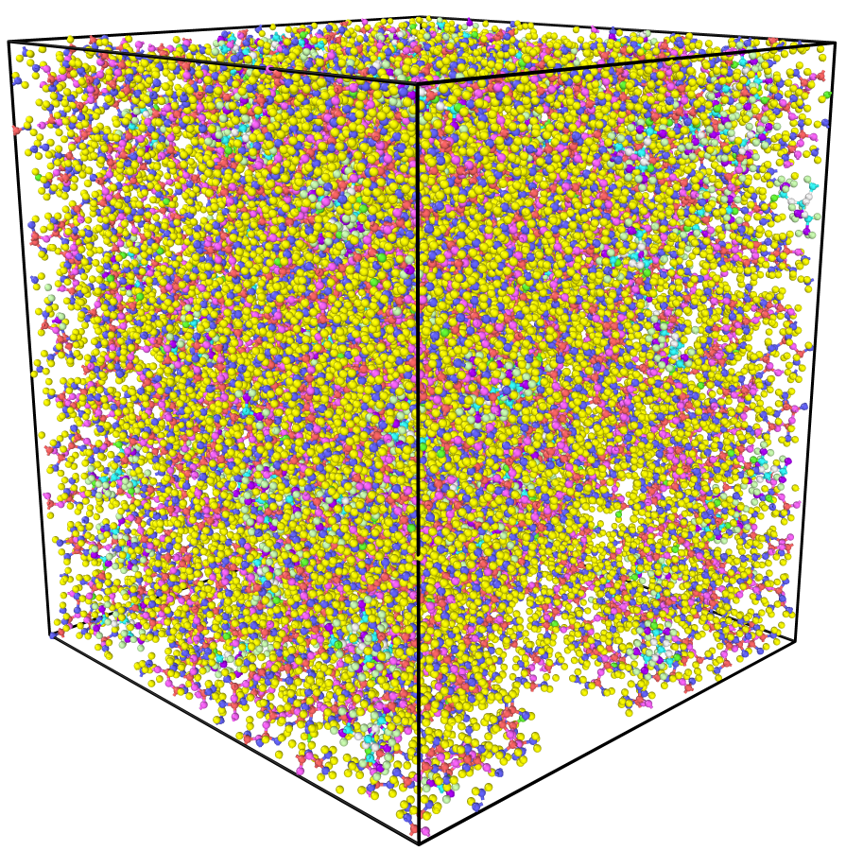
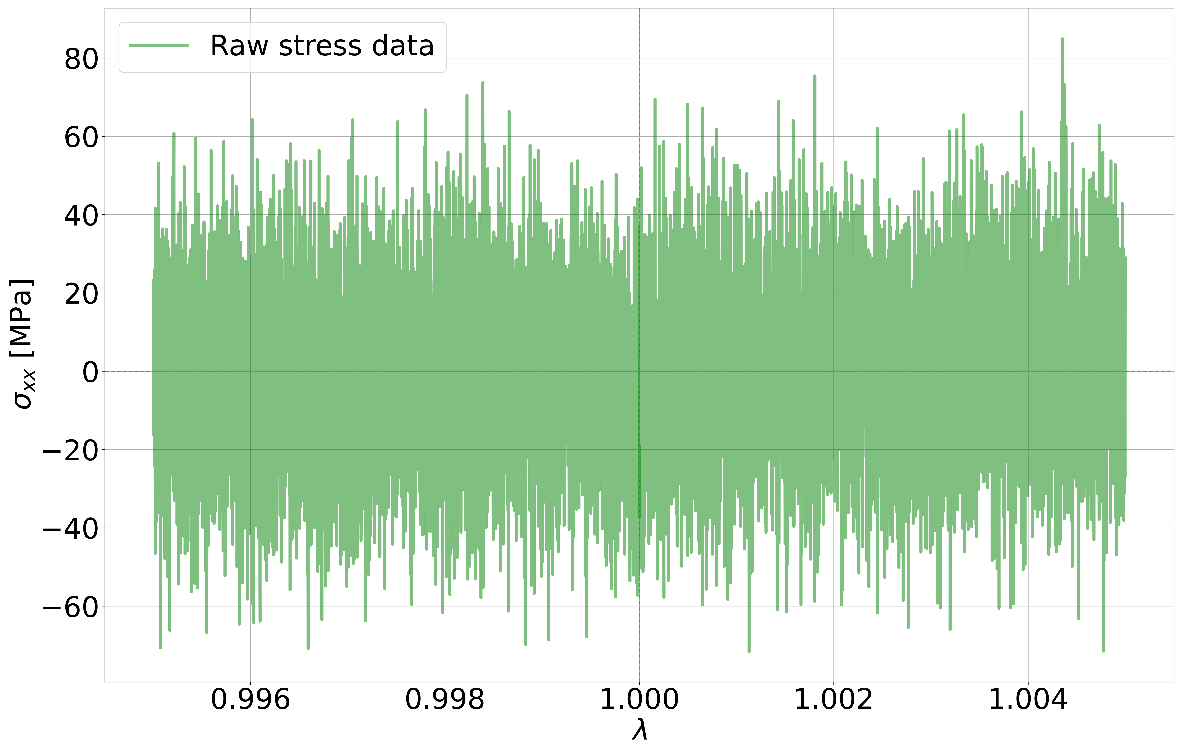
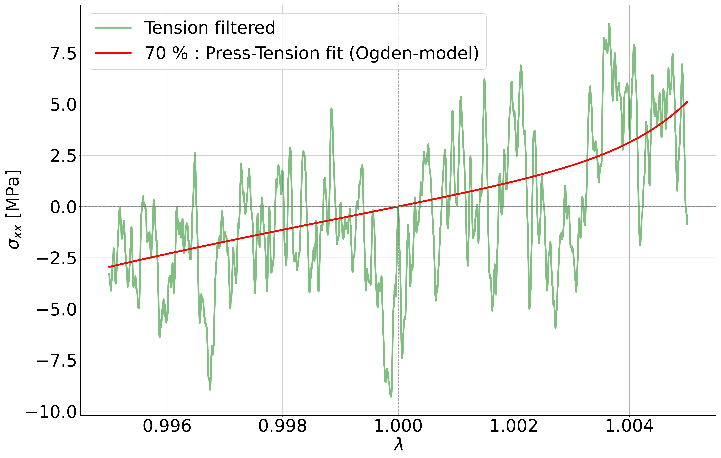
End-Crosslinked Polymer Structures
Strain controlled deformation
Variation of the strain rate, simulation time → Different final strains
$$\frac{ε}{2}$$
$$\frac{ε}{2}$$
Problem:
Raw stress data contents strong fluctuations
Solution:
Matching with different smoothing and filtering methods
$$λ −\text{stretch} \text{factor}$$
$$λ=1+ε$$
Noise reduction is essential for machine learning methods

Slide 6
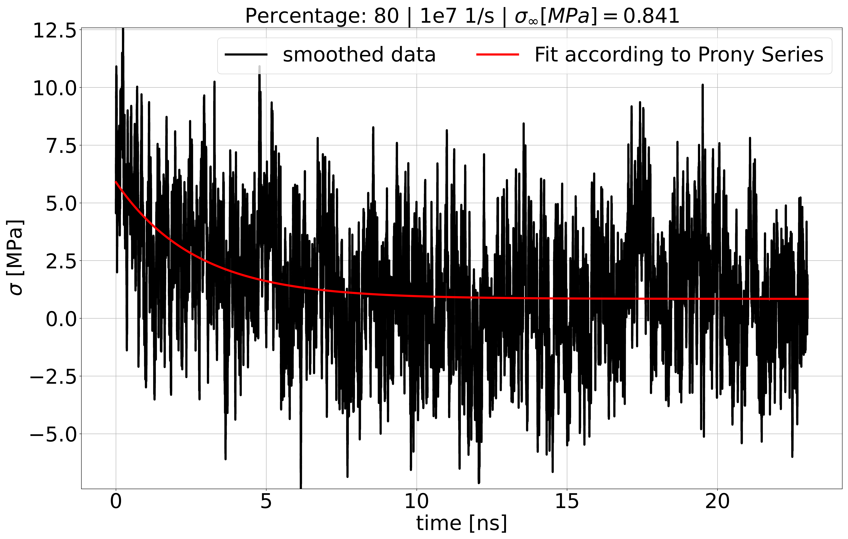
End-Crosslinked Polymer Structures
Relaxation at defined strain states of RVE
Use Prony Series to get final value for $t→∞$
Determination of relaxation modulus
Start of relaxation

Slide 7
Modeling of hyperelasticity based on artificial neural networks
Data mining
Data processing
Training process
Collaboration with group of Prof. Kästner
[4]
Based on the Ogden material model
Prof. Markus Kästner
Dr. Karl Kalina
We want to substitute the material model based simulation with Molecular Dynamics Simulations
Goal: Prediction of stress-strain-relation
Dr. Jörg Brummund
Dipl.-Ing. Lennart Linden

Slide 8
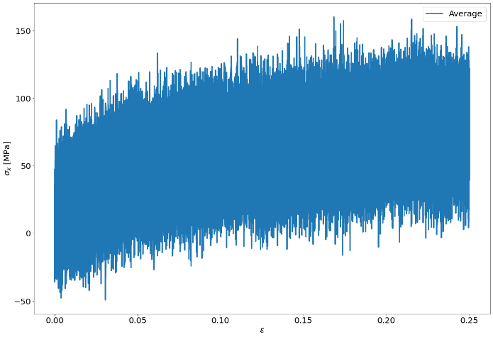
Modeling of hyperelasticity based on artificial neural networks
Input for the artificial neural network
Fluctuations of strain is negligible
Fluctuations of stress are high
Requirement: MD data must be noise-free
→ Important to verify different filter and smoothing methods for tensor components
Current step: Waiting for results of artificial neuronal network

Slide 9
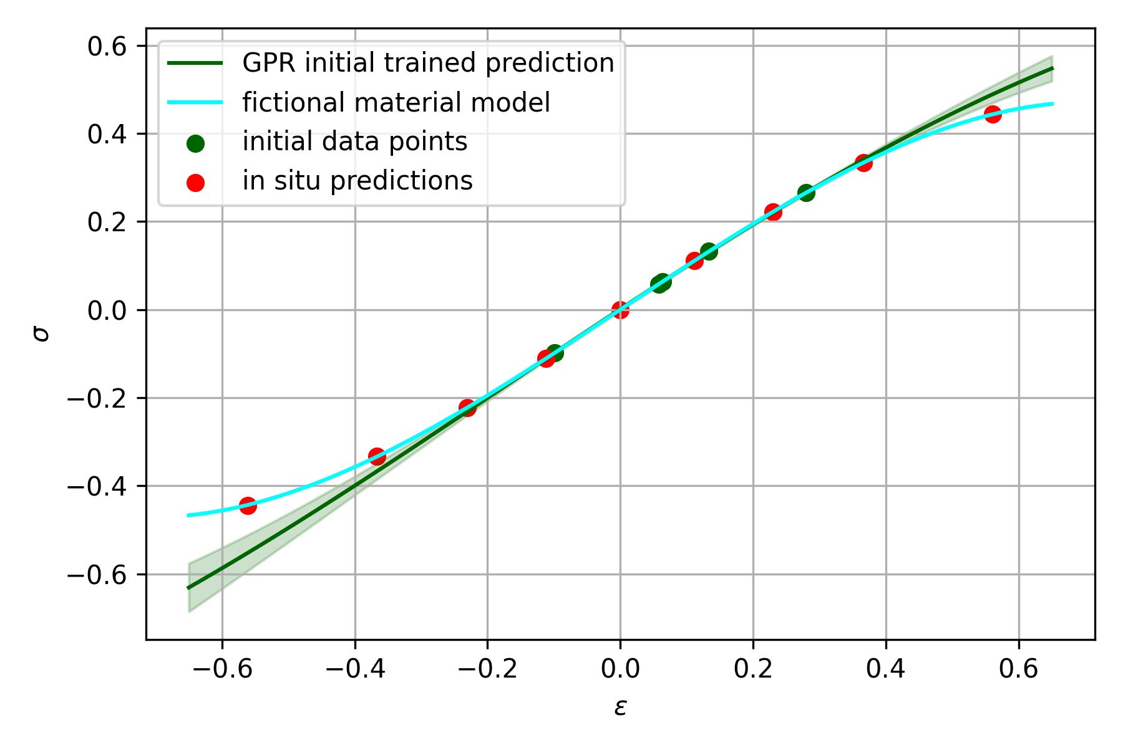
In situ MD-FEM coupling based on Gaussian Process Regression (GPR)
Based on same idea like ANN
Learning of $σ_{ij}\left(ε_{ij}\right)$ relation
Full symmetric tensor description of stress and strain states
Use GPR for in-situ training of stress-strain relation
Prediction of stress states
Inclusion of molecular dynamics simulations for fitting stress-strain prediction
Current step: Integration of MD-Simulation in 2D

Slide 10
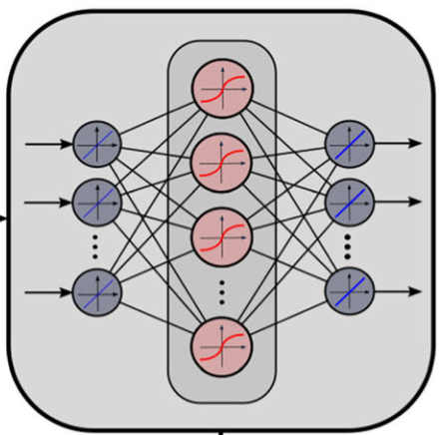
Conclusion & Overview
tensile and compression tests as data basis to verify structural models
$$\frac{ε}{2}$$
$$\frac{ε}{2}$$
Post-processing of stress data from molecular dynamics simulations
Use of different machine learning methods (ANN, GPR) to describe stress states
$$\overset{̿}{σ}$$
[4]

Slide 11
Literature
[1] https://link.springer.com/article/10.1007/s40843-019-9445-9
[2] Takamatsu et al. ,2010: doi:10.1088/0960-1317/20/7/075017
[3] https://www.businesswire.com/news/home/20150203005027/en/Interstate-Specialty-Products-Supplies-PDMS-Sheets-and-Membranes
[4] Kalina et al., Automated constitutive modeling of isotropic hyperelasticity based on artificial neural networks; Computational Mechanics, 69, pages 213–232 (2022)

Slide 12
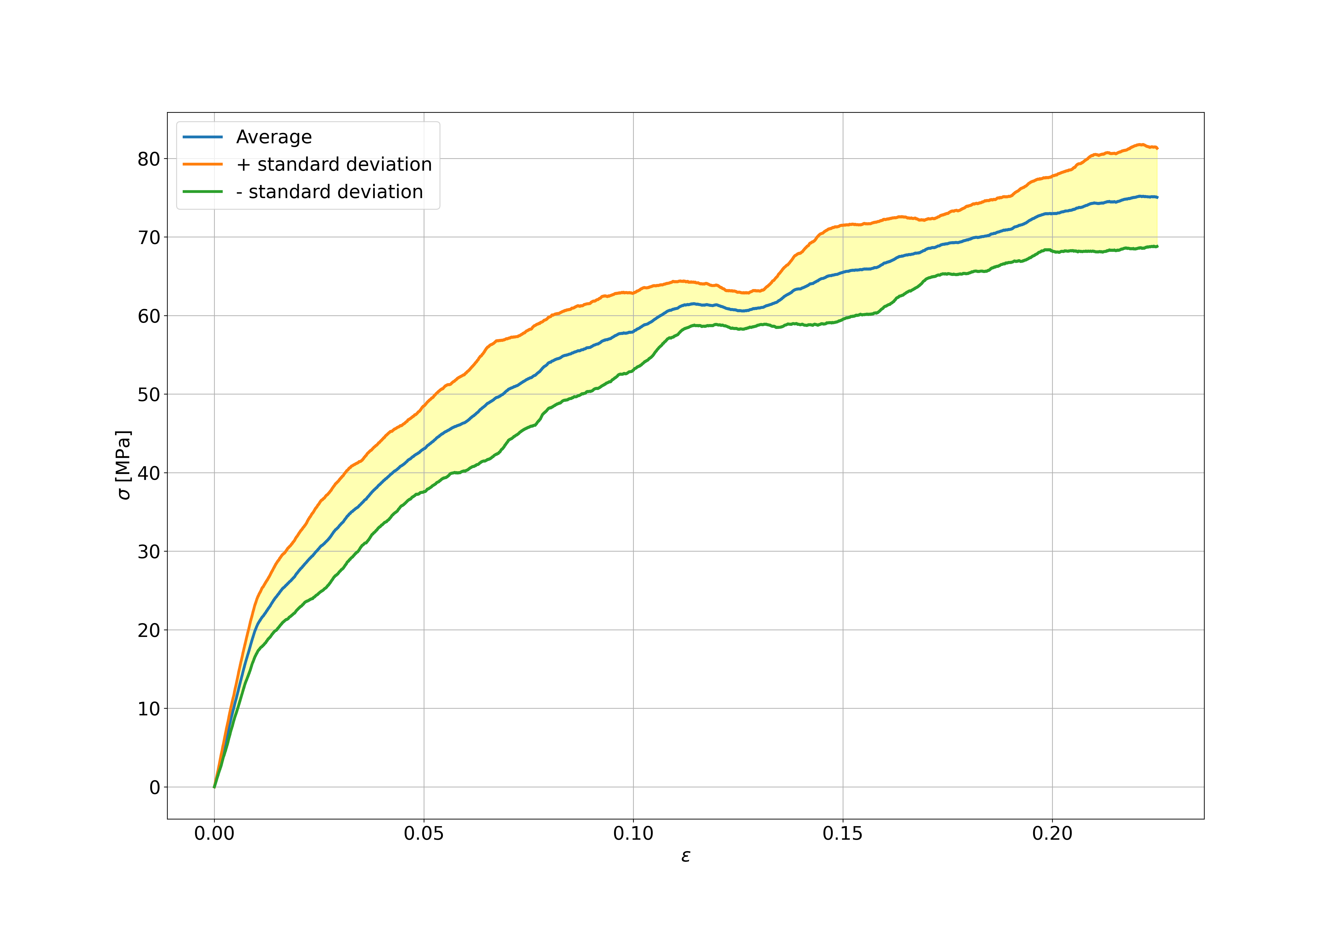
End-Crosslinked Polymer Structures

