Slide 1
Defense diploma thesis
Chair of Materials Science and Nanotechnology
Timo Land
An automated data analysis process
for a new e-nose sensor
1. Examiner: Prof. Cuniberti
2. Examiner: Prof. Aßmann
Supervisor: Dr. Biele
5.5.2022

Slide 2
Outline
Introduction
Measurement Setup
Feature Extraction
Data Quality
Conclusion

Slide 3
1. Introduction: Electronic noses
Loosely based on human olfaction
Combine
array of electric chemical sensor with partial specificity
pattern-recognition system
to detect simple and complex odors
!
J. W. Gardner and P. N. Bartlett, “A brief history of electronic noses”, Sensors and Actuators B: Chemical 18 210, 1994

Slide 4
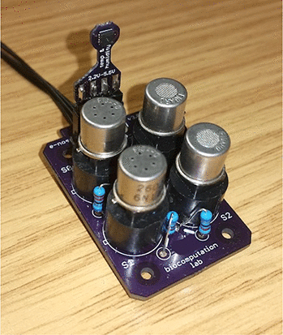
Electronic noses
Various suppliers of e-nose systems on the market
Mostly based on Metal-oxide (MOX) sensors
Specifically tailored for specific use cases
Problems: energy consumption, sensitivity, selectivity, ...
Sensor array of 4 MOX sensors
M. Schmuker et al., “Exploiting plume structure to decode gas source distance using metal-oxide gas sensors” ,Sensors and Actuators B: Chemical, 235 636, 2016
D. Karakaya et al., “Electronic Nose and Its Applications: A Survey,” International Journal of Automation and Computing, 17 179, 2020
J. A. Covington, S. Marco, K. C. Persaud, S. S. Schiffman, and H. T. Nagle, “Artificial Olfaction in the 21st Century” IEEE Sensors Journal, 21 969, 2021

Slide 5
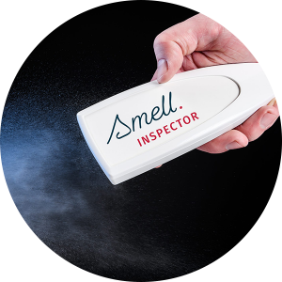
The Smell Inspector
new e-nose sensor based on carbon nanotubes (CNTs) by SmartNanotubes Technologies GmBH
originally developed at the Chair of Materials Science and Nanotechnology (TUD)

Slide 6
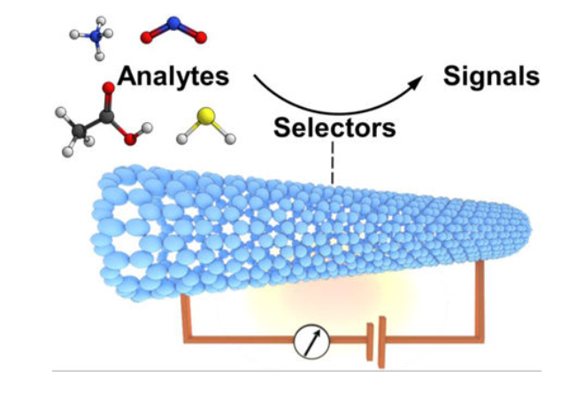
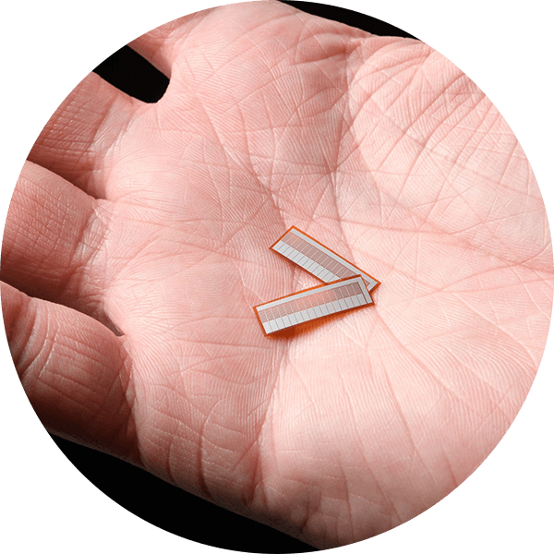
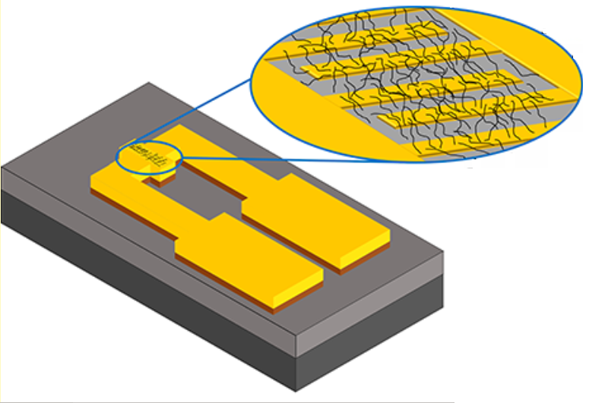
The Smell Inspector
One foil contains multiple channels
A channel consists of an electrode pair connected by a carbon nanotube network
Each channel is “functionalized” (chemically modified) in order to achieve partial odor specificity
L. A. Panes-Ruiz et al., “Toward Highly Sensitive and Energy Efficient Ammonia Gas Detection with Modified Single-Walled Carbon Nanotubes at Room Temperature”, ACS Sensors, 3 79, 2018
V. Schroeder, S. Savagatrup, M. He, S. Lin, and T. M. Swager, “Carbon Nanotube Chemical, Sensors” Chemical reviews, 119 599, 2019

Slide 7
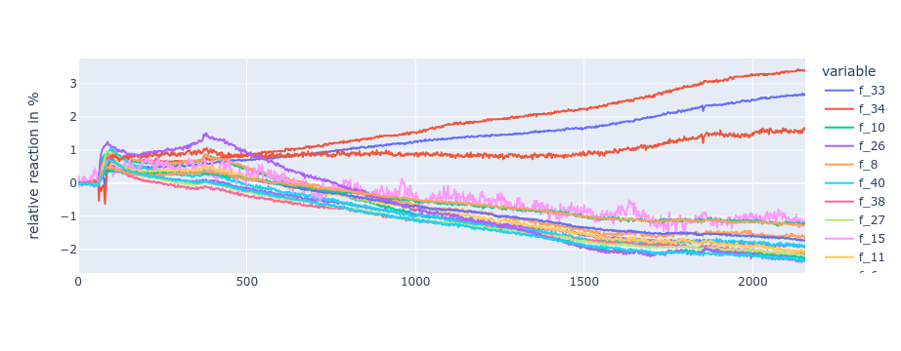
Real-world applications
Different organizations with specific applications
Measurements are taken by multiple sources:
in different environments
of different odors
with different goals
→ Automated process for analysis of data quality necessary

Slide 8
Thesis goals
Implement an automated process for feature extraction and data analysis
Find analysis methods for examination of the quality of the measurement data

Slide 9
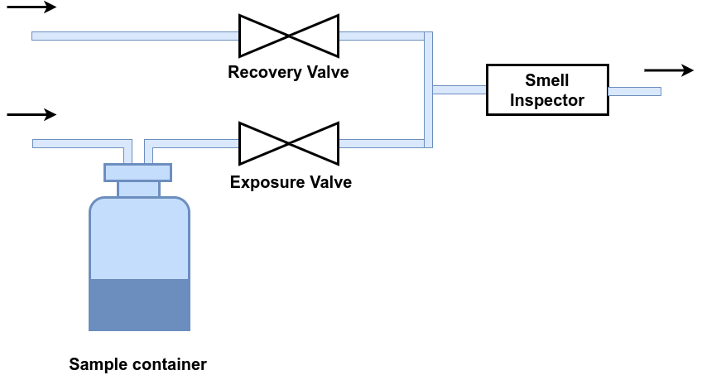
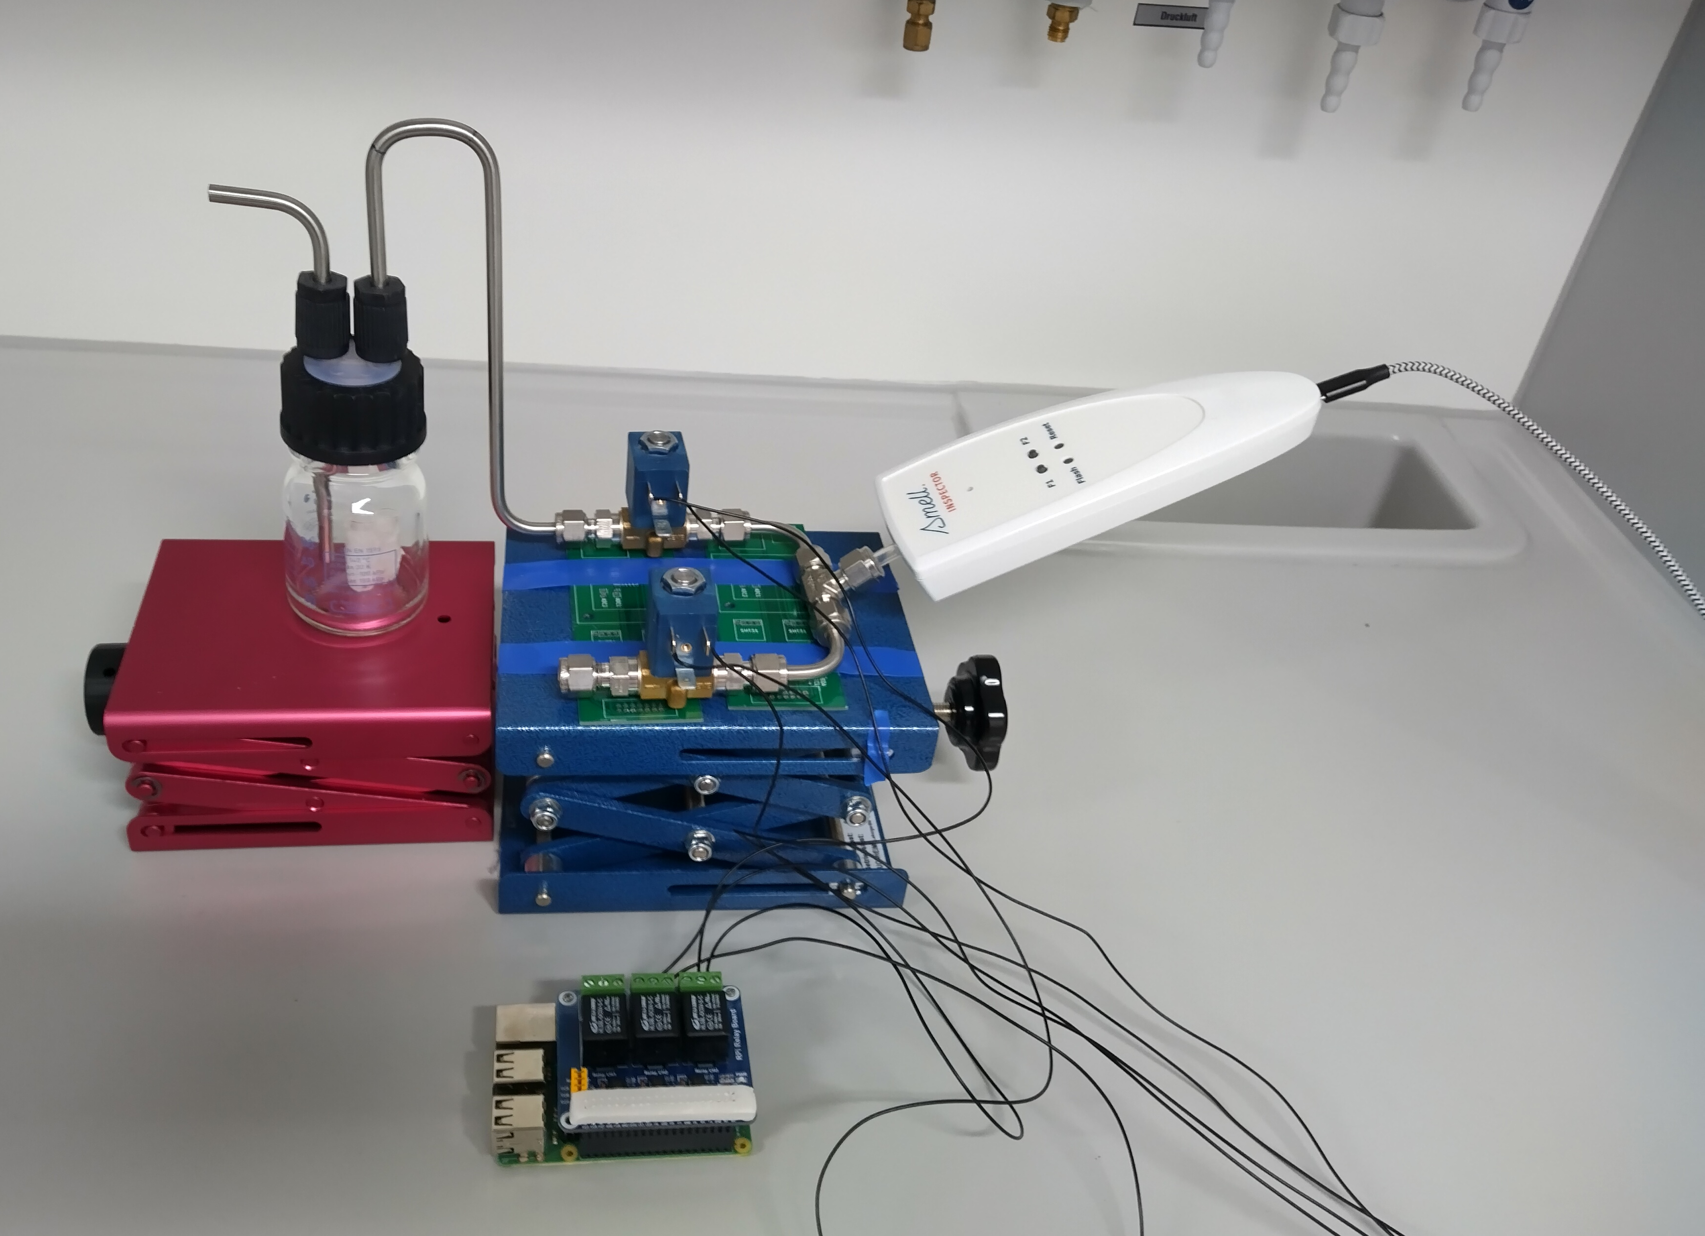
Measurements controlled by Raspberry Pi
Automatic continuous measurement cycle
Dynamic headspace sampling
2. Measurement Setup
J. Burlachenko, et al, TrAC Trends in Analytical Chemistry 82 222, 2016

Slide 10
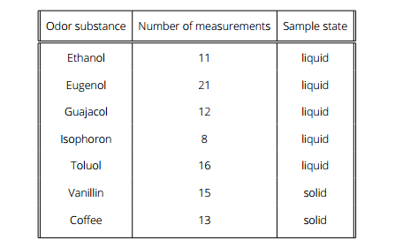
Measurements conducted in 3 phases: Stabilization, Exposure and
Recovery
Conducted with two detector sets at the same time
Each detector set has the same 8 functionalizations
Overall 96 measurements of 7 odor substances
2. Measurement setup

Slide 11
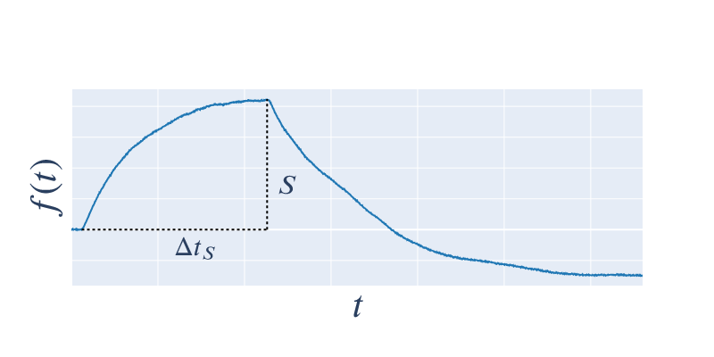
Most commonly used feature in e-Nose systems
High discrimination information
Long measurements
3. Feature Extraction: Static Feature S
M. Pardo and G. Sberveglieri, “Comparing the performance of different features in sensor arrays,” 123 437, 2007

Slide 12
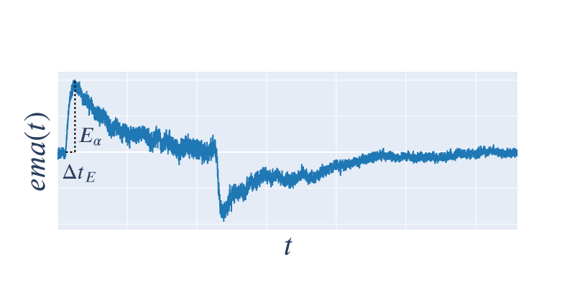
Transient Feature E_{α}
Maximum of first derivative filtered by an exponential moving average:
to speed up feature availability (faster measurements)
to combine with steady-state feature (improve classification accuracy)

Slide 13
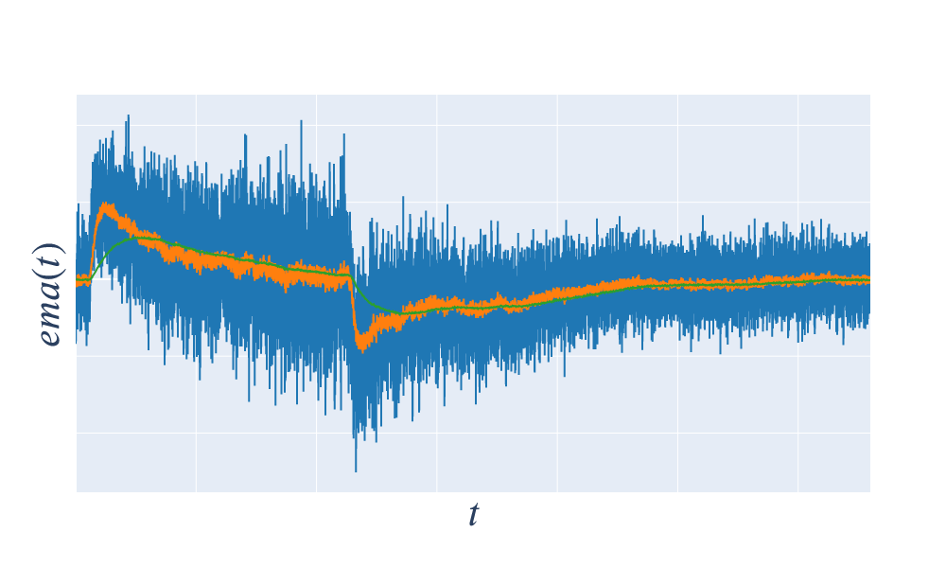
Transient feature E_{α}

Slide 14
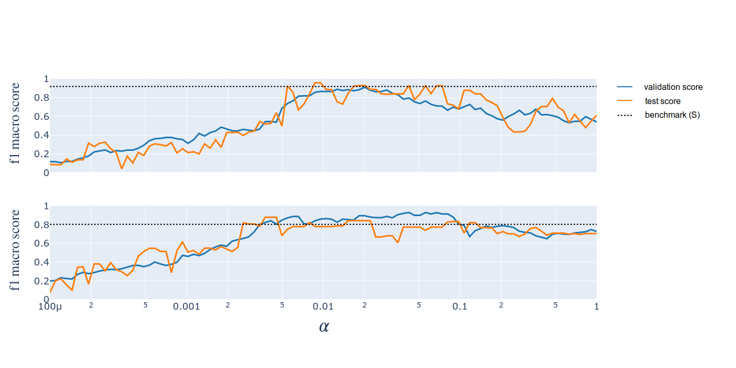
Feature Comparison
Detector set A
Detector set B
α₀ = 0.005 and α₁ = 0.02 were picked for further investigation

Slide 15
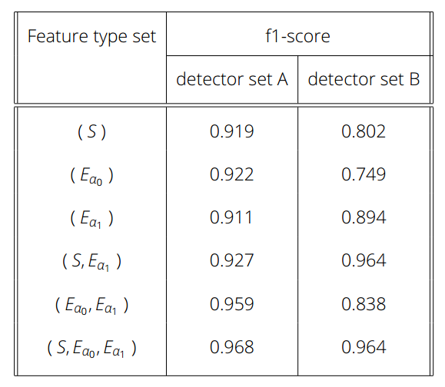
Feature Comparison
can be used to substitute
Combination of multiple and improve
classification results
Feature availability time of and
is on average ~20% of Δt_{S}

Slide 16
4. Data Quality
Typically defined in dimensions
Each dimensions can be described by a set of metrics and categories
Highly dependent on the context of the data
→ Defined 4 dimensions relevant for the Smell Inspector
C. Batini et al. “Methodologies for data quality assessment and improvement” ACM Computing Surveys, 41 16, 2009
M. Scannapieco and T. Catarci, “Data quality under a computer science perspective”, Journal of The ACM - JACM, 2, 2002

Slide 17
Inner/ Outer Consistency
Repeatability of measurements
Distinguish-ability of different odors
Availability of sufficient data
→ Given measurement data from one source
→ Given measurement data from multiple sources

Slide 18
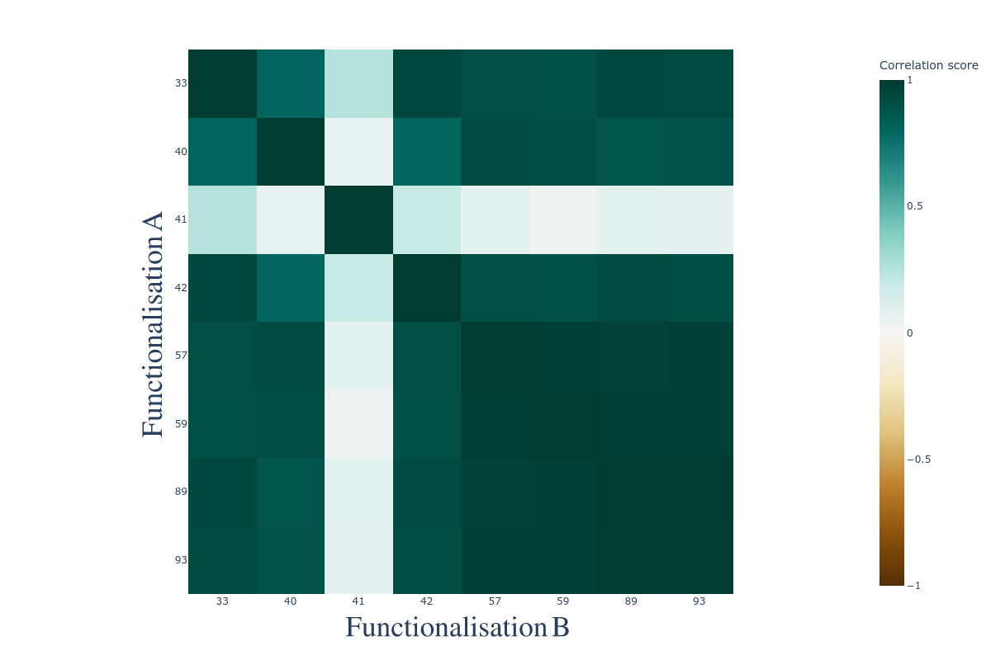
High correlation between functionalisation pairs for measurements of the same odor
Can be used to determine inner consistency of measurements of one odor
Inner Consistency: Correlation

Slide 19
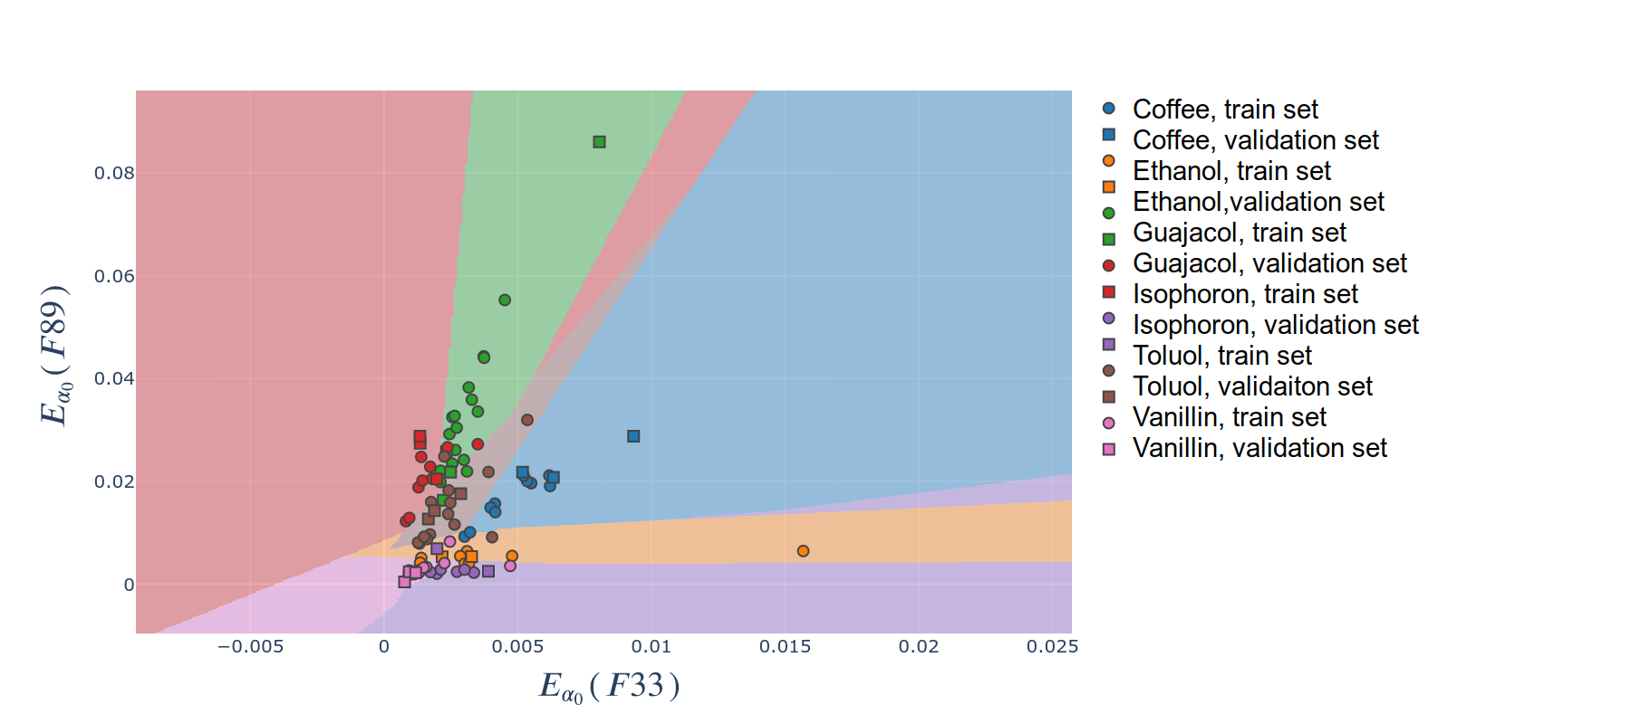
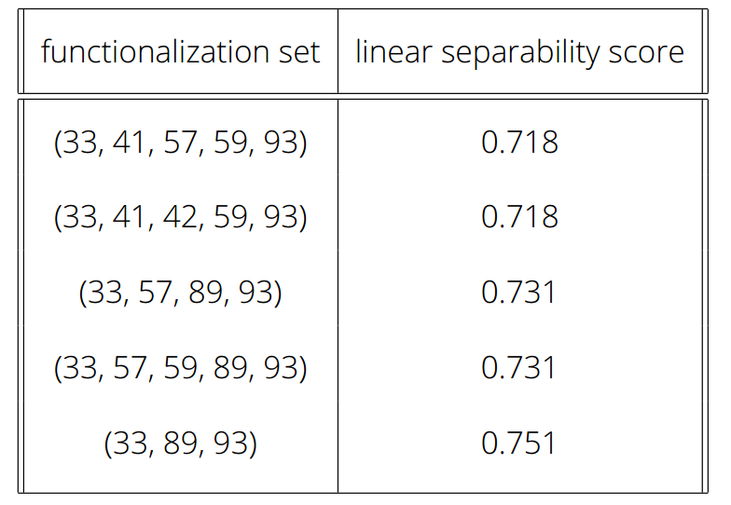
Metric for linear separability of a set of classes based on a set of features
Was used to determine optimal subset of three functionalizations
Performance of ML pipeline with functionalization subset as good as with full functionalization set
Inner Consistency: Linear Separability

Slide 20
Outer Consistency
Detector set A
Detector set B

Slide 21
Dashboard
For interactive exploration of the features and underlying measurements
Quick filtering for features from desired sources and smell substances
Implemented in Python using Plotly and Dash

Slide 22
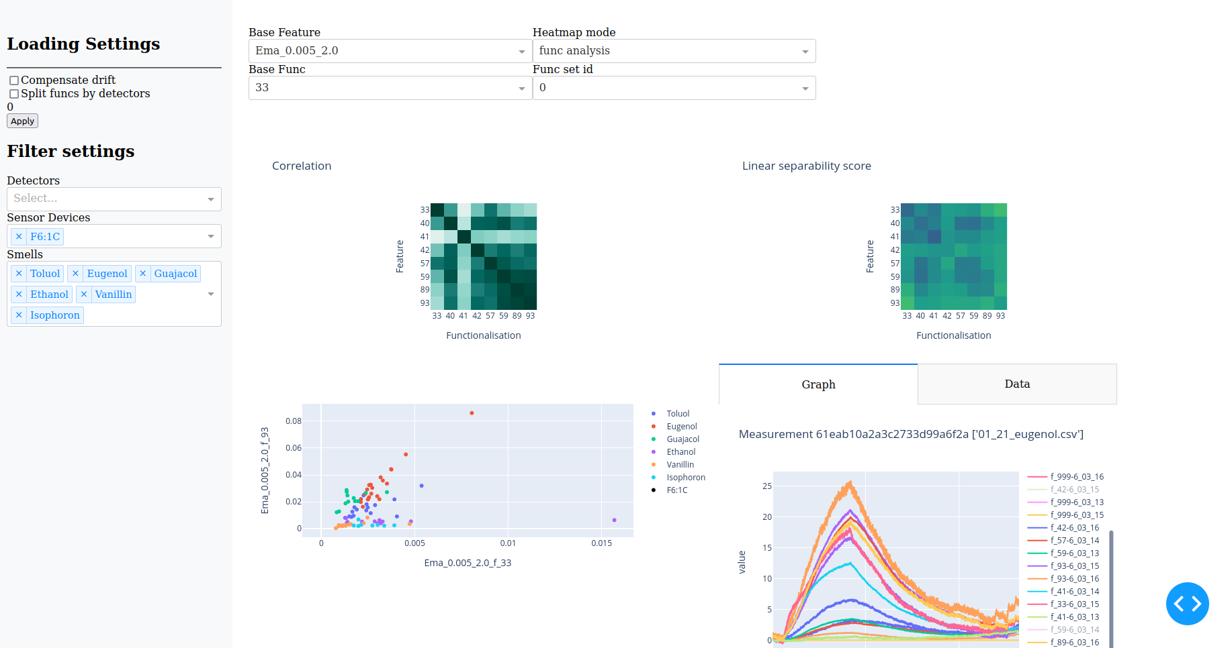
Dashboard

Slide 23
Conclusion
Gathered measurement data with automated setup
Implemented automated feature extraction process
Used transient feature type E_{α} to speed up and improve classification
Demonstrated two methods for analysis if the data quality dimension
Implemented a dashboard for interactive exploration of data quality
More research into Outer consistency necessary

Slide 24
Special thanks to:
Dr. Biele
Prof. Cuniberti
Prof. Aßmann
Dr. Bezugly
Dr. Riemenschneider
Thank you for your attention!

Slide 25
Extra slides

Slide 26
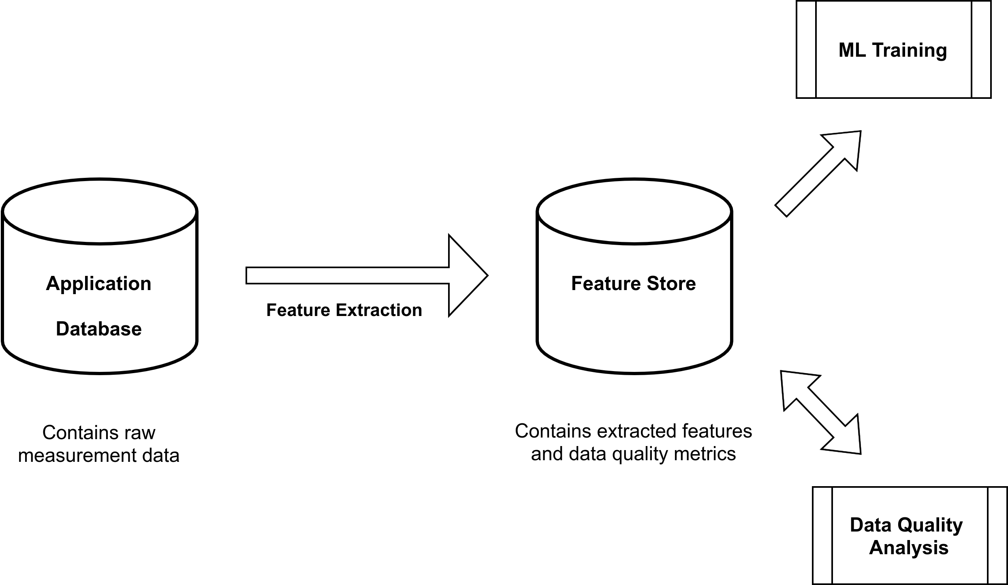
Feature extraction process
V. Lakshmanan, S. Robinson, and M. Munn, Machine Learning Design Patterns: Solutions to Common Challenges in Data Preparation, Model Building, and MLOps.

Slide 27
Feature store
Decouples feature engineering from model training
Can house multiple feature sets
Each feature set is documented
Optimized data access (online vs batch training)

Slide 28
One set of features extracted from each measurement
One feature extracted from each functionalization for each feature type
3 feature types ( E_{α0}, E_{α1} and S), 8 functionalizations
→ 3 * 8 = 24 features for each measurement
Feature extraction process
M. K. Muezzinoglu et al., “Acceleration of chemo-sensory information processing using transient features,”

Slide 29
Transient feature E_{α}
Maximum of first derivative filtered by an exponential moving average
to speed up feature availability (faster measurements)
to combine with steady-state feature (improve classification accuracy)
M. K. Muezzinoglu et al., “Acceleration of chemo-sensory information processing using transient features,”
Sensors and Actuators B: Chemical, 137 507, 2009

Slide 30
Data quality dimensions
Inner consistency
Outer consistency
Label accuracy
Measurement definiteness

Slide 31
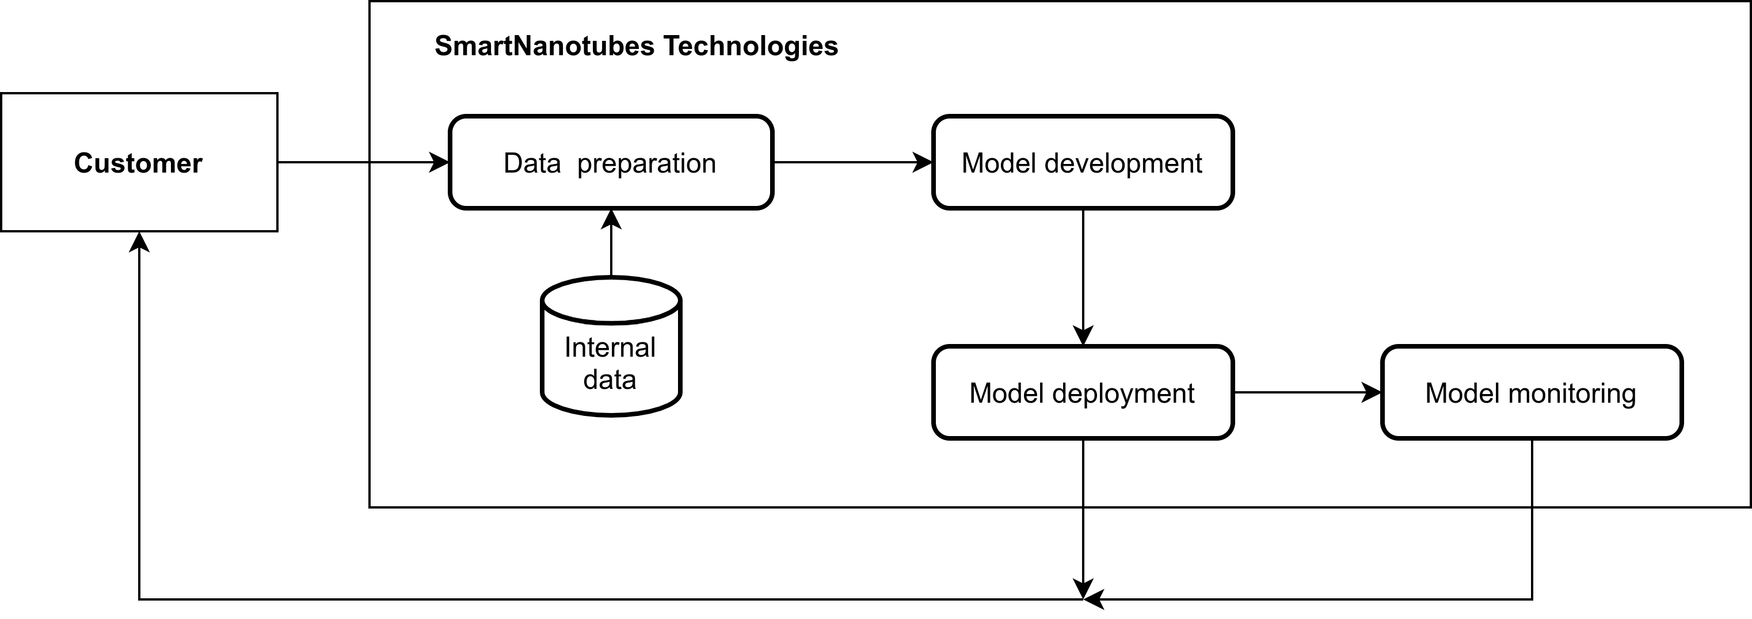
ML model life cycle^{[1]}

