Slide 1
TAC meeting
Kwan Ho Au-Yeung
Single Molecule Machines Group, cfaed, TU Dresden, Germany
17.11.2022

Slide 2
Content
1. Transmitting rotation between molecule-gears
2. Exploring new on-surface synthesis pathway – Knoevenagel condensation
3. Molecule-rotor and nanocar – E-DMBI-P

Slide 3
Motivation: Transmiting rotation between molecule-gears
Molecular gears
Transmission of motion
Molecular mechanical device
Information
Information

Slide 4
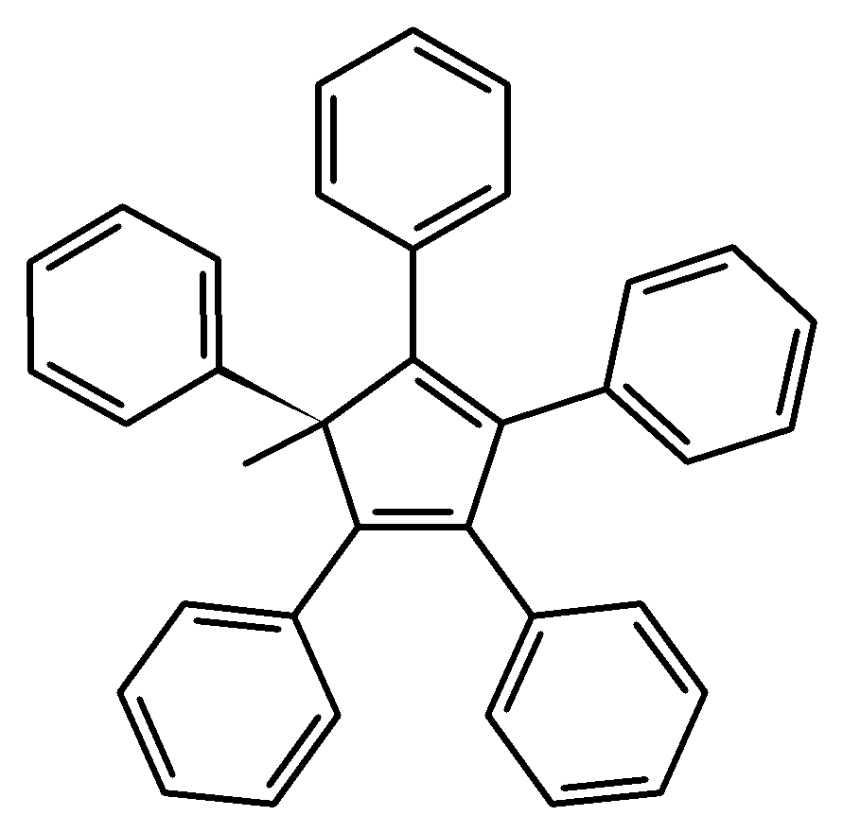
Optimizing under Pentaphenylcyclopentadiene (PPCP) framework
STM Tip
Manipulation
Marker for visualization
Tip-induced manipulation
Optimization for transmitting rotation
On-surface anchoring strategy
Total: 5 designs

Slide 5
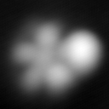
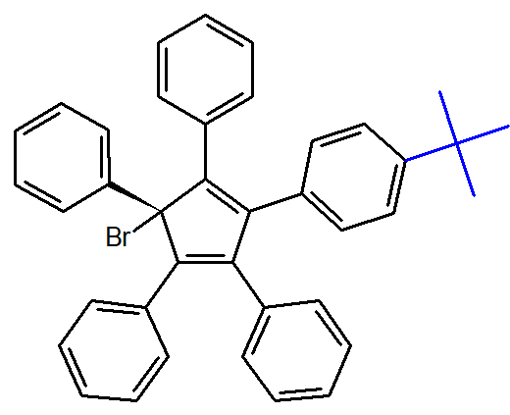
PPCP-tert-butyl
Evaporation: T = 180 °C; t = 30 s
2.5 x 2.5 nm²/15 x 15 nm², 7.2 pA, 500 mV
Au(111)

Slide 6
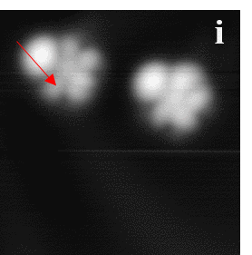
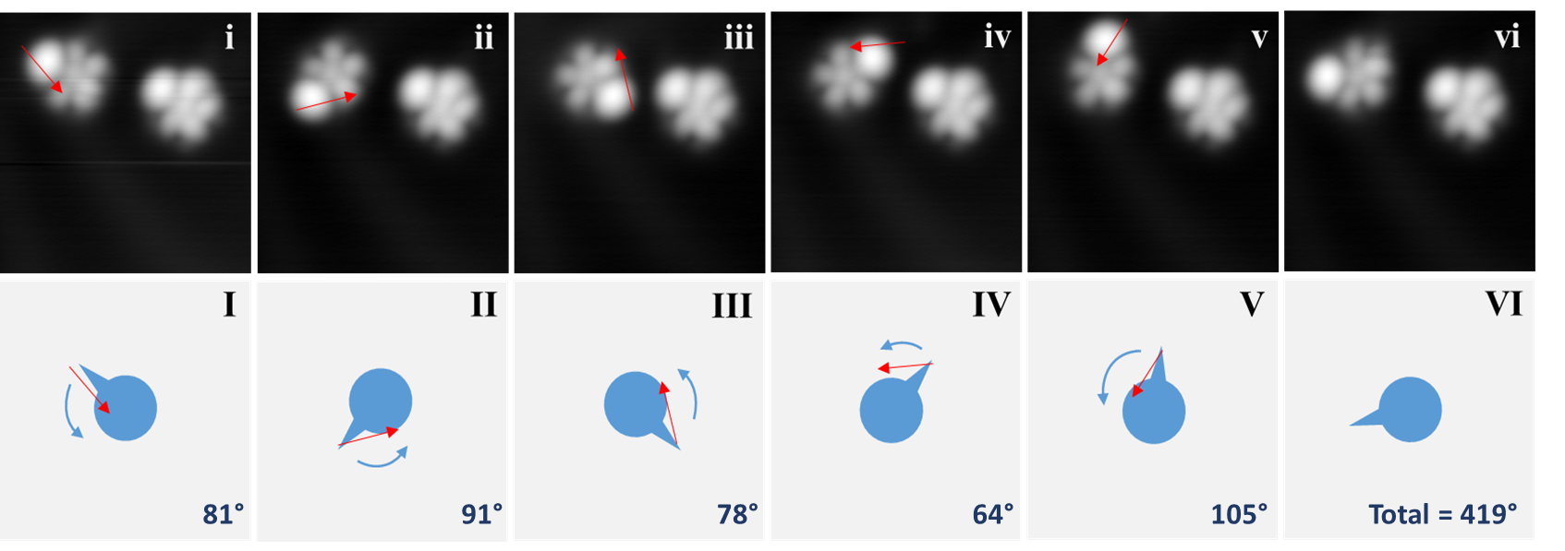
Single molecule-gear rotation
6.5 x 6.5 nm², 13 pA, 530 mV
Red arrows indicate the trajectories of lateral manipulations (V = 10 mV and I = 8 pA; Tunneling resistance = 1.25 GΩ) achieved by STM tip

Slide 7
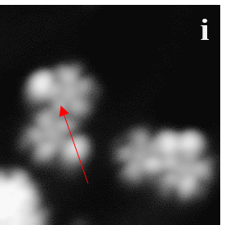
Two interlocked gears
6.5 x 6.5 nm², 13 pA, 530 mV
Red arrows indicate the trajectories of lateral manipulations (V = 10 mV and I = 8 pA; Tunneling resistance = 1.25 GΩ) achieved by STM tip

Slide 8
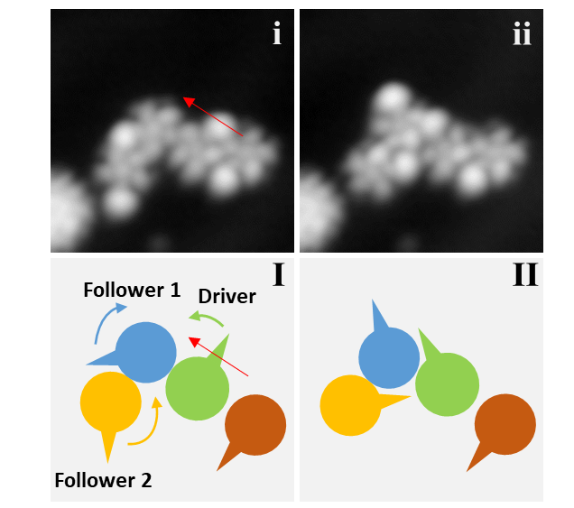
Three interlocked gears
6.5 x 6.5 nm², 1.9 pA, 530 mV
Red arrows indicate the trajectories of lateral manipulations (V = 10 mV and I = 14 pA; Tunneling resistance = 0.71 GΩ) achieved by STM tip

Slide 9
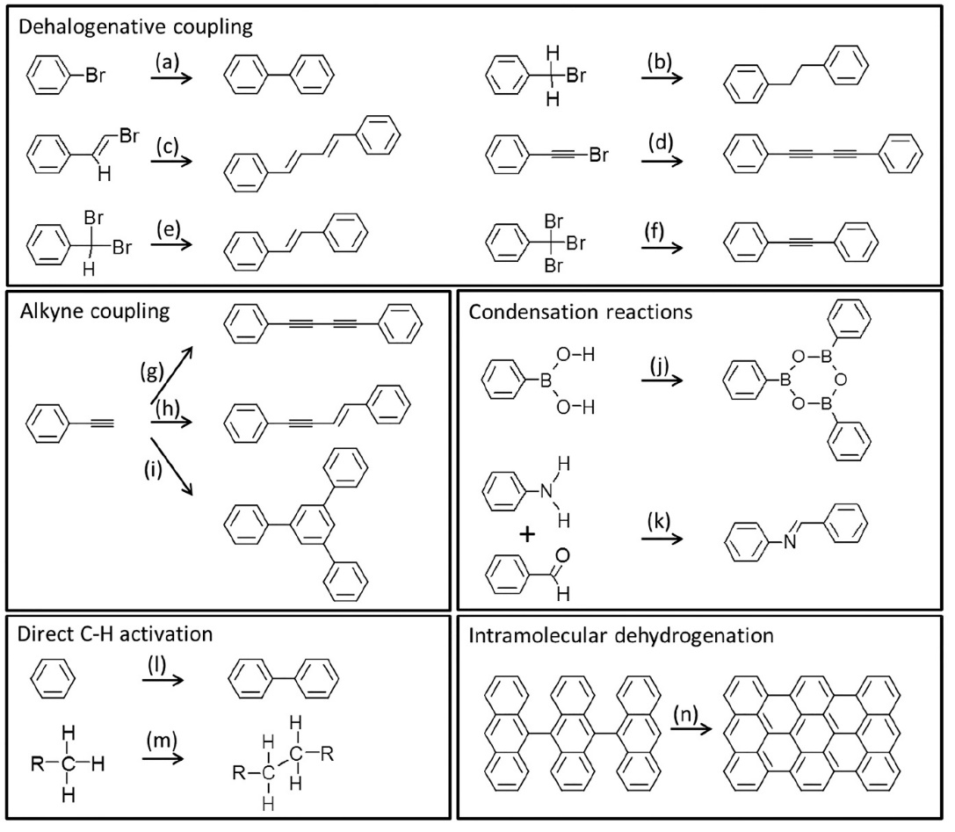
On-surface synthesis – examples of pathways
We need more!
Chem. Rev., 119, 7, 4717-4776 (2019)

Slide 10
Exploring new on-surface synthesis pathway
STM imaging at 5K
STM tip
Precursor 4-formyl(4,4’’-terphenyl)-4’’-methylenenitrile
Final Conjugated oligo-phenylenevinylenes (PV)
Intermediate
Goal:
On-surface reactions between aldehydes and methylene nitriles
➔ CN-substituted structures coupling with C=C bond

Slide 11
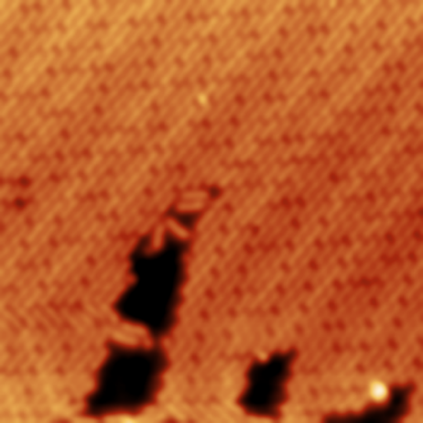
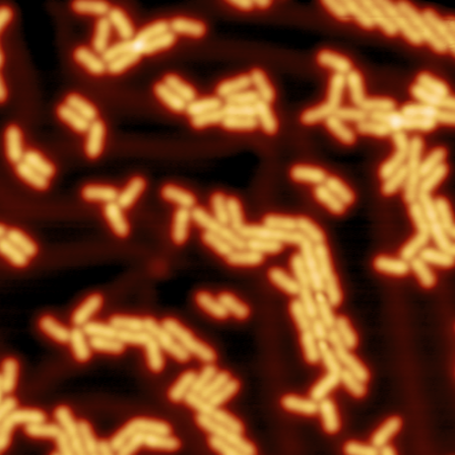
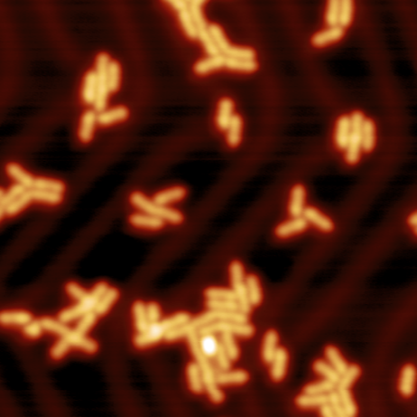
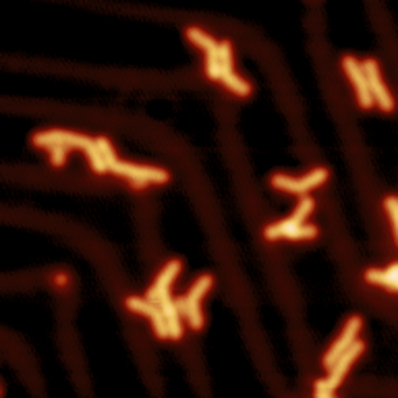
Stepwise post-annealing on Au(111)
Anneal @200°C
Anneal @220°C
Anneal @240°C
Deposition @RT
Monolayer islands
Diffusion and desorption
Reaction and desorption
Further desorption
(23 nm x 23 nm); V = 300-500 mV and I = 3-10 pA

Slide 12
Knoevenagel condensation activated on Au(111)
Constant height CO-tip
Calculated trimer structure
Calculated adsorption geometry
(4.6 nm x 1.1 nm); V = 10 mV
Calculations from Dmitry A. Ryndyk

Slide 13
Single-molecule machines Movement induced by inelastic electron tunneling
Motion activated by voltage pulses with the STM tip
Energy is introduced by inelastic tunneling
Most of the tunneling current is however elastic
Electric field always present between STM tip and surface
V, I, t
V, I
t
A.M. Moore and P.S. Weiss, Annu. Rev. Anal. Chem. 1, 857 (2008)

Slide 14
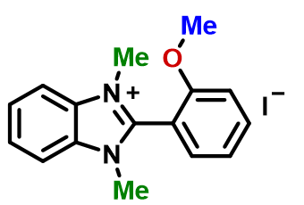
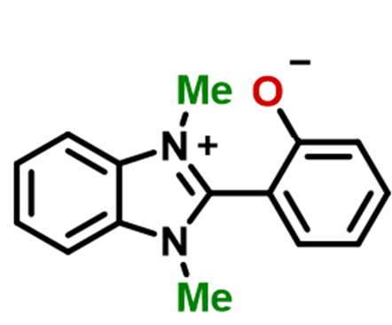
Single-molecule rotor (Previous results) Chemically anchored DMBI-P
Anchoring reaction
heating in UHV
chemisorption
-MeI
on Au(111)
o-MeO‑DMBI‑I
DMBI‑P
molecule-rotor
DMBI-P: 2-(1,3-dimethyl-1H-benzo[d]imidazol-3-ium-2-yl)-phenolate
F. Eisenhut, et al. Nanoscale 13, 16077 (2021)
Notes:
Iodine dissociation, resulting in a radical form. Alternative: cleavage of the O–Me bond and the elimination of methyl iodide (MeI). Not a radical

Slide 15
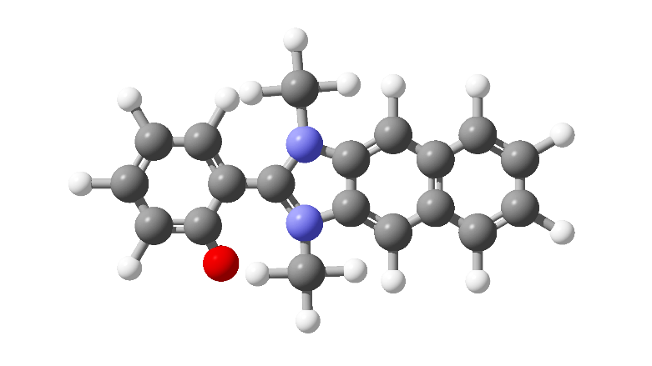
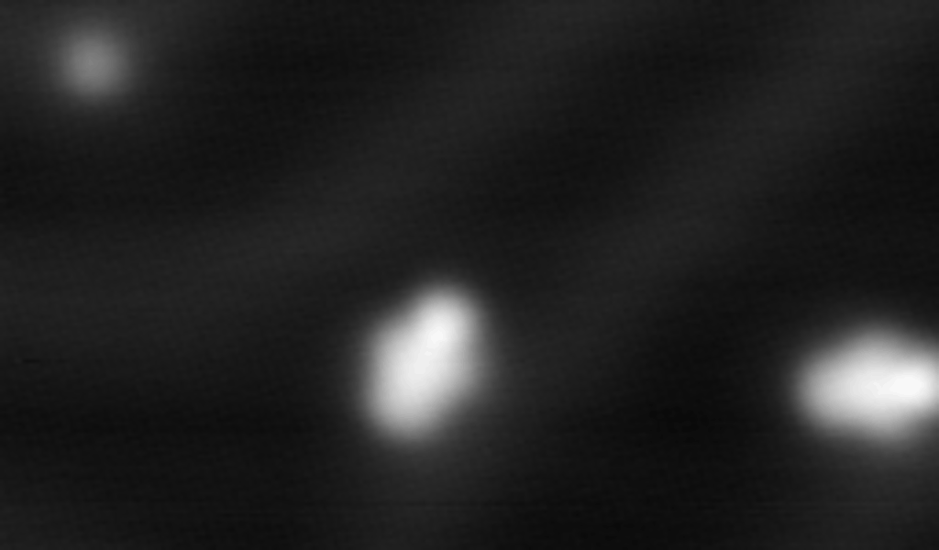
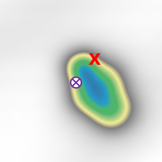
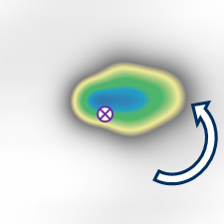
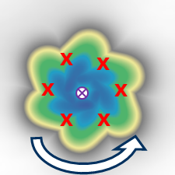
Single-molecule rotor Adding a ring – Extended DMBI
Single molecules (low coverage)
Same behavior as DMBI-P by voltage pulses (typically V = 500 mV, I = 500 pA)
Unidirectional rotation
A left-DMBI-P, always rotates CCW by positive voltage pulses
x
x
x
x
x
x
I = 250 pA and V = 0.5 V

Slide 16
From rotor to nanocar Both rotors and nanocars after dimer separation
Separated dimers form a rotor and a nanocar (60%) or two nanocars (40%)
Typical voltage pulses of V = 0.5 V and I = 500 pA move both
4 nm x 4 nm

Slide 17
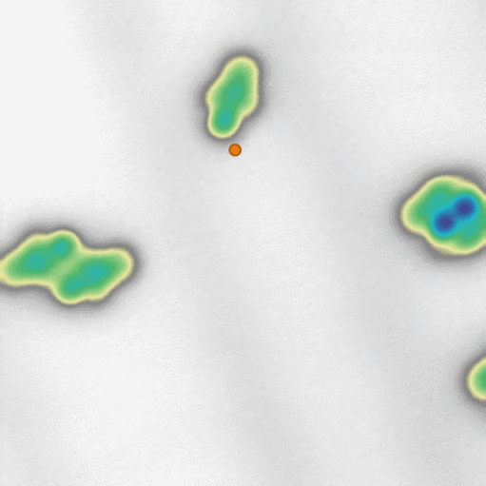
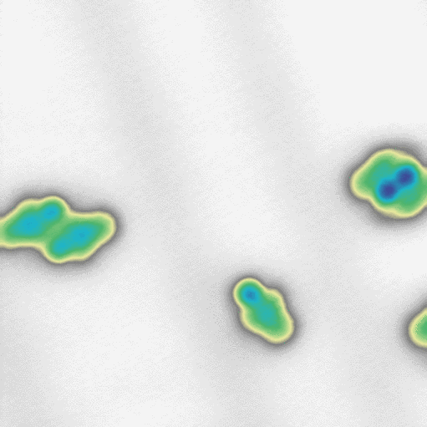
Nanocar Controlled translation by voltage pulses
Tip at a lateral distance of 1–1.5 nm (red mark), pulse V ≥ 0.4 V, I ≥ 100 pA
By positive voltage pulses, the molecule is attracted by the tip independently on its chirality (379 pulses)
By negative voltage pulses, the molecule moves less and randomly away from the tip
V > 0
V < 0

Slide 18
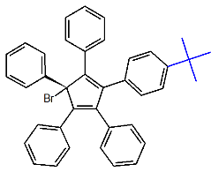
Thank You!
Publications:
K.H. Au Yeung, T. Kühne, F. Eisenhut, M. Kleinwächter, Y. Gisbert, R. Robles, N. Lorente, G. Cuniberti, C. Joachim, G. Rapenne, C. Kammerer, and F. Moresco. J. Phys. Chem. Lett. 2020 11 (16), 6892-6899.
K. H. Au-Yeung, T. Kühne, D. Becker, M. Richter, D. A. Ryndyk, G. Cuniberti, T. Heine, X. Feng, F. Moresco. Chem. Eur. J. 2021, 27, 17336.
In preparation.
1)
2)
3)

