Slide 1
1st TAC meeting
Mr Li Chen
Chair of Materials Science and Nanotechnology
1st TAC meeting // Feb. 2024

Slide 2
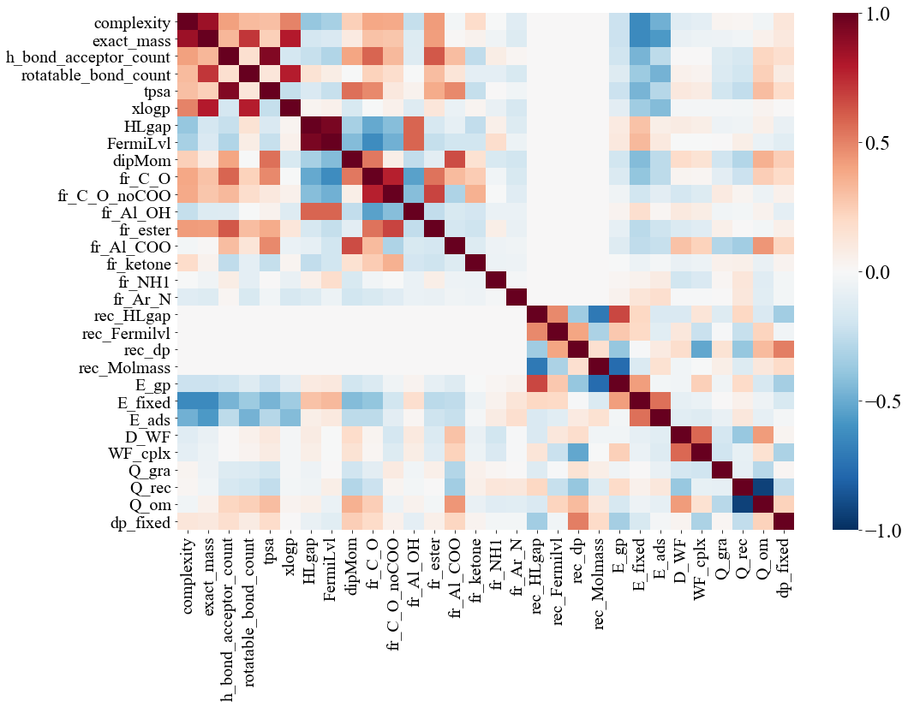
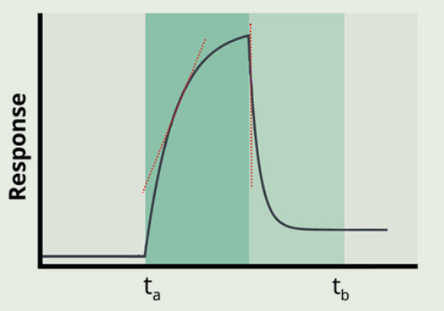
PhD Motivation
Aiming at correlating microscopic molecular features to sensor response via atomistic and mesoscale simulations
https://datascientest.com/
Machine learning
Huang et al. APR. 2023
Molecular features
Sensor signal
➔ Analyte-receptor binding features collection
Notes:
About my system

Slide 3
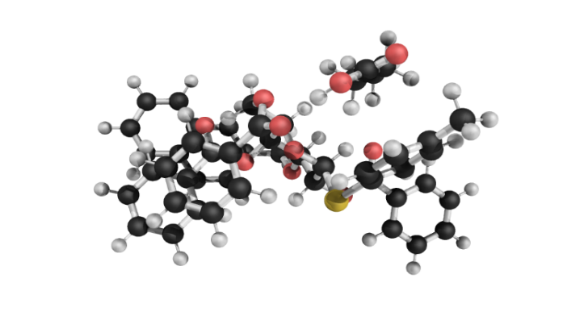
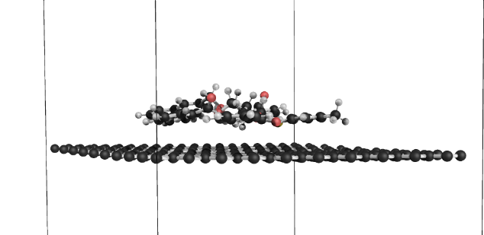
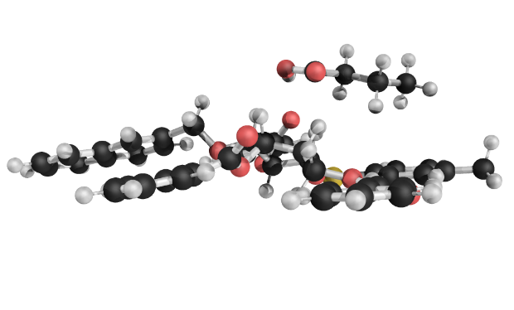
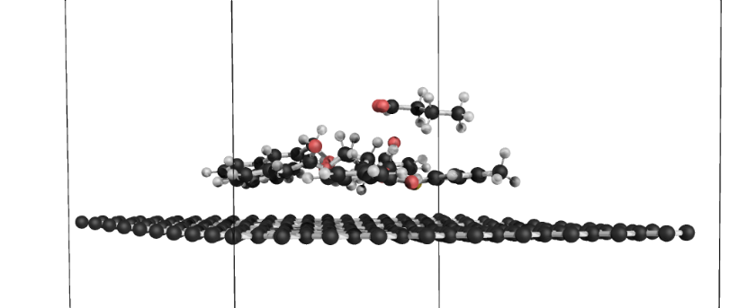
Analyte-receptor binding features collection Workflow
18·102=1836 systems
Binding energy E_gp
Binding energy E_fixed
Total dipole moment dp_fixed
Adsorption energy E_ads
Odor Charge change Q_om
Receptor Charge change Q_rec
Graphene Charge change Q_gra
Any simple relationship between binding features?
Complex system work function WF_cplx
Work function change D_wf
Notes:
Before entering ANN to correlate signal, it’s easier and never a bad idea to look at

Slide 4
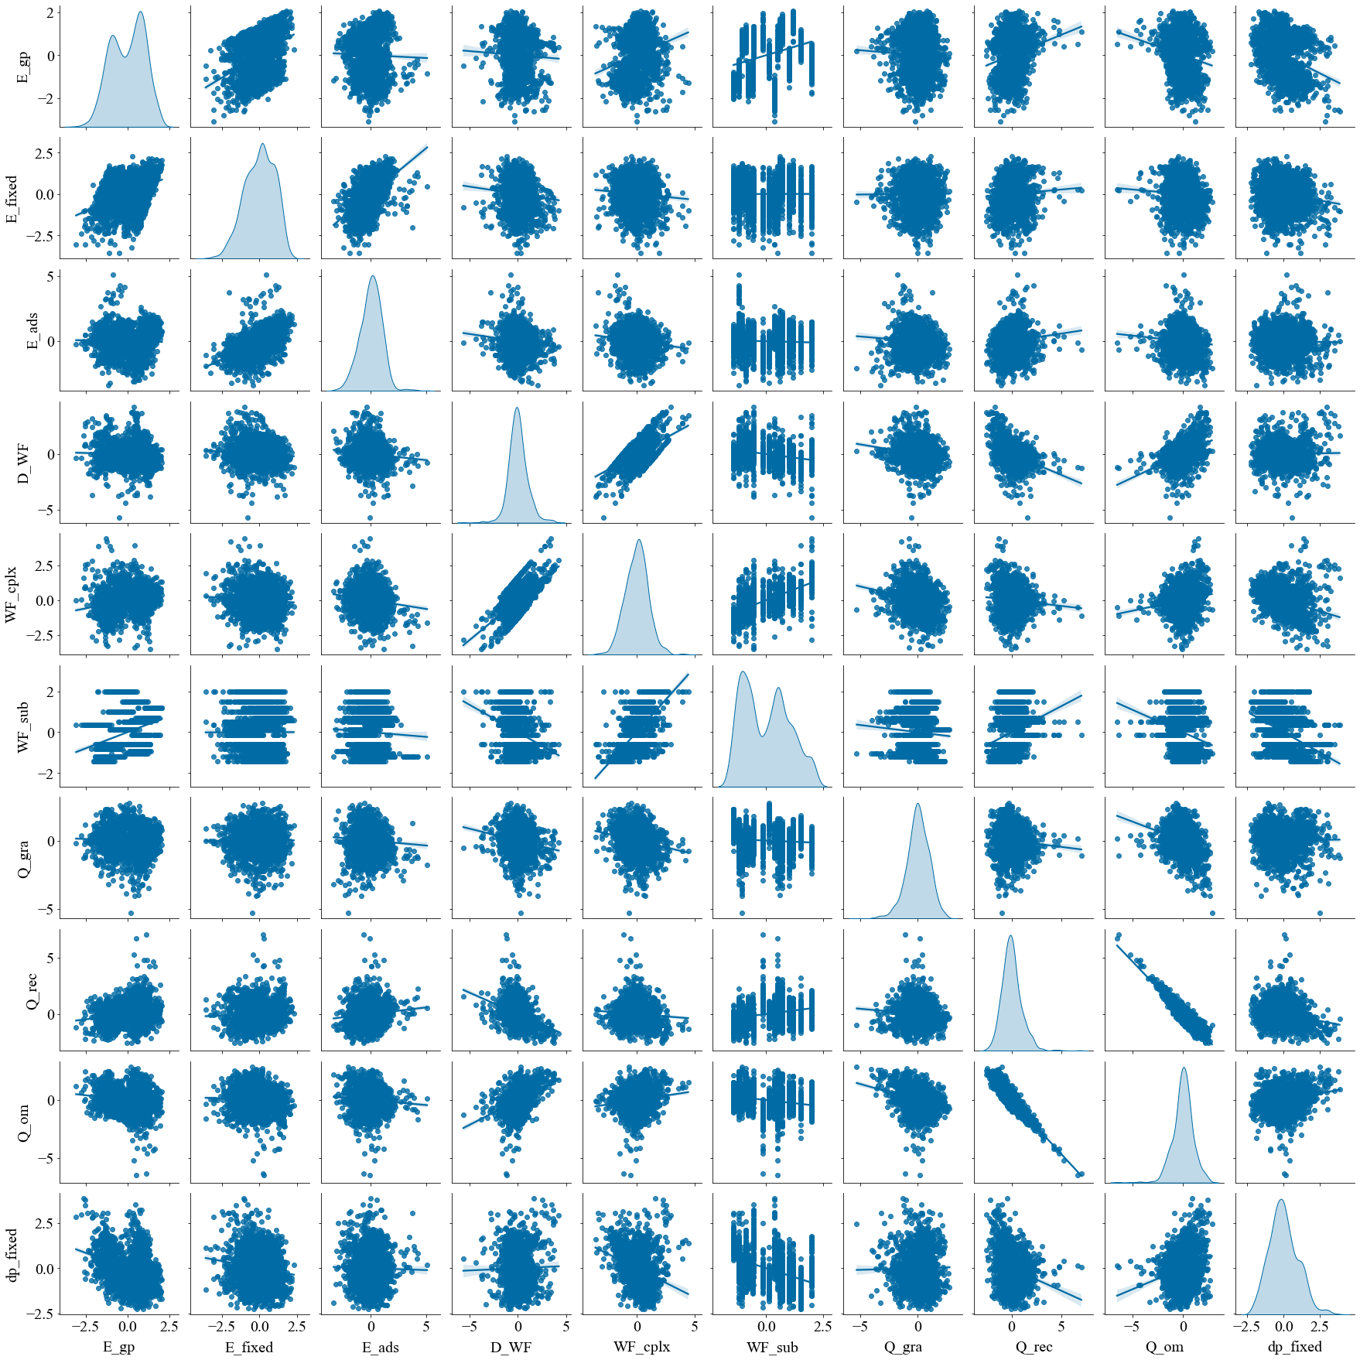
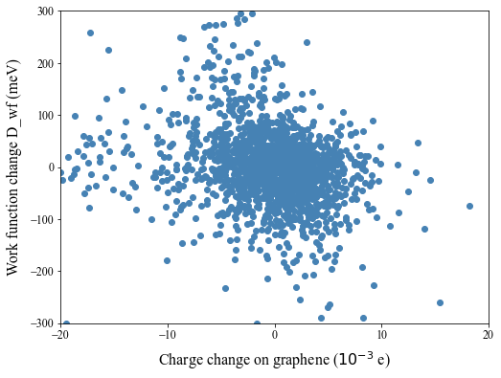
No simple correlation
between the most properties
Relationship between
binding feature and odorant descriptors?

Slide 5
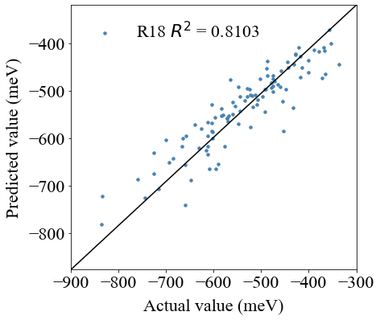
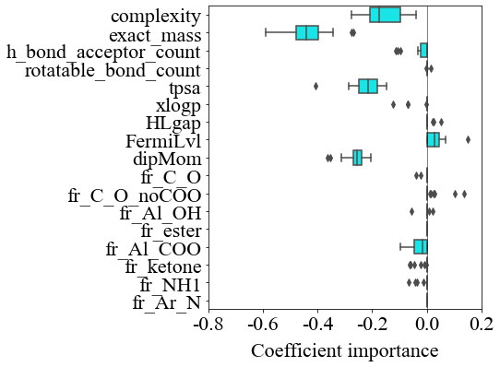
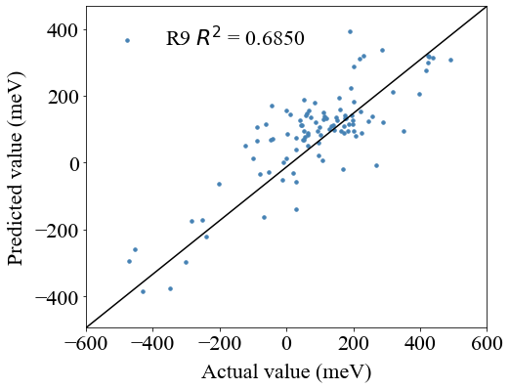
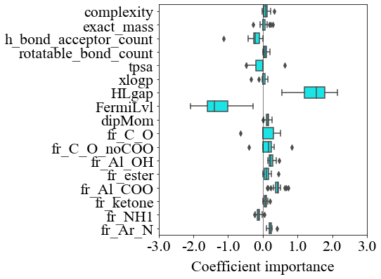
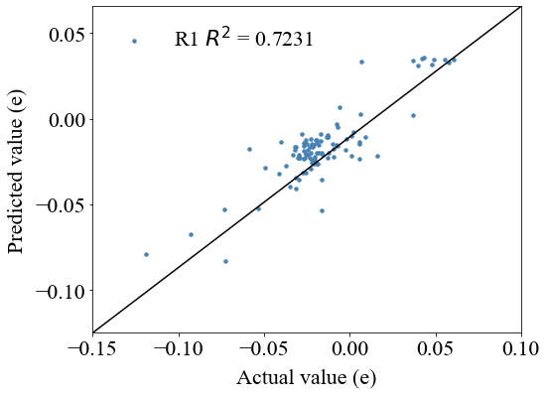
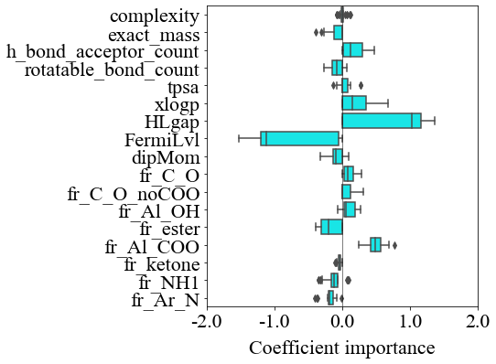
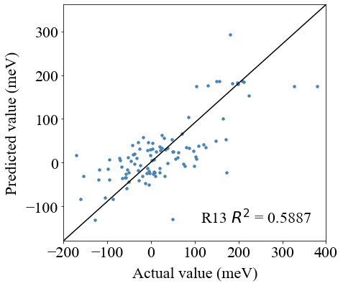
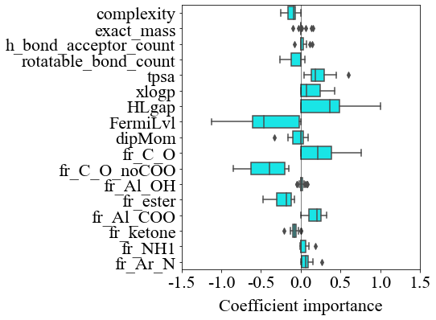
Binding feature prediction Multiple feature linear regression
E_fixed
D_WF
Enlarge WF value and involve receptor and substrate descriptors
D_WF
Q_om
➔ Molecular descriptors are very likely correlating to the binding features

Slide 6
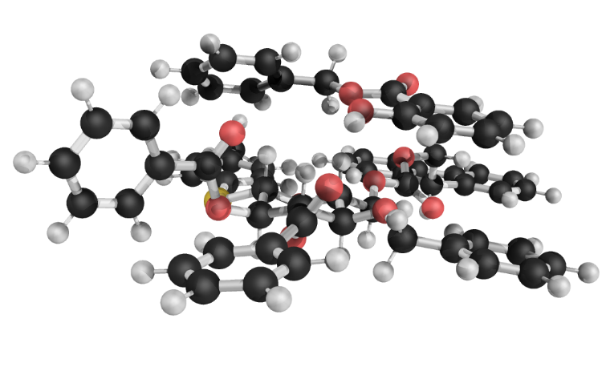
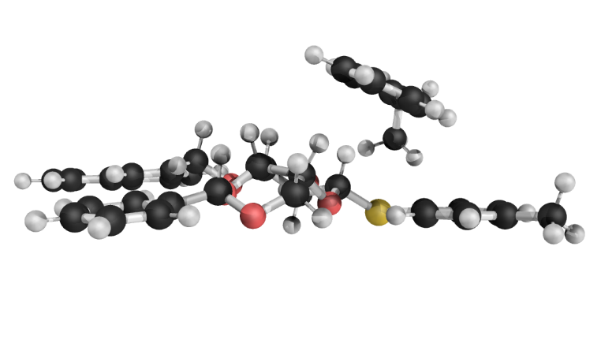
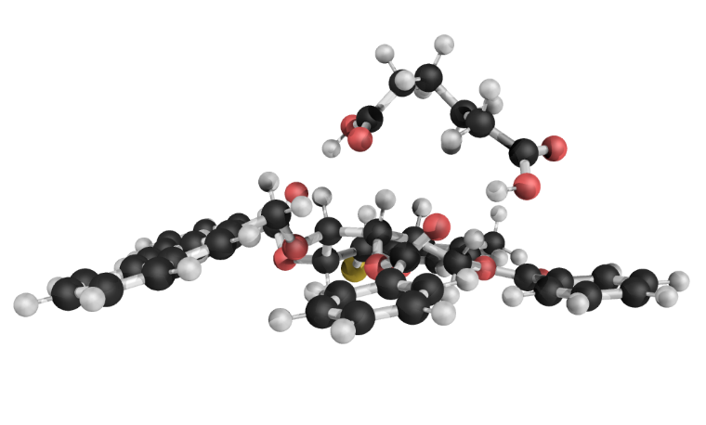
Binding energy pattern
Binding energy E_fixed
Odorant 90
Receptor 06
Strong dispersion
· Different interaction types result in
binding energy difference
Odorant 39
Odorant 49
· But reversely, can binding energy (1D) alone describe fully the complex
interaction mechanism space?
Receptor 17
Receptor 18
From one dimension to high dimension
Electrostatics of S atom
Hydrogen bonding
Notes:
Does single binding feature say something?
Does other binding feature say something?

Slide 7
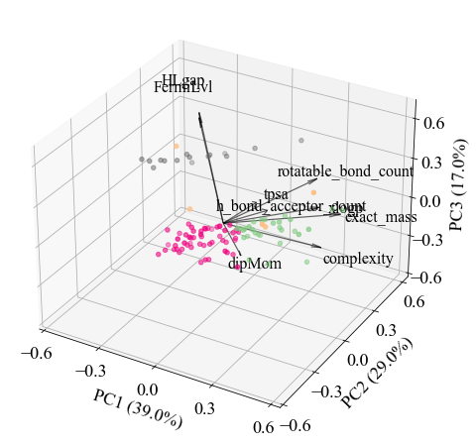
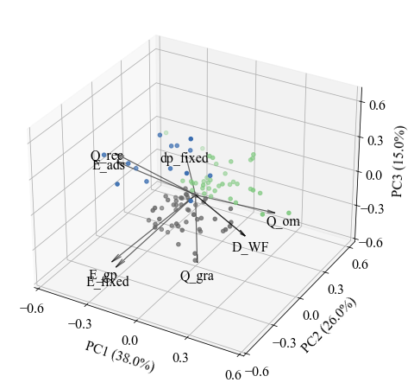
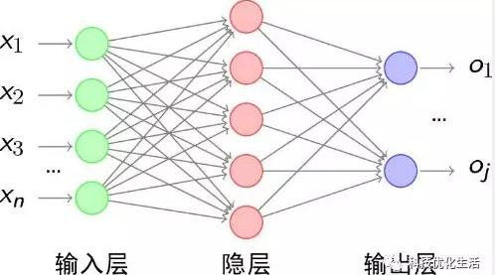
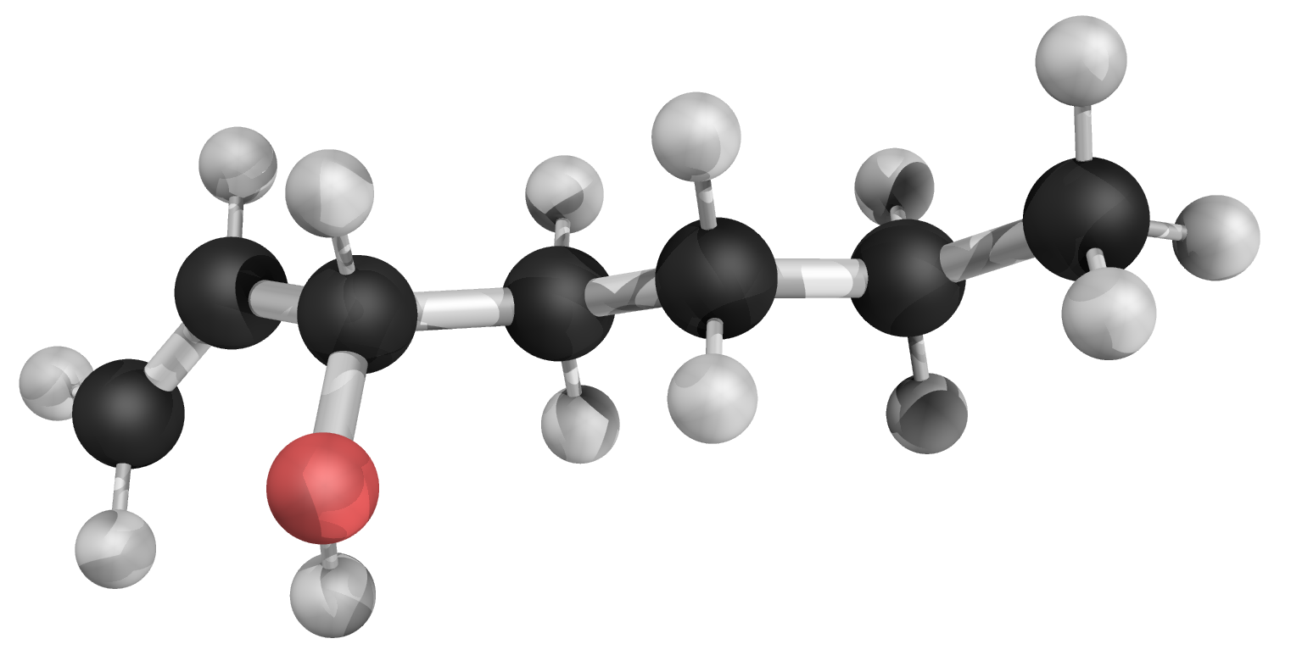
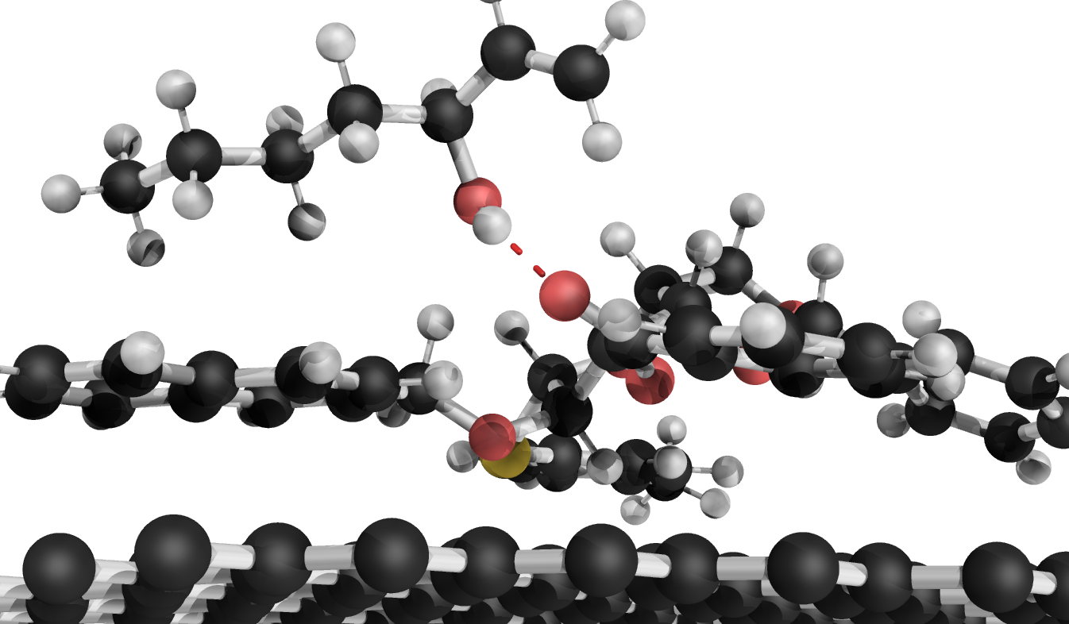
In progress: receptor – odorant map Unsupervised learning – PCA & k-means clustering
Odorant PCA space
Binding feature PCA space (Receptor 14)
46
46
Artificial neural network (ANN)
➔ Receptor – odorant map is doable!

Slide 8
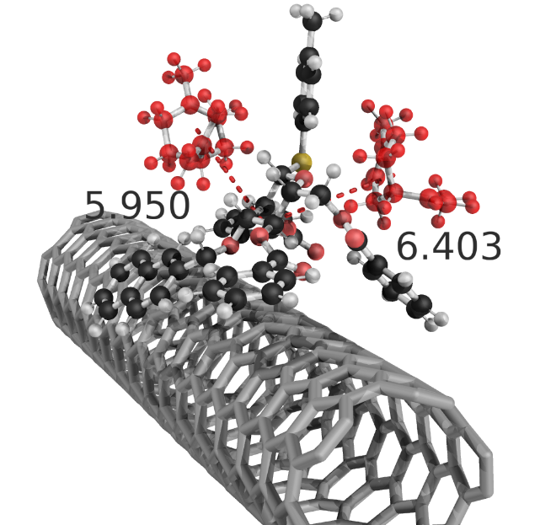
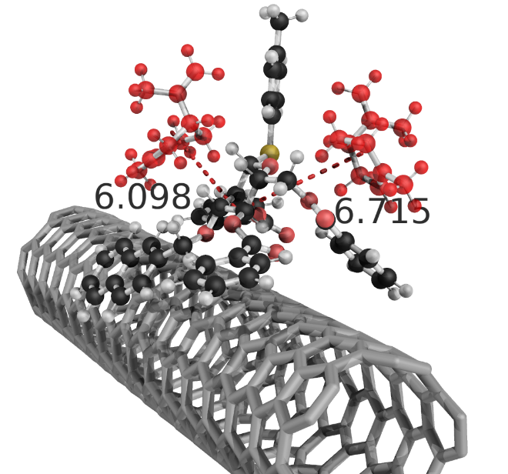
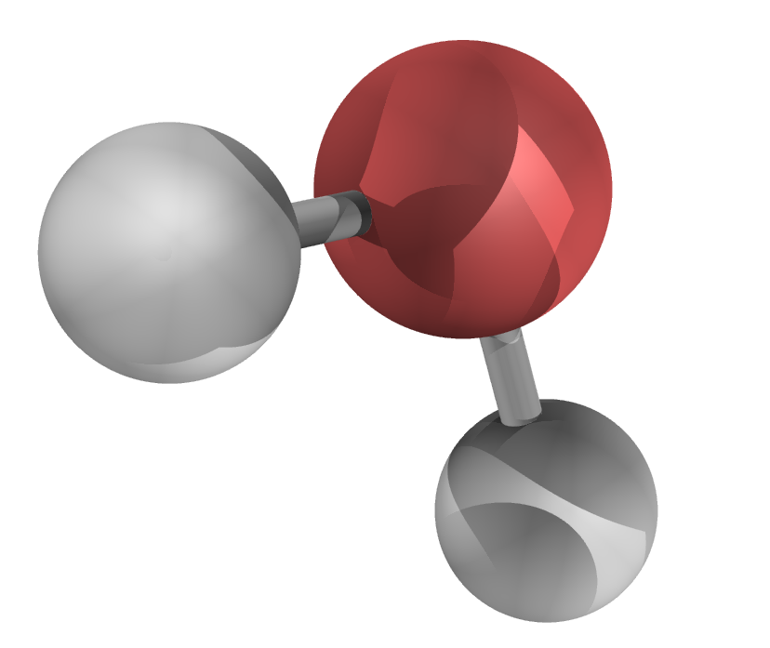
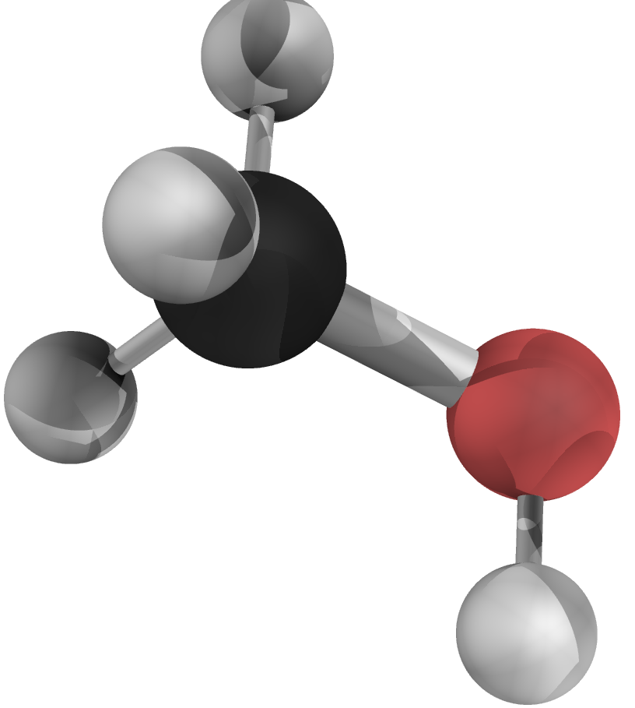
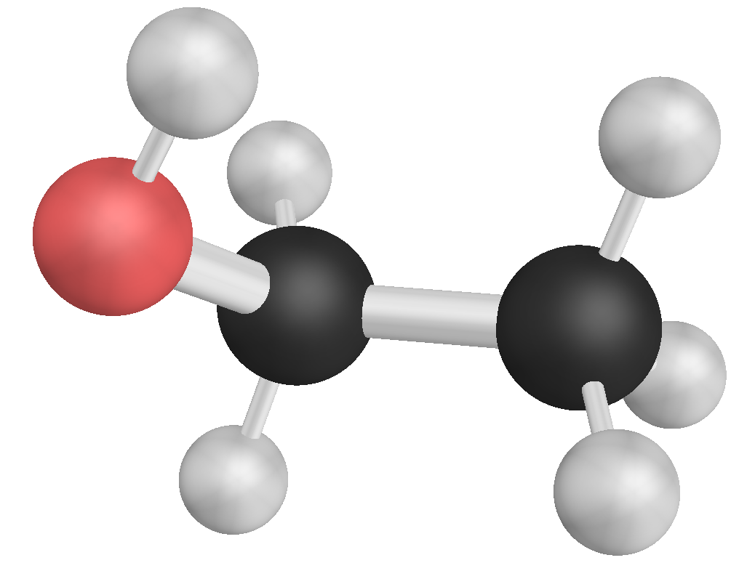
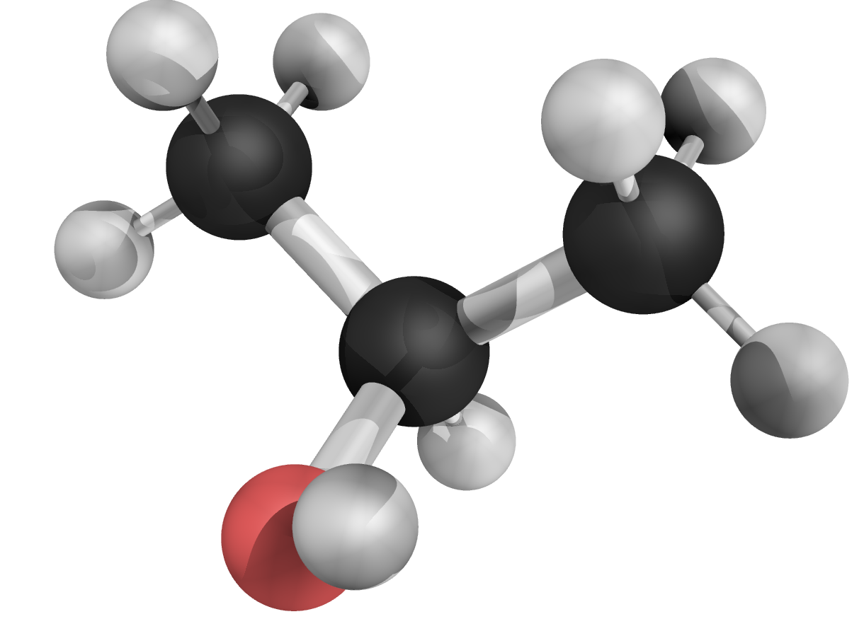
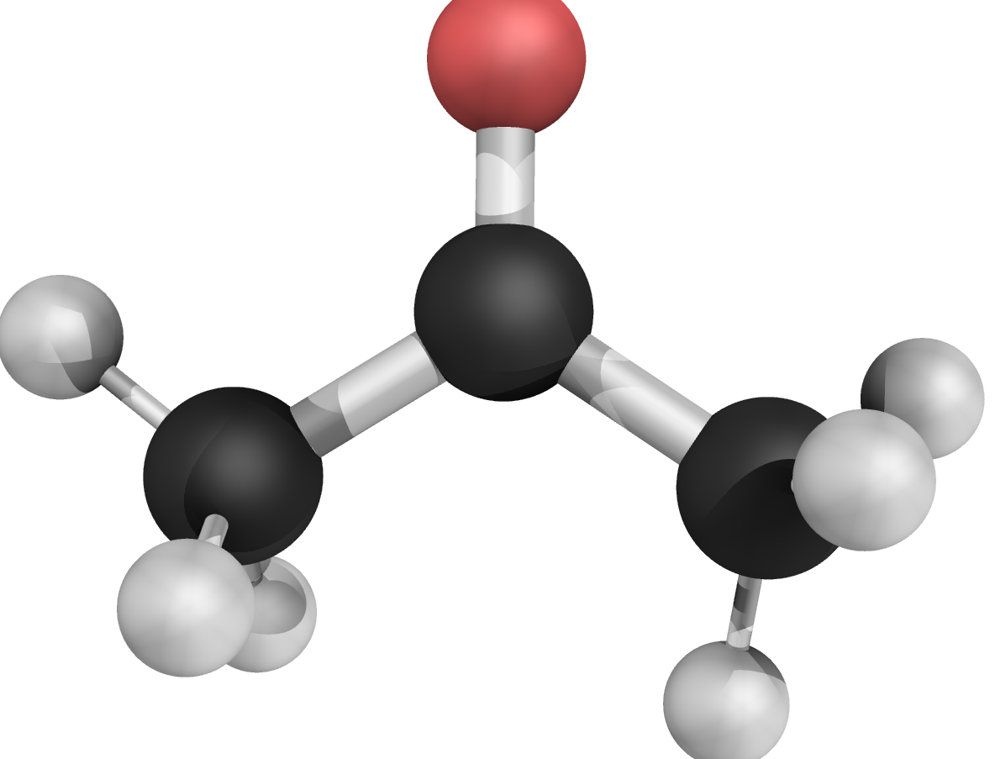
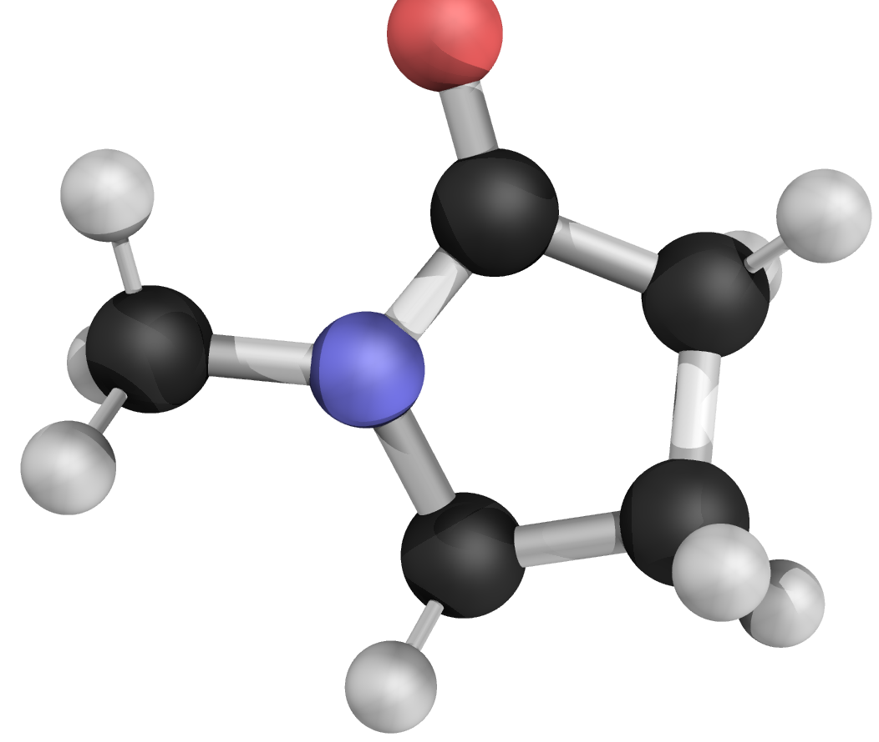
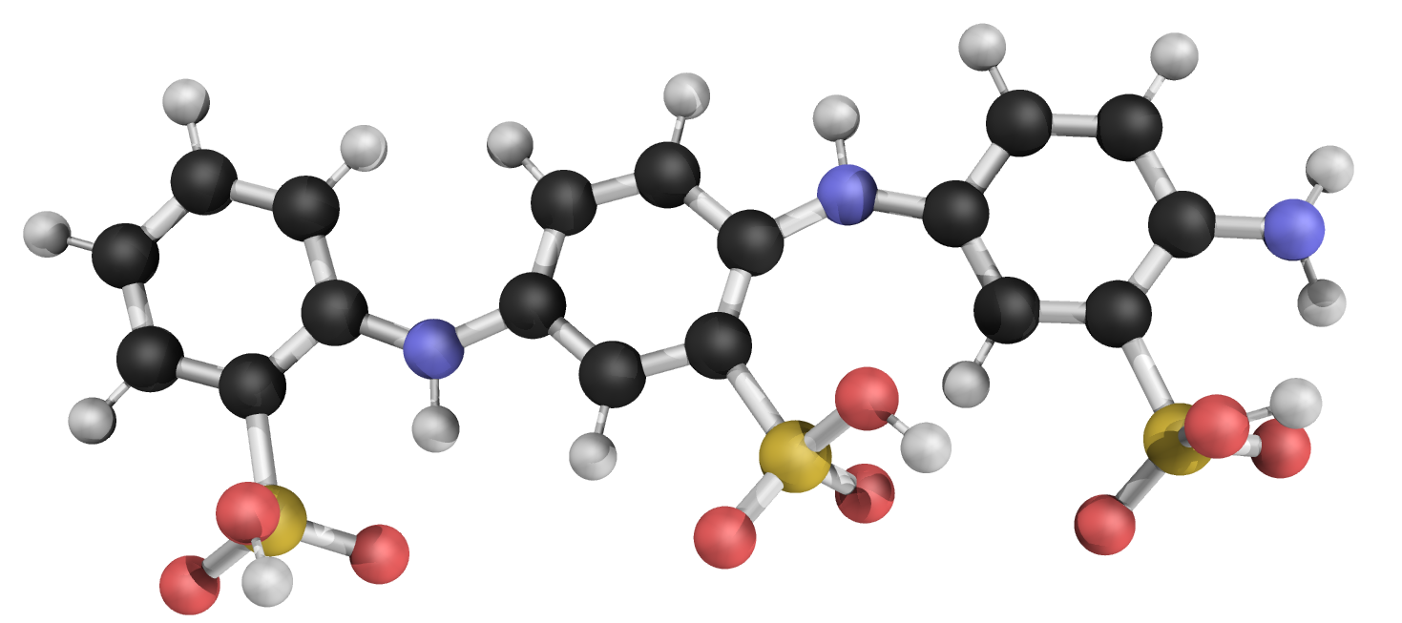
Side projects
Limonene story with Shlomo
ASA oligomer story with Shirong
Theoretical explanation of the S/R-limonene
discrimination in sensor response
➔ S tends to approach receptor closer than R
VOC molecules’ sensing mechanism with ASA
and explanation to the signal discrimination
Molecular size and H-bond count correlate well
to the response
➔ Both manuscripts are in preparation

Slide 9
Summary
High–throughput calculation for binding features collection
Linear regression for binding features using molecular descriptors
Receptor – odorant map (in progress)
Plan for the next year
A new screening round for odorants on CNT (2-3 months):
More descriptors: geometry, conductivity, dynamics descriptors, etc.
FEM method → sensor signal:
Correlating molecular features with signal features using ANN
Publications:
1. The first paper is ready to submit:
L. Chen, D. Bodesheim, A. Ranjbar, A. Dianat, R. Biele, R. Gutierrez, and G. Cunibert.
2. Current work in preparation:
L. Chen et al.
3. Limonene story with Shlomo
4. ASA story with Shirong
➔ Thank you for your attention

Slide 10
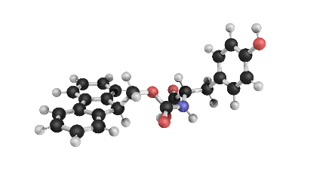
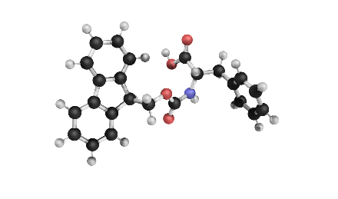
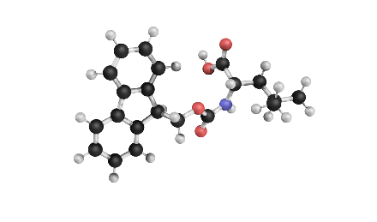
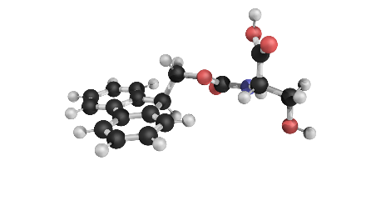
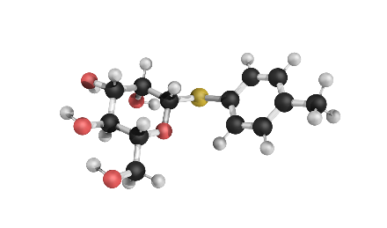
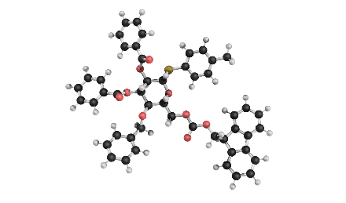
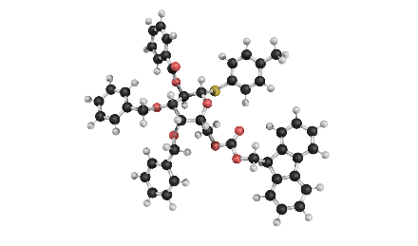
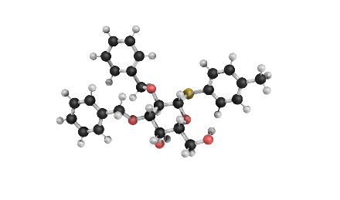
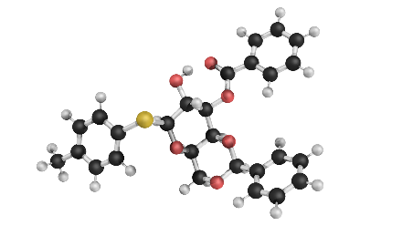
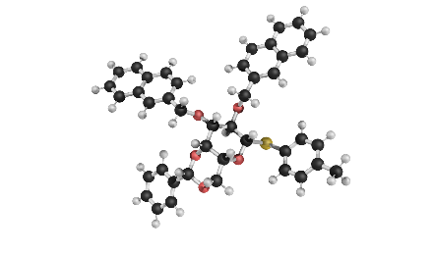
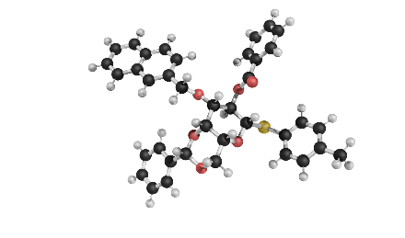
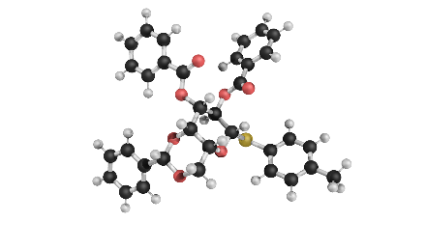
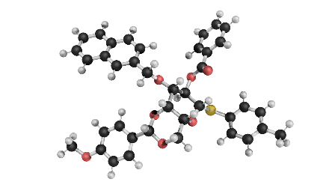
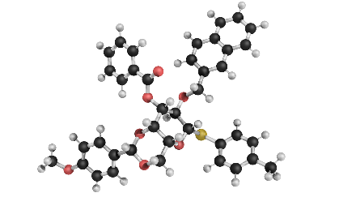
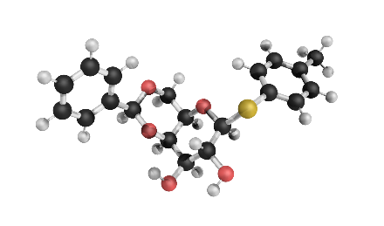
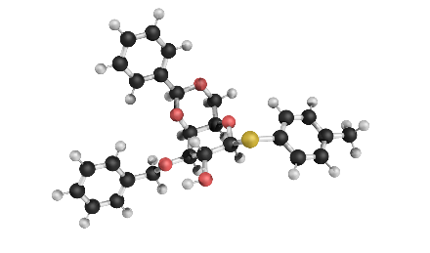
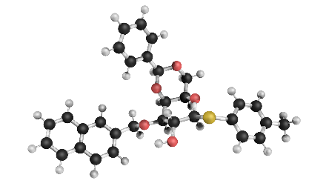
Workflow and motivation
01
02
03
04
05
06
07
08
09
10
11
12
13
14
15
16
17
18

Slide 11
Analyte-receptor binding features collection Pearson correlation for descriptors
Binding features
➔ Any simple correlation between single binding features?
Notes:
Single value to see how relevant they are.

