Slide 1
Inkjet printed Gas Sensors based on 2D materials
Abdallh Herbawe
Chair for Materials Science and Nanotechnology, TU Dresden
Thesis Advisory committee (TAC) Kick-off meeting
Olfactorial Perceptronics
Friday, January 26, 2024

Slide 2
Outline
Introduction
2D materials
What Are MXenes?
Why MXenes for gas sensing?
MXenes based gas sensors in Literature today!
Strategies for modifying MXenes for gas sensing?
Why Inkjet Printing?
Project goals
Project Plan
Results and proof of concepts
Research Time table
Proof of concept and results so far

Slide 3
2D Materials
High Surface Area
Tunable Electronic Properties
High Electron Mobility
Chemical Sensitivity
Potential for Multifunctionality
Graphene
H-BN
MXene
TMDs
BP
LDHs
Polymer
MOFs
Metal oxides

Slide 4
Introduction: What Are MXenes?
A family of 2D materials consisting of:
Transition metal.
Carbides/nitrides/Carbonitrides/oxycarbides.
They are general made of etching away Al in MAXene precursors such as Ti₂AlC, or Ti₃AlC₂.
MXenes are generally represented by M_{n+1}X_{n}T_{x}
M represents an early transition metal.
X denotes either carbon, nitrogen, carbonitride, or oxycarbide.
T represents surface terminations on the outer transition metal layers.
Credit: © Martin Künsting/HZB

Slide 5
Introduction: Why MXenes for gas sensing?
Base line drift
Large surface area
POSITIVES
Cross-interference
NEGATIVES
High conductivity
Low band-gap
easily degraded in moisture environment
high signal-to-noise ratio

Slide 6
Introduction: MXenes based gas sensors in Literature today!
M. Sai Bhargava Reddy, Coordination Chemistry Reviews (2024)

Slide 7
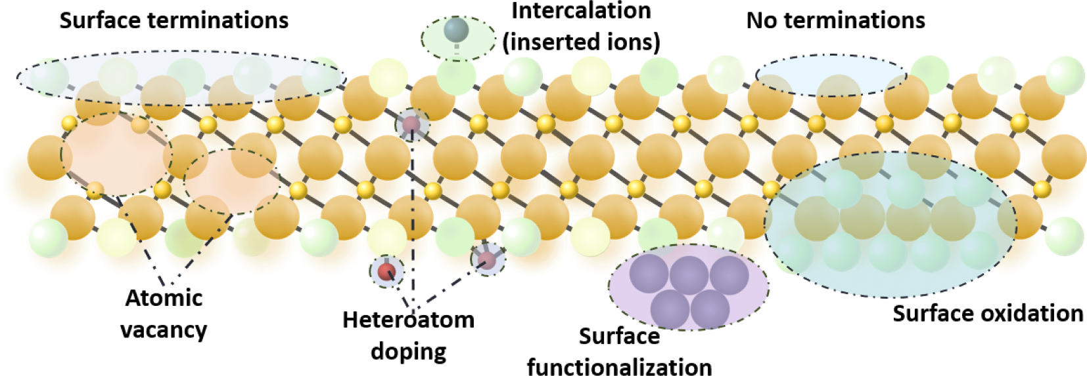
Introduction: Strategies for modifying MXenes for gas sensing?
Surface terminations
Intercalation
(inserted ions)
No terminations
Atomic
vacancy
Heteroatom
doping
Surface oxidation
Surface
functionalization
M. Sai Bhargava Reddy, Coordination Chemistry Reviews (2024)

Slide 8
Introduction: Why Inkjet Printing?
M. Sai Bhargava Reddy, Coordination Chemistry Reviews (2024)

Slide 9
Research Goals
Fabrication of Inkjet printed 2D materials based gas sensors for smart olfactory mimicking and sensing of H₂S and H₂

Slide 10
Research Plan
Other modifications
Synthesis of Titanium Carbide Mxenes
Growing gold nano structures on Mxene sheets
Formulating ink for inkjet printing out of the Mxene sheets
Inkjet printing gas sensor with Mxene sheets as sensing material
Conducting Gas sensing experiments
Mxene
Synthesis
Surface Modification
Ink
Formulation
Sensor Fabrication
Gas
Sensing

Slide 11
Research time table
Task | 2024 1st half |  | 2024 2nd half |  | 2025 1st half |  | 2025 2nd half |  | 2026 1st half |  | 2026 2nd half
Synthesis of Titanium Carbide Mxenes
Growing gold nano structures on Mxene sheets
Formulating ink for inkjet printing out of the Mxene sheets
Inkjet printing gas sensor with Mxene sheets as sensing material
Conducting Gas sensing experiments
Other modifications
Mxene
Synthesis
Ink
Formulation
Gas
Sensing
Surface Modification
Sensor Fabrication
Other modifications

Slide 12
Proof of concept and results so far
Graphene was used so far, but it proved:
The ability to print stable and repeatable advanced nanomaterials patterns.
The ability to control the pattern dimensions down to 11 $μm$.
Graphene and CNTs are other materials that could be also an interest in future implementations and modifications.

