Slide 1


Rational Design of 2D Polymers
Chair of Materials Science and Nanotechnology
TAC Meeting // 14.02.2024
David Bodesheim

Slide 2
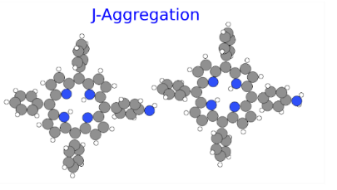

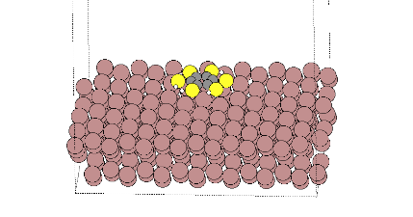
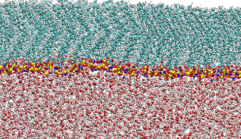
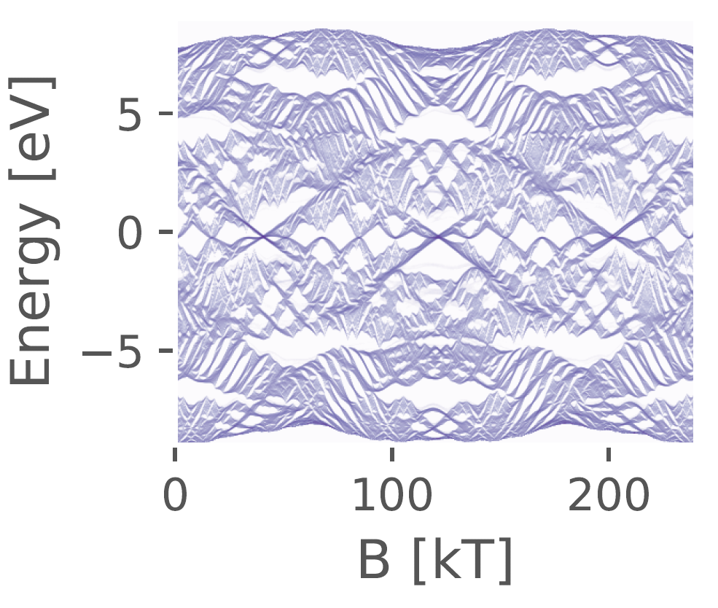
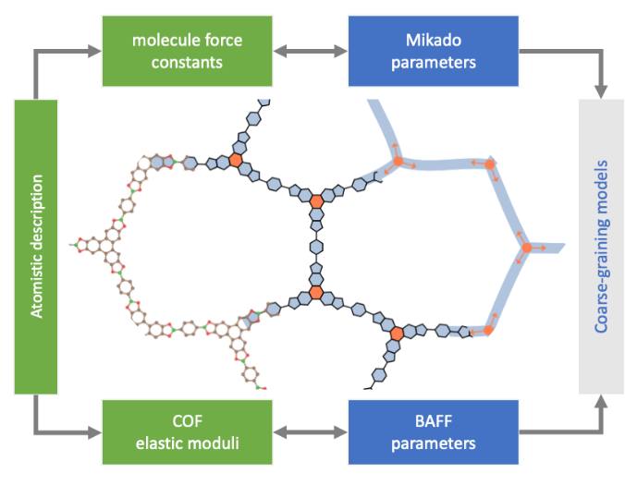
Elucidating the Synthesis of 2D Polymers at Interfaces
Energy
Rational Design of 2D Polymers
Magnetic Field
Electronic and Elastic Properties
High-Throughput Calculations

Slide 3

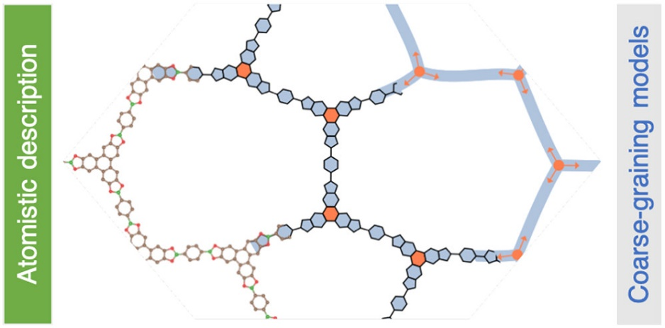
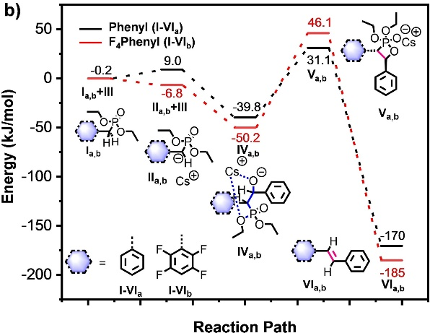
01
Control of Crystallinity of Vinylene‐Linked Two‐Dimensional Conjugated Polymers by Rational Monomer Design | Toward Coarse-Grained Elasticity of Single-Layer Covalent Organic Frameworks
Calculation of reaction barriers | Elasticity calculations via DFTB Co-Development of methods
D. L. Pastoetter, D. Bodesheim, G. Cuniberti, X. Feng, et al. Chemistry A European J. 2022, 28, e202104502. | A. Croy, A. Raptakis, D. Bodesheim, A. Dianat, G. Cuniberti, J. Phys. Chem. C 2022, 126, 18943–18951.
02

Slide 4
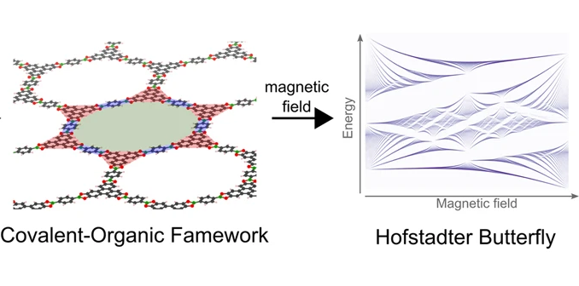
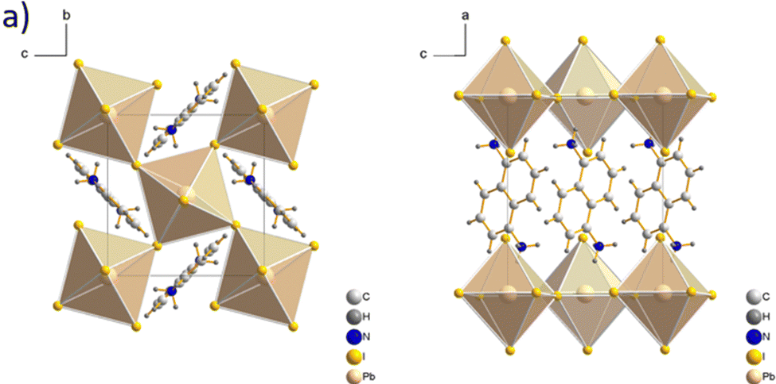
03
Molecular engineering of naphthalene spacers in low-dimensional perovskites | Hierarchies of Hofstadter butterflies in 2D covalent organic frameworks.
Elucidation of structures of some layered perovskites via DFT calculation | Developed tight-binding model for 2D COFs Investigated the Hofstadter Butterfly
A. Mitrofanov, D. Bodesheim, G. Cuniberti, A. Kuc, B. Voit, et al. J. Mater. Chem. C 2023, 11, 5024–5031. | A. Croy, A. Raptakis, D. Bodesheim, A. Dianat, G. Cuniberti, J. Phys. Chem. C 2022, 126, 18943–18951.
04

Slide 5

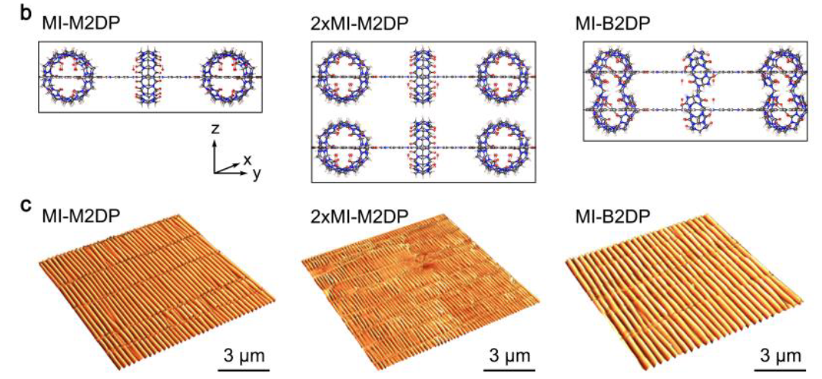
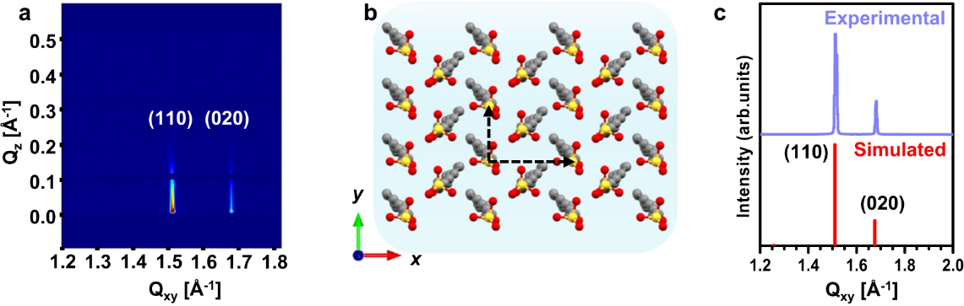
05
Site-selective chemical reactions by on-water surface sequential assembly | Structural Reinforcement in Mechanically Interlocked Two-Dimensional Polymers by Suppressing Interlayer Sliding
Writing python program for simulation of 2D XRD Basic understanding self-assembly via DFTB calculations | Probing the in-plane elasticity and the slipping behaviour of the layers
A. Prasoon, D. Bodesheim, G. Cuniberti, Y. Nagata, S. C. B. Mannsfeld, R. Dong, M. Bonn, X. Feng, et al. Nat. Commun. 2023, 14, 8313. | Y. Yang, A. Knapp, D. Bodesheim, G. Cuniberti, R. Dong, A. Fery, X. Feng, et al. 2024, DOI 10.48550/ARXIV.2401.09099. (in Revision)
06

Slide 6
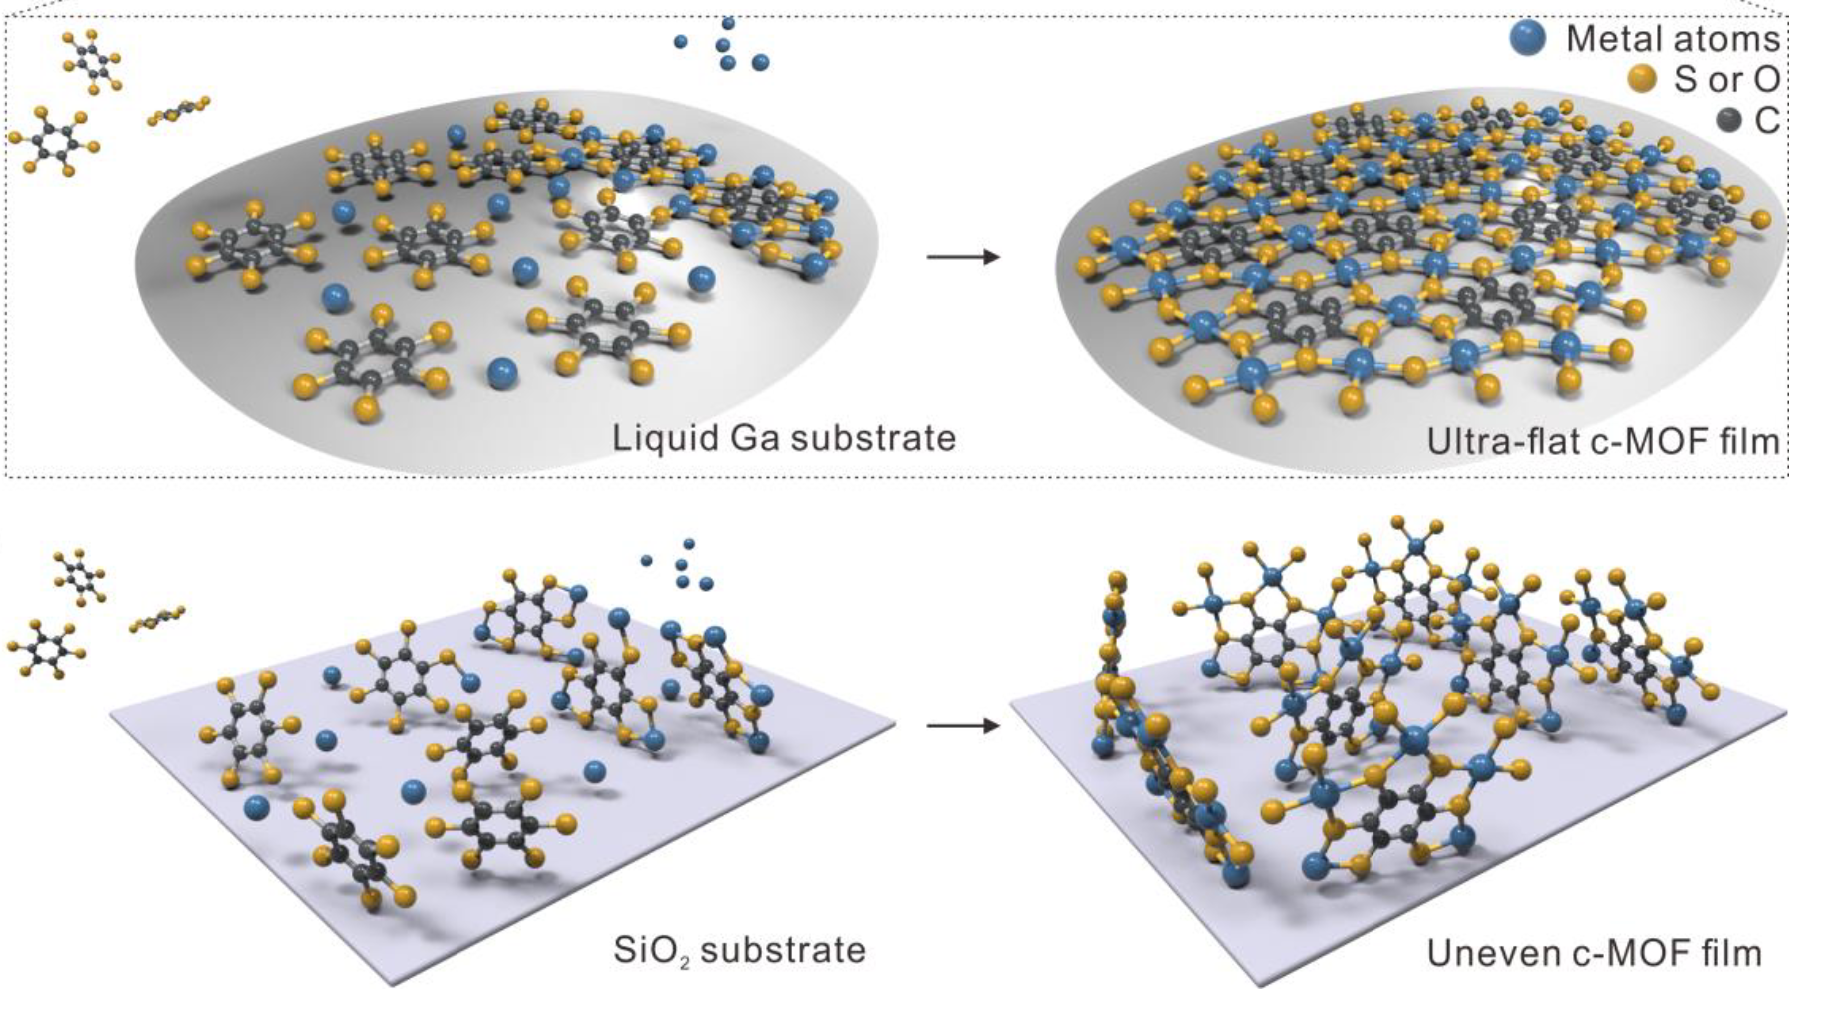
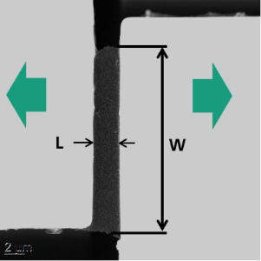
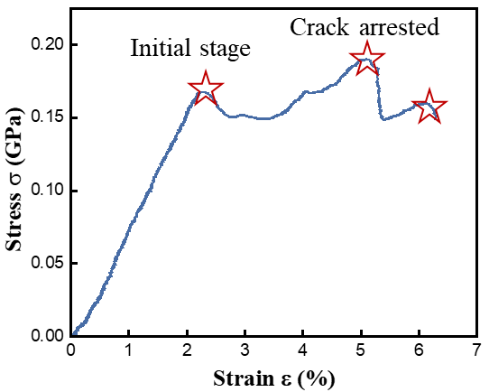
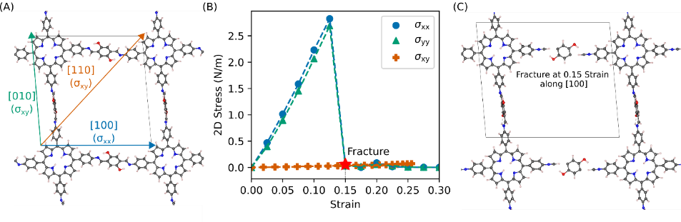
07
On-liquid-gallium surface synthesis of ultra-smooth conductive metal-organic framework thin films | Fracture behavior of two-dimensional imine-based polymer
Calculating why on liquid gallium synthesis yields smooth MOF film ➔ Stronger binding energy of precursor to Ga compared to SiO2 | Calculating the fracture point of a 2D polymer Calculating the stiffness tensor and related properties of the 2D polymer
J. Liu, D. Bodesheim, G. Cuniberti X. Feng , R. Dong, et al. Nature Synthesis (in Revision) | B. Zhang, L. Zhongquan, D. Bodesheim, G. Cuniberti, et al. (In progress)
08

Slide 7

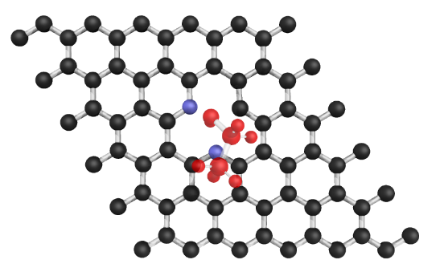
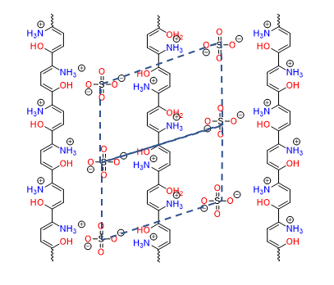
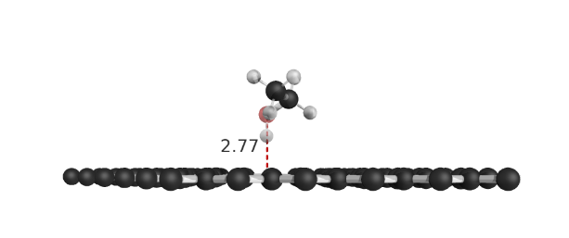
09
Unraveling the Impact of Nitrogen Doping on the Adsorption of Volatile Organic Compounds onto Graphene | Synthesis and charge-transport study of semiconducting quasi-2D polyacetylene film of record-high mobility via ring-opening polymerization of pyrrole on water surface by SMAIS method
Supervision of Li | Elucidate Structure Elif: calculate bandstructure and mobility
L. Chen, D. Bodesheim, A. Ranjbar, A. Dianat, R. Gutierrez, G. Cuniberti (in progess) | K. Liu, E. Ünsal, D. Bodesheim, G. Cuniberti, et al. (in progress)
10

Slide 8
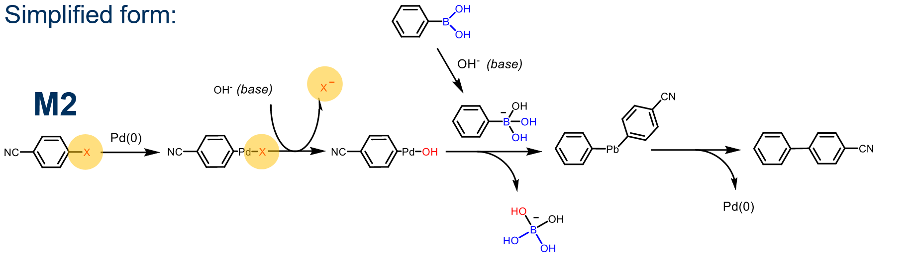
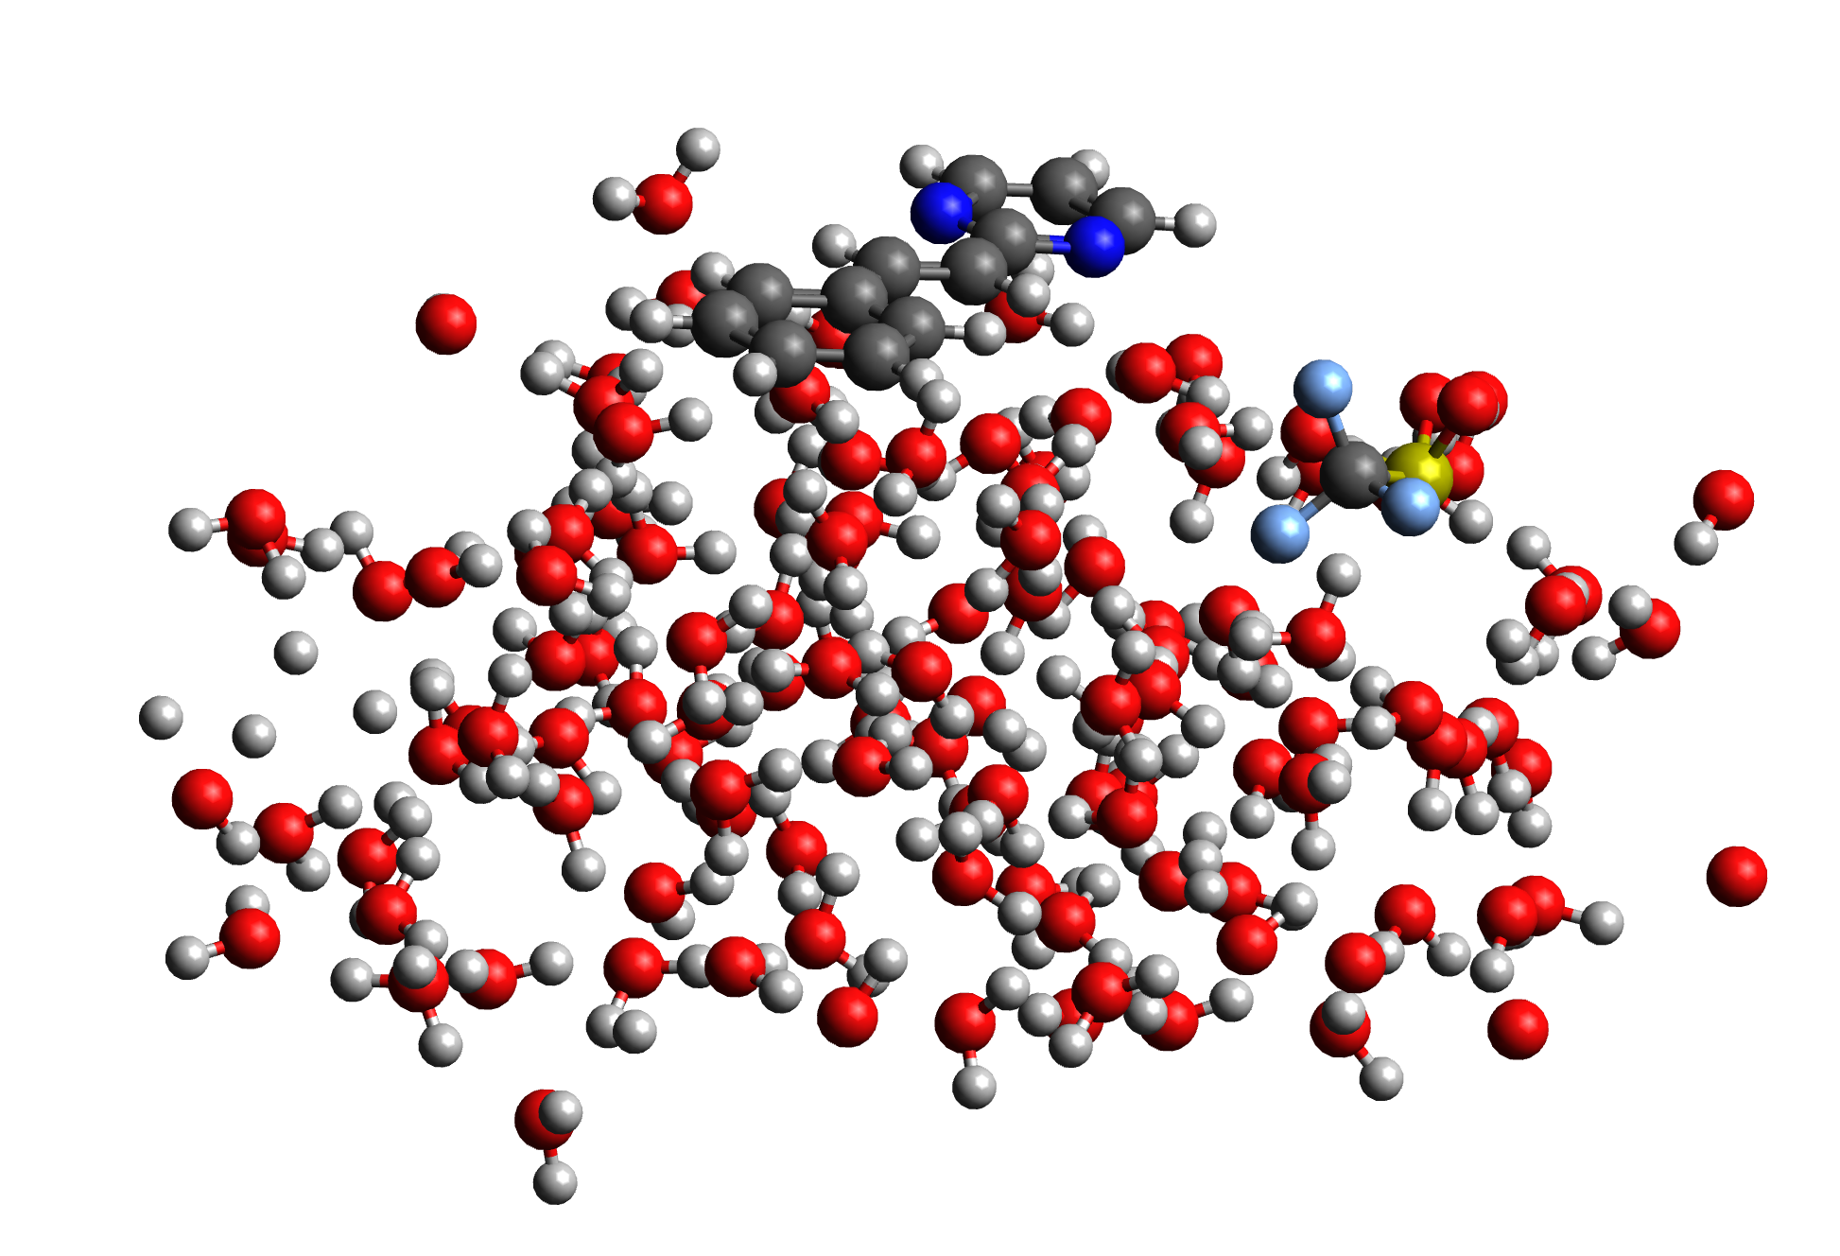
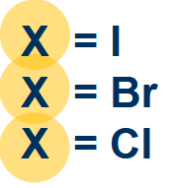
11
Reaction Barrier Study for Suzuki Coupling in the SMAIS Method | Reaction Barrier Study for Glaser Coupling DMAc/water mixture and Aldol condensation
Calculating reaction barriers on water surface for different systems | Calculating reaction barriers on water+organic solvent surface for different systems
H. Chen, Z. Wang, D. Bodesheim, A. Dianat,, G. Cuniberti, X. Feng, et al. (in progess) | Y. Ye, , Z. Wang, D. Bodesheim, A. Dianat, G. Cuniberti, X. Feng, et al. (in progress)
12

Slide 9
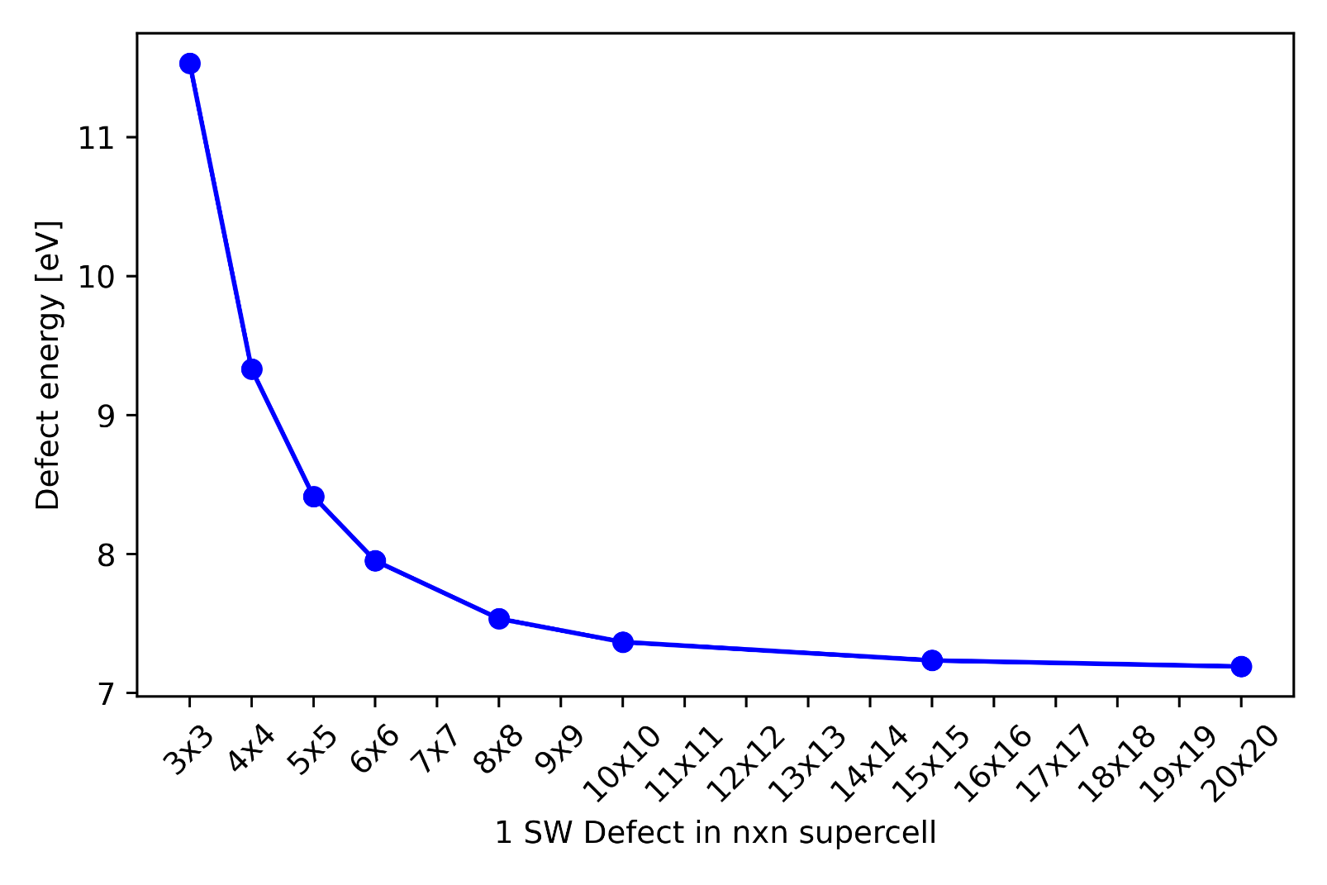
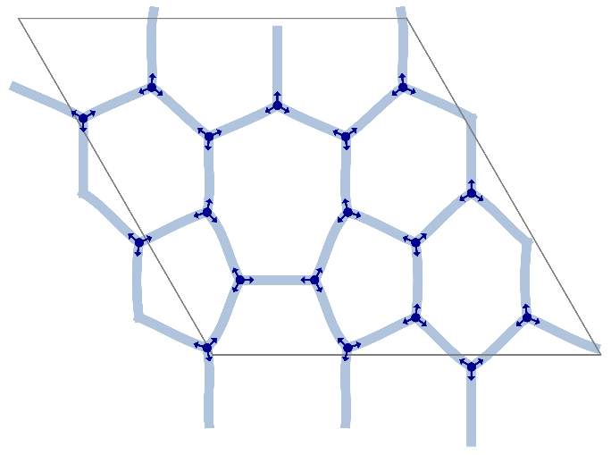
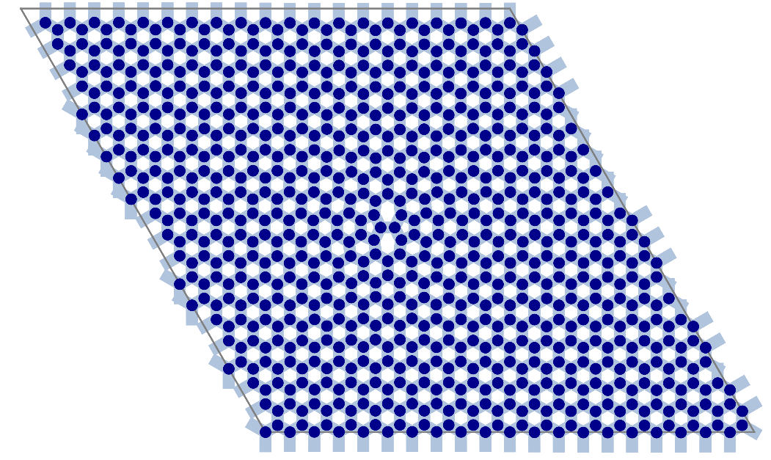
13
Optimized Ridge-Regression Mikado model for Coarse-Graining 2D Polymers
  Mikado model as Surrogate Model :
  ➔Ridge regression fitting
  Implementing a faster algorithm
  Application to multiple 2D systems
  Making a publicly available package on github
Elastic beam ≙ Linker
Mikado
Model
Example: SW defect concentration in COF-5
Rigid joint ≙ Core
3x3 supercell
20x20 supercell
D. Bodesheim, A. Croy, G. Cuniberti, et al.
(in progress)

Slide 10

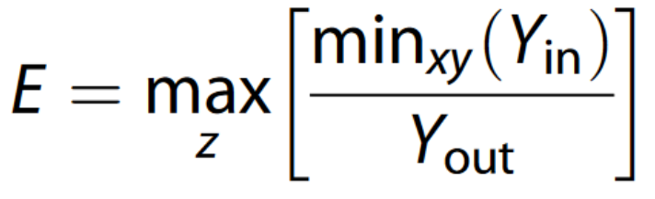
Structural and Elastic Properties of experimentally known covalent organic frameworks
14
Extract 2D COFs
Extract single-layer
Calculate
2D Stiffness Tensor
➔Elastic moduli
➔Elastic stability
➔Anisotropy
➔….
Single
Layer
2D COF
C.U.R.A.T.E.D. Database
Experimentally known COFs
Construct different stacking configurations
Likelihood of exfoliability
Exfoliation energy
Are there several stackings configurations of similar energy?
Elasticity measure of exfoliability [1]
Calculate
3D Stiffness Tensor
D. Bodesheim, G. Cuniberti
(in progess)
[1] npj Comput Mater 7, 211 (2021)

Slide 11
Summary Projects
Fully completed and published: 5
Mostly completed and manuscript available: 4
In Progress: 5
Σ
Sum of papers at the end of the PhD: 14

Slide 12
Teaching and Supervision activities
Teaching
4xNanostructured Materials:
Grading homework assignments
Redesigning and creating new exercises
4xConcepts of Molecular Modeling (MolMod):
Teaching Tutorial classes
Grading final Reports
Restructuring Tutorials
Creating four completely new tutorial classes
(Co-)Supervision
1 Lab Rotation
1 Bachelor’s
5 Student jobs
3 Diploma/Master’s Thesis

Slide 13

Time Plan
February
March
ACS March Meeting
April
Simultaneously continue writing thesis
May
Finish HTC COF project and Coarse Graining-Project
Finish all open collaborations?
June
End of contract
July
Hand in Thesis

