Slide 1
Sliding contacts in liquid environments: Nanotribology in Liquid
Thesis Advisory Committee
Progress Report
Dennis Kang
Jan 2023

Slide 2
Agenda
Brief background
Friction Force Microscopy in liquid
Prandtl-Tomlinson model
Piezo-electric sensors
Normal & Lateral Force calibrations
Results and Potential publications
Tribolayer phenomenon of MoS₂ in PYR-14 TFSI ionic liquid
Milestone
What needs to be done in the future
Questions to consider
Jan 2023

Slide 3
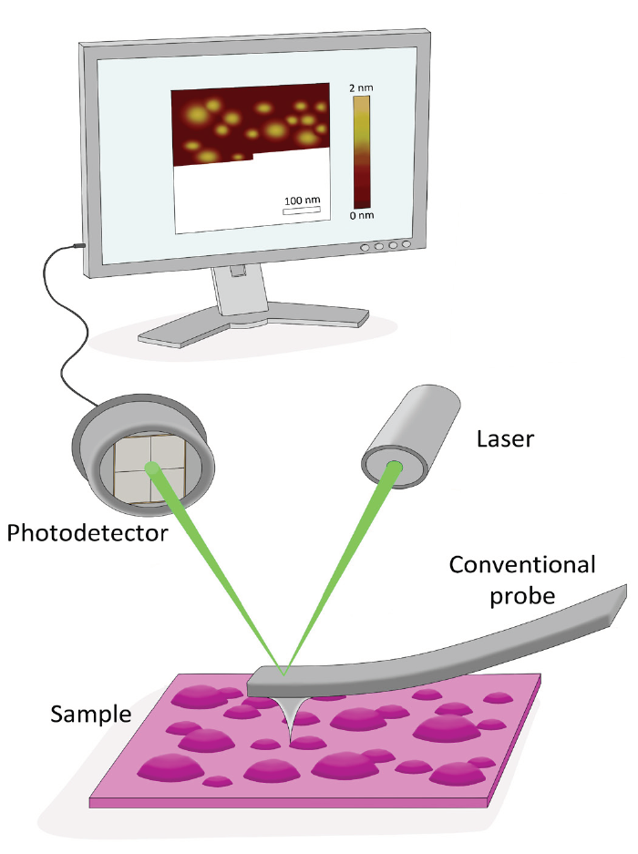
Friction Force Microscopy
Laser is directed onto the back coating of the cantilever then reflected towards the photodetector
Photodetector experiences an exaggerated movement of the laser position
Topography (height) is recorded along the scan direction
Torsion bending of the cantilever is also recorded
Torsion angle is proportional to the friction / lateral force (↗ Torsion = ↗ Friction)
Software projects these signals into an image (line by line)
[1]
[2]
[1] https://nunano.com
[2] https://www.ntmdt-si.com/resources/spm-principles/atomic-force-microscopy/contact-afm
Jan 2023

Slide 4
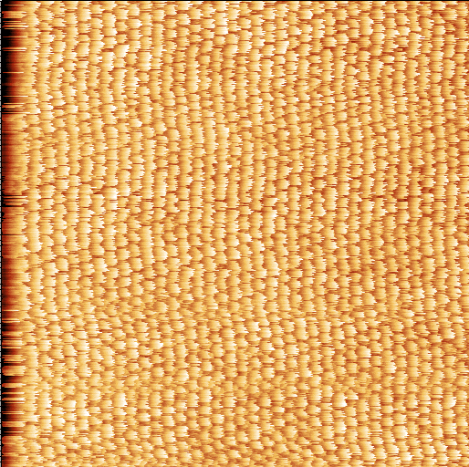
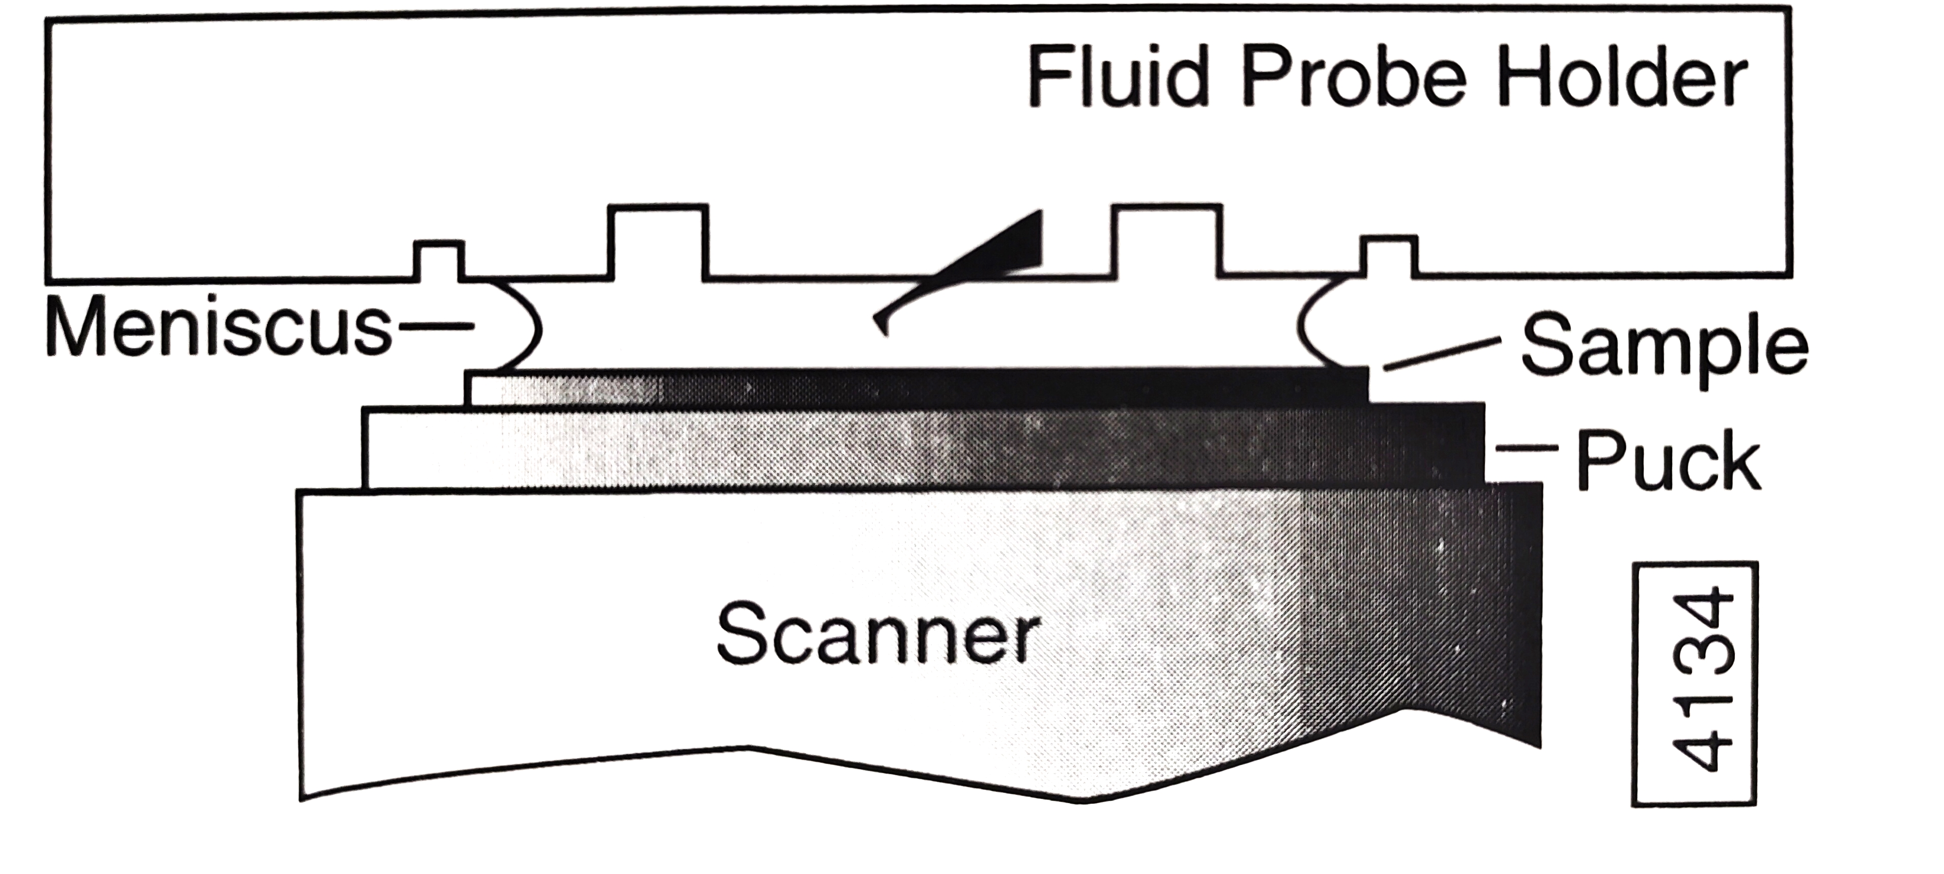
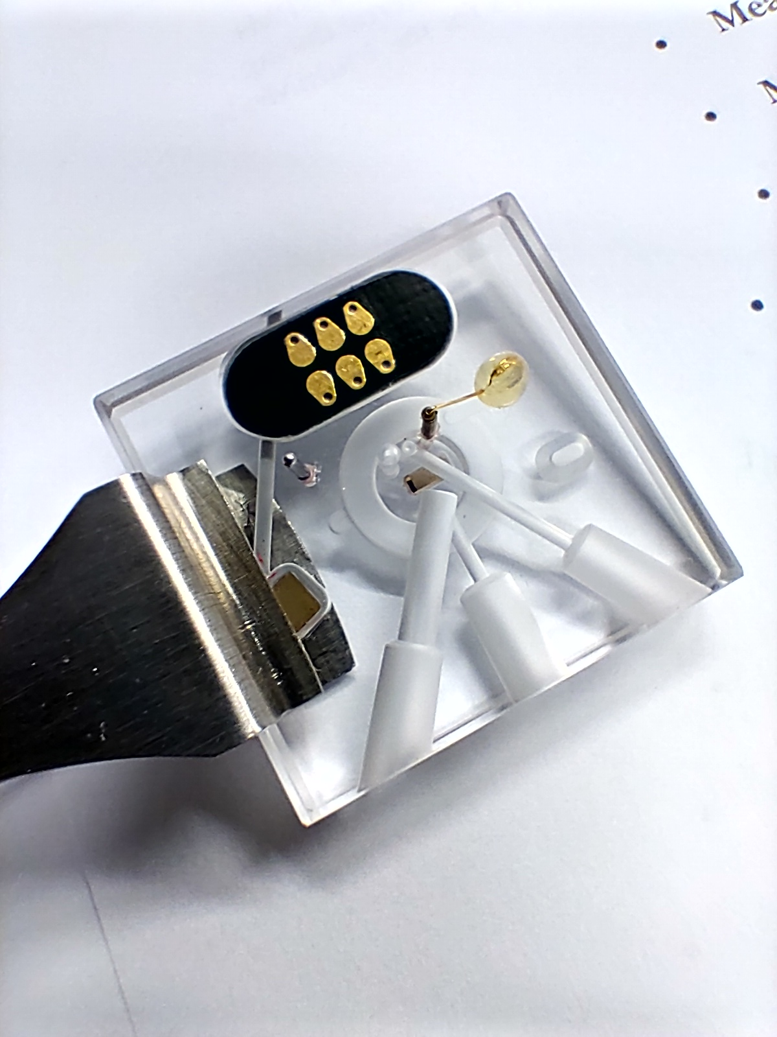
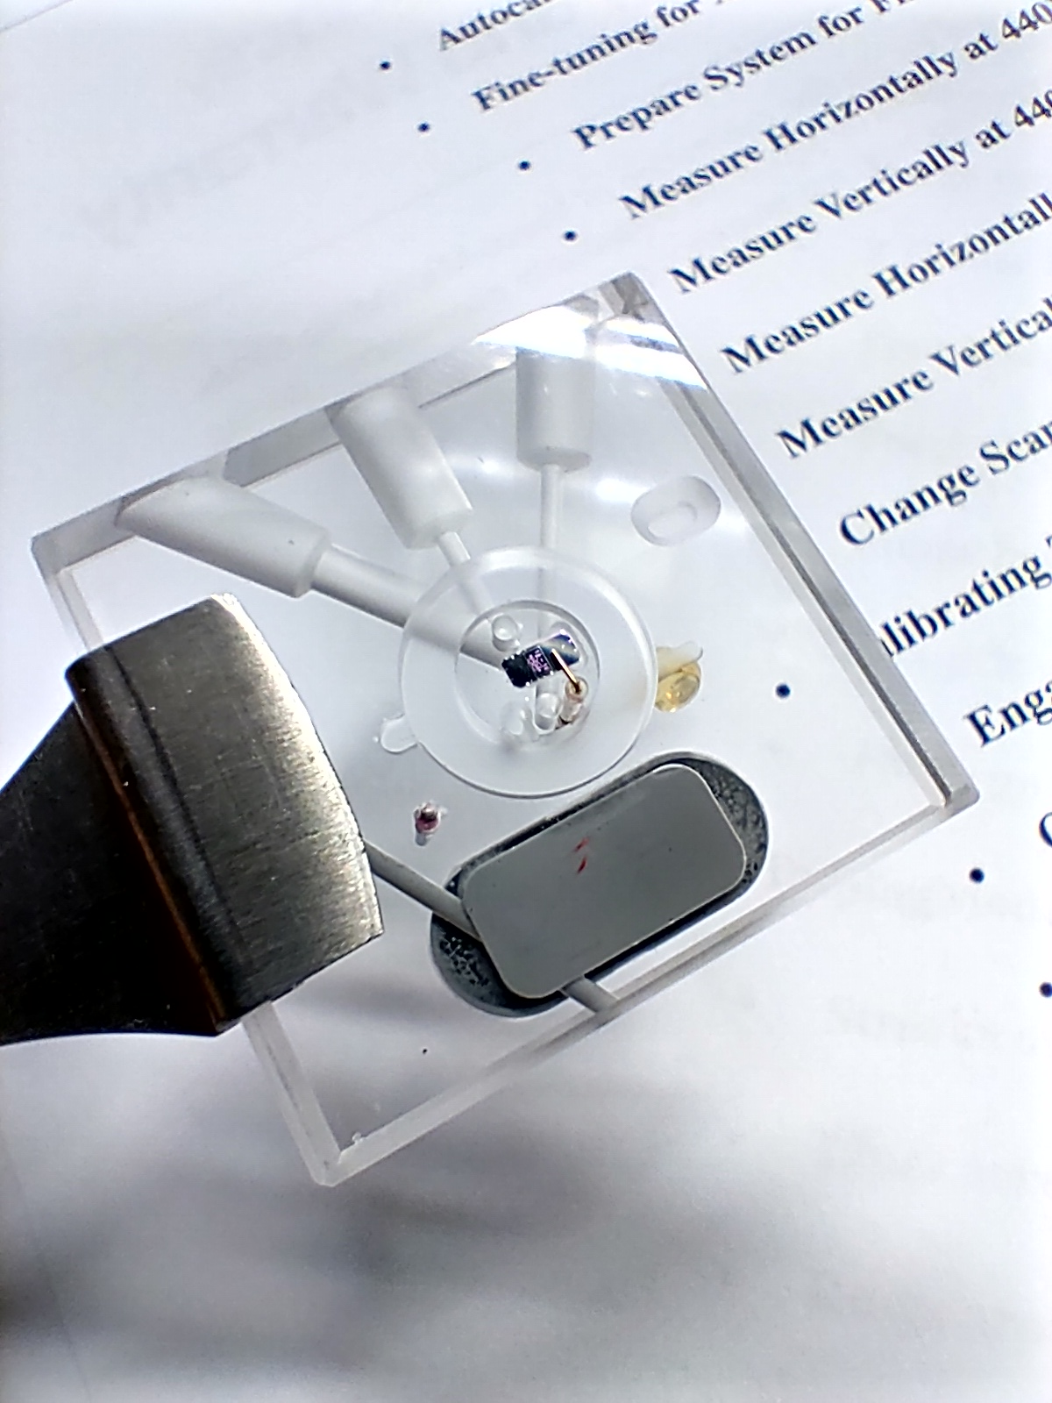
Friction Force Microscopy in liquid
Probe holder = Glass block
Transparency allows laser to go through
Meniscus formation
Liquid droplets are squeezed in between the sample and the probe holder = ↓ Friction variation (i.e. capillary condensation) = ↑ image quality
Closed-cell is no different
Restricts liquid to escape (i.e. volatile liquids)
Open-cell configuration
Top
Bottom
Mica in Water (20 x 20 nm²)
Jan 2023

Slide 5
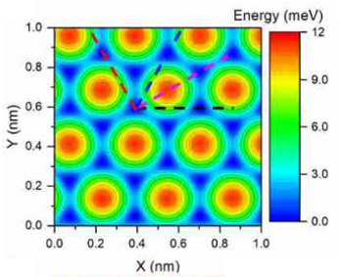
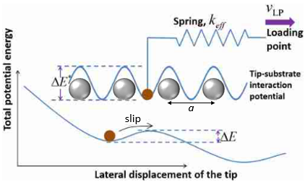
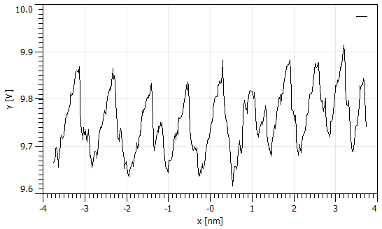
Prandtl-Tomlinson (PT) model
Potential Energy Profiles
Atoms are arranged
as corrugated energy wells
Stick-Slip motion
Tip (point-mass) is being pulled as it climbs up the energy well (atom), but slight resistance (friction) is present = Stick
The tip attains enough energy to overcome the energy well, relaxing immediately after passing the peak = Slip
[3]
[4]
Saw tooth (stick-slip) profile of MoS₂
[5]
[3]M. R. Vazirisereshk, K. Hasz, R. W. Carpick, A. Martini, J. Phys. Chem. Lett, 2020, 11, 6900-6906
[4] K. Tian, D. L. Goldsby, and R. W. Carpick, Phys. Rev. Lett, 2018, 120, 186101
[5] J. S. Helman, W. Baltensperger, and J. A. Holyst, Simple model for dry friction, Phys. Rev. B 49, 3831 (1994)
Jan 2023

Slide 6
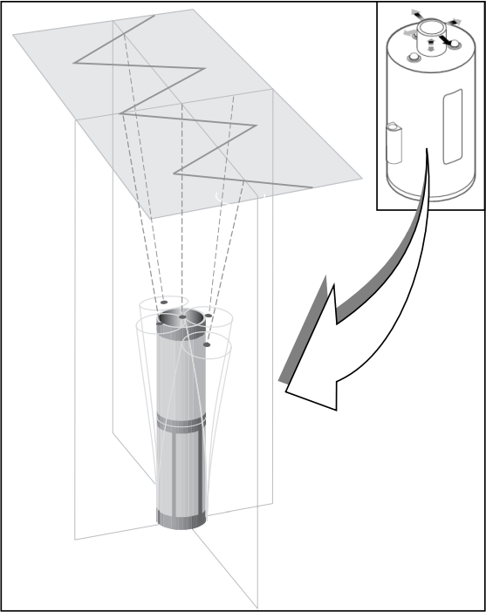
Piezo-electric scanners
[6]
2 types, but same principle
AFM Head (Nanowizard, Nanosurf, Bioscope)
Sample base (Multimode)
Voltage application
Planar XY raster pattern
↓ Scanner Size = ↓ Acoustic noise = ↑ Precision (i.e. atomic scale)
A - piezo
slow (Y) axis
Fast (X) axis
Tripod adjustment nozzles
J - piezo
A | E | J
Superior atomic resolution (size range 8 - 400 nm²) | Mid-range between A and J (max. size up to 10 μm²) | Auto tripod adjustment (max. size up to 125 μm²)
Manual tripod adjustment is required, Poor Z-position stability (E - piezo is more stable) |  | Cannot attain atomic resolution
[6] Multimode SPM Instruction Manual, p.23
Jan 2023

Slide 7
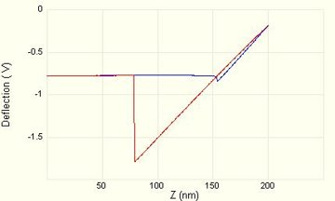
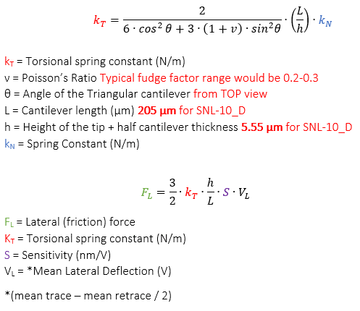
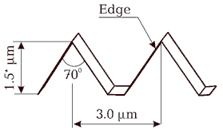
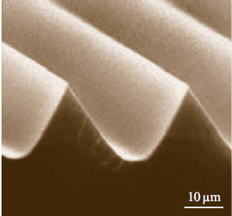
Force calibrations
All corresponding forces are measured in Voltages
Normal Force (F_{N})
Force-Distance curve
Thermal oscillation method (not available in Multimode AFM)
Friction Force (F_{F})
TGG1 calibration gratings
Varying normal force to identify conversion ratio between V and nN
Conversion formulae
Fast estimation
incompatible with thermal oscillation method
Gradient
= Sensitivity (S)
Adhesion
[7]
[7] https://www.ntmdt-tips.com/products/view/tgg1
Jan 2023

Slide 8
Results and potential publications
In Progress…
MoS₂ in PYR-14 TFSI ionic liquid
Friction transition of tribolayer penetration
Pending
Single Material, Several liquids
MoS₂ in air (reference), water, PYR-14 TFSI, BMIM-PF₆
Several Materials, Single liquid
Mica, NaCl, CaCO₃, MoS₂, in BMIM-PF₆
Jan 2023

Slide 9
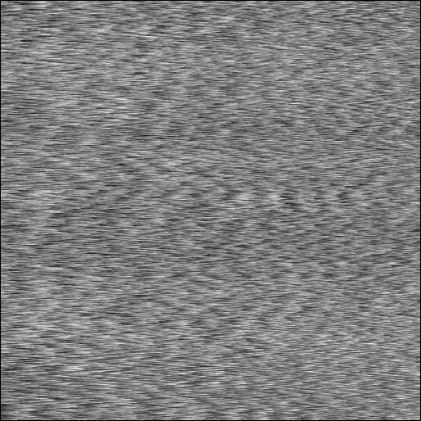
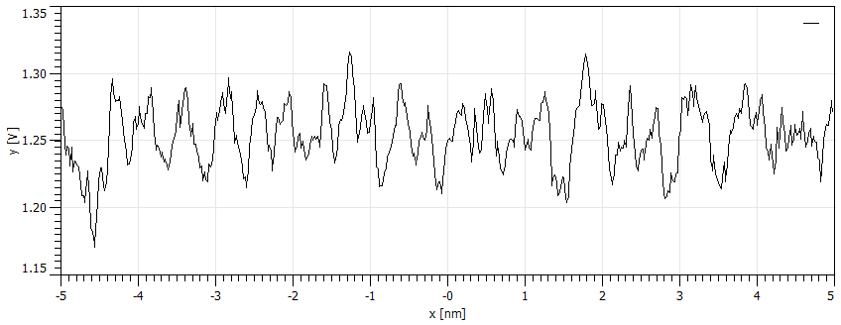
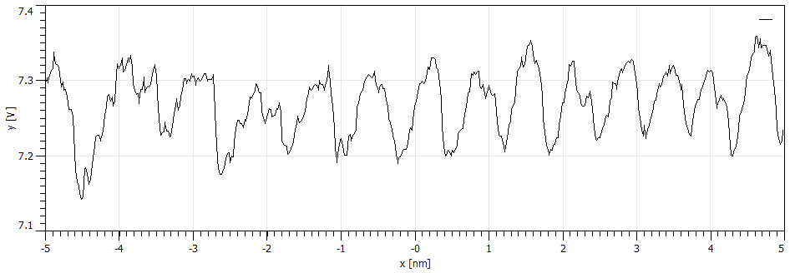
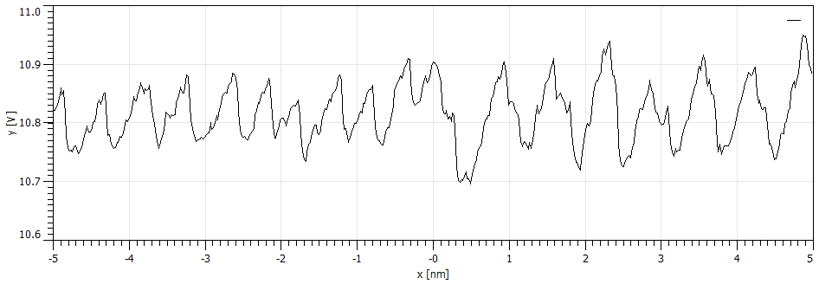
Sample | Medium / Mode | Image (Pixels) | Cantilever | Measurement Date
MoS₂ (Bulk_sheet) | PYR14 - TFSI / Contact Mode | Lateral Deflection (512 x 512) | SNL-10_D (no.10) | 24 – JUNE – 2021
10 x 10 nm² | Pre-transition
Set-Point (nN) | iGain (Hz) | 50 | Line Rate (Hz) | 50
98 | PGain | 0.001 | Tip Velocity (μm∙s⁻¹) | 1.56
10 x 10 nm² | Moment of transition
Set-Point (nN) | iGain (Hz) | 50 | Line Rate (Hz) | 50
98.5 | PGain | 0.001 | Tip Velocity (μm∙s⁻¹) | 1.56
10 x 10 nm² | Post-transition
Set-Point (nN) | iGain (Hz) | 50 | Line Rate (Hz) | 50
103 (max.) | PGain | 0.001 | Tip Velocity (μm∙s⁻¹) | 1.56

Slide 10
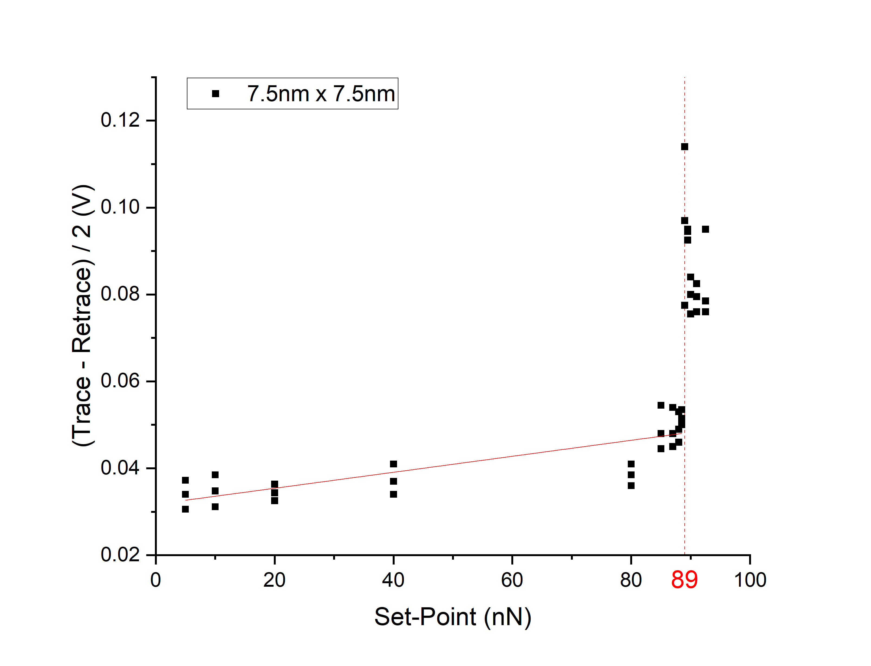
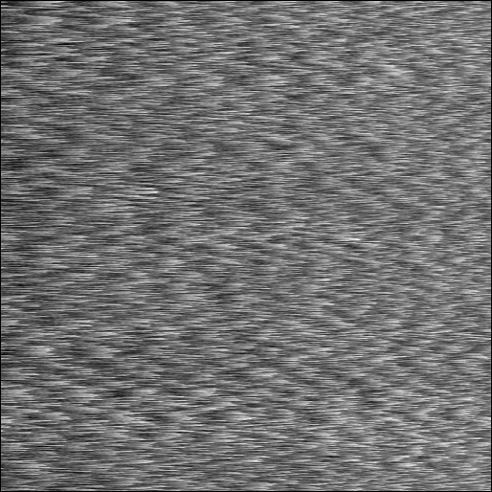
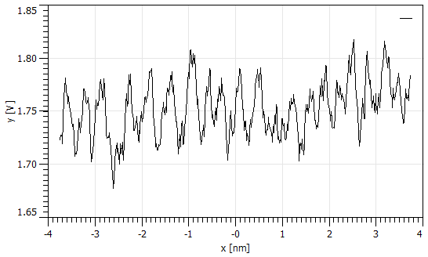
Sample | Medium / Mode | Graph | Cantilever | Measurement Date
MoS₂ (Bulk_sheet) | PYR14 - TFSI / Contact Mode | Set-point vs Mean Lateral Deflection | SNL-10_D (no.10) | 25 – JUNE – 2021
Pre-Transition (F_{N} = 88.5 nN)
Post-Transition (F_{N} = 92.5 nN)
Friction (uncalibrated) vs normal force plots of MoS₂ in PYR14-TFSI IL
Bulk MoS₂ in PYR14-TFSI
Jan 2023
Notes:
10

Slide 11
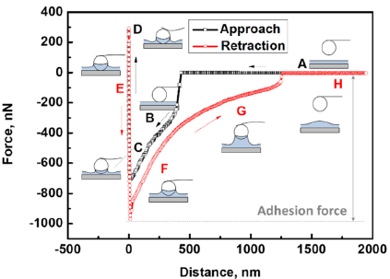
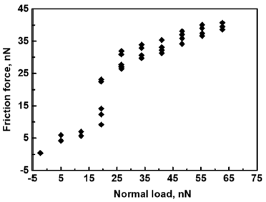
MoS2 in PYR-14TFSI
[8]
‘’Atomic force microscopy probing interactions and microstructures of ionic liquids at solid surfaces’’ by Rong An et al.
Load dependence relationship of the graphite (HOPG) and mica in ionic liquid
Same ionic liquid (MBIM-PF₆) was used in this publication
Instead of sharp tip, they used colloidal silica probe (more common in this field)
their lattice scale image is missing
There is a chance to establish tribolayer related phenomenon with comparable dataset beyond state of the art
[8] R.An et al. Nanoscale, 2022, 14, 11098-11128
Jan 2023

Slide 12
Milestone
 | MoS₂ Bulk sheet | Mica | CaCO₃ (Calcite) | NaCl (Salt crystal)
Air (Reference) | ○ (Jena 2021) | ○ (Dresden 2021) | ○ (Dresden 2021) | ○ (Dresden 2022)
Water |  | ○ (Dresden 2022) | ○ (Dresden 2022)
PYR-14 TFSI (Jena) | ○ (Jena 2021) | ○ (Krakow 2022) | ○ (Krakow 2022)
BMIM-PF₆ (Israel) | ○ (Krakow 2022) | ○ (Krakow 2022)
Some of the dataset needs to be repeated with Multimode (Dresden)
To ensure its consistency with other hardware
i.e. Nanosurf (Krakow), Nanowizard (Jena)
Troubles with friction force calibration
Possible solution: Apply average of all previously measured conversion ratio
Jan 2023

Slide 13
What needs to be done in the future
Complete rest of the dataset
Different ionic liquids and materials
Replication with Multimode
Explain the chemistry of tribolayer phenomenon
Prof. Berkovich may be able to help with his background knowledge
Simulation of PT model in liquid
Compare the dataset with the colloidal probe measurements in IL
Produce drafts for the publication
Jan 2023

