Slide 1
TAC kick-off Meeting of
Mr. M.Sc. Wei Wang
21.12.2022

Slide 2
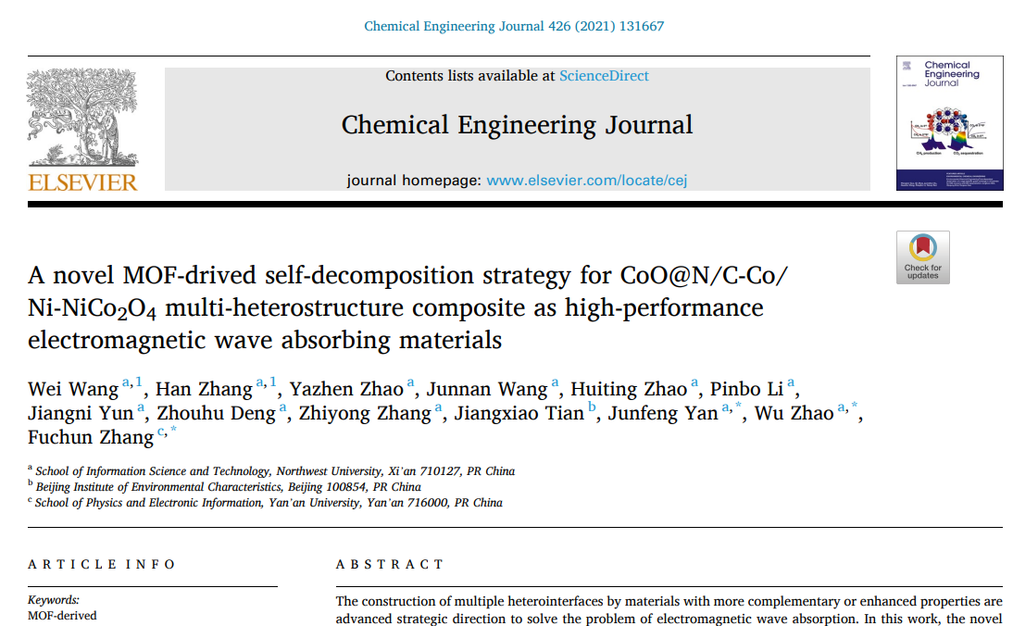

M. Sc. Wei Wang
Date of Birth: 03/05/1995
Cell: 0049 17687915397
Email: wei.wang1@mailbox.tu-dresden.de; weiwang9505@gmail.com
Holder of CSC (China Scholarship Council) Scholarship for PhD project, since 05.2022
Master of Science in Microelectronics and Solid State Electronics in 2021 from the College of Information Science Technology, Northwest University, Xi’an, P.R. China
Bachler of Science in Electronic Information Engineering in 2018 from the College of Physics and Electronic Information, Yan’an University, Yan’an, P.R. China
Achievements: 9 Papers as a first author and 5 papers as a coauthor in peer-reviewed journals !
Main topics of the papers:
  MOF structures MCo₂O₄ (M=Ni, Zn)@ZIF-67 and derivatives (12 surfaces and one pore system)
  Unpublished work on MOF structures ZIF-8 (focus on electromagnetic wave absorbing, possible application might be hydrogen and CO₂ separation)
  Photocatalysis using (Ag⁺-, Er³⁺-, Cd²⁺-, Fe³⁺-, doped BiOBr)
  Magnetic Ni- or Co- doped ZnO nanowires array for information storage

Slide 3
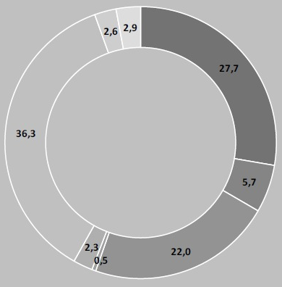
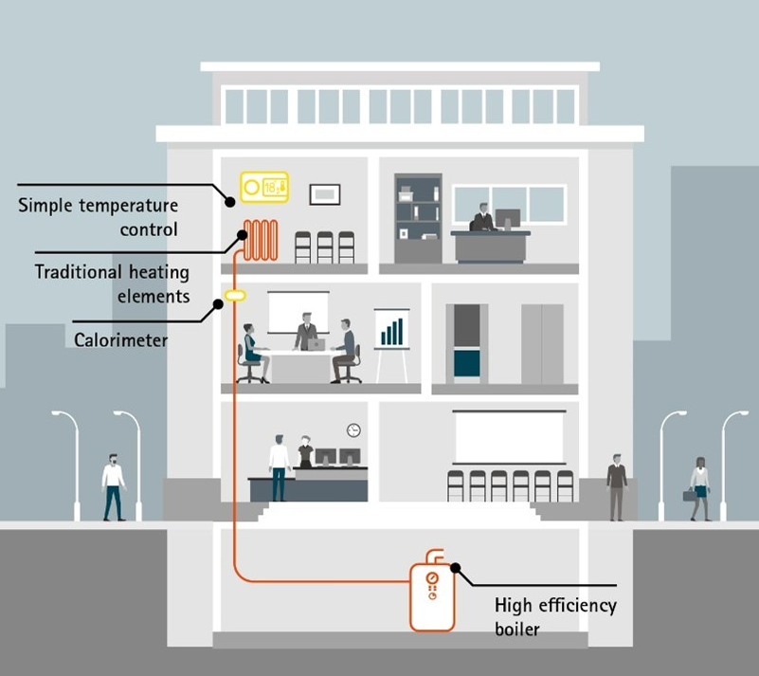
Background: Sustainability Issues in the Building Sector
Cementitious Matrices:
Portland Cement
Geopolymers etc.
Energy Balance in Households in Germany (2020)
Thick materials are needed.
More Materials → Higher CO₂ discharge!!!
Thermal Isolation:
EPS (Expanded Polystyrene)
PUR-Foams
Environmentally unfriendly!
EPS is not biodegradable!
Central Question:
What are strategies to reduce the energy amount needed for heating？
Room heat
Mechanical energy
Process warming

Slide 4
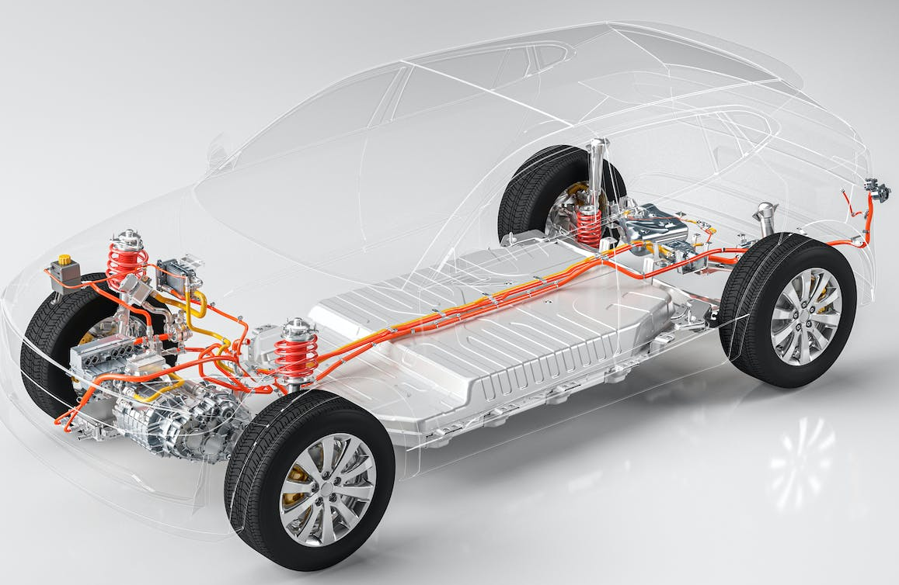
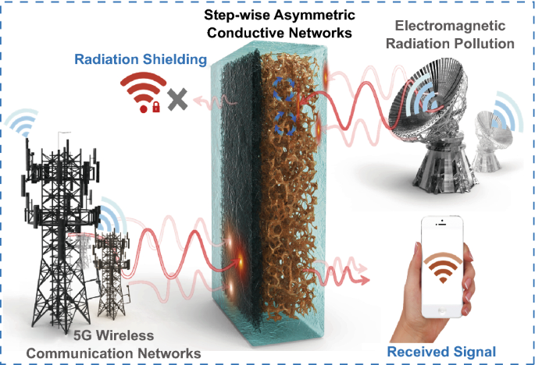
Background: Functionality Issues reg. Electro Magnetic Interferences
Sources of EMI in Electric Cars
Power converters
Traction batteries and interconnectors
Shielded and unshielded cables
Battery chargers
Collision avoidance radar
Navigation systems etc.!
Sources of EMI in Building sector
Electromagnetic radiation pollution
Communication networks etc.
Central Question:
What are strategies to design EMI Shielding principles with
adjustable wide frequency ranges,
ability for miniaturized design,
light weight ( e. g. to increase the efficiency of E-cars)
strong EMWA performance and for energy harvesting

Slide 5
Topic:
Multidimensional nanostructured materials for energy storage applications and electromagnetic wave absorbing (EMWA) applications
3D materials (MOFs (Co-MOF, Ni-MOF and Zn-MOF), MOFs derivatives, Bimetallic oxides (MCo₂O₄ (M=Ni , Mn, Fe))).
Ni-, Mn-, Fe-, Zn- doped 3D materials.
2D materials (Graphene, rGO, Mxene).
1D materials (CNT).
3D&1D, 3D&2D composites.
For energy storage applications
Literature survey on MOF-based phase-change materials (PCM).
How to design MOF-based Phase-change materials (PCM)?
Which temperature range can be designed for proper latent heat storage and release?
What mechanisms of alkali-activated geopolymers reinforcement are possible using MOF-based PCMs?
Mechanism for improvement of thermal conduction in cements, e. g. by 1D or 2D Materials ( CNTs, Gr, r-GO)

Slide 6
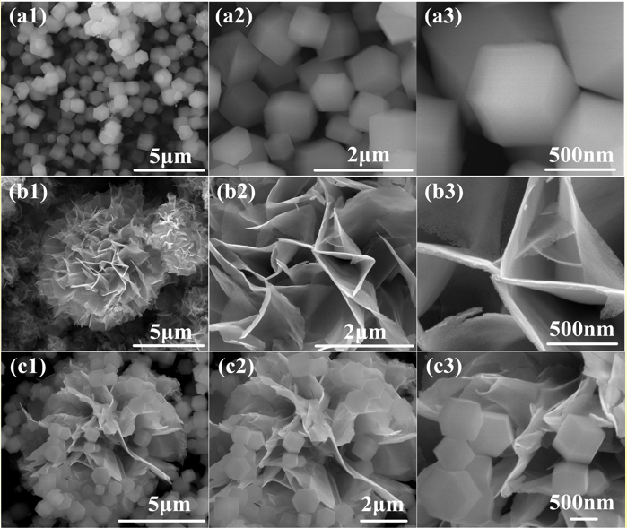
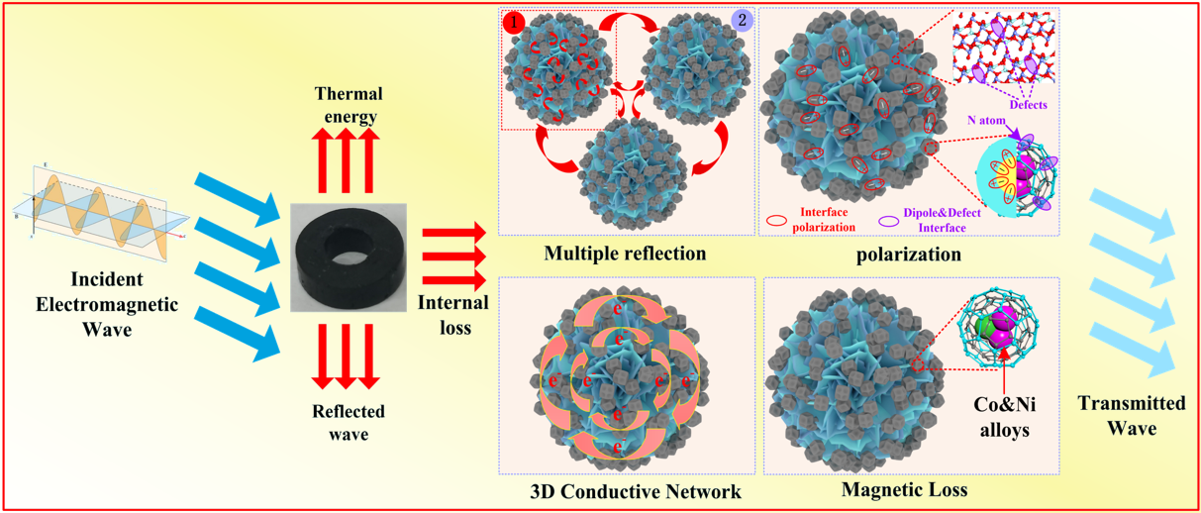
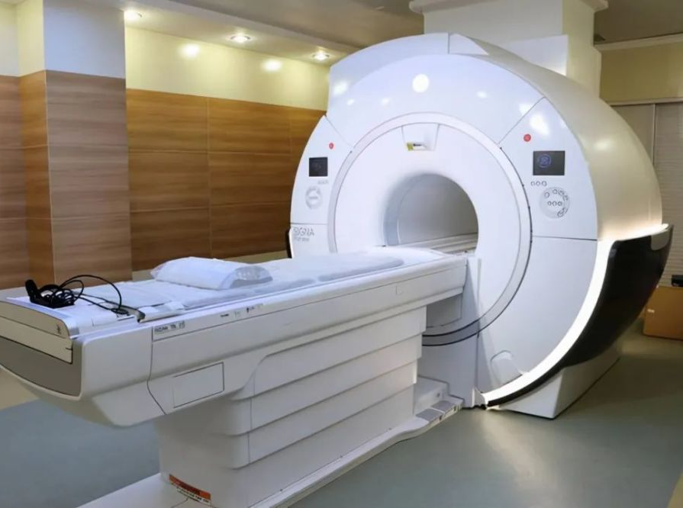
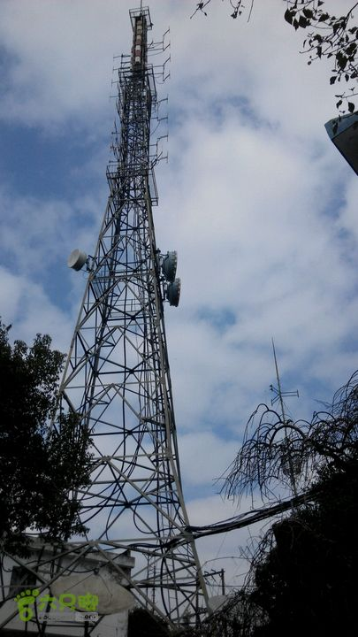
Topic:
Multidimensional nanostructured materials for energy storage applications and electromagnetic wave absorbing (EMWA) applications
For electromagnetic wave absorbing applications
Literatures survey on the mechanism of electricity and magnetism of MOF based composites.
Electromagnetic matching is essential principle for EMWA.
How to design MOFs with unique structure to enable EMWA in CFRP (carbon fibers reinforced plastics)
Principles needed to increase polarization, conductivity and magnetic loss of the MOFs, i. e. via low-temperature carbonization under inert atmosphere (derivatization processes of MOF).
Mixing of material and paraffin
Magnetic resonance imaging (MRI)
Signal tower

Slide 7
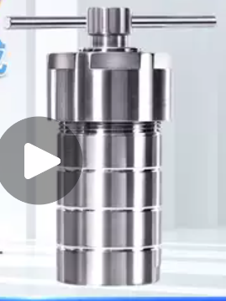
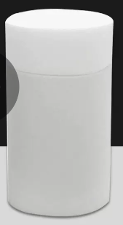
Required Equipment:
High pressure reactors, beakers, magnets;
Chemical reagents of analytical purity grade;
Fabrication;
Characterizations and data analysis software;
Instruments | Model | Manufacturers
Electronic analytical balances | FA1004 | N/A
Ultrasonic cleaners | KQ2200DB | N/A
Magnetic string | CJJ78-1 | N/A
High Pressure Reactor | 100 mL, Contain: Polytetrafluoroethylene liner | N/A
Tabletop high-speed centrifuges | TD4K-Z | N/A
Tube Furnaces | OTF-1200X-S | N/A
Ultra Pure Water Machine | ED12-100-U | N/A
Vacuum drying ovens | HJ-3 | N/A
Vacuum drying ovens | 101-0ASB | N/A
Scanning Electron Microscope (SEM) | SIGMA | N/A
Transmission Electron Microscope (TEM) | JEM-F200 | N/A
X-ray diffractometer (XRD) | XRD-6100 | N/A
Raman Spectroscopy (Raman) | XPLORA PLUS | N/A
X-ray photoelectron spectroscopy (XPS) | XPS-UltraDLD | N/A
Integrated physical property measurement systems (PPMS) | PPMS-9 | N/A
Vector network analyzers | AV3629 | N/A
Reagents | Chemical formula | M (g/mol) | Purity | Manufacturers | Amount
Cobalt nitrate hexahydrate | Co(NO₃)₂·6H₂O | 291.03 | 99.0% | Kermel | 1
Nickel nitrate hexahydrate | Ni(NO₃)₂·6H₂O | 290.81 | 99.0% | Kermel | 1
Zinc nitrate hexahydrate | Zn(NO₃)₂·6H₂O | 297.49 | 99% | Kermel | 1
2-Methylimidazole | C₄H₆N₂ | 82.104 | 98.0% | Macklin | 1
Hexamethyltetramine | C₆H₁₂N₄ | 140.19 | 99% | Rhawn | 1
Isopropyl alcohol | C₃H₈O | 60.06 | ≥99% | Kermel | 1
Anhydrous ethanol | CH₃CH₂OH | 46.07 | ≥97.0% | Rhawn | 1
Anhydrous methanol | CH₃OH | 32.07 | ≥99.5% | Rhawn | 1
Liner: PPL+PTFE,
Temperature:
-200 ~ +300 ℃

Slide 8
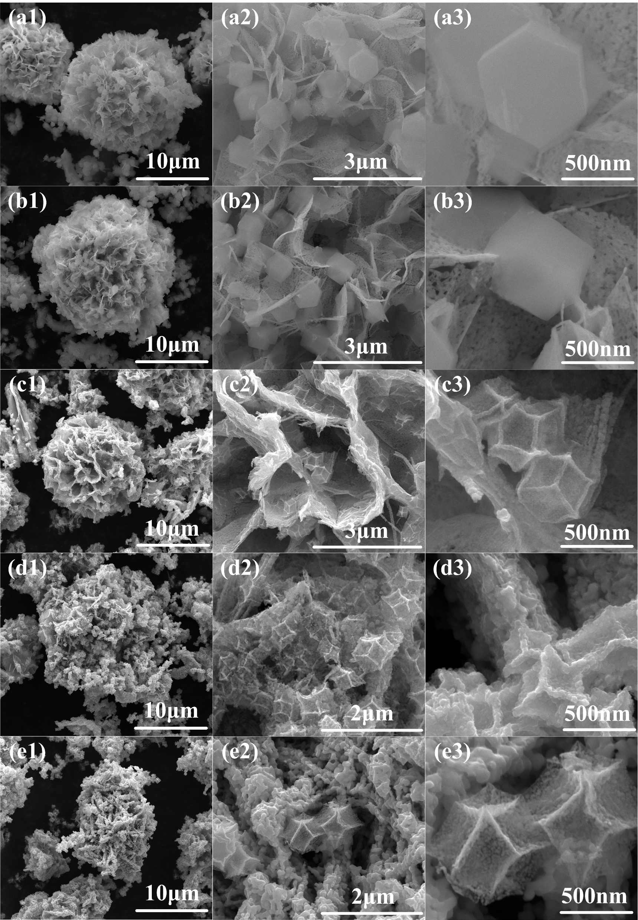
Process:
Fabrication of MOFs;
Fabrication of MOFs based composites;
Exploration of temperature ranges;
Parameter adjustment and improvement;
Fabrication of Bimetallic oxides (MCo₂O₄ (M=Ni , Mn, Fe)), 2D, 1D materials

Slide 9
Potential Risks:
For Building sector
  finding of the right PCM for latent heat storage
  Methods for encapsulation the PCMs in MOFs (e. g. one-pot method, or two-step method (impregnation and leaching in the pores of MOFs be capillary forces)
  Reinforcing, deteriorating or maintaining the mechanical properties (compressive strength, flexural strength) by incorporation the MOFs and PCM encapsulated MOFs
  Inconsistency between designed experimental results and objectives (better or worse).
  Unsuitable temperature and pH ranges for MOFs in highly alkaline environments, e. g. alkali-activated geopolymers
For composites materials
  Compatibility between the resin and the selected MOFs or calcinated MOFs
  Finding the possible processing window when filling the resin with the MOFs or the calcinated MOFs
  Balancing the required MOFs concentration for achieving the desired EMWA and the resulting viscosity of the resin for further processing (coating, spraying etc.)
  The possibility of increasing the thermal conductivity of the composites (MOFs + resin) by modification of MOFs via pre-carbonization (calcination @ 450 ℃ under inert atmospheres)

Slide 10
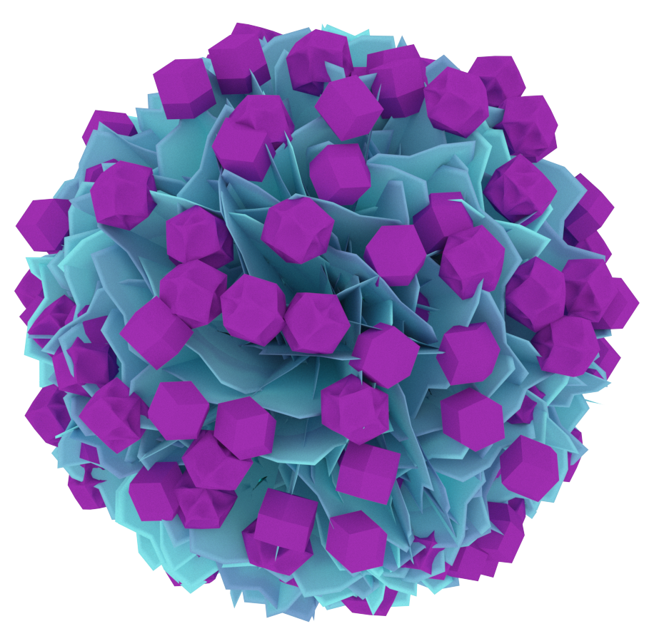
Thank you for your kind attention
NiCo₂O₄@ZIF67 before calcination

