Slide 1



Mechanical Characterization of Nano-scale Interfaces in Biocomposite Material
Mohammad Tadayon B CUBE – Center for Molecular Bioengineering, Technical University of Dresden, Germany
TAC Meeting 10.02.2021

Slide 2

OUTLINE
Introduction
- Biological materials and their mechanical properties
- Interfaces in biocomposite material
Purpose of the study
- Challenges
Three main approaches to conduct the study
- Theoretical
- Instrumental
- Experimental
Work Plan

Slide 3
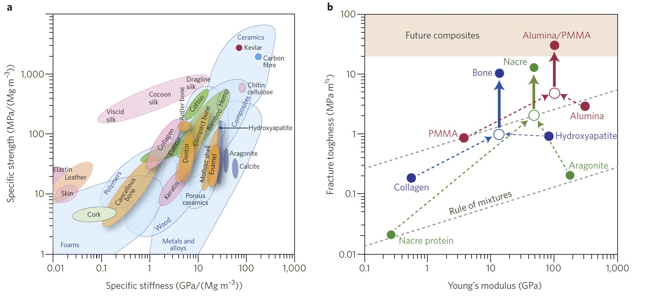
MECHANICAL PROPERTIES OF BIOMATERIALS
Complex composite materials with diverse mechanical functionalities
Properties are achieved through hierarchical structuring over many length scales
U. Wegst et. al. , Nature Materials, 2014

Slide 4
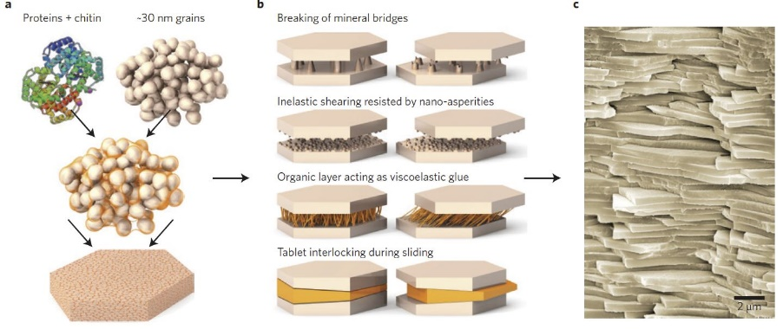
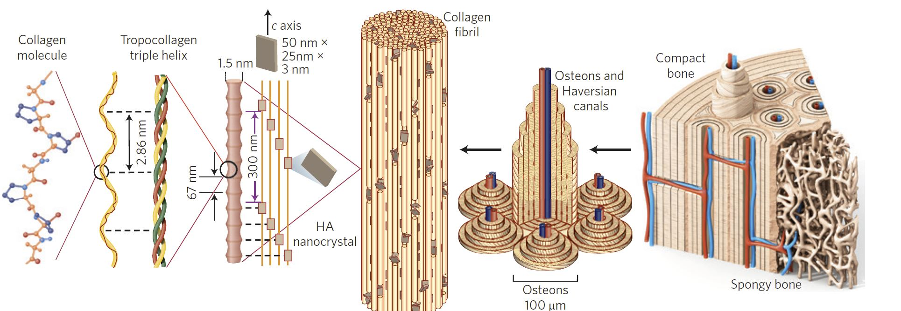
HIERARCHY
Nacre
Bone
U. Wegst et. al. , Nature Materials, 2014

Slide 5
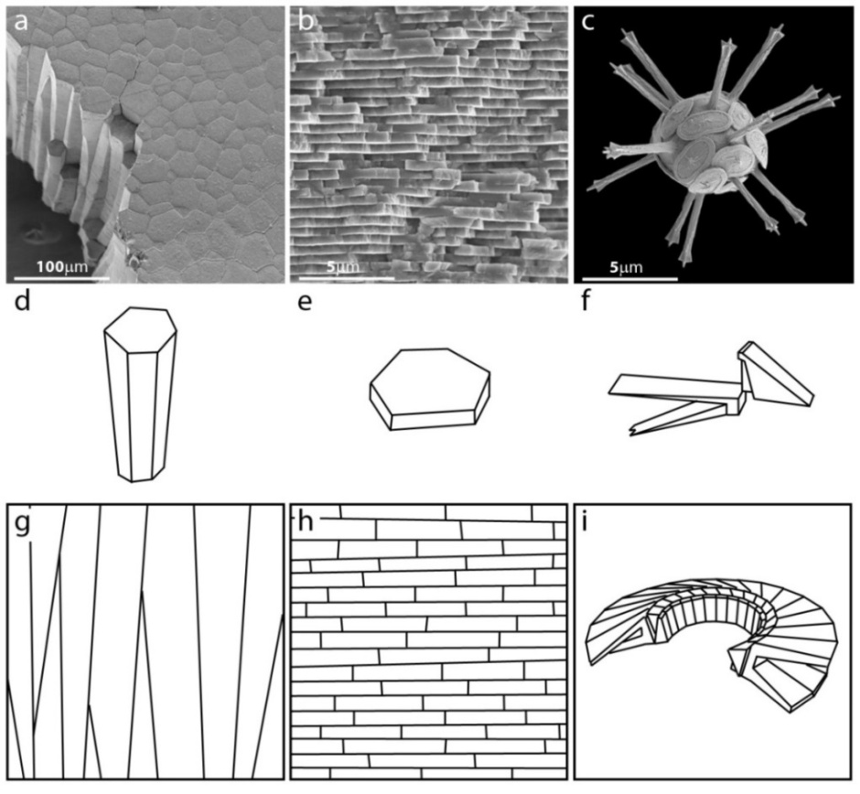
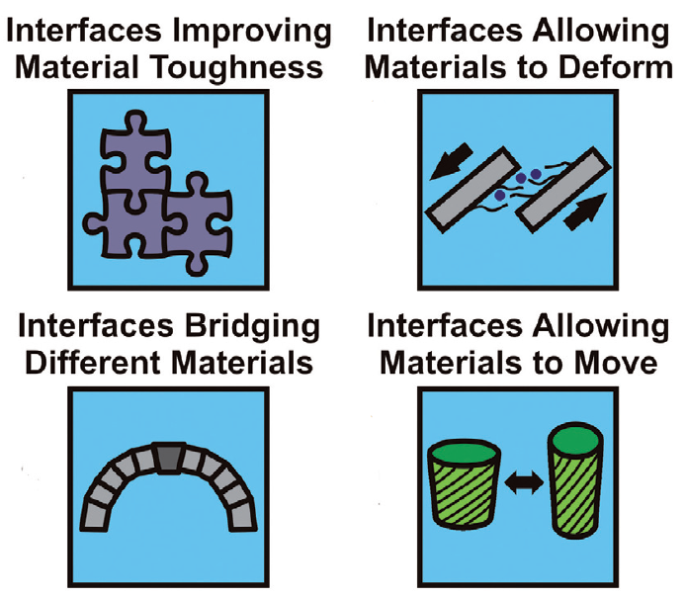
INTERFACES IN BIOCOMPOSITE
Pinna Nobilis
Perna Canaliculus
Coccolithophore
Interfaces Improving
Material Toughness
Interfaces Allowing
Materials to Deform
Mineral
– Stiffness
– Strength
Organic Interfaces
– Toughness
– Deformability
– Viscoelasticity
Interfaces Bridging
Different Materials
Interfaces Allowing
Materials to Move
~ 1 µm ~ 40 nm ~ few nm
Dunlop et al., MATERIALS TODAY (2011)
Tough, stiff and stable bodies with the capability to creep, recover, undergo stress relaxation, absorb energy and more…

Slide 6
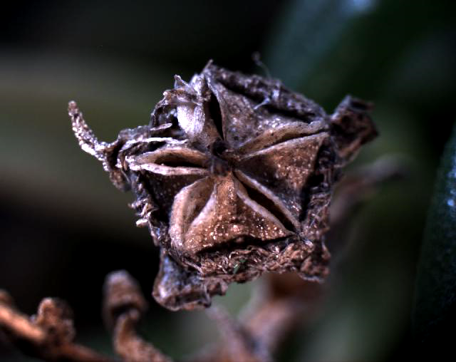
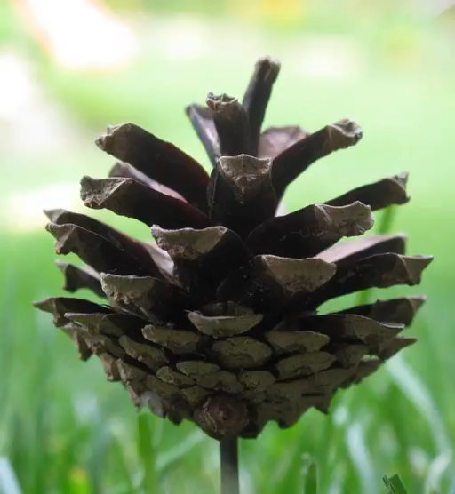
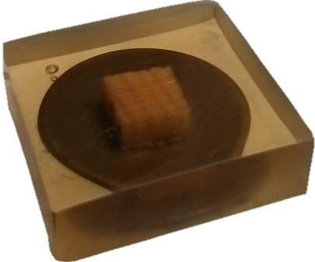
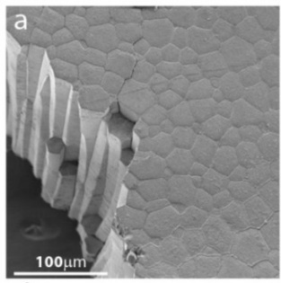
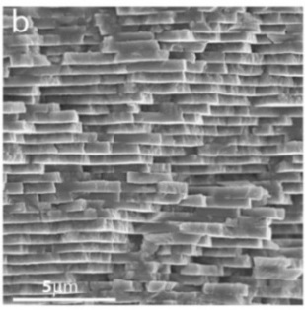
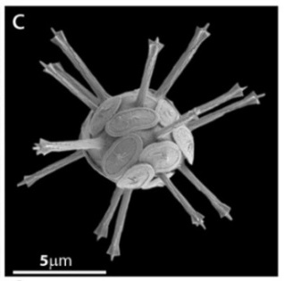
CHALLENGES
Environmental Dependence
Interfaces are Small
How to Probe Dynamic and Static Performance of a Single Interface – Elasticity, Plasticity and Viscoelasticity?
Seed Capsule
Pine Cone
Pinna Nobilis
Perna Canaliculus
Coccolithophore
~ 1 µm
~ 40 nm
~ few nm
B. Bayerlein et. al. , Advanced Functional Materials, 2016
H. M. Drezner et. al. , Advanced Functional Materials, 2010
Peisker et al., Nat. Commun. , 2013

Slide 7


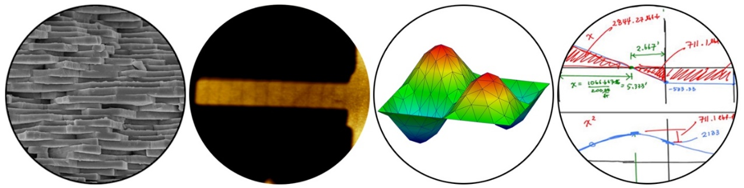
PURPOSE OF PhD STUDY
A multi-disciplinary and collaborative study
Mechanical Characterization of Nano-scale Interfaces in Biocomposite Material
Zlotnikov’s Lab.
Bar-On’s Lab. (Ben-Gurion University)
Objectives:
To develop and test Theoretical/Instrumental/Experimental frameworks to probe the mechanical properties of mineral/organic interfaces in biocomposites as a function frequency and environmental properties.

Slide 8
NANOINDENTATION BASED METHODS
Three main approaches
Theoretical
Instrumental
Experimental

Slide 9
THEORETICAL

Slide 10
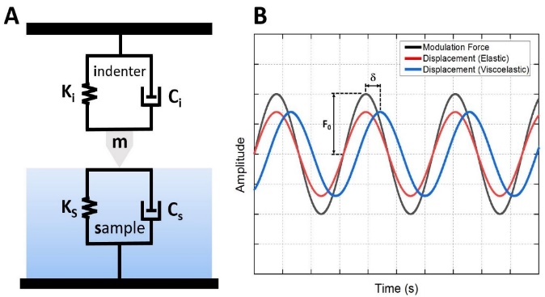
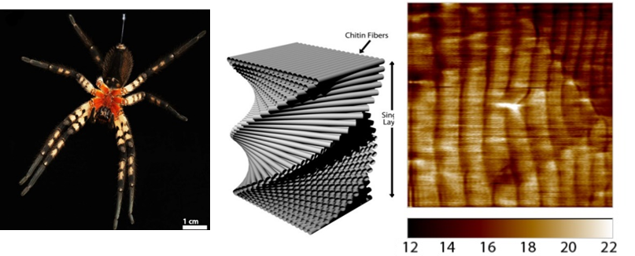

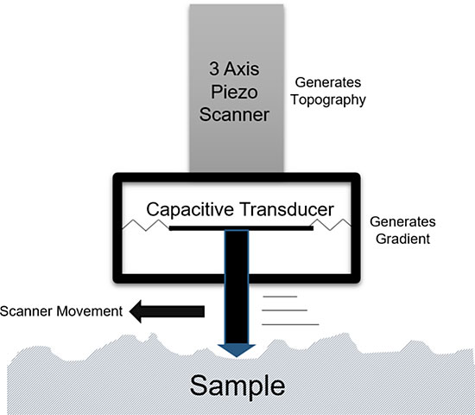
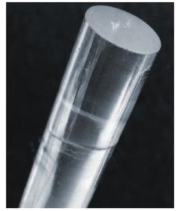
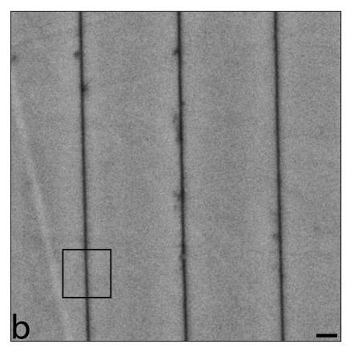
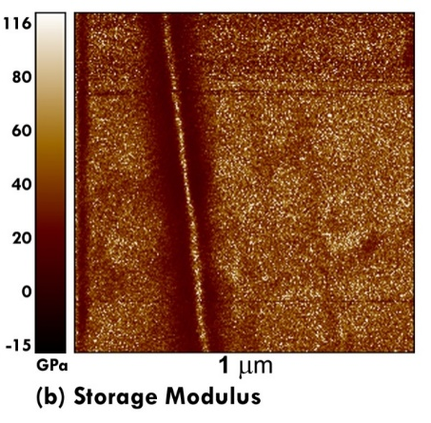
Nano-SCALE MODULUS MAPPING
Nanoscale Dynamic Mechanical Analysis
Cupiennius salei Cuticle (Tibia):
5 µm
Scanning Probe Microscopy (SPM)
3x3 µm
Anchor spicule in Monorhaphis chuni:
I. Zlotnikov et. al. , Progress in Materials Science , 2017

Slide 11
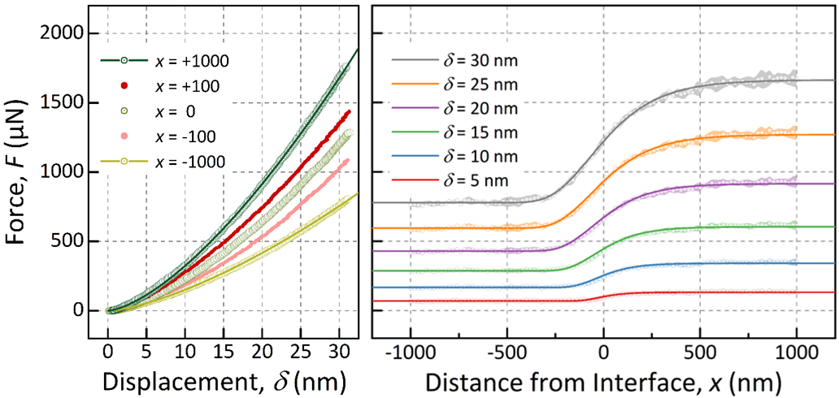
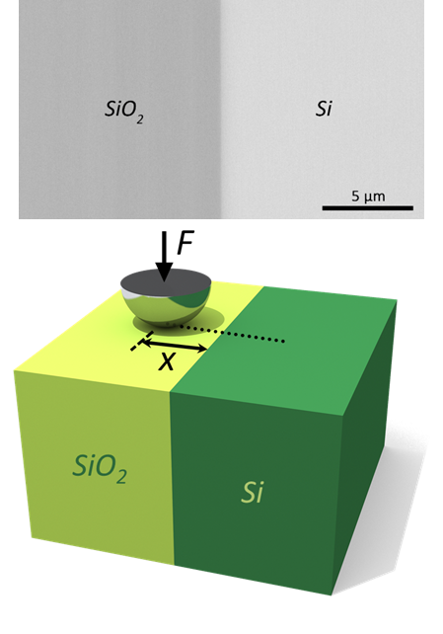
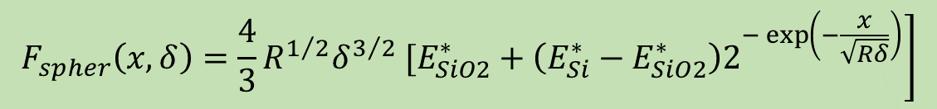
THEORETICAL
Developing a method for Modulus Mapping to formulate contact with an interface boundary
$$\left.F_{spher}\left(x,δ\right)=\frac{4}{3}R^{1/2}δ^{3/2} [E_{SiO2}^{∗}+\left(E_{Si}^{∗}−E_{SiO2}^{∗}\right)2^{−\exp\left(−\frac{x}{\sqrt{Rδ}}\right)}\right]$$
We defined a fully analytical description for a contact problem across an interface.
K. Tadayon et. al. , Extreme Mechanics Letters, 2021
Notes:
Therfore we need to understand better the effect of distance from the interface, so we reploted all the data in another format, force vs. distance from the interface at 6 different depth of penetration. As can be seen in this diagram, far from the interface we have plateus. Obviously, the left ones correspond to the indents on silica and right ones correspond to the indents on Si.
But in between we have an assymetric growth, therefore we proposed an unlinear weight function. A sigmoidal function which is able to weigh the force close to the interface.
Now we need to find the parameters b and a. Using the boundary condition at the interface from the previous slide, we conclude that b=2 and therefore this formula.
Interestingly, the formula fits perfectly to all the curves. After fitting we measured the parameter a at each displacement which are ploted on the right hand-side figure. This prameter is beautifully fitted with the radius of the contact area.
Therefore we could physically defined an analytical description for a contact problem across an interface.

Slide 12
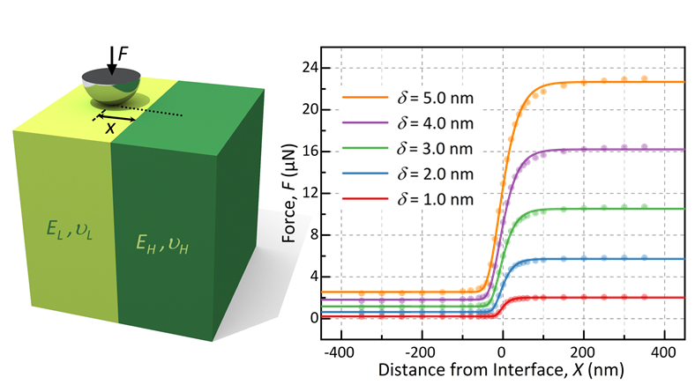
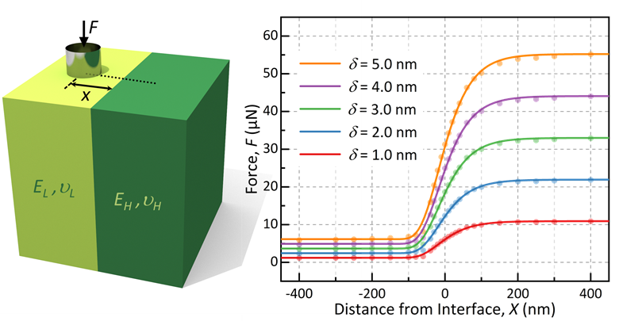


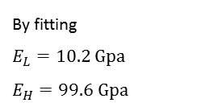
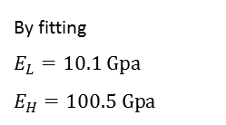


FINITE ELEMENT MODELING
Hertz Model
By fitting
$$E_{L}=10.2 Gpa$$
$$E_{H}=99.6 Gpa$$
$$a=\sqrt{Rδ}$$
$$\left.F_{spher}\left(x,δ\right)=\frac{4}{3}R^{1/2}δ^{3/2} [E_{L}^{∗}+\left(E_{H}^{∗}−E_{L}^{∗}\right)2^{−\exp\left(−\frac{x}{a}\right)}\right]$$
Sneddon Model
By fitting
$$E_{L}=10.1 Gpa$$
$$E_{H}=100.5 Gpa$$
$$a=R$$
$$\left.F_{flat}\left(x,δ\right)=2Rδ [E_{L}^{∗}+\left(E_{H}^{∗}−E_{L}^{∗}\right)2^{−\exp\left(−\frac{x}{a}\right)}\right]$$
The FEM data validates the hypothesis well.
K. Tadayon et. al. , Extreme Mechanics Letters, 2021
Notes:
We plotted the FEM data, and as you can see the analytical description fits very well to not only the data from Hertz model but also Sneddon model.
There is only, a small difference.
As for sneddon model, we have a flat-ended cylinder and at different depth of penetration the contact area is constant and the radius of the contact area is exactly the radius of our cylinder.

Slide 13
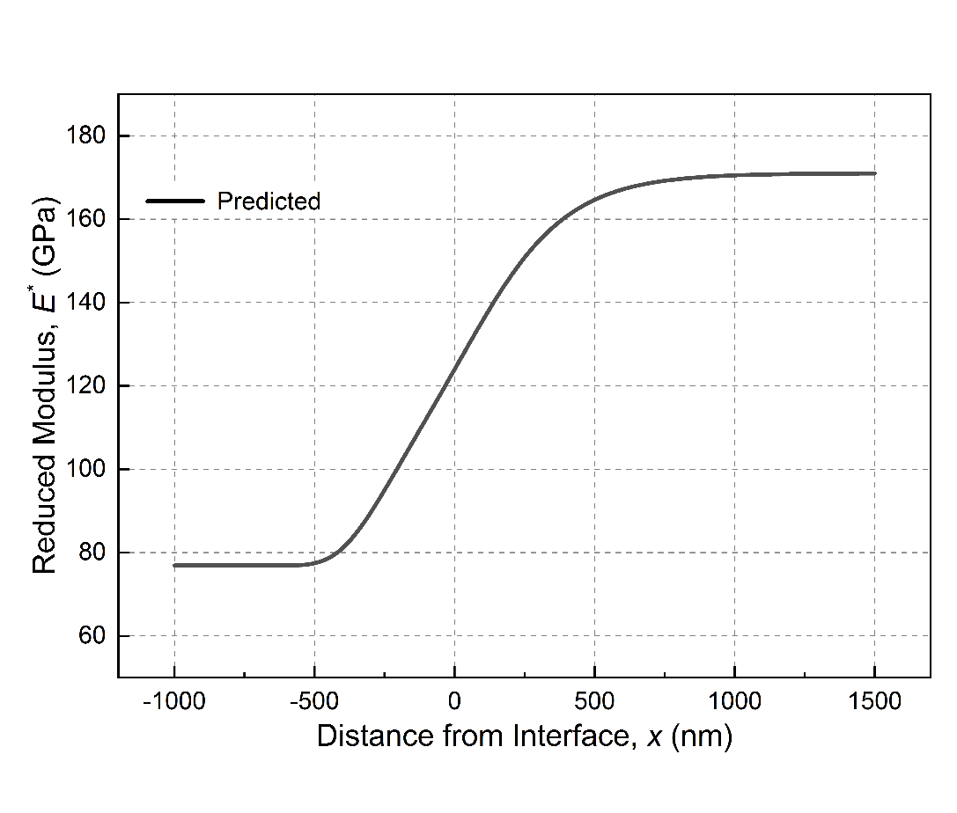
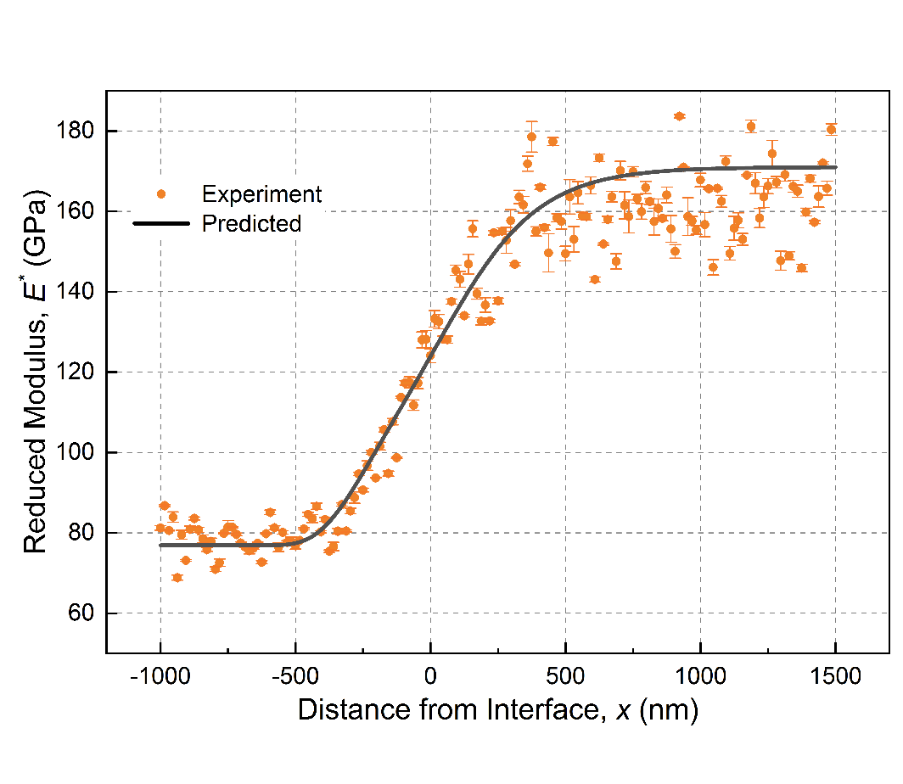
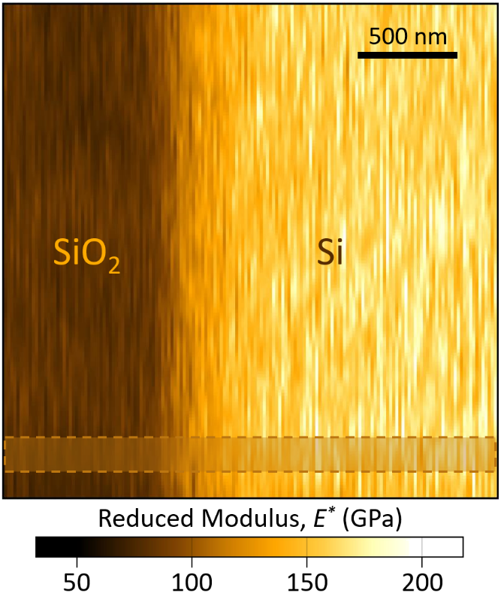

Nano-SCALE MODULUS MAPPING
Scan size: 2.5×2.5 µm²
Contact force: 200 µN
Dynamic force: 20 µN
Frequency : 205 Hz
$$E_{eff}^{∗}\left(x\right)=E_{SiO_{2}}^{∗}+\left(E_{Si}^{∗}−E_{SiO_{2}}^{∗}\right)2^{−\exp\left(−\frac{x}{\sqrt{Rδ}}\right)}$$
The formula well-predicts the effective elastic modulus and it can be a stepping-stone toward establishing an analytical expression for contact with multilayered biocomposite architectures.
K. Tadayon et. al. , Extreme Mechanics Letters, 2021
Notes:
The last but not the least, we investigated if we can predict effective elastic modulus at different distances from the interface while doing modulus mapping.
Based on the developed descriction, we derived the formula on the top right side which is the effectic elastic modulus as a function of distance from interfce. With this we could well predict the modulus mapping data which are mesured from the shaded rectangular area.

Slide 14
INSTRUMENTAL

Slide 15
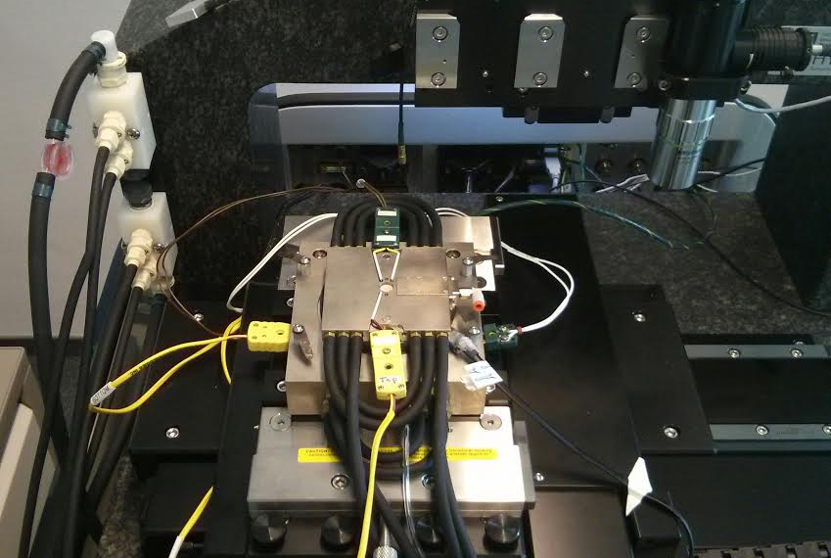
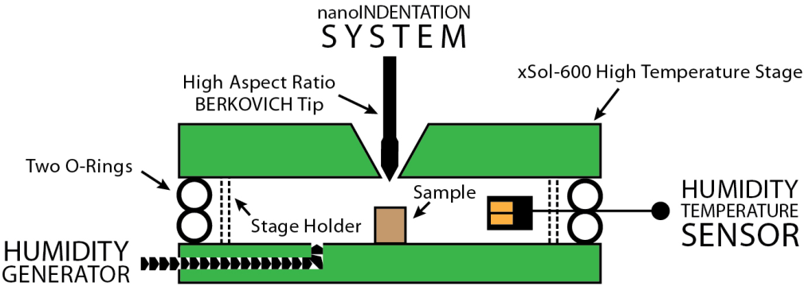
ENVIRONMENTAL CONTROL
THE SET-UP:
High Temperature Stage with Inert Gas Infrastructure (xSol)
Humidity Generator
Humidity Temperature Sensor
Our In-house Set-up
Can we also observe the sample while indenting and controlling the humidity ?
L. Bertinetti et. al. , Philosophical Magazine, 2015

Slide 16
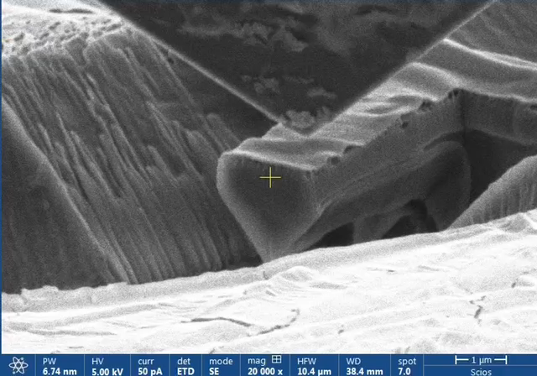
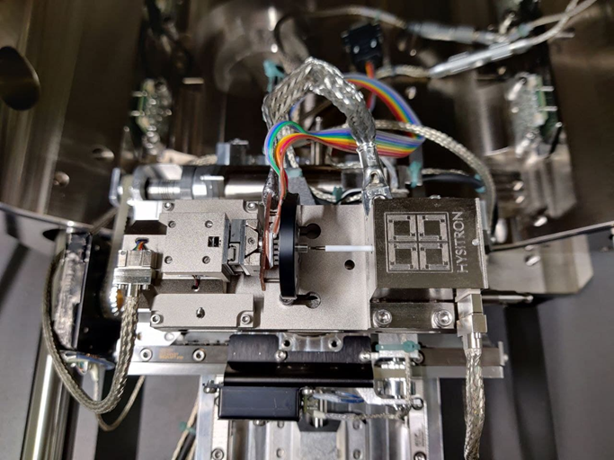
INSTRUMENTAL
Environmental Control
Developing a setup for a picoindenter inside an environmental SEM to do in-situ indentation while controlling the humidity and temperature!
Notes:
Contact mechanics is a study of deformation of bodies which are in contact with one or more points.
It has lots of engineering and scientific applications such as locomotive rail wheel contact, the design of hip joints, the principles of atomic force microscopy and so on.
The contact can be elastic, viscoelestic or plastic. But today I am going to focus only on elastic contact mechanics.
Two of the most commonly used theories in elastic contact mechanics are ...

Slide 17
EXPERIMENTAL

Slide 18
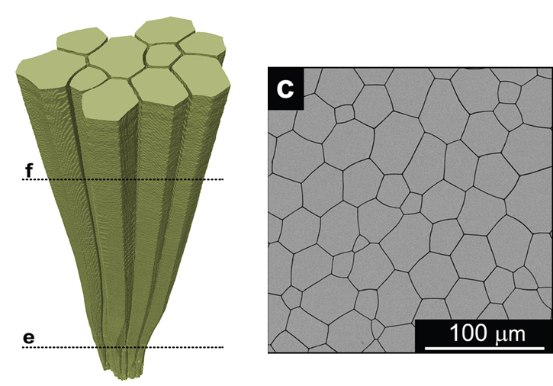
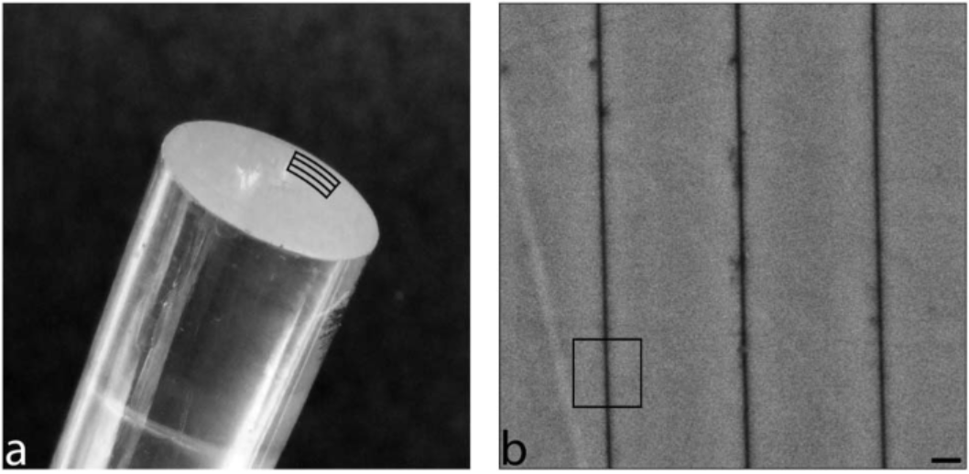
EXPERIMENTAL
Model System
Amorphous Silica/Organic periodic structure in the spicules of marine sponges (M. chuni)
Calcite/Organic prismatic structure in mollusks (A. vexillum)
Experiments:
1- Direct approach
2- Indirect approach
I. Zlotnikov et. al. , RSC Advances, 2013
D. Zöllner et. Al. ,Materials Horizons, 2019
Notes:
Contact mechanics is a study of deformation of bodies which are in contact with one or more points.
It has lots of engineering and scientific applications such as locomotive rail wheel contact, the design of hip joints, the principles of atomic force microscopy and so on.
The contact can be elastic, viscoelestic or plastic. But today I am going to focus only on elastic contact mechanics.
Two of the most commonly used theories in elastic contact mechanics are ...

Slide 19
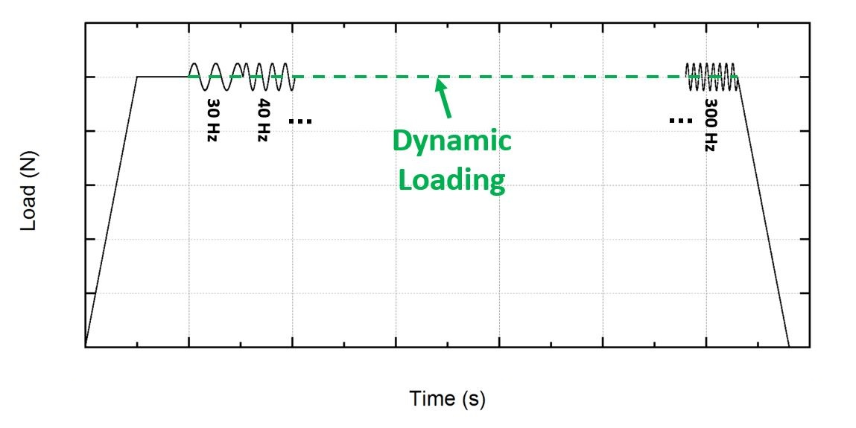
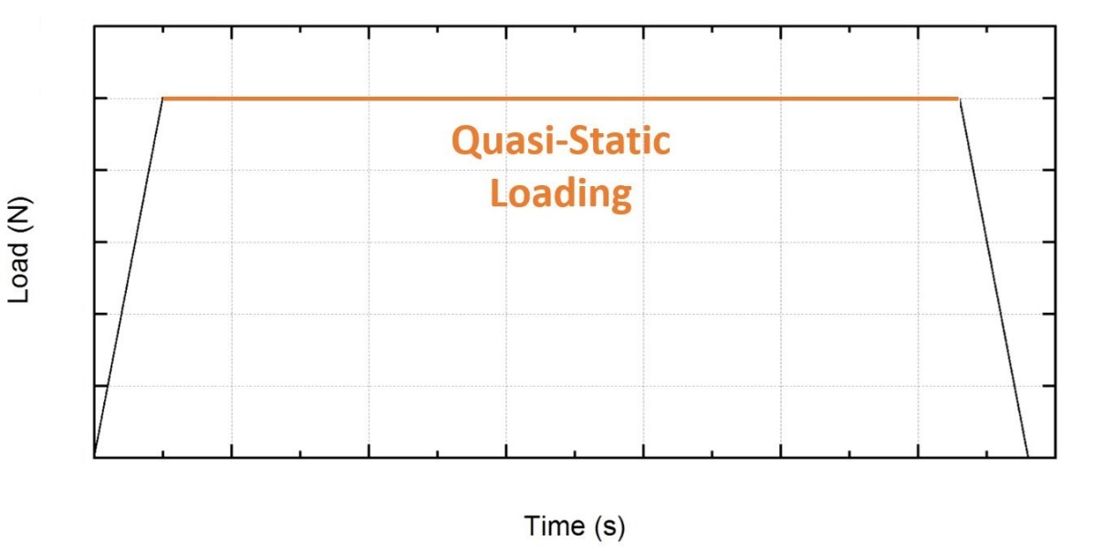
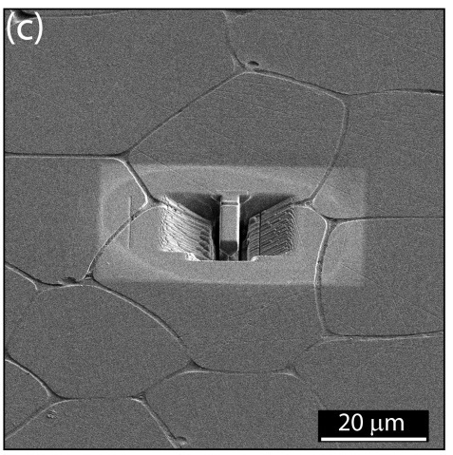
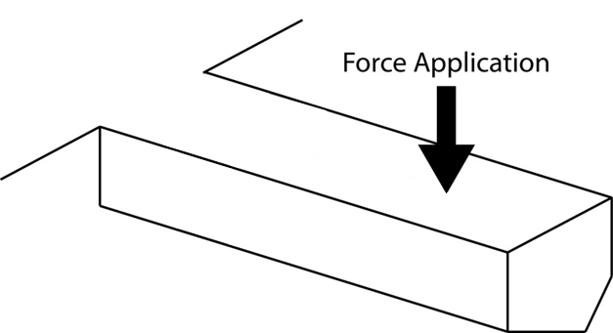
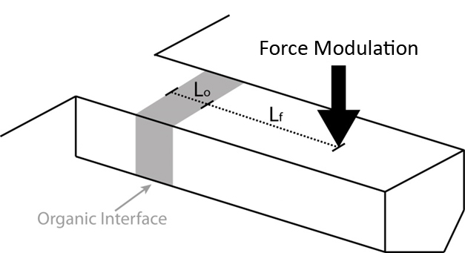
PROBING A SINGLE INTERFACE
To study the behavior of a single interface decoupled from the geometry of the composite
To measure its elastic, plastic and viscoelastic response
B. Bar-On et. al. , Physical review letters, 2017

Slide 20
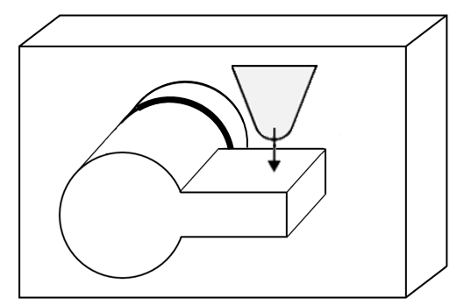
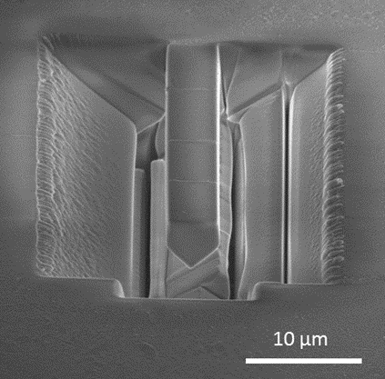
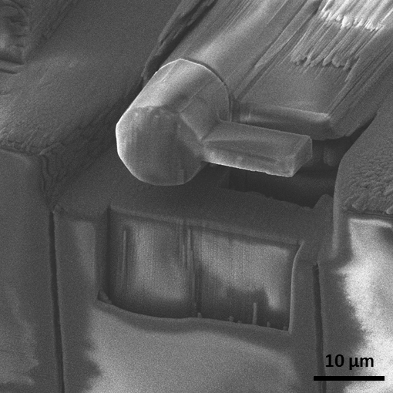
EXPERIMENTS
Bending analysis
(micro-cantilevers vibrations)
Torsion analysis
(micro-key vibrations)
Relaxation analysis
(micro-pillar compression)
Notes:
Contact mechanics is a study of deformation of bodies which are in contact with one or more points.
It has lots of engineering and scientific applications such as locomotive rail wheel contact, the design of hip joints, the principles of atomic force microscopy and so on.
The contact can be elastic, viscoelestic or plastic. But today I am going to focus only on elastic contact mechanics.
Two of the most commonly used theories in elastic contact mechanics are ...

Slide 21

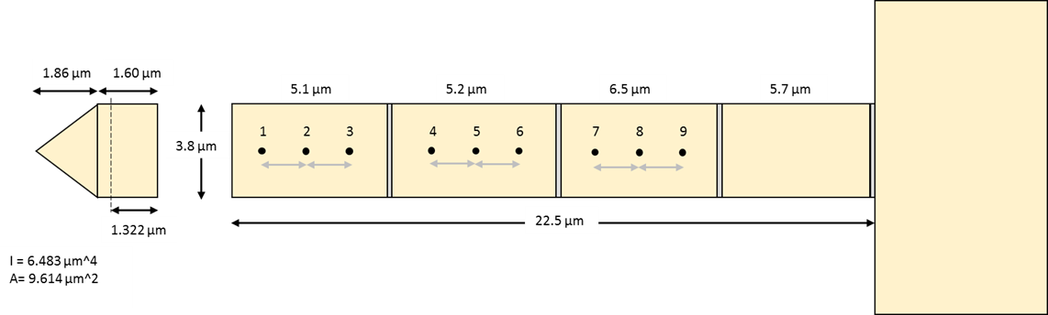
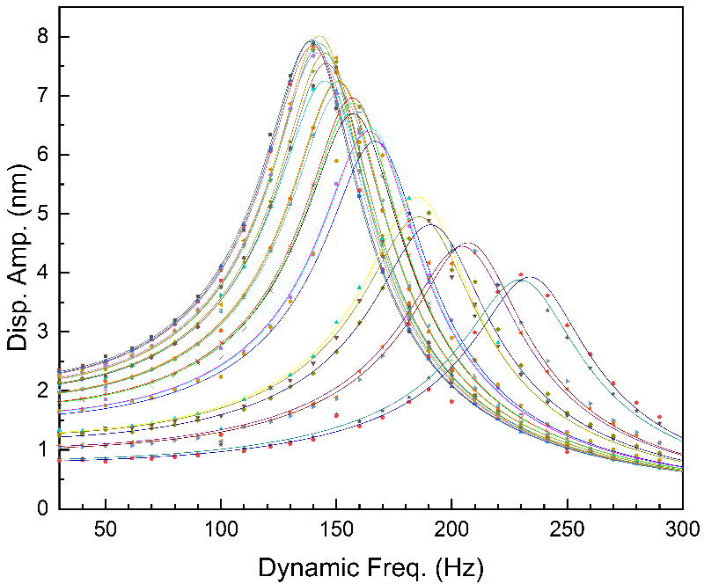
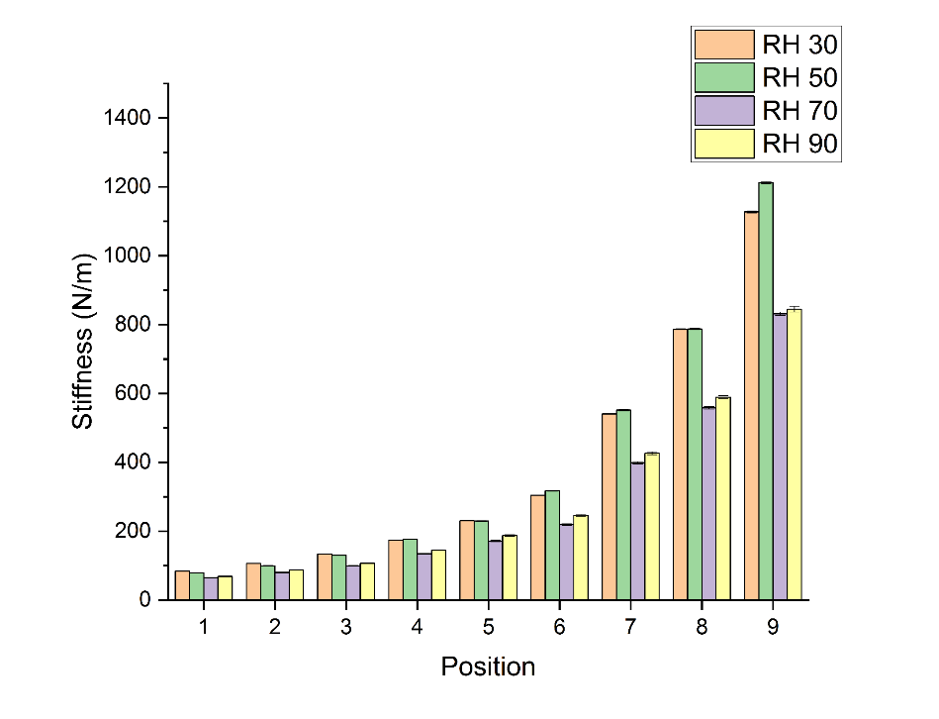
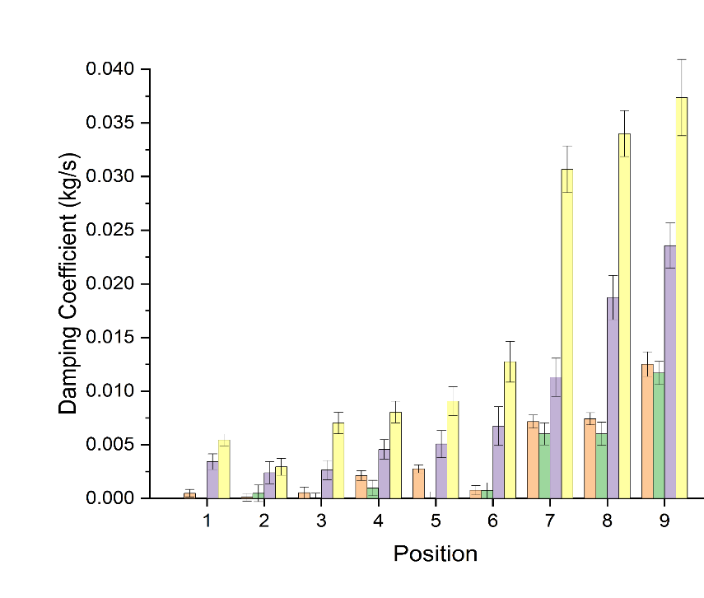
MICRO-CANTILEVERS VIBRATIONS
Notes:
Contact mechanics is a study of deformation of bodies which are in contact with one or more points.
It has lots of engineering and scientific applications such as locomotive rail wheel contact, the design of hip joints, the principles of atomic force microscopy and so on.
The contact can be elastic, viscoelestic or plastic. But today I am going to focus only on elastic contact mechanics.
Two of the most commonly used theories in elastic contact mechanics are ...

Slide 22
WORK PLAN
Overview of the time schedule for the continuation of the study in 2022 and 2023:
Work Packages | Feb. – May. | Jun. – Sep. | Oct. – Jan. | Feb. – Jul.
FIB-SEM sample preparation
Instrumental project
Direct measurements (nanoDMA and modulus mapping)
Indirect measurements (bending and shearing experiments)
Writing thesis

Slide 23
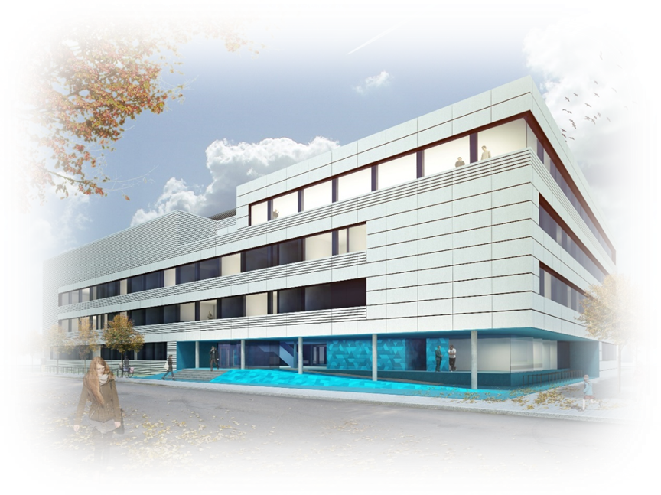


Acknowledgements
  Dr. Igor Zlotnikov
  Prof. Benny Bar-On
  Dr. Robert Lemanis
  Dr. Elke Reich
  Zlotnikov‘s Group
Thank you for your attention!

