Slide 1
Rational Design of 2D Framework-Materials
Chair of Materials Science and Nanotechnology
1st TAC Meeting // 16.02.2021
David Bodesheim

Slide 2
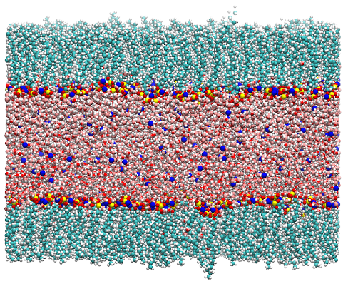
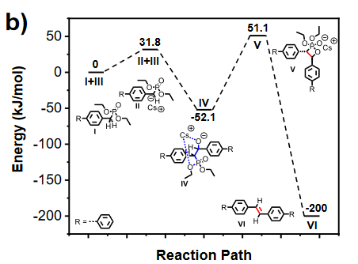
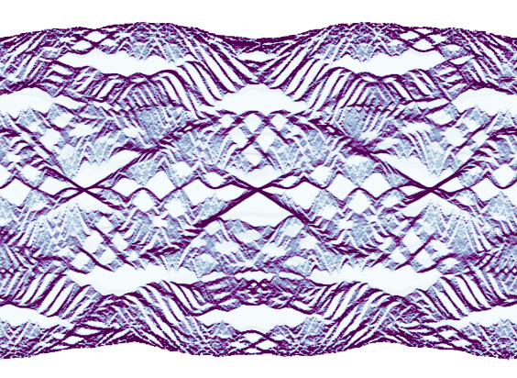
Current Projects
Understanding the synthesis of 2D polymers at liquid/air interfaces
Calculation of Reaction profiles for HWE reactions
Hofstadter‘s Butterfly for COFs
[1]
[1] Angew. Chem. Int. Ed. 2020 , 59, 1 – 7

Slide 3
Understanding synthesis of 2D polymers at liquid/air interfaces
Why liquid/air interfaces?
2D templating effect
Facil experiments
The case of the SMAIS method
Improving crystallinity?
[2]
How do the surfactants order at the surface?
What influence does the counterion have?
Is the monolayer stable at RT?
Surfactant monolayer on water surface
Monomer 1 injection into water phase (+ acid)
Monomer 2 injection into water phase
2D Polymerization
[2] Angew. Chem. Int. Ed. 2020, 59, 6028

Slide 4
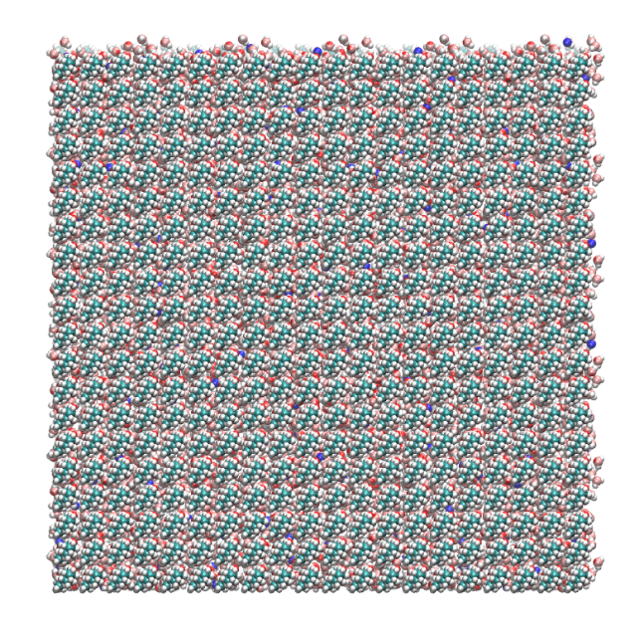
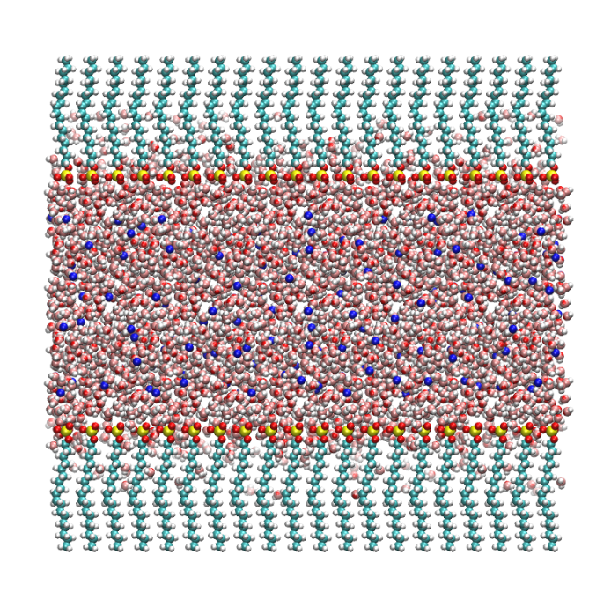
Understanding synthesis of 2D polymers at liquid/air interfaces
Modelling Surfactant Monolayer
Classical molecular dynamics
SOS as surfactant and no monomers included*
Two monolayers setup for efficiency
20 x 20 surfactants per side: MMA = 25 Å² (exp. value: 24 Å² [3])
Hydrophilic
head
100 Å
Hydrophobic
tail
100 Å
50 Å
Sodium oleyl sulfate
(SOS)
[3] Nature Chemistry volume 11, 994–1000 (2019)

Slide 5
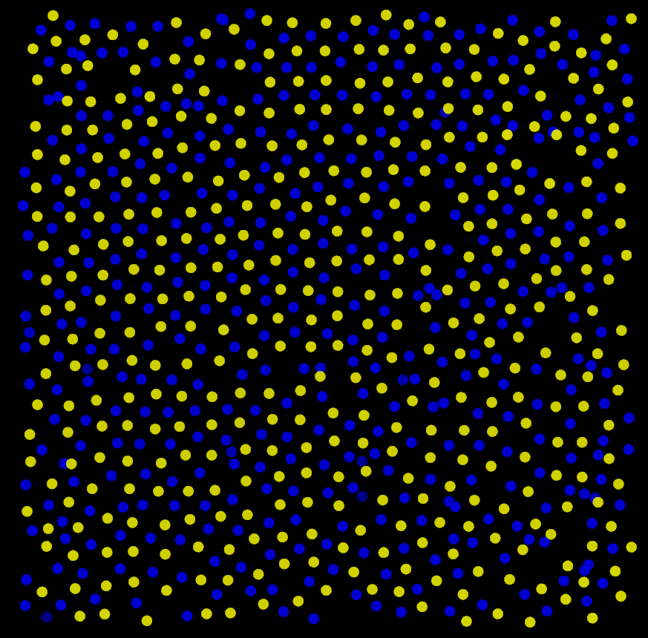
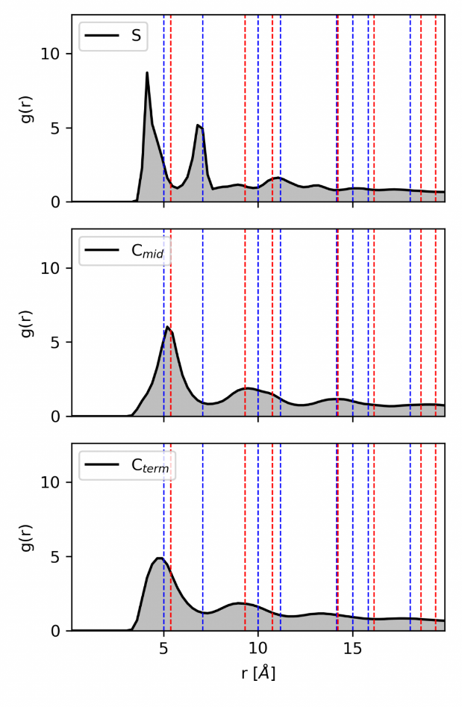
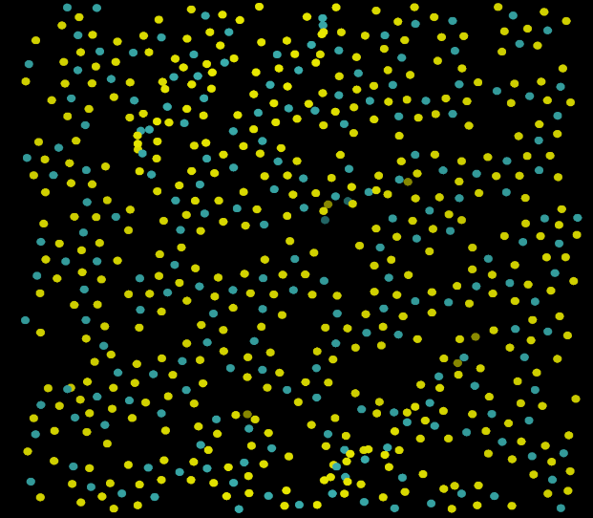
Understanding synthesis of 2D polymers at liquid/air interfaces
Na⁺
Ca²⁺
S
Na⁺
Ideal 2D hexagonal packing
Ideal 2D square packing
sq
hex
S
Ca²⁺
hex

Slide 6
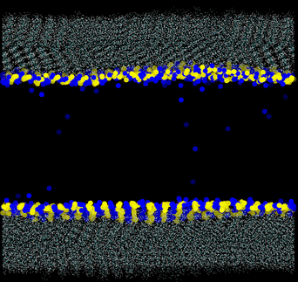
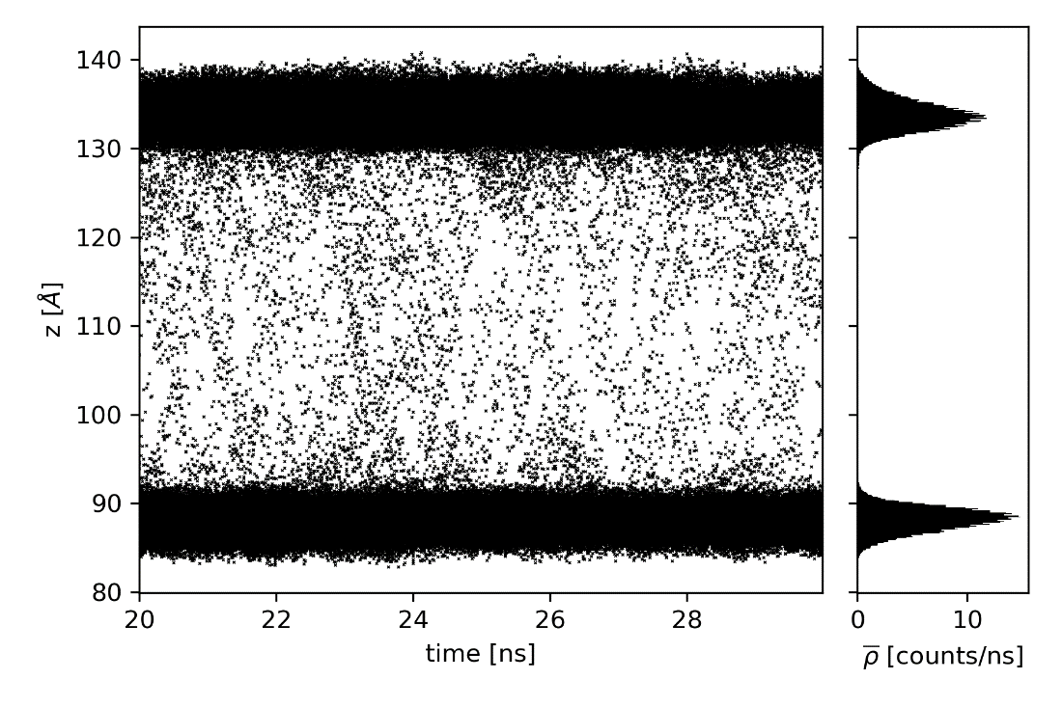
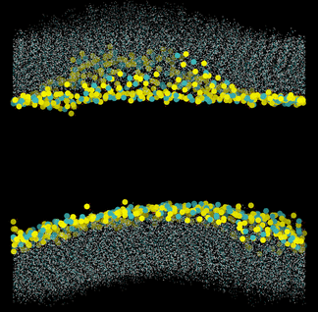
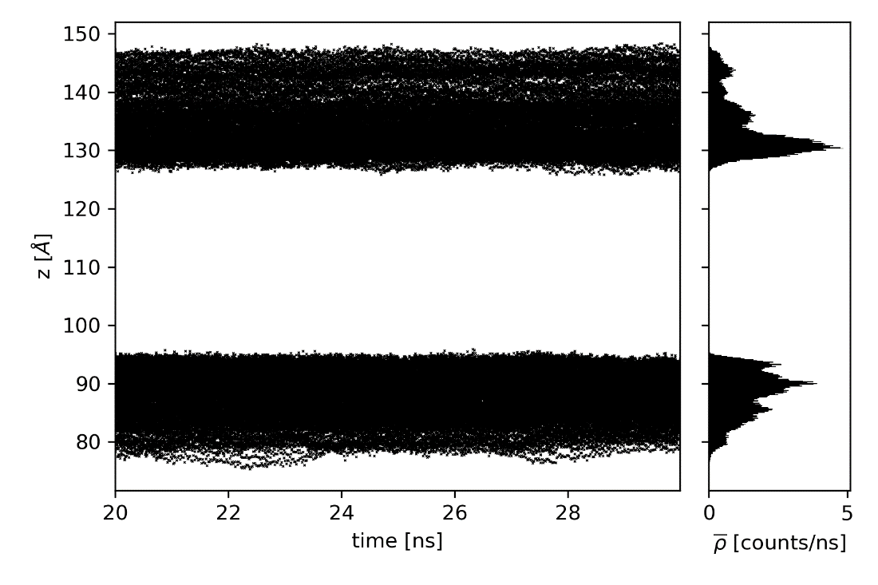
Understanding synthesis of 2D polymers at liquid/air interfaces
Na⁺
Some vertical ion mobility
Ca²⁺
No vertical ion mobility

Slide 7
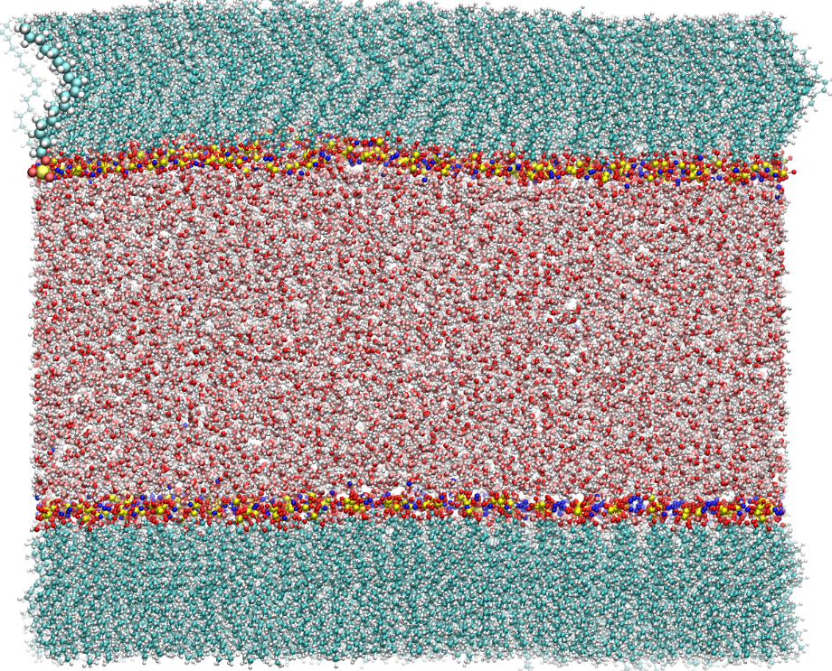
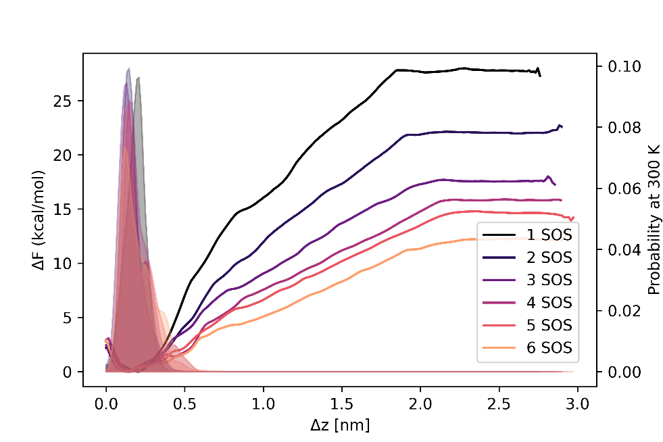
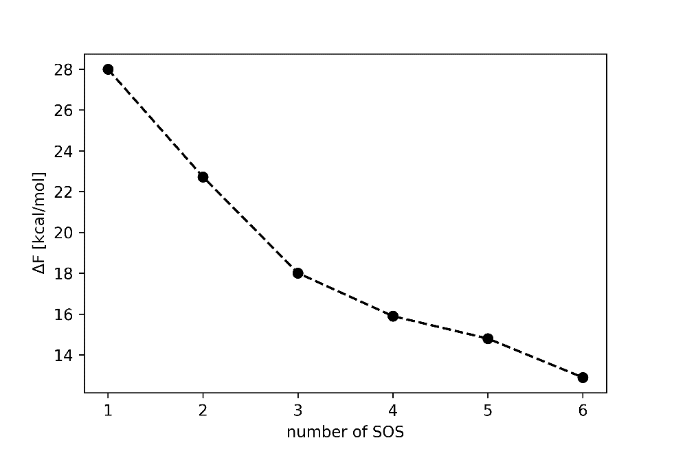
Understanding synthesis of 2D polymers at liquid/air interfaces
Is the surfactant monolayer stable?
Potential mean Force calculation via Umbrella Sampling
probability
∆z
Cooperative effect of multiple surfactants
Energy barrier is still significant
Monolayer is stable at 300 K

Slide 8
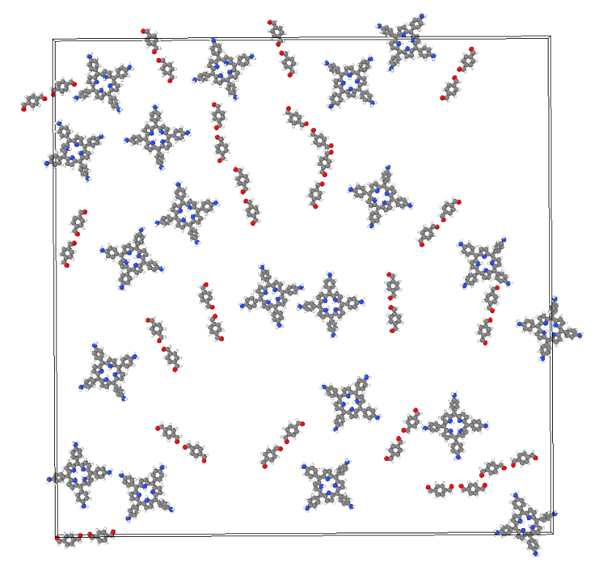
Understanding synthesis of 2D polymers at liquid/air interfaces
Modelling reactions with classical MD: Crosslinking
Bonding via distance criterion
Creating new bonds and deleting atoms
Possible combination with SMAIS model in the future

Slide 9
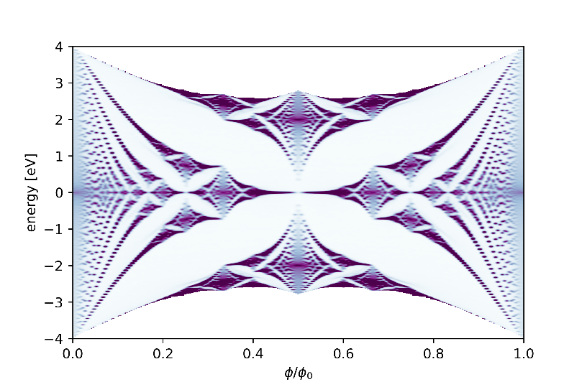
Hofstadter‘s Butterfly in COFs
Square lattice butterfly
Interaction of electrons in a lattice with a magnetic field leads to a fractal energy spectrum
The relevance of the butterfly
Original theoretical paper from 1973 cited more than 1800 times [4]
Since then, many other theoretical studies on the butterfly structure on other lattices
Several experimental proves were performed
First proof in a real material: 2013 in graphene on h-BN with Moiré-Pattern [5, 6, 7]
Other measurements in materials with superlattices followed
B_{z}
[4] Phys. Rev. B 14, 2239 (1976)
[5] Nature volume 497, pages 598–602(2013)
[6] Nature volume 497, pages594–597 (2013)
[7] Science 2013, Vol. 340, Issue 6139, pp. 1427-1430

Slide 10
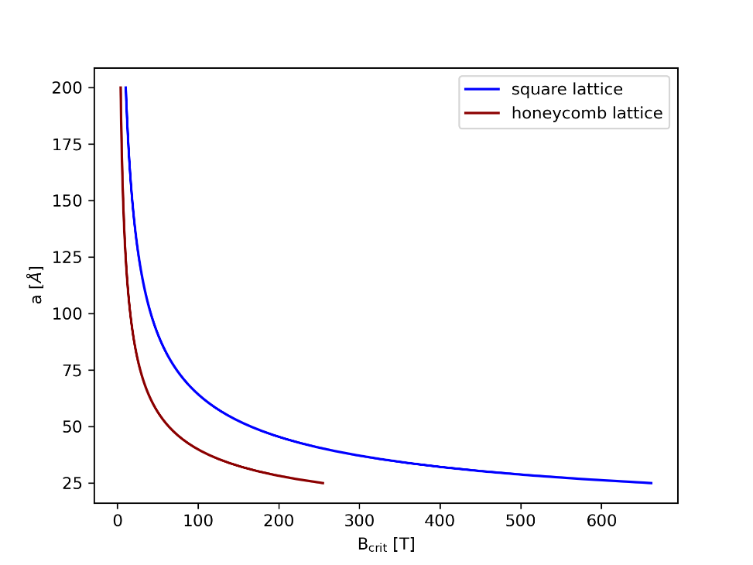
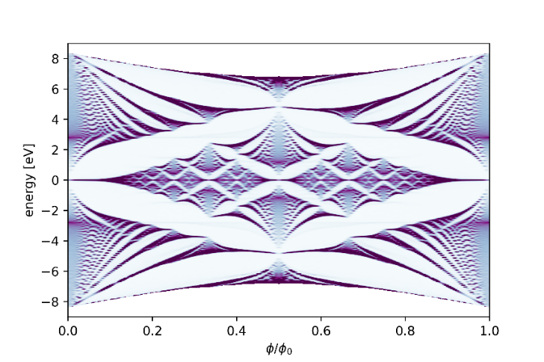
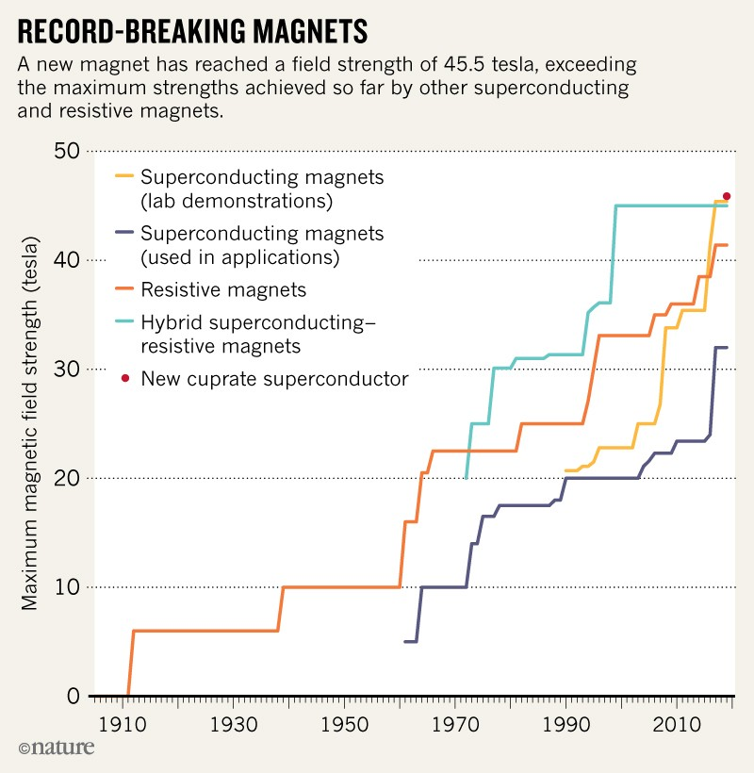
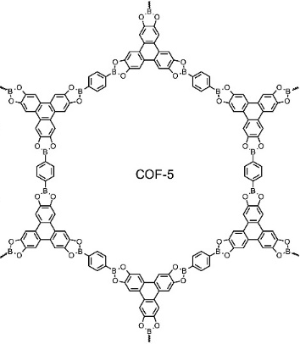
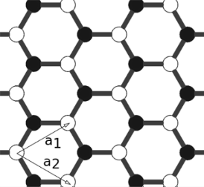
Hofstadter‘s Butterfly in COFs
Graphene butterfly
a
a
Why is the butterfly to difficult to measure?
Periodicity of the pattern: $B_{crit}=\frac{Φ_{0}}{A_{loop}}$
Why COFs?
Big rings reduce necessary magnetic field
Can we find similarities between COF-topologies and simple lattices?
a
80000 T
[8]
[9]
Similarity?
[8] https://www.nature.com/articles/d41586-019-01869-1
[9] Chinese Science Bulletin, Volume 63 , Issue 22 : 2229-2245 (2018)

Slide 11
Hofstadter‘s Butterfly in COFs
Calculating the Butterfly structure
Tight-Binding model with only nearest-neighbor interactions
Only p_{z}-orbitals and π-bonds
Distance-dependent parameters from Salter-Koster files
Finite 2D system
Altering hopping parameters via Peierls-Substitution
$t_{nm} \underset{→}{} t_{nm}e^{i\frac{2π}{Φ_{0}}\int_{n}^{m}{\vec{A_{nm}}d\vec{l}}}$

Slide 12
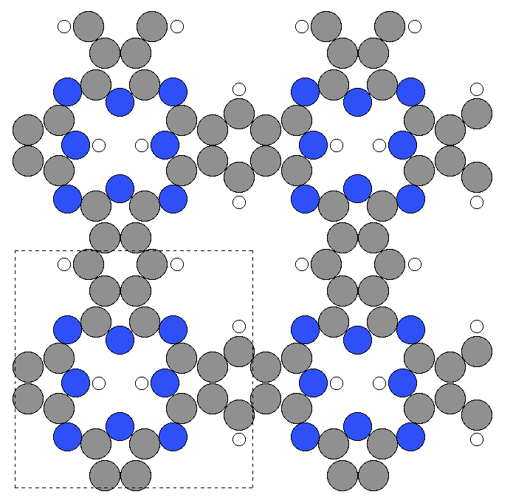
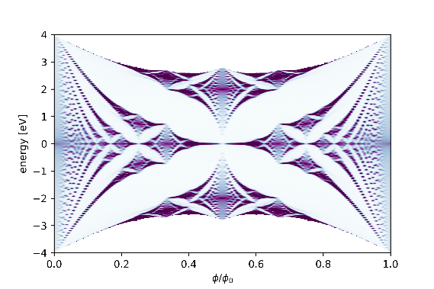
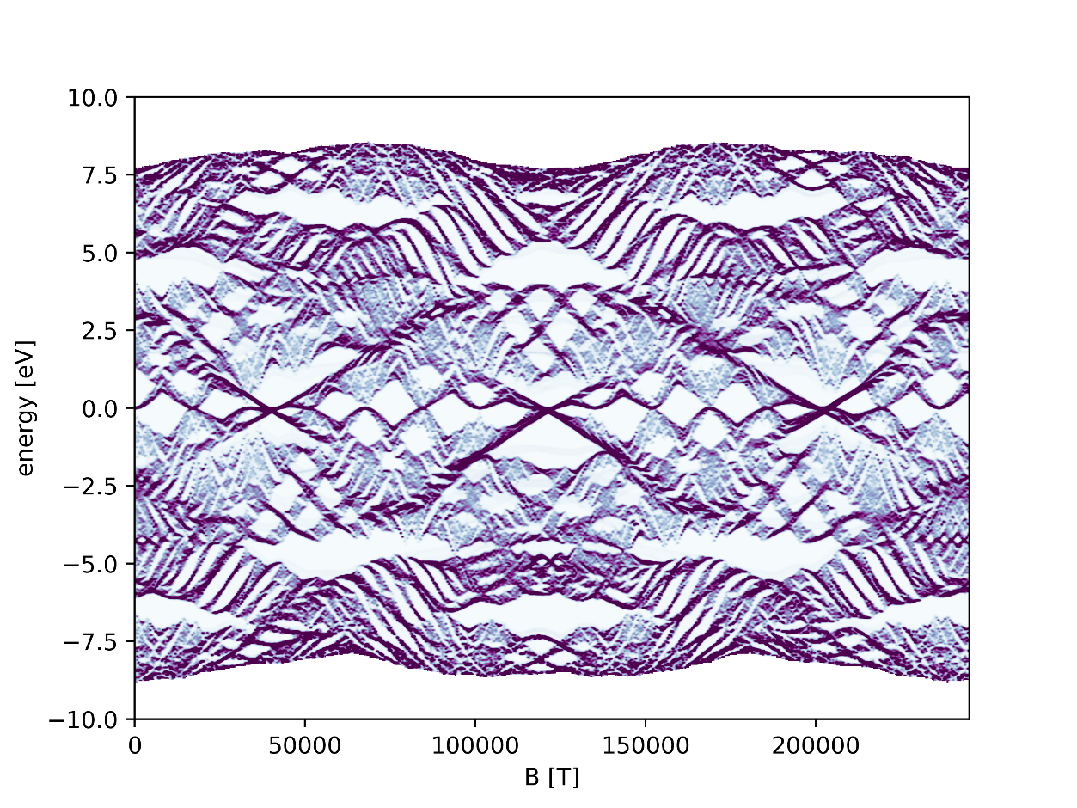
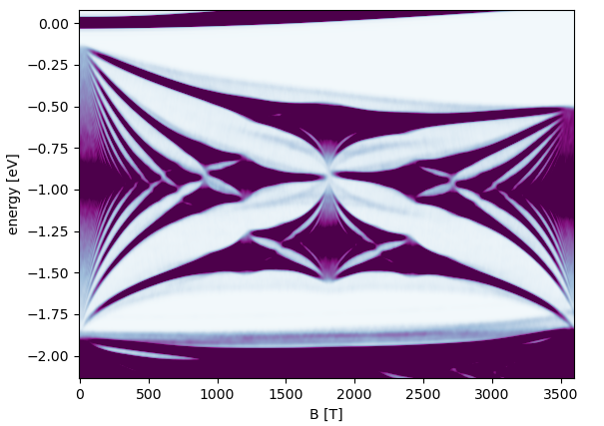
Hofstadter‘s Butterfly in COFs
Square lattice butterfly
B_{crit} = 3612 T
1.07 nm
COF with square topology

Slide 13
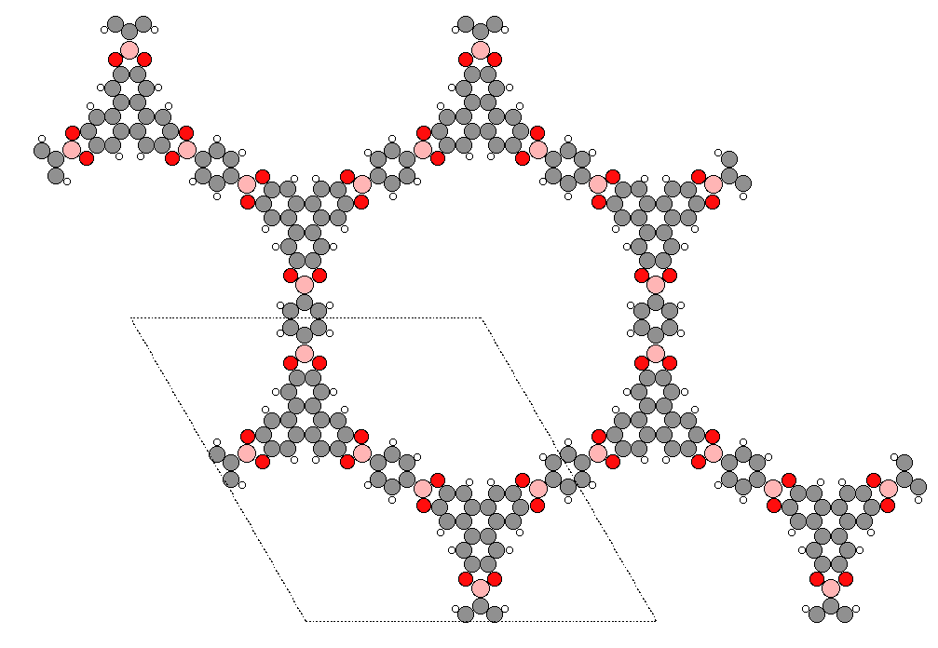
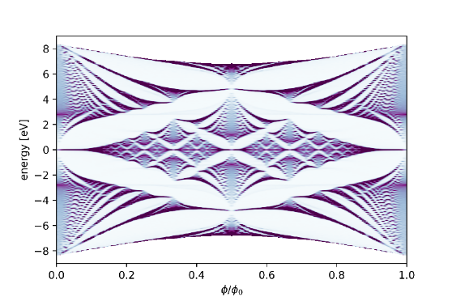
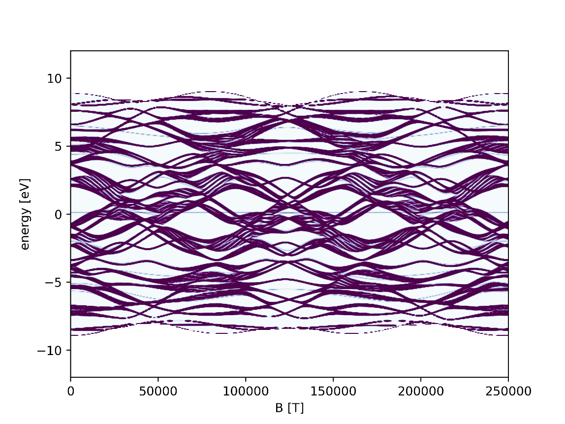
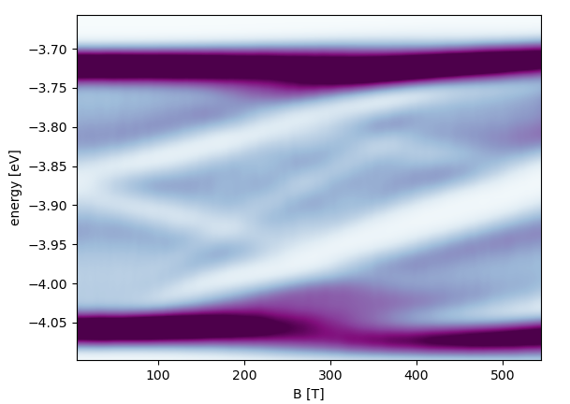
Hofstadter‘s Butterfly in COFs
Graphene butterfly
B_{crit} = 544 T
1.71 nm
COF with honeycomb topology: COF-5

Slide 14
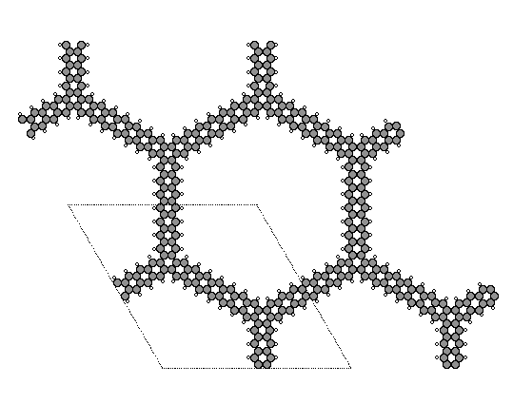
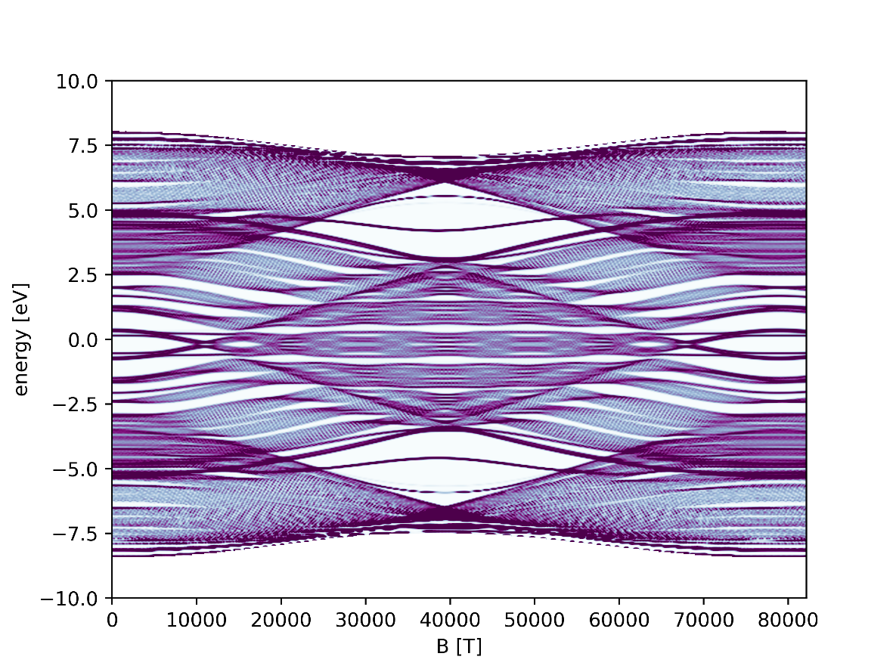
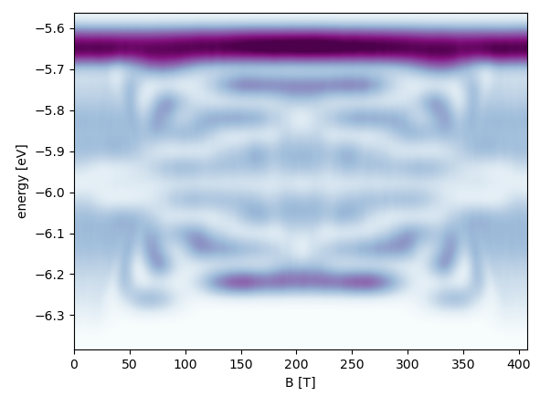
Hofstadter‘s Butterfly in COFs
Graphene butterfly
B_{crit} = 409 T
COF with honeycomb topology: pure C
1.97 nm

Slide 15
Research plan
SMAIS simulations with different parameters/molecules
Crosslinking simulation to understand defect formation
Hofstadter’s Butterfly for different COFs and understanding pattern formation
Mechanical and electronic properties of defective COFs
Machine learning for structure property relationships of COFs
Making Hofstadter’s Butterfly machine learnable
2021
2022

Slide 16
Other activities
Teaching Assistant for Concepts of Molecular Modeling
Created python introduction tutorials and an Ising-model tutorial
Managing the jobs-email account
Attended workshops:
MOLSIM 2021 (2 weeks workshop about MD and MC)
MGK member since September 2020
MGK student seminar, MGK seminar, IRTT Meetings

Slide 17
Thank you for your attention!

Slide 18
Appendix

Slide 19
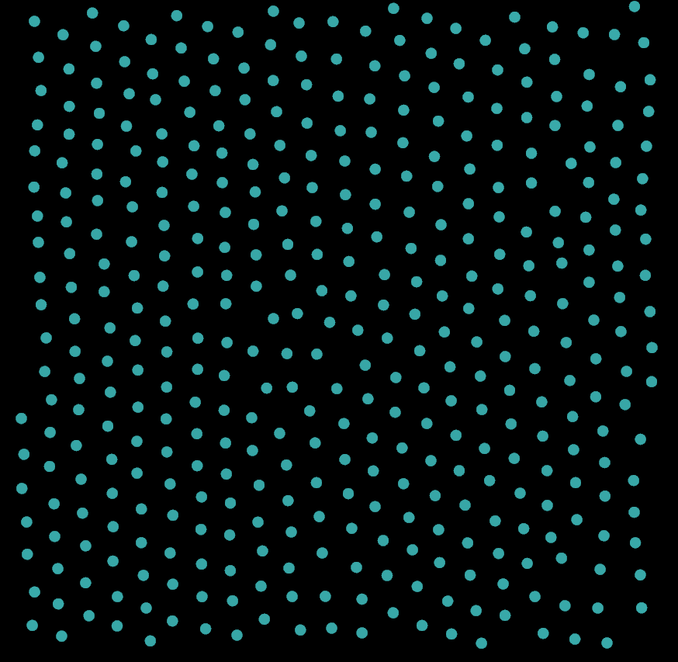
Top-down snapshots of ordering in SOS
S
C_{mid}
C_{term}
Na⁺

Slide 20
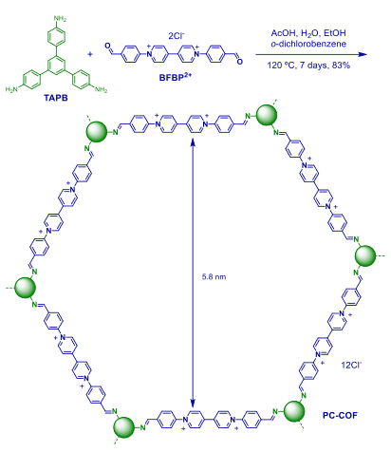
Largest ring so far
Bcrit = 189 T
Polym. Chem., 2016,7, 3392-3397

Slide 21
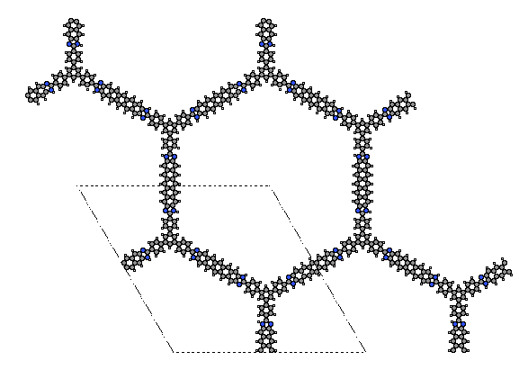
Other possible (hypothetical) COFs
Bcrit = 170 T
Bcrit = 448 T

Slide 22
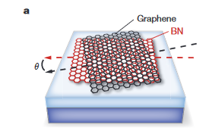
Measuring the Butterfly
Via longitudinal resistance measurements and
Hall resistance measurements
B up to 26 T
Moiré periodicity up to 15.5 nm
[5] Nature volume 497, pages 598–602(2013)

Slide 23
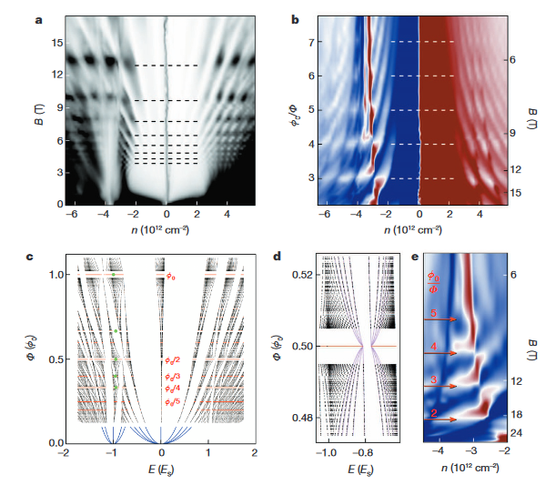
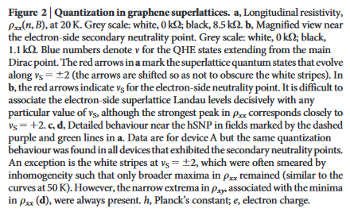
Measuring the Butterfly
Via longitudinal conductivity measurements and Hall resistivity measurements
B up to 12 T
Moiré periodicity up to 13 nm
[6] Nature volume 497, pages594–597 (2013)

Slide 24
Measuring the Butterfly
B up to 45 T
Moiré periodicity up to 13.5 nm
Via magnetoconductance measurements
[7] Science 2013, Vol. 340, Issue 6139, pp. 1427-1430

Slide 25
Measuring the Butterfly
Other experimental measurements:
https://pubs.acs.org/doi/pdf/10.1021/acs.nanolett.0c03021
https://pubs.acs.org/doi/abs/10.1021/acs.nanolett.5b05161
https://www.nature.com/articles/nphys2979
https://arxiv.org/ftp/arxiv/papers/2006/2006.13963.pdf
https://journals.aps.org/prb/pdf/10.1103/PhysRevB.90.165404
[7] Science 2013, Vol. 340, Issue 6139, pp. 1427-1430

