Slide 1
Chair of Materials Science and Nanotechnology
Timo Land
Proposal: Data analysis for E-Nose measurement data for Machine Learning
23.06.2021

Slide 2
Simplified ML cycle
Source 1
Source 2
Source 3
Source 4
…
Source n
data analysis
Focus of
thesis
Machine Learning

Slide 3
Problem statement
Measurements are taken by multiple sources:
in different environments
with different gases/ smells
ML problem: Garbage in – garbage out
→ Data quality should be verified for ML

Slide 4
Research goals
Define different data quality aspects for measurements of multiple sources
Find data analysis techniques for the verification of the data quality aspects
Gather real measurement data from multiple sources
Evaluate data analysis techniques with data gathered

Slide 5
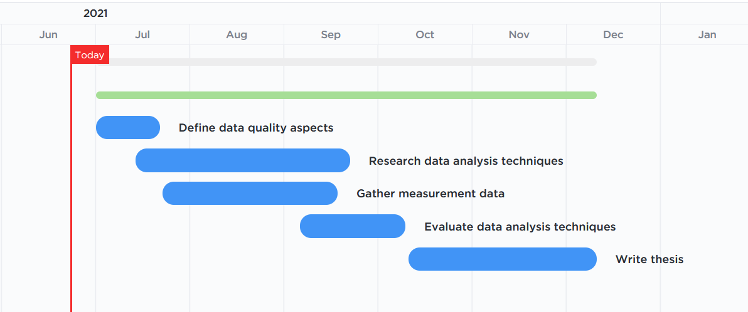
Thesis roadmap

Slide 6
Outlook
Sniffboard
Application of electronic nose in multiple environments
SMELLODY
Body smell measurements from multiple sources

