Slide 1
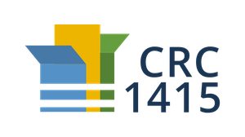
Rational Design of 2D Framework-Materials
Chair of Materials Science and Nanotechnology
TAC Kick-Off Meeting // 18.08.2020
David Bodesheim

Slide 2
Motivation
(2D) COFs: very young field (first COF 2005)
Previous methods:
On surface synthesis
Exfoliation
2D
Small domains sizes Difficult transfer to other surfaces | Low structure integrity High tendency of re-stacking Broad distribution of sheet thickness and lateral size
Problems:
Phys. Chem. Chem. Phys., 2019, 21, 13222-13229
Science 2005: Vol. 310, Issue 5751, pp. 1166-1170

Slide 3
Motivation
New approach: synthesis on liquid interfaces (first in 2014)
Advantages | Challenges
No restriction of monomer diffusion Interface as a template for 2D confinement Direct transfer to solid surfaces Large-area High structural perfection High mechanical stability Single-layer or multilayer thickness | Intrinsic limitations (e.g. temperature) Crystalline domains Grain boundaries Edge structures ….
How can we overcome these challenges?
npj 2D Mater Appl 2, 26 (2018)

Slide 4
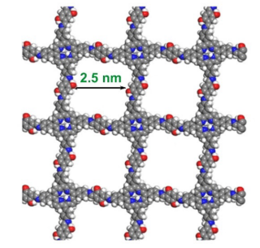
Vision
Rational Design
Building Blocks/Monomers
Predict/Calculate
MD, MC, DFT(B)
(Meso-) Structure
Defects
Grain Boundaries
Flake size /morphology
Stacking
Properties
Mechanical
Electronic
Thermal
Feedback via experiments
2D
HTC, ML
Discovering new Materials
Rationalize/Optimize Synthesis conditions

Slide 5
Challenges
Very young topic → many processes are unknown
Processes can differ vastly depending on chemistry
Many different synthesis strategies
Time and length scales
Outlook: Applications?
Difficult to generalize

Slide 6
Research Plan
Mechanistic insights of the COF formation on liquid interfaces (MD)
Mesoscale simulation of 2D COF formation on liquid interfaces (MC, DFT(B))
Properties of defective 2D COF structures (DFT(B))
Method-Generalization for different 2D materials
HTC for different building blocks
Making 2D material formation machine learnable
2020
2021
2022
Main cooperations within SFB1415 project: Prof. Feng, Prof. Eychmüller
Cooperations for characterization methods: Dr. Moresco, Prof. Weidinger

Slide 7
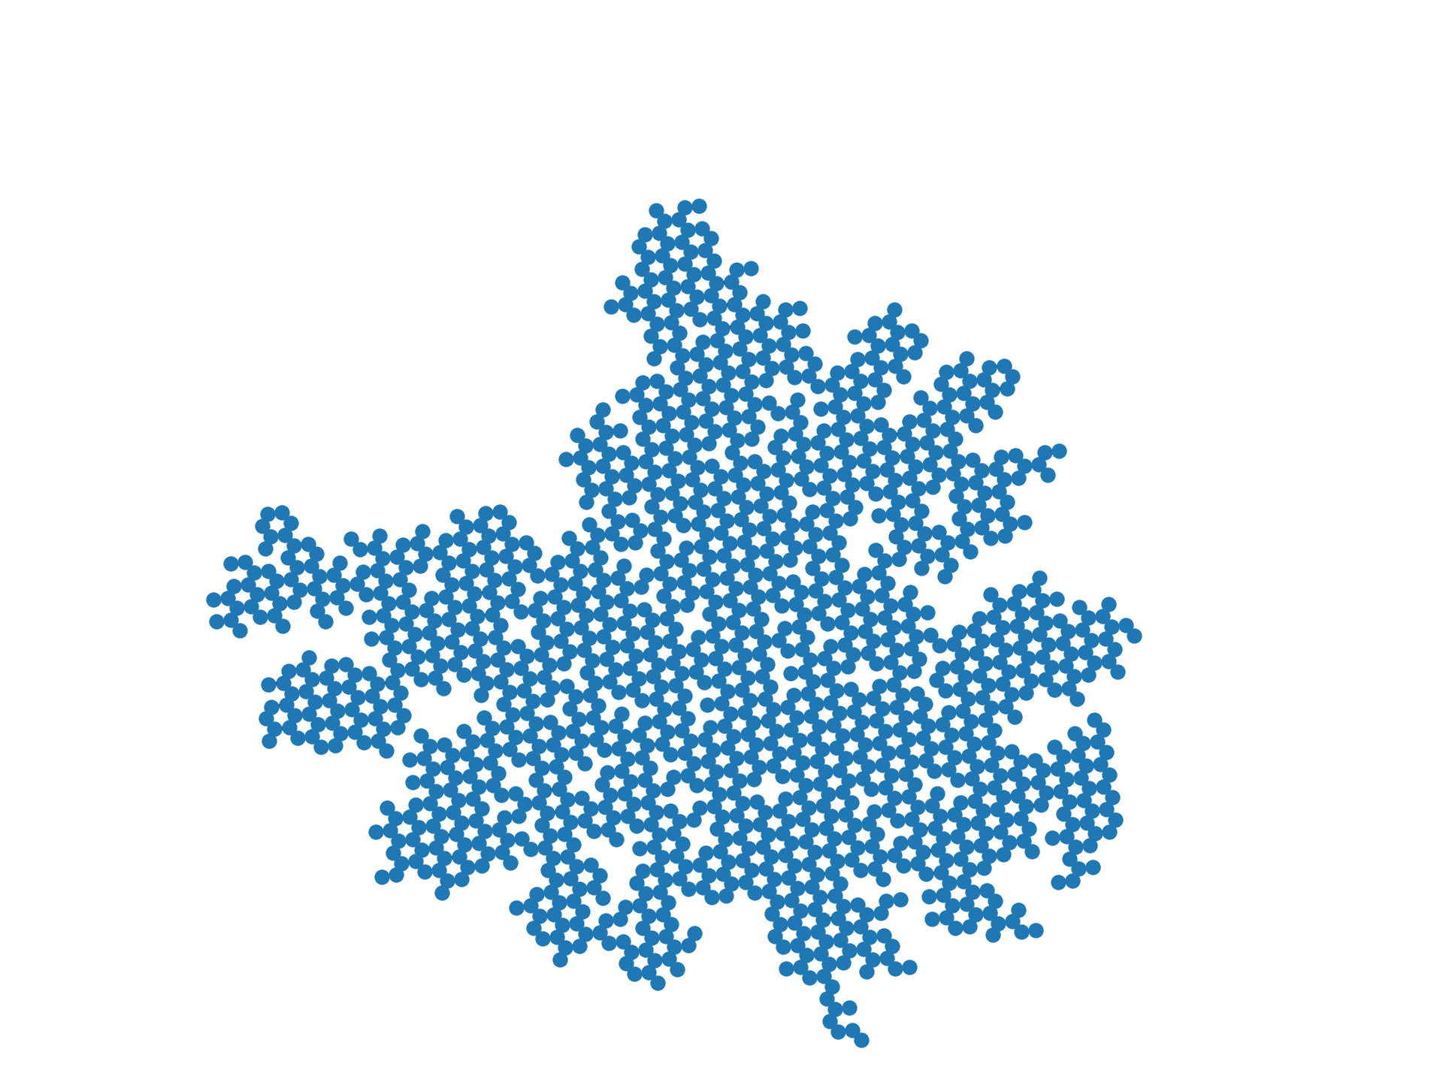
Research activities in 2020
Development of a Monte Carlo:
Metropolis MC or Kinetic MC?
Based on graph theory
Based on energy penalties
No explicit description of building blocks (= nodes)
= monomer molecule
Bond Formation
Bond Breaking

Slide 8
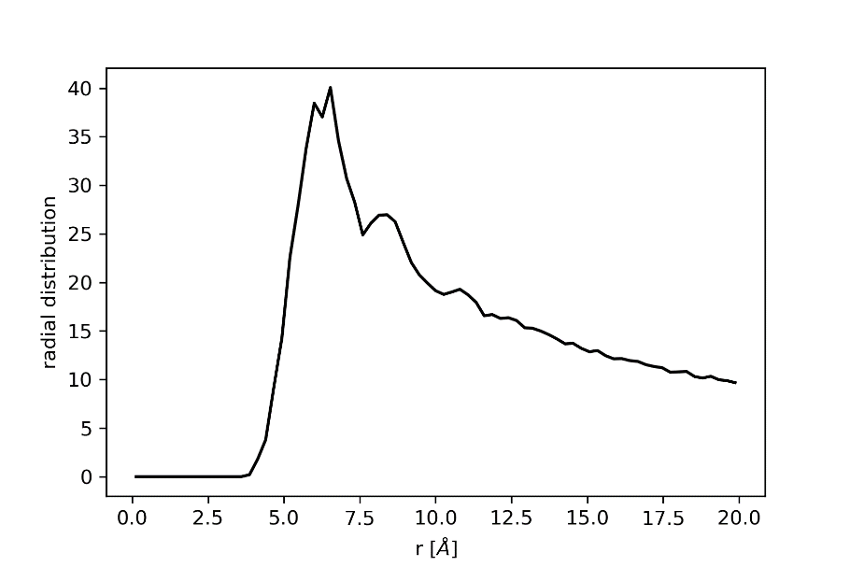
Research activities in 2020
Analysis of the role of Surfactants in COF synthesis
Cooperation with Prof. Feng
Analysis of:
Different surfactants
Different surface coverage
Interaction with monomers
NVT MD (1000 ps)
Sodium Oleyl Sulfate (SOS)

Slide 9
Goals
Achieved Goals
Teaching (Nanostructured Materials)
Attending online lectures and seminars
Future
Taking part at the MGK of SFB:
Lectures
Summerschools
Workshops
Seminars
Soft Skills
Research abroad
Attending a non-virtual summerschool
Notes:
https://tu-dresden.de/mn/postgraduales/promotion/haeufige-fragen
https://tu-dresden.de/mn/postgraduales/promotion/promotionsordnung
https://tu-dresden.de/mn/postgraduales/promotion/ordnung-fuer-das-promotionsstudium
Lehre für Physik evtl 4 SWS: https://tu-dresden.de/mn/physik/forschung/promotion-habilitation#section-2
https://www.verw.tu-dresden.de/Amtbek/PDF-Dateien/2019-09/05_13soDWW29.04.2019.pdf

Slide 10
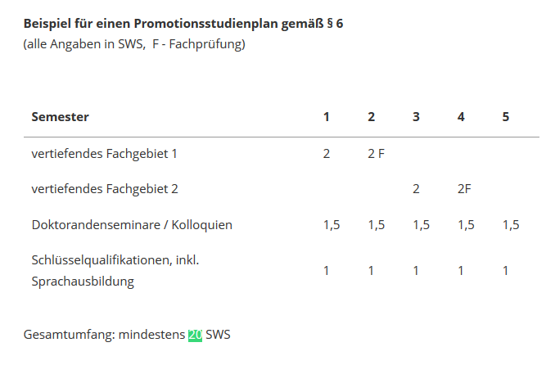
Dr. Ing. vs Dr. rer. Nat.
Dr. Ing. | Dr. rer. Nat.
20 Leistungspunkte zusätzlich aus Ingenieursbereich (=4-5 Vorlesungen)
12 Leistungspunkt Rigorosum (= 2 Vorlesungen) Nur ein Jahr vor Ende der Promotion möglich | Teilnahme an Promotionsstudium (20 SWS gesamt): 2 Rigorosumsprüfungen (2x4SWS) Doktorandenseminare Schlüsselqualifikationen Sonstige Vorlesungen
Lehre ? | Lehre: 4 SWS
Notes:
https://tu-dresden.de/mn/postgraduales/promotion/haeufige-fragen
https://tu-dresden.de/mn/postgraduales/promotion/promotionsordnung
https://tu-dresden.de/mn/postgraduales/promotion/ordnung-fuer-das-promotionsstudium
Lehre für Physik evtl 4 SWS: https://tu-dresden.de/mn/physik/forschung/promotion-habilitation#section-2
https://www.verw.tu-dresden.de/Amtbek/PDF-Dateien/2019-09/05_13soDWW29.04.2019.pdf

Slide 11
Thank you for your attention!

Slide 12
Appendix

