Slide 1
1st TAC meeting
Alexandra Parichenko
Thursday 02.03.2023

Slide 2
Content
Introduction
Methods
Results
Ideas and plans
Further plans (review, conferences, summer school)

Slide 3
Perceptronics
Module 1: Psychology
Deferences in individual olfaction perception
Module 3: Material science
Nanosensor (e-nose)
Module 4: Physical Chemistry
Data analysis using machine learning
Module 2: Medicine
Olfactory mechanisms and disfunction.

Slide 4
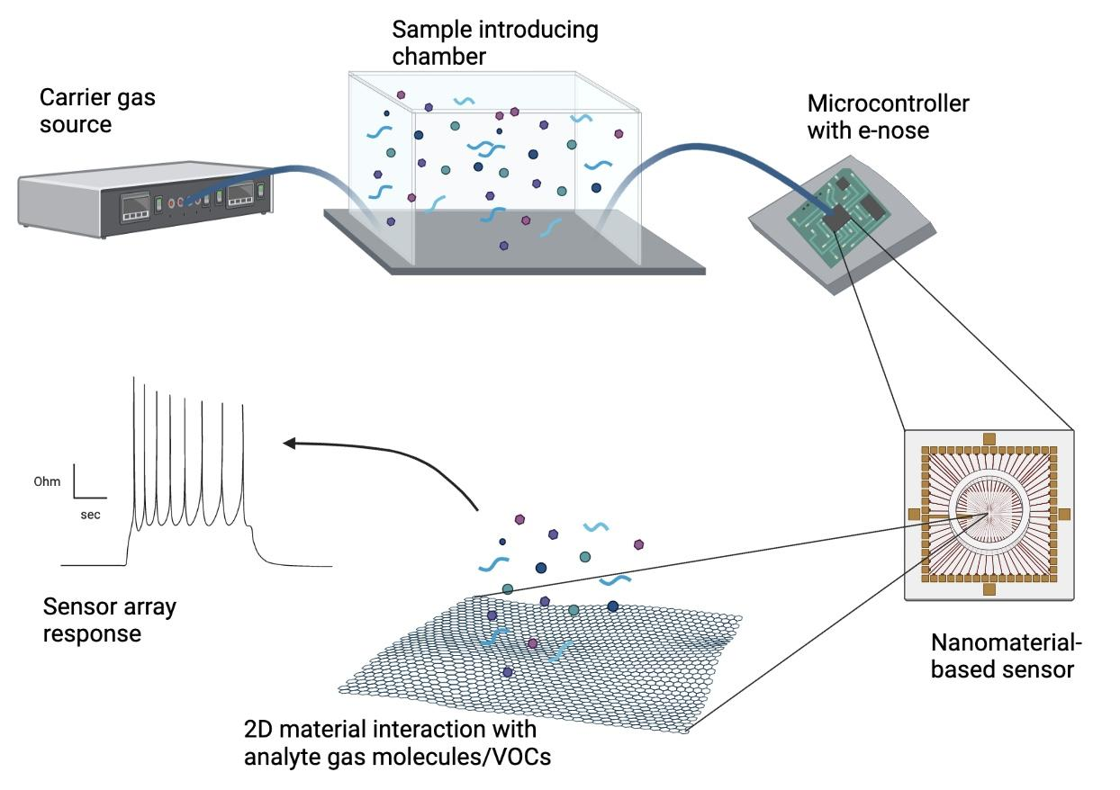
Module 3 - 2D material- based electronic nose
E-nose technology. Chemical fingerprints identification of gases, volatile organic compounds (VOCs), or their mixtures.
Chemiresistive e-noses.
Transduction mechanism - resistivity changes caused by adsorbed gas molecules which can act as electron donors or acceptors on the 2D material surface.

Slide 5
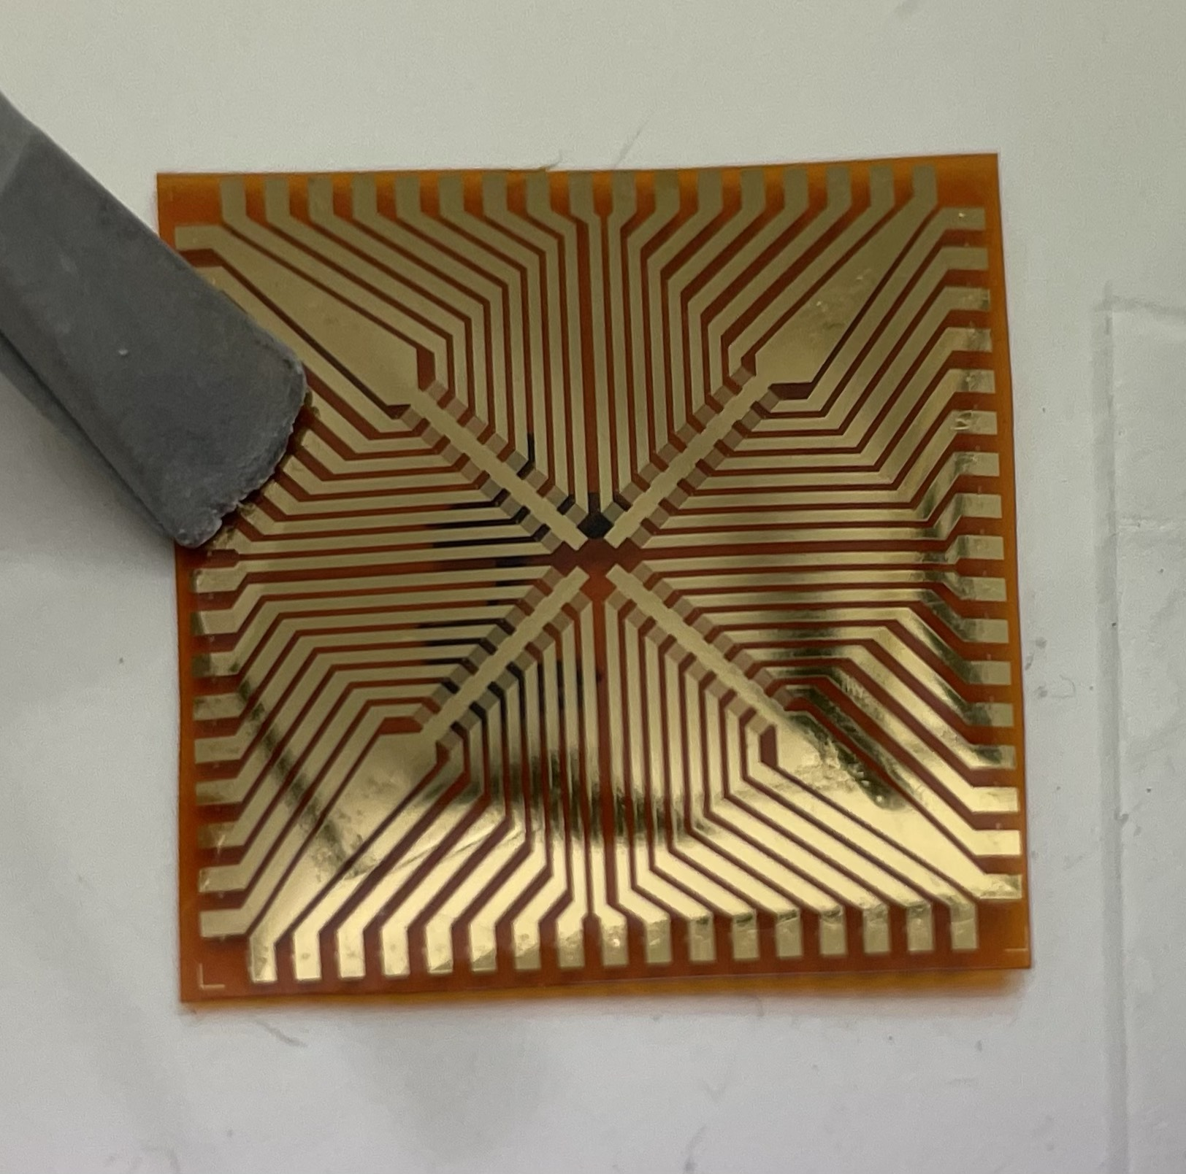
Methods. Nanosensor fabrication
Fabrication of the nanosensor’s electrodes patterns using UV lithography and gold deposition techniques.
Multiple nanomaterials deposition on a fabricated chip (Graphene, CNT, MoS2)

Slide 6
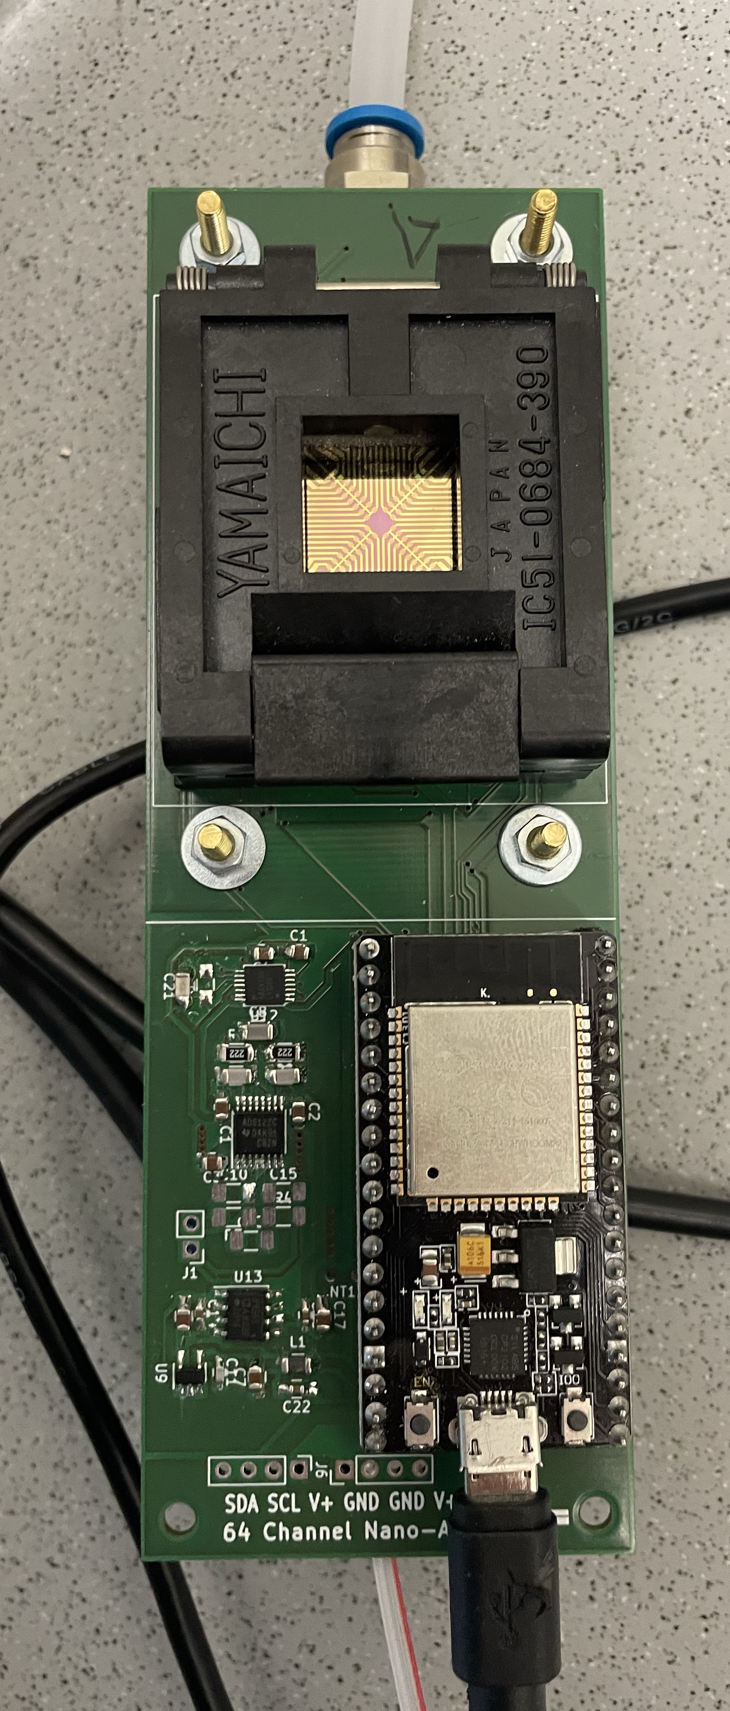
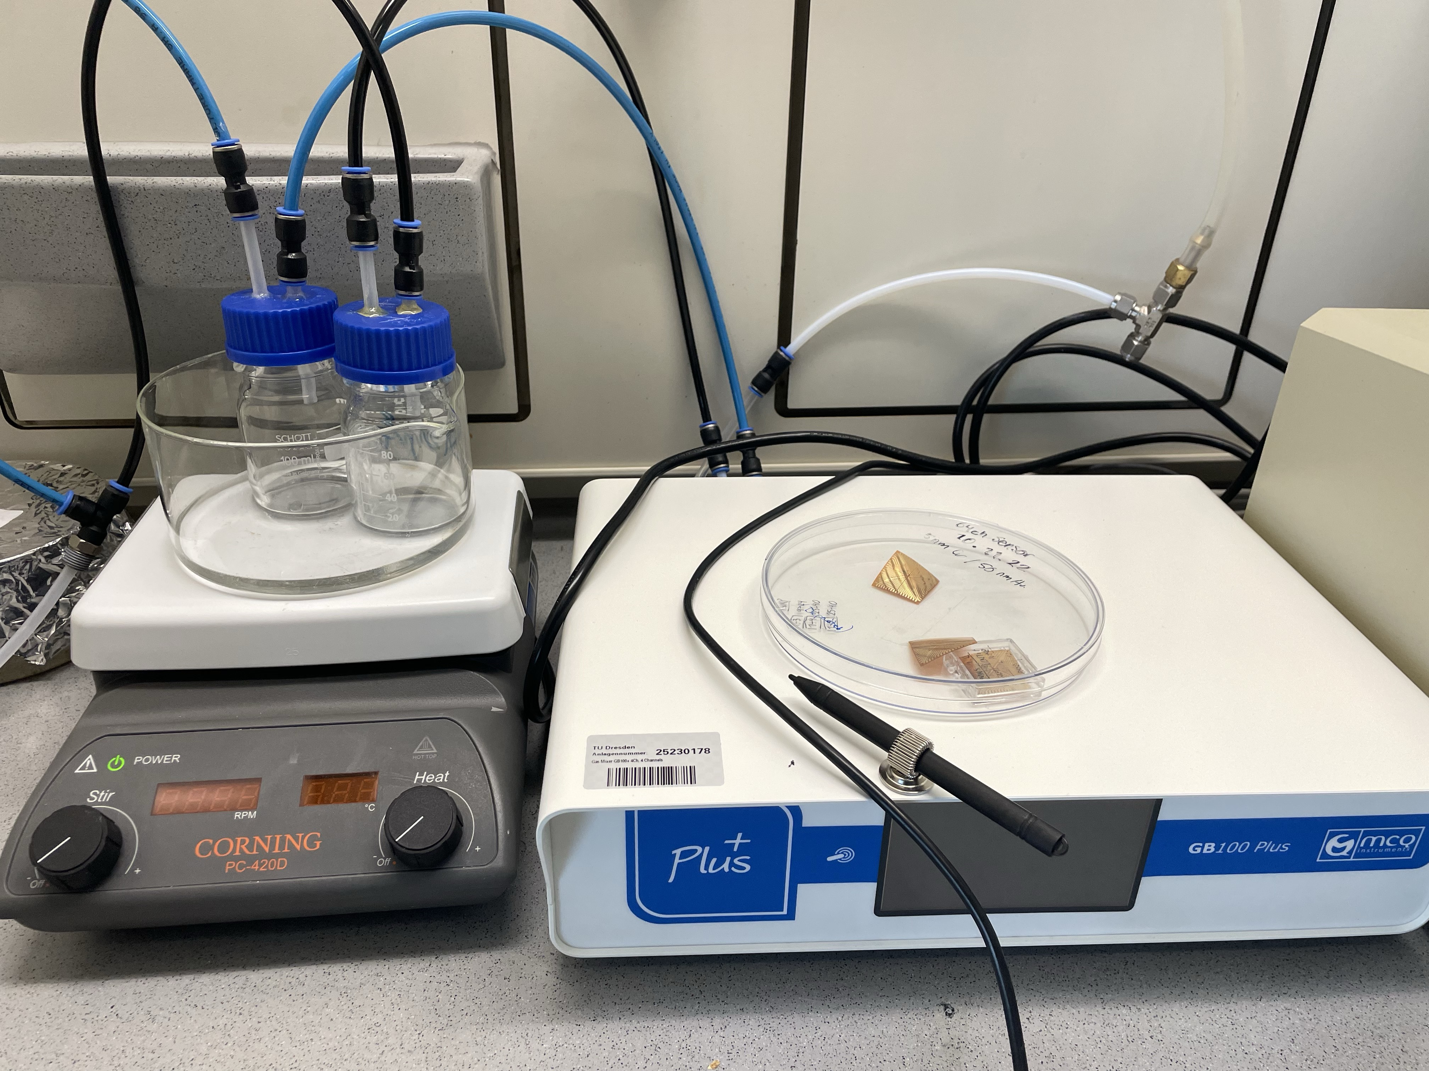
Methods. Gas sensing set-up

Slide 7
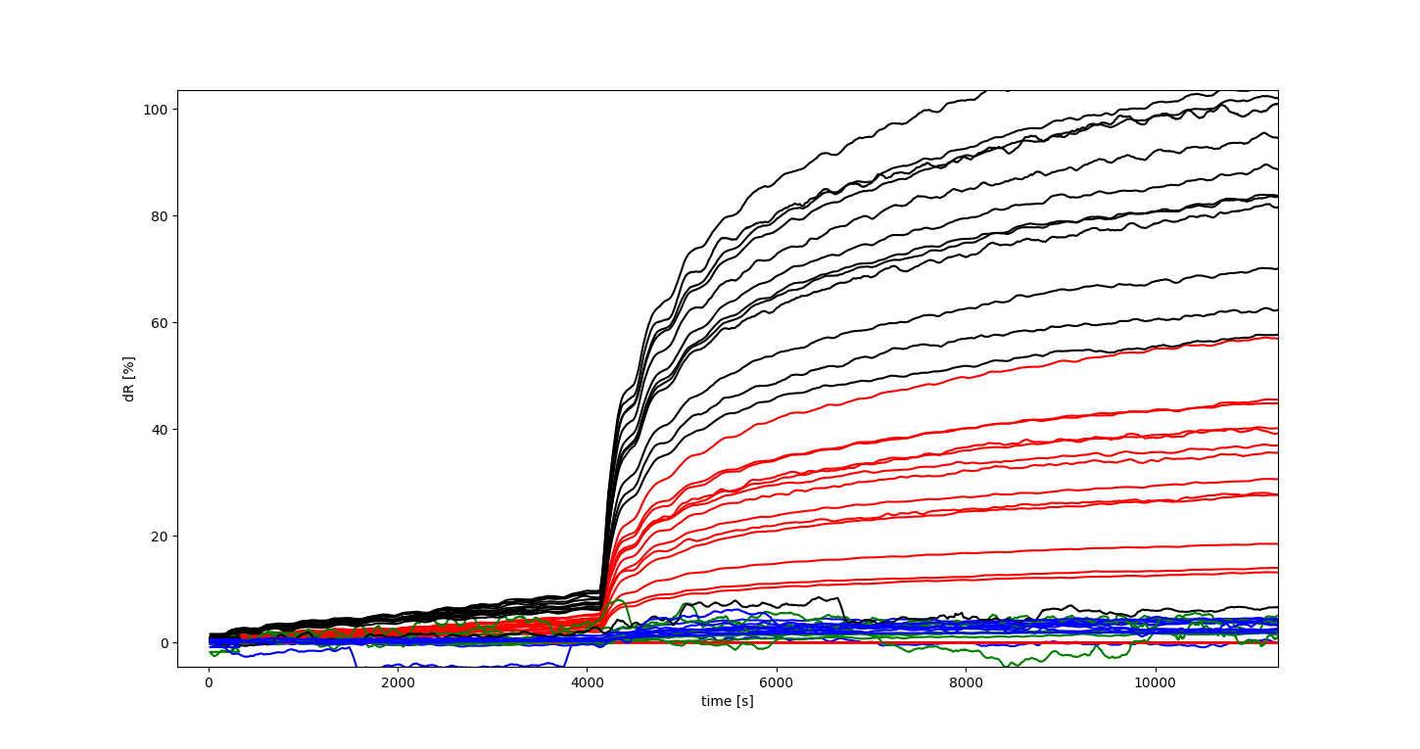
Gas sensing experiment with Octadecanal (Parkinson biomarker)

Slide 8
Current ideas and plans
Collect e-nose fingerprints corresponding to various gas molecules and VOCs (e.g. Parkinson, Alzheimer biomarkers).
After collecting a database with e-nose signatures corresponding to various molecules, is it possible to “smell” them in environment or from patients (diseases smelling )?
Will be an e-nose signature corresponding to a gas molecules (or VOCs) equal to the sum of the signatures corresponding to the mixture of the ingredients ?
Integrate the e-nose into olfaction dysfunctions study and personal human perception study.

Slide 9
Further plans
Finalize the review “Recent advances in 2D-materials based electronic noses”
Conferences and summer schools:
1. The 3rd International Electronic Conference on Biosensors
2. Olfaction symposium (20.03.2023 CRTD Zentrum für Regenerative Therapien TU Dresden)
3. Summer School on Human Olfaction (University Hospital Carl Gustav Carus Dresden)

