Slide 1
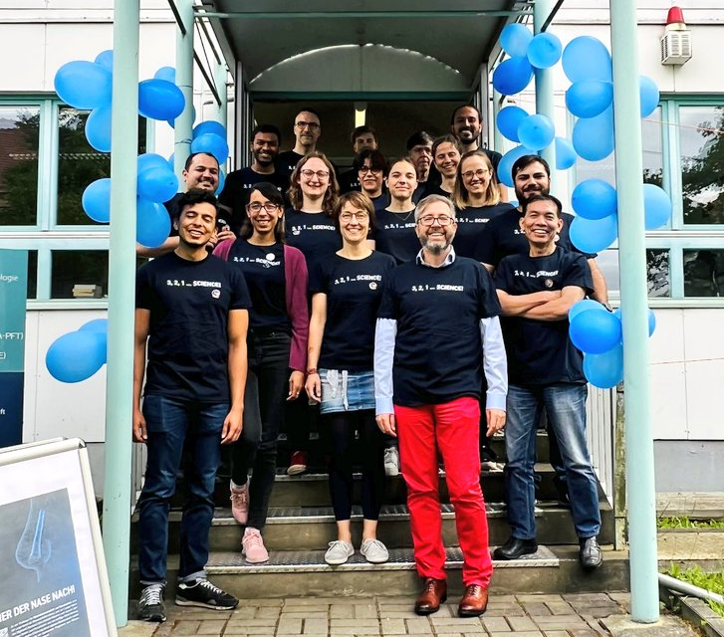
Chair of Materials Science and Nanotechnology Give us your five stars!

Slide 2
HAL – Hallwachsstr. 3 Give us your five stars!

