Slide 1
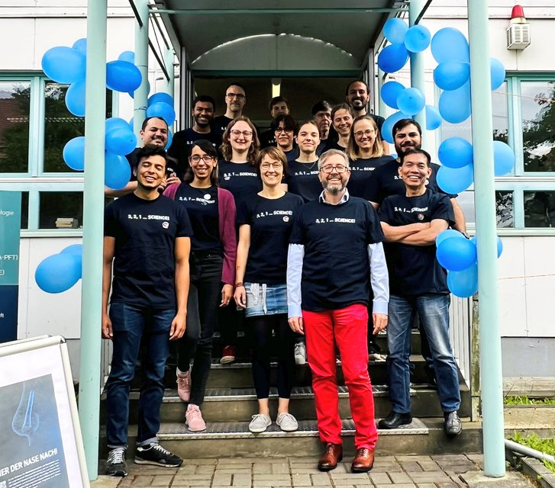

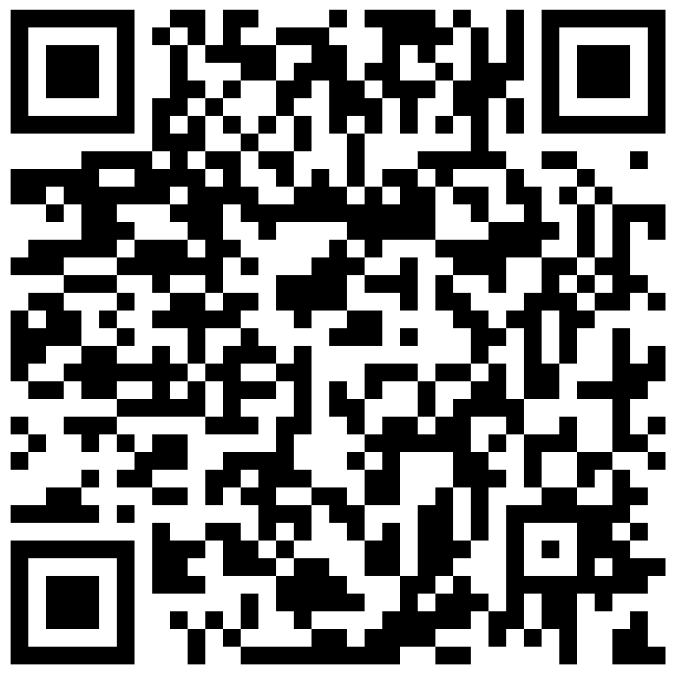
HAL – Hallwachsstr. 3
Give us your five stars!

Slide 2

HAL – Hallwachsstr. 3
Give us your five stars!

