Slide 1
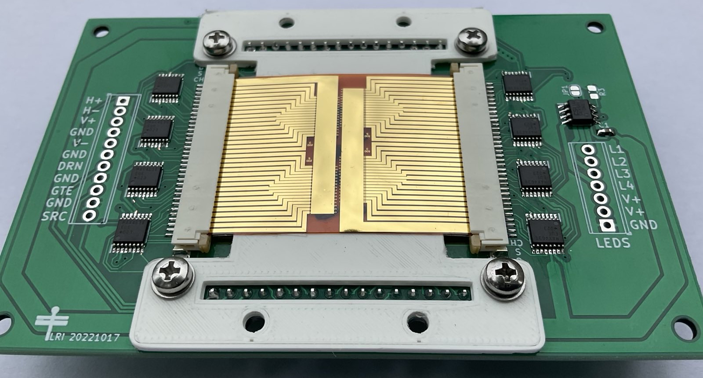
Olfactive Navigation
64 channel e-Nose
Leif Riemenschneider
Enabling robots to navigate in the environment using the sense of smell
Nanomaterial based e-Noses detect smell.
Neural networks translate data into steering commands
The robot follows an odor on the red rope using the two e-Noses that are attached to the front of the robot

